Slide 1
Real-Time QoS-Aware Vehicle Tracking: An Experimental and Comparative Study
Dr. Basem Almadani, Abdullah Al Mamun, Ahmad Khayyat
Department of Computer Engineering
King Fahd University of Petroleum and Minerals
Dammam, Saudi Arabia.

Slide 2
Introduction
Socket IO
Socket IO is nothing but a javascript library that runs on a node js server, it has two parts: a client-side library that runs in a browser, others library runs on server. Both components have a nearly identical API. Usually node.js is an event-driven server scripting. Socket IO primarily uses the Web Socket protocol and it will automatically select the best suited real-time communication protocol at run-time per client.
Data Distribution Service (DDS)
It is a set of stipulations standardized by the OMG. The DDS middleware is a known standard with fixed data-structures and attributes quantified by meta-information called topics [6].

Slide 3
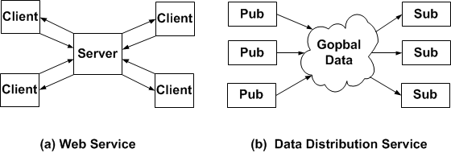
Architectural View

Slide 4
Supporting DDS QoS Polices
Deadline
Network congestion occurs when a link or node is overloaded and as a consequence, it results in packet loss, increased delays and blocking of connections at a time. A lot of research has been done for mitigating network congestion. In the middleware layer, a deadline QoS policy can be used for congestion detection and control, as illustrated in fig1(c) where red arrows shows the amount of time taken by sender to send a packet which is reached at destination after deadline.
Time-based Filter
The minimum separation time is the time gap between two successive packets that are going to be receive by the subscriber. This QoS policy used in tracking applications is to reduce application load (receiving rate) at the subscriber.

Slide 5
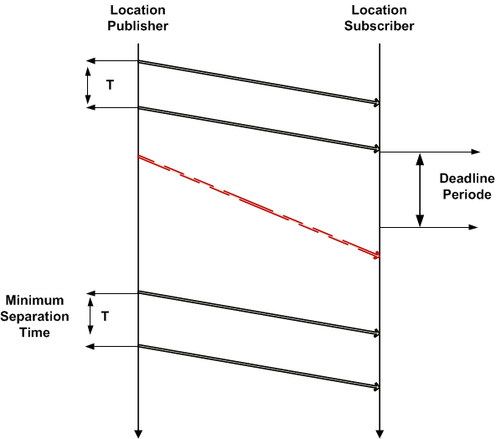
Time-based Filter
T is indicating the
minimum separation
time. Note that the
time-based filter
value must be less
than the value of
deadline because the
deadline is the maximum
wait time for data update on the subscriber.

Slide 6
Experimental Work - Tools
Soket IO (MIT licensed)
Nodejs server
Google Map
Android SDK
Smart Phone
RTI connext
Wire Shark

Slide 7
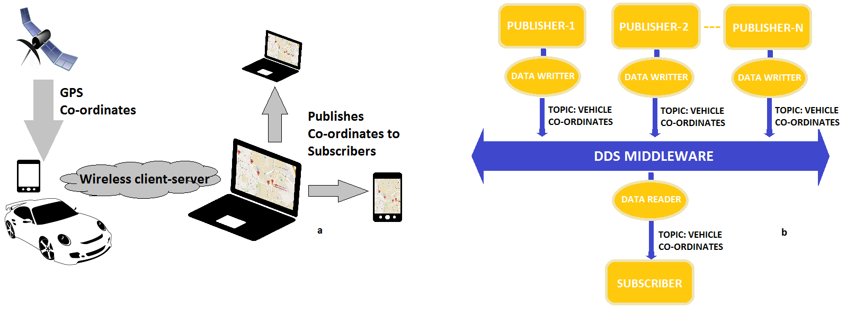
Experimental Work - Setup

Slide 8
Result - RTT Comparison
Type | No. of sample | Avg. RTT (ms) | STD. (ms) | Min RTT (ms) | Max. RTT (ms)
 | 1000 | 124.12 | 220.02 | 6 | 2458
 | 2000 | 105.61 | 234.91 | 6 | 2458
Socket-IO | 3000 | 104.41 | 255.31 | 6 | 2590
 | 4000 | 95.36 | 255.82 | 5 | 2590
 | 5000 | 89.89 | 258.25 | 5 | 2590
 | 6000 | 88.28 | 262.22 | 5 | 2590
 | 1000 | 31.61 | 14.23 | 0.03 | 49.35
 | 2000 | 32.64 | 14.40 | 0.03 | 49.35
DDS | 3000 | 33.33 | 14.62 | 0.03 | 49.35
 | 4000 | 33.40 | 14.59 | 0.03 | 49.35
 | 5000 | 33.54 | 14.62 | 0.03 | 49.35
 | 6000 | 33.75 | 14.65 | 0.03 | 49.35

Slide 9
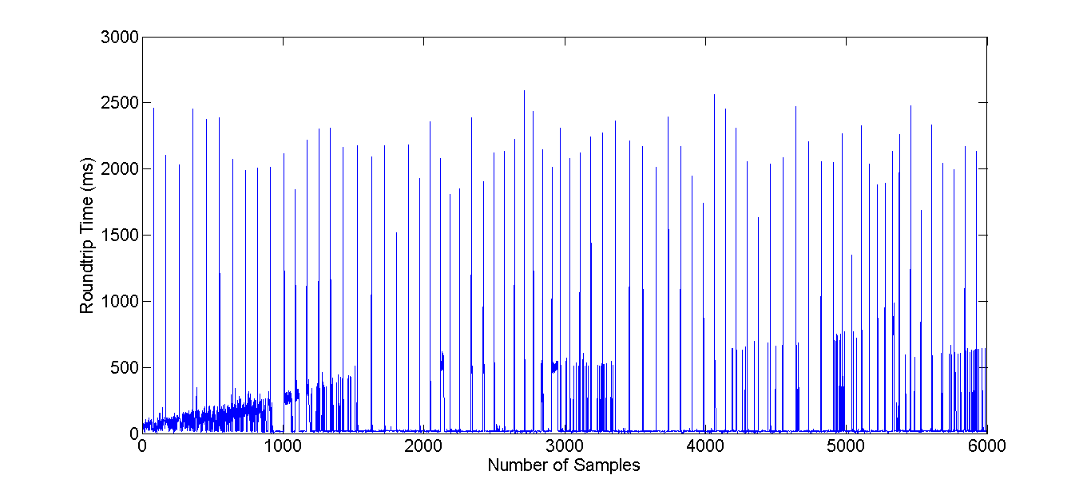
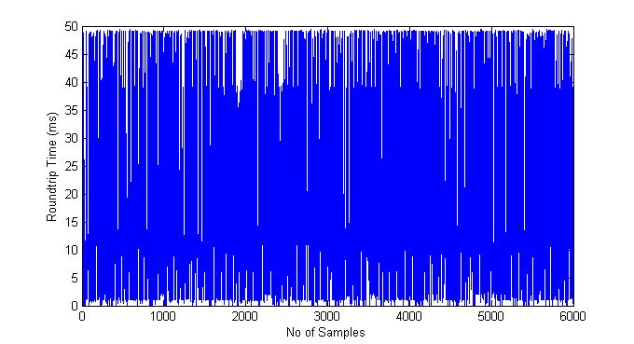
Result – RTT.

Slide 10
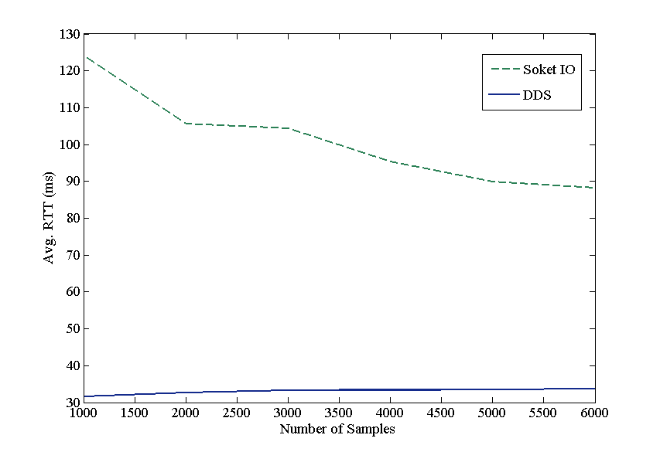
Result - RTT Comparison graph

Slide 11
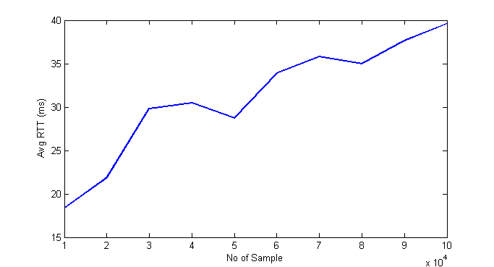
Result – DDS TBF QoS

Slide 12
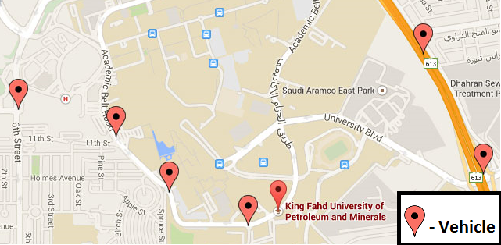
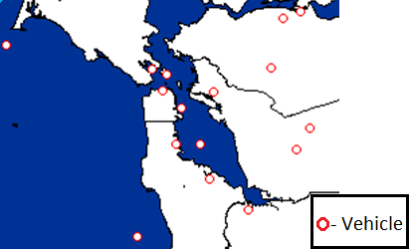
Visual Output
Socket IO with google map
DDS map

Slide 13
Related Works
A DDS based middleware called Scalable Data Distribution Layer (SDDL) [19] presents the OMG DDS standard based communication service middleware that supports unicast, groupcast and broadcast and live tracks with more than thousand cellular nodes.
David, L. et al. [20] presented same things in large scale integration for thousand of nodes. They also used SDDL for developing an application for mobile device to support vehicle inspection by traffic police.
Traffic surveillance [21] describes the problems related to tracking based on feature which is basically a real time system that is nothing but a prototype, and shown system performance using large data.
For large-scale mobile system, a middleware called Scalable context-Aware Middleware for mobile environments (SALES) [22] is developed.
Two main terminologies used are: Quality of Context (QoC) and Context Data Distribution Level Agreement (CDDLA) in this paper. QoC is associated with context information distributive service whereas CDDLA is a quality agreement between consumer and producer imposed by the middleware. The architecture 23 middleware supports mobile nodes and provides reliable data delivery.
The mobile nodes in this middleware execute light version of the DDS whereas the fixed nodes execute the full version of the DDS. In case of Industrial scenarios [24] proposes a real time Automatic Vehicle Location (AVL).

Slide 14
References
(MIT), S.I.O.S., CONTRIBUTORS, R.B.. Socket-io documentation. http://socket.io/docs/; 2014, . 2. http://www.rti.com/company/, . Rti connext. https://community.rti.com/documentation/rti-connext-dds-510/; 2014, . 3. Kotte, S., Yanamadala, H.B.. Advanced vehicle tracking system on google earth using gps and gsm ????;. 4. Verma, P., Bhatia, J.. Design and development of gps-gsm based tracking system with google map based monitoring. International Journal of Computer Science, Engineering and Applications (IJCSEA) 2013;3(3):33–40. 5. Santoso, F., Malaney, R.. Tracking-based wireless intrusion detection for vehicular networks. In: Vehicular Technology Conference (VTC Fall), 2011 IEEE. IEEE; 2011, p. 1–5. 6. Al-Madani, B., Al-Roubaiey, A., Baig, Z.A.. Real-time qos-aware video streaming: A comparative and experimental study. Advances in Multimedia 2014;2014. 7. Detti, A., Loreti, P., Blefari-Melazzi, N., Fedi, F.. Streaming h. 264 scalable video over data distribution service in a wireless environment. In: World of Wireless Mobile and Multimedia Networks (WoWMoM), 2010 IEEE International Symposium on a. IEEE; 2010, p. 1–3. 8. Wang, N., Schmidt, D.C., van’t Hag, H., Corsaro, A.. Toward an adaptive data distribution service for dynamic large-scale network-centric operation and warfare (ncow) systems. In: Military Communications Conference, 2008. MILCOM 2008. IEEE. IEEE; 2008, p. 1–7. 9. OMG, . Web-enabled dds. http://www.omg.org/spec/DDS-WEB; 2013, . 10. Tanenbaum, A.. Computer Networks chapter six. Prentice Hall Professional Technical Reference; 4th ed.; 2002. ISBN 0130661023. 11. Huang, Y., Garcia-Molina, H.. Publish/subscribe in a mobile environment. Wireless Networks 2004;10(6):643–652. 12. Nogueira, J., de Middleware, T.. A large-scale and decentralised application-level multicast infrastructure ????;. 13. Carzaniga, A., Rosenblum, D.S., Wolf, A.L.. Design and evaluation of a wide-area event notification service. ACM Transactions on Computer Systems (TOCS) 2001;19(3):332–383. 14. Terpstra, W.W., Behnel, S., Fiege, L., Zeidler, A., Buchmann, A.P.. A peer-to-peer approach to content-based publish/subscribe. In: Proceedings of the 2nd international workshop on Distributed event-based systems. ACM; 2003, p. 1–8. 15. Pietzuch, P.R., Bacon, J.M.. Hermes: A distributed event-based middleware architecture. In: Distributed Computing Systems Workshops, 2002. Proceedings. 22nd International Conference on. IEEE; 2002, p. 611–618. 16. Mahambre, S.P., Kumar, M., Bellur, U.. A taxonomy of qos-aware, adaptive event-dissemination middleware. Internet Computing, IEEE 2007;11(4):35–44. 17. Corsaro, A., Querzoni, L., Scipioni, S., Piergiovanni, S.T., Virgillito, A.. Quality of service in publish/subscribe middleware. Global Data Management 2006;19:20. 18. Esposito, C., Cotroneo, D., Gokhale, A.. Reliable publish/subscribe middleware for time-sensitive internet-scale applications. In: Proceedings of the Third ACM International Conference on Distributed Event-Based Systems. ACM; 2009, p. 16. 19. David, L., Vasconcelos, R., Alves, L., Andre, R., Baptista, G., Endler, M.. A large-scale communication middleware for fleet tracking´ and management. In: Simposio Brasileiro de Redes de Computadores e Sistemas Distribuidos (SBRC 2012), Salao de Ferramentas. 2012, p. 964–971. 20. David, L., Vasconcelos, R., Alves, L., Andre, R., Endler, M.. A dds-based middleware for scalable tracking, communication and´ collaboration of mobile nodes. Journal of Internet Services and Applications 2013;4(1):1–15. 21. Coifman, B., Beymer, D., McLauchlan, P., Malik, J.. A real-time computer vision system for vehicle tracking and traffic surveillance. Transportation Research Part C: Emerging Technologies 1998;6(4):271–288. 22. Corradi, A., Fanelli, M., Foschini, L.. Adaptive context data distribution with guaranteed quality for mobile environments. In: Wireless Pervasive Computing (ISWPC), 2010 5th IEEE International Symposium on. IEEE; 2010, p. 373–380. 23. Herms, A., Schulze, M., Kaiser, J., Nett, E.. Exploiting publish/subscribe communication in wireless mesh networks for industrial scenarios. In: Emerging Technologies and Factory Automation, 2008. ETFA 2008. IEEE International Conference on. IEEE; 2008, p. 648–655. 24. Almadani, B., Khan, S., Sheltami, T.R., Shakshuki, E.M., Musaddiq, M., Saeed, B.. Automatic vehicle location and monitoring system based on data distribution service. Procedia Computer Science 2014;37:127–134. 25. Rekik, R., Hasnaoui, S.. Application of a can bus transport for dds middleware. In: Applications of Digital Information and Web Technologies, 2009. ICADIWT’09. Second International Conference on the. IEEE; 2009, p. 766–771/.

Slide 15
Thank You
?

