Slide 1
Performance Evaluation of Routing Protocols for Video Conference over MPLS VPN Network
Abdullah al mamun - 201403680

Slide 2


What is MPLS VPN
Multi-protocol Label Switching virtual private network is defined by Internet engineering Task Force (IETF)

Slide 3
Goal
1. Design an MPLS layer3 VPN network & configure routers.
2. Evaluation the performance of routing protocols EIGRP & OSPF

Slide 4
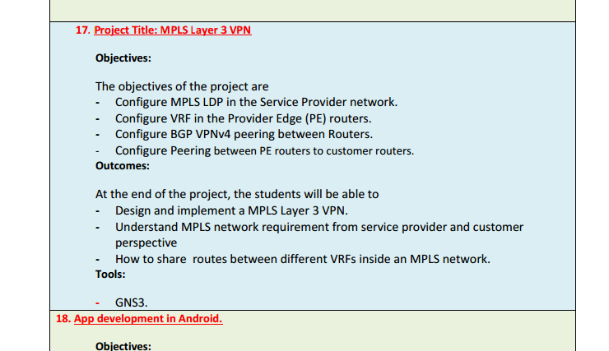
Part - 1

Slide 5
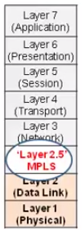
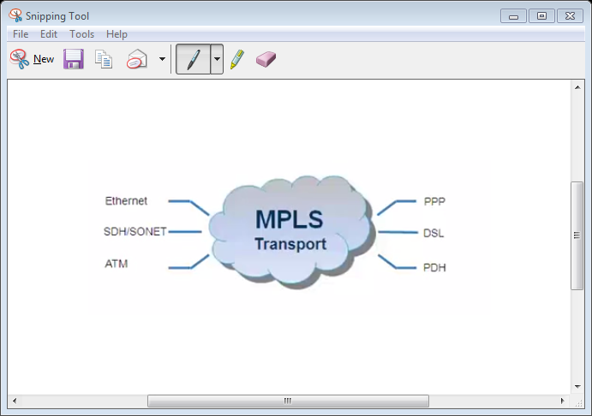
MP = Multi-Protocol. Why layer 3?

Slide 6

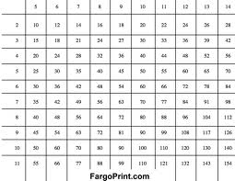

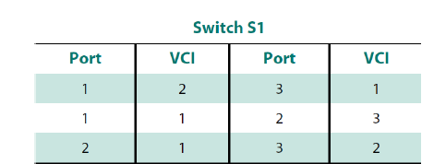
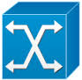

LS = Label Switching
Multiple Network Checking (A match with longest Network mask wins)
IP
IP
IP
Router
Switch
New reference is applied to packet
In ref
Out ref
ATM
3
ATM
2
ATM
1
MPLS uses best of both switch if possible, Router if necessary

Slide 7

Lebel switch Router (LSR)
LSR

Slide 8
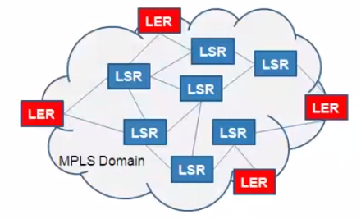


MPLS Domain Router & modified header
Label Edge Router also known as Provider Edge router (PE)
Ingress LER
Egress LER
Label Switch Router also known as Provider router (P)

Slide 9


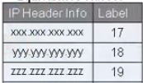
PUSH
IP Domain
Ingress LER
MPLS Domain
Label is Pushed

Slide 10

IP to MPLS Domain
IP Domain
Ingress LER
MPLS Domain

Slide 11
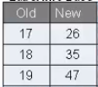
LER to LSR
MPLS Domain
LSR
MPLS Domain

Slide 12
SWAP - 1
MPLS Domain
LSR
MPLS Domain

Slide 13

SWAP - 2
MPLS Domain
LSR
MPLS Domain
Label is Swapped

Slide 14

LSR to LSR
MPLS Domain
LSR
MPLS Domain

Slide 15

POP - 1
MPLS Domain
LSR
MPLS Domain

Slide 16
POP -2
MPLS Domain
Egress LER
IP Domain
Label is Popped

Slide 17
Advantages of MPLS
Improve Uptime
Create Scalable IP VPNs
Improve User Experience
Improve Bandwidth Utilization
Hide Network Complexity
Reduce Network Congestion

Slide 18
Disadvantages
Your routing protocol choice might be limited.
Your end-to-end convergence is controlled primarily by the service provider.
The reliability of your L3 MPLS VPN is influenced by the service provider's competence level.
Deciding to use MPLS VPN services from a particular service provider also creates a very significant lock-in. It’s hard to change the provider when it’s operating your network core.

Slide 19
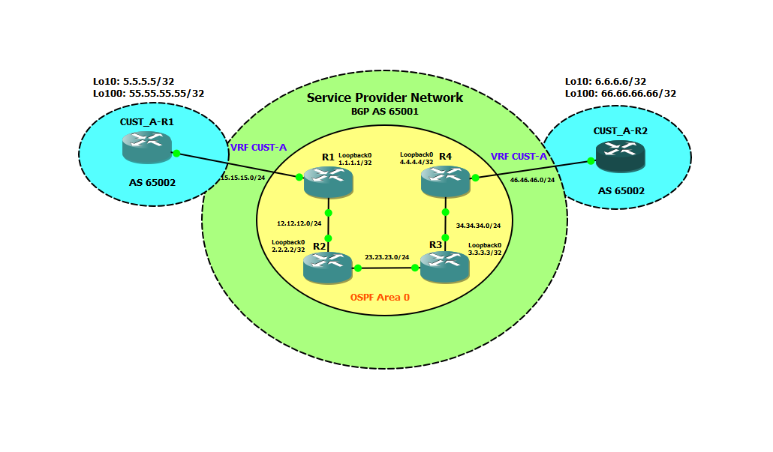
Topology (GNS3)

Slide 20
Router configuration
Configure MPLS LDP in the Service Provider network.
Configure VRF in the Label Edge (LER) routers.
Configure BGP VPNv4 peering between Routers.
Configure Peering between LER to customer routers.

Slide 21
1. Configure MPLS LDP in the Service Provider network.
LDP * = Label Distribution Protocol (16 to 1,048,575)
TABLE I. Label range
Router | Interface | MPLS Label range
Router 1 | Fast Ethernet 0/0 | 1000-1999
Router 2 | Fast Ethernet 0/0
 | Fast Ethernet 0/1 | 2000-2999
Router 3 | Fast Ethernet 0/1
 | Fast Ethernet 0/0 | 3000-3999
Router 4 | Fast Ethernet 0/0 | 4000 - 4999

Slide 22
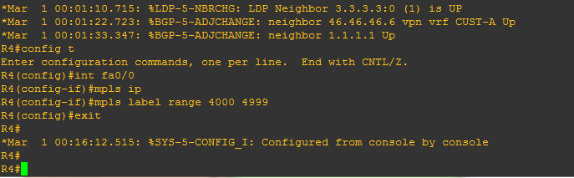
Command
Router 1 - 4
mpls ip = It’s required to form LDP neighbors
mpls label range = assign a range of label on LER or LSR

Slide 23
2. Configuration of VRF in the Provider Edge (PE) Routers
VRF = Virtual Routing and Forwarding
It is comparable to a VLAN in a switch. VRF is used to create different routing tables that are separated from each other. Since one VRF can’t see what routes are in another VRF, the same IP prefix can exist in different VRFs. However, duplicate IP prefixes will have an issue when it comes to route-leaking between VRFs.

Slide 24
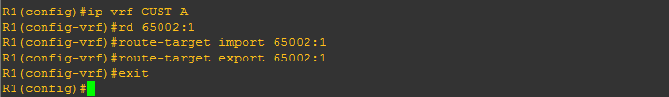
Command
R1(config)#ip vrf CUST-A
R1(config-vrf)#rd 65002:1
R1(config-vrf)#route
R1(config-vrf)#route-target import 65002:1
R1(config-vrf)#route-target export 65002:1
Rd = Route Distinguisher
RD is what Multiprotocol BGP uses to distinguish and makes the route unique
“export” = the route will be marked and announced out with that value;
“import” = put all the routes with that mark, into the VRF’s routing table specified above the command.

Slide 25
3. Configuration of BGP VPNv4 peering between R1 and R4
VPNv4 is a collection of all routes from different VRFs that were marked with the extended community route-target.
This is the address-family where route-leaking can be performed. Route-leaking is simply sharing a route from one VRF to another. Common application for this is, one company wants to connect to another company’s servers and they happen to be connected to the same MPLS provider.

Slide 26
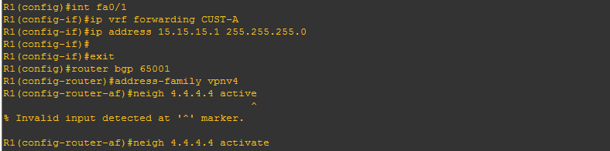
Command
R1(config)#router bgp 65001
R1(config-router)#address-family vpnv4
R1(config-router-af)#neigh 4.4.4.4 activate
In VPNv4 address-family configuration, I simply issue the neighbor statement and the keyword “activate”. The BGP peering configuration needs to be done outside the address-family. The router understands that VPNv4 peering needs to activate extended communities so it automatically configured.
In regards to the VPNv4 BGP peering, it is not possible to see any prefixes for now since there is no peering yet between the PE s and CEs.

Slide 27
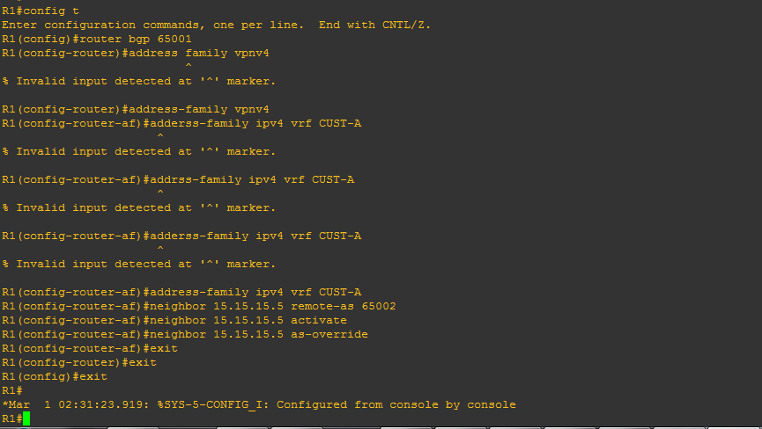
4. Configure Peering between PE routers to customer routers
Configure Peering between PE routers R1 and R4 to customer routers CUST_A-R1 and CUST-A-R2. Announce Loopback 10 and 100 in the CE routers.
Router 1
R1(config)#router bgp 65001
R1(config-router)#address-family vpnv4
R1(config-router-af)#address-family ipv4 vrf CUST-A
R1(config-router-af)#neighbor 15.15.15.5 remote-as 65002
R1(config-router-af)# neighbor 15.15.15.5 activate
R1(config-router-af)# neighbor 15.15.15.5 as-override

Slide 28
Explanation
The PE is configured with an “address-family ipv4 vrf” when peering with the CE routers. The “as-override” command replaces the AS of the route to circumvent the BGP loop prevention. BGP loop prevention blocks any route that it receives from an eBGP peer with its own AS (65002 in this case) inside it. The AS for the customer is 65002, but notice the output below, the PE’s replaced the AS to 65001 to enable communication between these two routers with the same AS inside an MPLS cloud. CUST_A-R2 is now able to see the CUST_A-R1 routes but with a different AS. Another way to do this is to configure a neighbor statement with “allowas-in” keyword.
However, The BGP-MPLS VPN simulations are directed using two beset interior routing protocol namely EIGRP and OSPF on similar topology as in Fig 1. The rate of a video call call is fixed at 500, 2500 and 4000 calls/hour. Average call duration is set to 10 minutes and the voice flow duration is set to 3 hours. The simulations are beset to measure the voice packet end-to-end delay, voice jitter and mean opinion score as to define the overall video and voice quality in both scenarios during the three following scenarios.

Slide 29
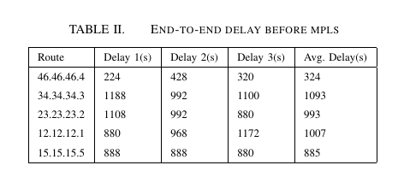
Result and Analysis (part -1 )
Connectivity Verification
CUST_A-R2#traceroute 55.55.55.55 source l100
First Test
Tracing the route to 55.55.55.55

Slide 30
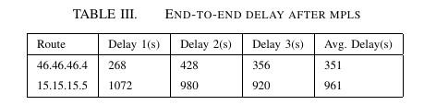
Second Test
CUST_A-R2#traceroute 55.55.55.55 source l100

Slide 31
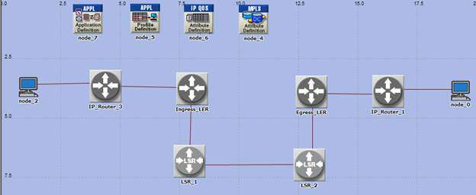
Part-2 : Evaluation of routing protocols for video conferencing application over MPLS
Topology
Topology = EIGRP, OSPF
CODEC = H.393
Video call = 500, 2500, 4000 per hr.
Performance metric = End to end delay,
Jitter and MOS

Slide 32
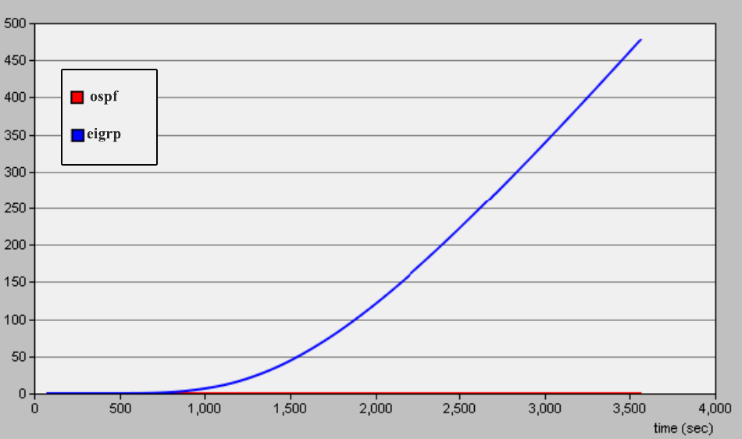
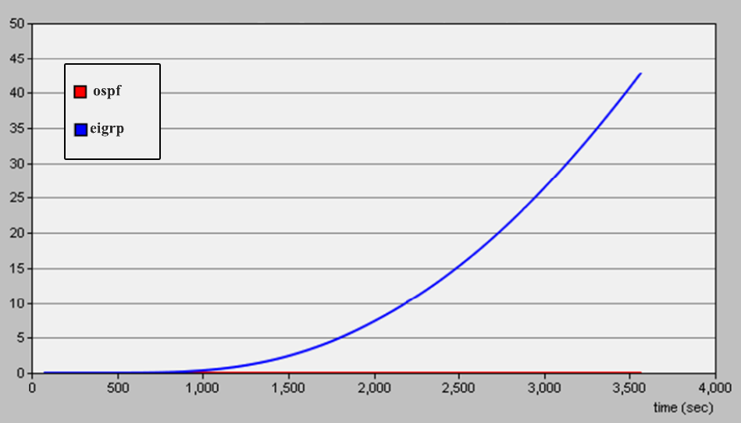
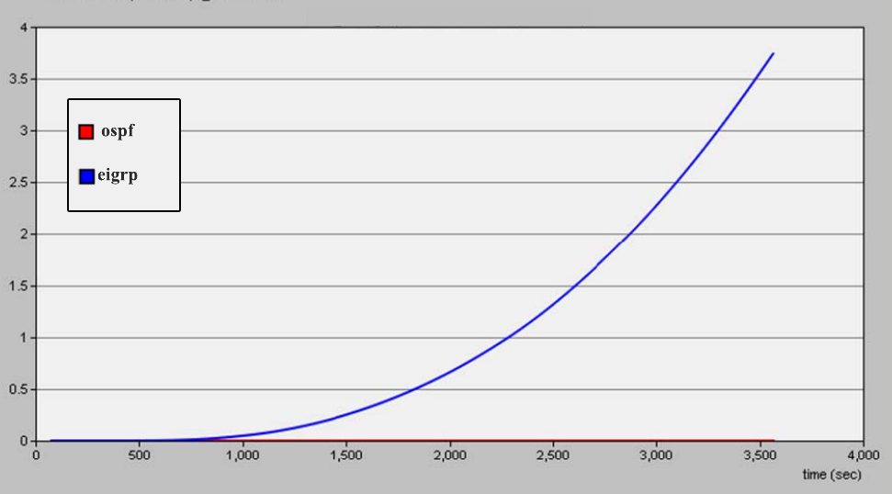
Simulation result
End-to-end packet Delay: The amount of time taken for transmitted a packet across a network from source to destination is shown in below fig. The line graph presents the packet delay for 500 calls per/hours using both EIGRP and OSPF. Initially, the delay is same for both protocols that is almost zero but it is tart to increase suddenly at 890s for eigrp whereas ospf is remain unchanged.
Fig. 500 video calls/hour Fig. 2500 video calls/hour Fig. 4000 video calls/hour

Slide 33
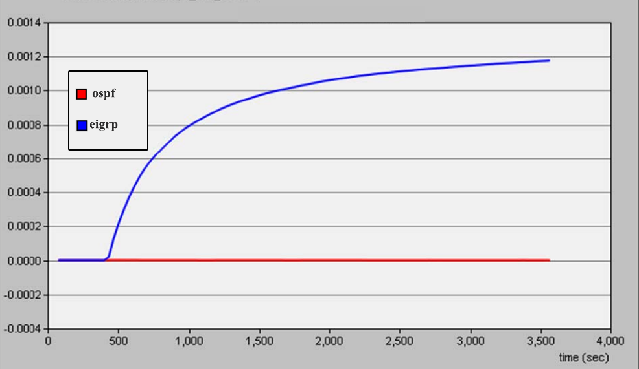
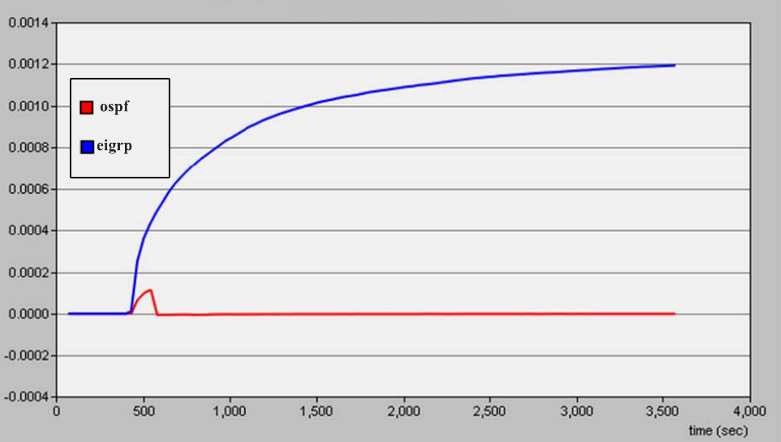
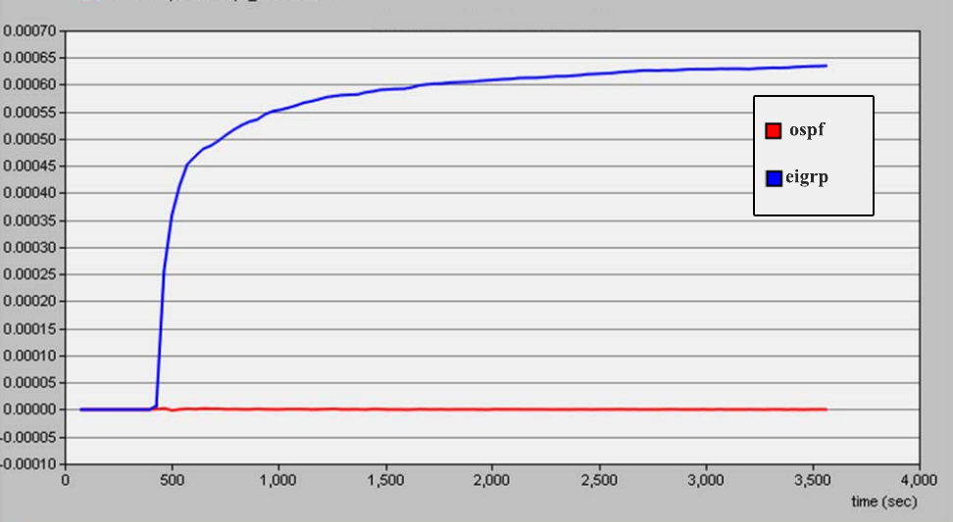
Jitter
Time difference between two frames due to transmission latency is shown in below fig, Jitter for 500 calls per hour is shown in fig where jitter is start to happen from less than 500s for eigrp whereas ospf is remaining unchanged to last the frame.
In the same manner, jitter for 2500 calls per hour is shown in fig where jitter is start to increase from 480s and it became saturated after a while in eigrp protocol, but almost zero jitter is experienced though a little changed happens initially while same setup ran with ospf protocol. Again, last fig is shows the jitter for 4000 calls per hour where jitter goes high quickly at little bit earlier than previous experiment which is 470s whereas ospf is still unchanged.
Fig. 500 video calls/hour Fig. 2500 video calls/hour Fig. 4000 video calls/hour

Slide 34
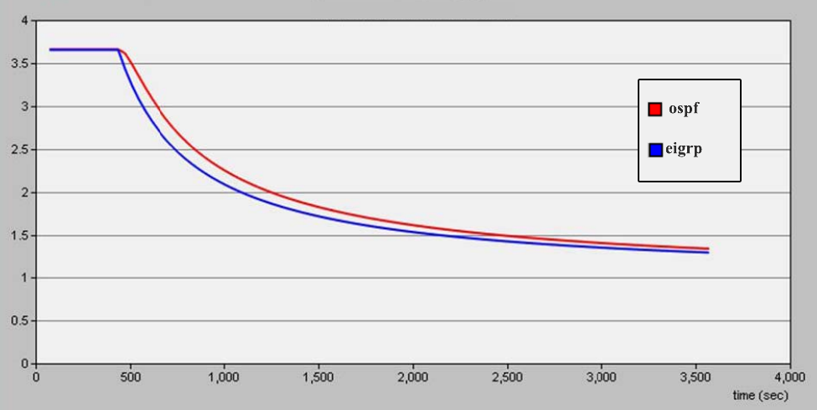
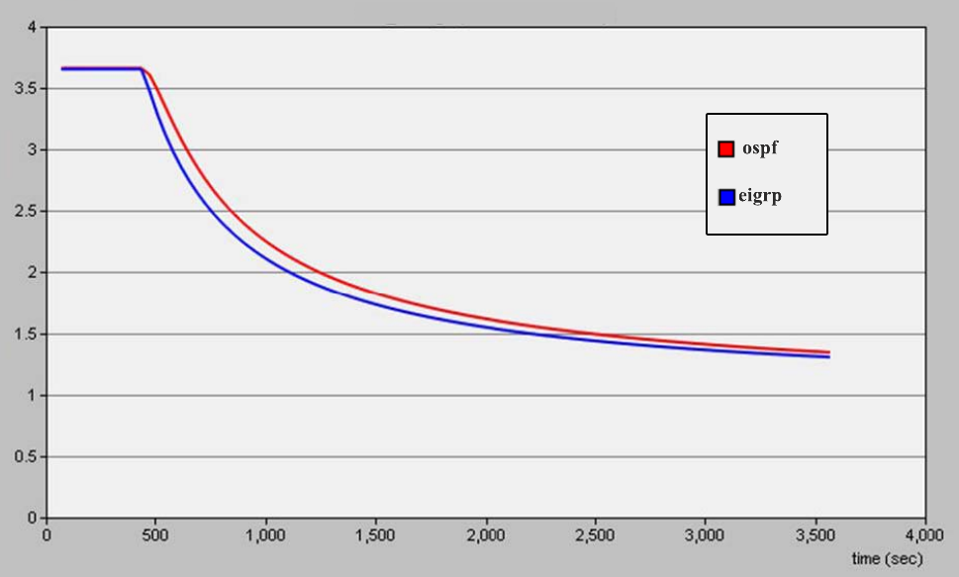
Mean Opinion Score (MOS)
In voice communications, particularly Internet telephony, the mean opinion score (MOS) provides a numerical measure of the quality of human speech at the destination end of the circuit [8]. MOS scores are shown below according to this experimental sequence. However, fig 10 displays the mos score for 500 calls per hour where score is start to drop for both eigrp and ospf at the same time which is less than 500s from 3.7 units of mos and it does not recovered until simulation end.
Fig. 500 video calls/hour Fig. 2500 video calls/hour Fig. 4000 video calls/hour

Slide 35
RELATED WORKS
So far many research has been done on video conferencing multi-cast and broadcast over MPLS are [9],[10] and [11] but few of them are comparison study among router protocols in MPLS VPN [1]-[4] and [12]. Relative comparison of network model infrastructure for delivering data over MPLS networks [2]-[4] shows MPLS perform better. Among many performance metric, end to end delay is considered in the paper [4][13], jitter cite5and [14], voice packet delay variation is shown, voice packet send and receive [4], packet loss[6], throughput putc[14] and MOS[15] and [16]. In video conferencing, performance measures shown in case of voice codec in paper [2] and [3]. However, G.711 is used as most popular codec for VoIP call in [17], [18] that is also discussed about security in multimedia communication. How many types of routing protocols is implemented in VoIP application is shown in paper [6]-[13]. Comparison of many well-known routing protocols such as RIP, OSPF and EIGRP is presented in the paper [16]-[19]. Determining the best routing protocol is complex task, here they are discussed how can it does easily based on convergence time and queueing delay in the paper [7] and [13].

Slide 36
Conclusion
This paper introduced a performance evaluation of video conferencing application using two different routing protocol respectively eigrp and ospf over MPLS VPN network. The empirical simulation result shows that router configuration on each provider router is successfully done and it can hide the PE router while data is traversing router to router. Moreover, It is clearly observed that the best performance is recorded in case of ospf protocols in every scenarios. We have plan to continue our research in large scale in future.

Slide 37


Recognition and Achievement

Slide 38
References
[1] Windstream, “Mastering Network Design with MPLS”, whitepaper, 2012, available from http://www.windstreambusiness.com/media/663859/masteringnetwork-design-with-mpls.pdf.
[2] R.S.Naoum and M.Maswady, “Performance Evaluation for VOIP over IP and MPLS”, World of Computer Science and Information Technology Journal (WCSIT), Vol.2 (3), pp. 110-114, 2012
[3] E.S.Jain, "Performance Analysis of Voice over Multiprotocol Label Switching Communication Networks with Traffic Engineering", International Journal of Advanced Research in Computer Science and Software Engineering, Vol.2 (7), pp. 195-199, 2012.
[4] I.S.I Alsukayti and T.J.Dennis, “Performance Analysis of VoIP over BMG/MPLS VPN Technology”, PGNET Conference, 2011.
[5] R Yunos, NM Noor, SA Ahmad, “Performance evaluation between IPv4 and IPv6 on MPLS Linux platform,” International Conference on Information Retrieval & Knowledge Management (CAMP10), pp. 204–208, 2010
[6] A.Chadha and A.K.Gupta, “Review on Enhanced Interior Gateway Routing Protocol”, Global Journal of Computer Science and Technology Network, Web & Secuirty, Vol. 13(6), 2013.
[7] K.Mirzahosein, A.Nguyen and S.Elmasry, “Analysis of RIP, OSPF and EIGRP Routing Protocols using OPNET”, Simon Fraser University, School of Engineering Final Year Project, ENCS 427: Communication Networks, 2013.
[8] S, Ali, and B. Z. Rana. "OPNET Analysis of VoIP over MPLS VPN with IP QoS." Master Thesis, Electrical Engineering, 2011.
[9] N.Aoki, “A Semi-Lossless Steganography Technique for G.711 Telephony Speech”, 2010 Sixth International Conference on Intelligent Information Hiding and Multimedia Signal Processing, pp. 534-537, 2010.
[10] R.Yasinovskyy, A.L.Wijesinha, R.K.Karne and G.Khaksari, “A Comparison of VoIP Performance on IPv6 and IPv4 Networks”, 2009.
[11] E.S.Myakotnykh, R.A.Thompson, “Adaptive Speech Quality Management in Voice-over-IP Communications”, 2009 Fifth Advanced International Conference on Telecommunications”, pp. 64-71, 2009.
[12] T.Huang, P.Huang, K.Chen and P.Wang, “Cloud Skype Be More Satisfying? A QoE-Centric Study of the FEC Mechanism in an Internet-Scale VoIP System”, IEEE Network, pp. 42-48, 2010.
[13] X.Che and L.J.Cobley, “VoIP Performance over Different Interior Gateway Protocols”, International Journal of Communications Networks and Information Security (IJCNS), Vol.1 (1), pp. 34- 41, 2009.
[14] S.G.Thorenoor, “Dynamic Routing Protocol Implementation Decision between EIGRP, OSPF and RIP based on Technical Background Using OPNET Modeler”, Second International Conference on Computer and Network Technology, pp.191-195, 2010.
[15] I.Kaur, “Performance Evaluation of Hybrid Network using EIGRP & OSPF for different Applications”, International Journal of Engineering Science and Technology (IJEST), Vol.3 (5), pp.3950-3960, 2011.

Slide 39
Thank You
?

