Slide 1


CMPT-643: Wireless Communication
Spring 2018
Simulation Model of Multi-RAT in Wireless Network
Abdulhadi J. Al-Qahtani QUID: 201102355
Abdulla Al-Mamun QUID: 201610594
Dr. Amr Mohamed
Qatar University, Qatar

Slide 2
Content
Scenario Simulated
Simulation and Data analysis
Conclusion and Future
Aim of This Project

Slide 3
Aim of This Project
Select the best RAT based on BER by varying SNR

Slide 4
Scenario Simulated

Slide 5
Scenario Simulated

Slide 6
Simulation and Data Analysis
 | LTE | IEEE 802.11ac
Scenario | Single Cell | Single Cell
Carrier frequency (GHz) | 2.6 | 2.4
Tx Power (dBm) | 23 | 24
NodeB/AP Type | TD-LTE eNodeB, based on LTE Rel-8 | AP: TP-Link router (TL-WR1041N), based on 802.11ac
Bandwidth (MHz) | 20 | 20
Antenna configuration | DL: 2x2 UL: 1x2 | DL: 2x2 UL: 2x2
The experiment was done using MATLAB.
Practical SNR ranges:
8 to 20 dB
Performance Measurements:
BER
Throughput

Slide 7
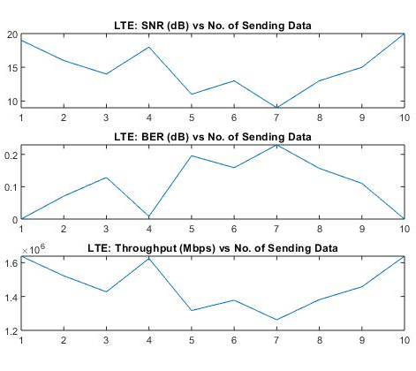
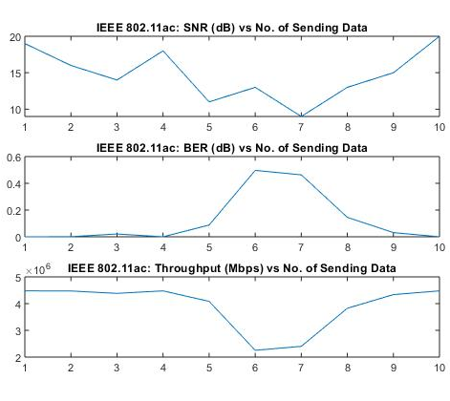
Simulation and Data Analysis (cont’d)

Slide 8
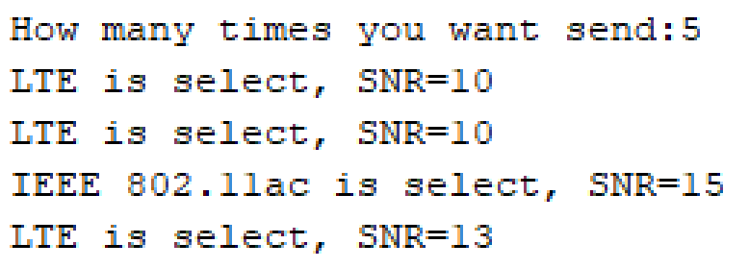
Simulation and Data Analysis (cont’d)
Selection Depend on SNR Value
6/2/2018
8

Slide 9
Simulation and Data Analysis (cont’d)

Slide 10
Simulation and Data Analysis (cont’d)

Slide 11
Conclusion and Future Work
What have been achieved?
Future Work:
Build 5G network and SDN.
Proposed algorithm for selection.

Slide 12
References
[1] A. Nanjundappa, S. Singh and G. Jain, "Enhanced multi-RAT support for 5G," 2018 15th IEEE Annual Consumer Communications & Networking Conference (CCNC), Las Vegas, NV, 2018, pp. 1-2.
[2] S. Borst, A. Ö. Kaya, D. Calin and H. Viswanathan, "Dynamic path selection in 5G multi-RAT wireless networks," IEEE INFOCOM 2017 - IEEE Conference on Computer Communications, Atlanta, GA, 2017, pp. 1-9.
[3] S. Chandrashekar, A. Maeder, C. Sartori, T. Höhne, B. Vejlgaard and D. Chandramouli, "5G multi-RAT multi-connectivity architecture," 2016 IEEE International Conference on Communications Workshops (ICC), Kuala Lumpur, 2016, pp. 180-186.
[4] U. Doetsch, H. Droste, A. Roos, T. Rosowski, G. Zimmermann, P. Agyapong, N. Fonseca, I. D. S. Lindqvist, H. Eriksson, H. Tullberg et al., “Deliverable d6. 4 final report on architecture.”
[5] A. Nanjundappa, S. Singh, and G. Jain, “Enhanced multi-rat support for 5g,” in Consumer Communications & Networking Conference (CCNC), 2018 15th IEEE Annual. IEEE, 2018, pp. 1–2.
[6] S. Borst, A. O¨ . Kaya, D. Calin, and H. Viswanathan, “Dynamic path selection in 5g multi-rat wireless networks,” in INFOCOM 2017-IEEE Conference on Computer Communications, IEEE. IEEE, 2017, pp. 1–9.

Slide 13
Thank you
Any Questions?

