Slide 1
STAIRCASE CLIMBING STRETCHER
B.TECH FINAL YEAR PROJECT
MECHANICAL ENGINEERING
Madan Mohan Malaviya University of Technology Gorakhpur
(UP State Govt. University)
PROJECT MENTOR PROJECT COORDINATOR
ASSISTANT PROFESSOR ASSISTANT PROFESSOR
SUNIL KUMAR YADAV SIR SUNIL KUMAR YADAV SIR

Slide 2
Group members
Saba tasleem (group leader)
(2019051115)
Surendra pandey
(2019051137)
Deepak kumar pandey
(2019051054)
Kanhaiya lal ranjan
(2019051069)

Slide 3
Contents
Abstract
Introduction
General stretcher
Need of stair climbing stretcher
Working
Advantage

Slide 4
Abstract
This project aims at developing a mechanism for easy transportation of heavy loads over stairs. The need for such a system arises from day-to-day requirements in our society. Devices such as hand trolleys are used to relieve the stress of lifting while on flat ground; however, these devices usually fail when it comes to carrying the load over short fleet of stairs. In the light of this the project attempts to design a stair climbing hand cart which can carry heavy objects up the stairs with less effort compared to carrying them manually.

Slide 5
Introduction
Generally, stretcher are used to transport patient on even surfaces. Stair climbing stretcher is an extension of general stretcher.
These are used to transport patient on stairs and uneven surfaces like holes, speed breakers.
These stretcher are very economical as the initial and maintenance costs are low. It is used to transport patient with less effort.
There need not be heavy mechanisms for stair climbing stretcher.
It is operated by single operator.

Slide 6
General stretcher
A Stretcher trolley is used in a Hospital to carry those patient who are not able to move from laying position
It need two person to operate the general stretcher
Stretcher are made to allow moving patients as simple as possible

Slide 7
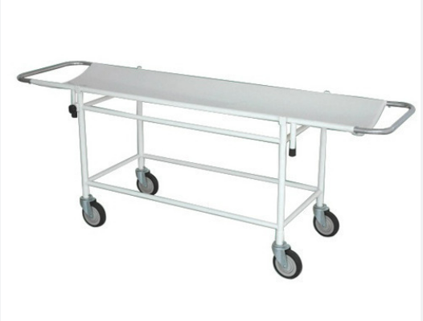
General stretcher

Slide 8
Need of stair climbing stretcher
The main problem with general stretcher is that it is not easy to operate general stretcher in stair
So to overcome this types of problem we make a stair climbing stretcher
It is easy to operate in stair so patient not feel any types of problem which faces during climbing of stair

Slide 9
It consists of three wheels at three corners of an equilateral triangle while moving on flat surfaces two wheels on either side will slide on ground. Because of two wheels on either side will slide can carry more loads compared to conventional stretcher. While, climbing stairs each wheel with respect to centre of triangle gets rolled. Control of this stretcher is made easier by using a flexible handle. Patient is carried on a plywood supported by a iron frame.
Working

Slide 10
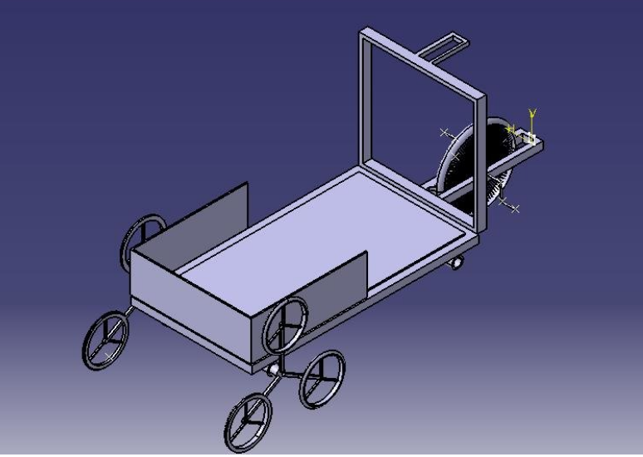

Slide 11
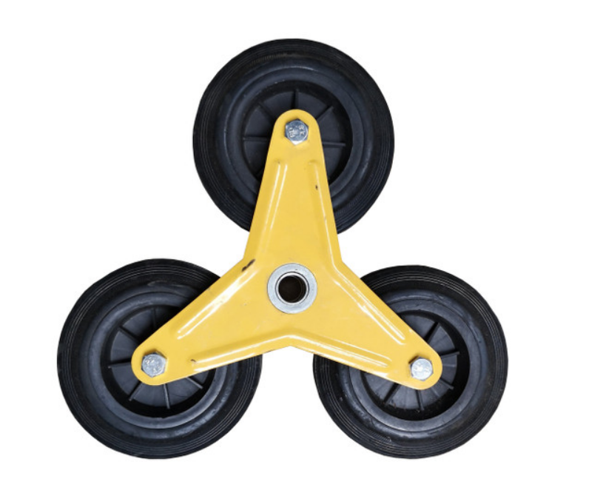

Slide 12
Advantage
These stretcher are very economical as the initial and maintenance costs are low.
It is used to transport loads with less effort.
There need not be heavy mechanisms for stair climbing trolley.

Slide 13
