Slide 1
ANTI-ALZHEIMER
Always remember for those who cannot

Slide 2
What is the problem?
To build a project for the people who are going through Alzheimer(Memory Loss) for their better living. -Alzheimer's is a type of dementia that causes problems with memory, thinking and behavior. -Over 5 million people over the age of 65 are living with such disease, it is found in adults too. -Symptoms such as forgetfulness and confusion makes it difficult to perform the daily tasks.

Slide 3
What is the solution?
-Continuously reminding them about their identity and people around them. -Notifying them about their daily schedule in order to perform the tasks. -So, that till the time they forget the details, they will again be notified.

Slide 4
Competitors:
There are few apps for people with Alzheimer:
-Mind Mate -Alzheimer’s Society’s Talking Point Forum -Spaced Retrieval Theory(Memory Training) -Lumosity Mobile

Slide 5
What’s Innovative?
In our project, we have added some functionalities to our App :
-Notifying about the regular schedule at specified intervals. -Tracking the patient and alerting the family members even the patient when schedule is not followed. -Chatbox is implemented so that the patient can ask some relevant questions(e.g Who am I? where am I?). -Clicking the picture of new people they meet with the details of the person and can verify it with the database. -In the App, we have provided a section where he can check the people he knows.

Slide 6
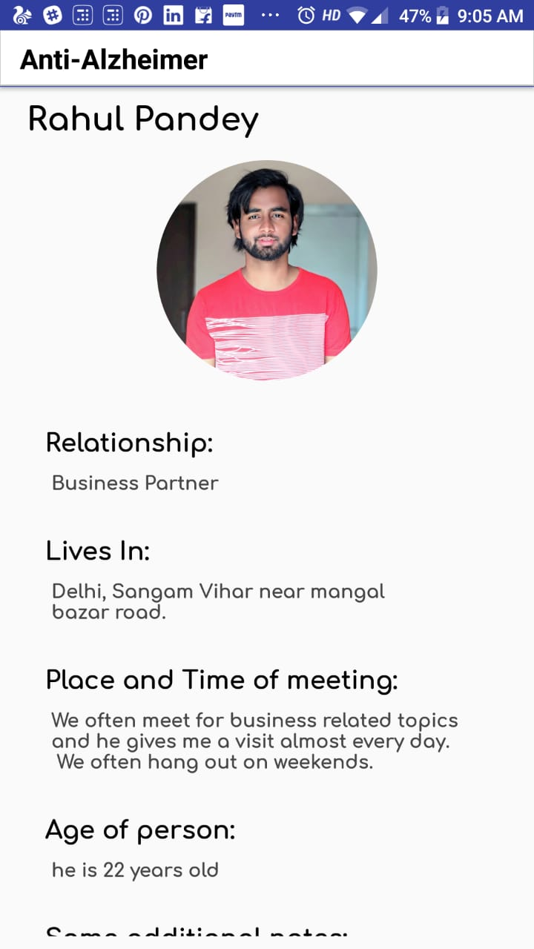
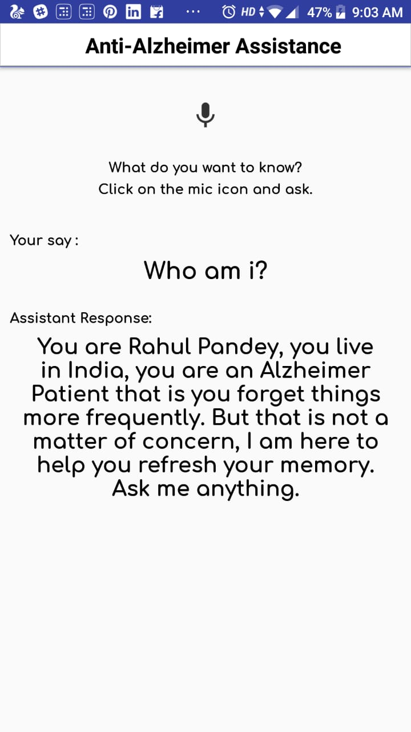
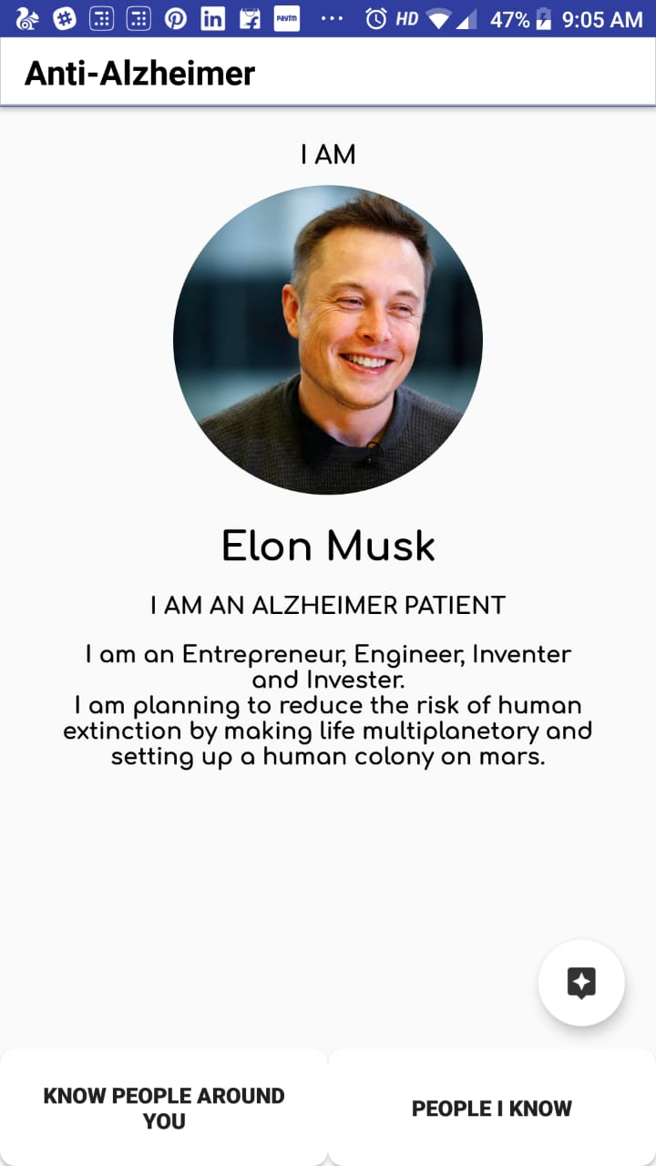
What we have covered?

Slide 7
What’s our team?
“Teamwork begins by building trust. And the only way to do that is to overcome our need for invulnerability.”
Ayantika Nandi (IoT Intern and Professional Writing) Deepak Kumar (IoT Intern and Python Developer) Rahul Pandey (App Developer and Java Developer)

