Slide 1

Comparative Analysis of RoBERTa and CodeBERT for Automated Misconfiguration Detection in Dockerfiles
(MIT Thesis Viva Voice Examination)
Tribhuvan University
Institute of Science and Technology
Central Department of Computer Science & Information Technology
(CDCSIT TU)
Presented By: Supervised By:
Deepak Aryal Asst. Prof. Bikash Balami
Roll no: 7925005 CDCSIT TU
CDCSIT TU Date: January 7, 2026

Slide 2
ABSTRACT
This thesis explores automated detection of Dockerfile misconfigurations using transformer-based NLP models.
A two-stage framework is proposed for binary and rule-specific misconfiguration classification.
The models are evaluated on a dataset of public Dockerfiles.
Results show high detection accuracy, with CodeBERT slightly outperforming RoBERTa.

Slide 3
Outline
Introduction
Problem Statement
Objectives
Scope and Limitation
Literature Review
Methodology
Dataset Description
Data Preprocessing
Description of Algorithms
Implementation Details
Result Analysis
Inference
Conclusion
Future Recommendation
References

Slide 4
Introduction
Docker is a core technology in modern DevOps for building and deploying applications
Dockerfiles define container build processes but are complex and under-analyzed
Misconfigurations in Dockerfiles can cause security vulnerabilities and build failures
Existing tools detect rule violations but fail to generalize to complex patterns
This research evaluates transformer-based NLP models to improve Dockerfile misconfiguration detection
Notes:
As software systems scale, DevOps tools like Docker have become essential. However, Dockerfiles—although critical—are often overlooked in automated analysis. Misconfigurations in these files can lead to serious security and deployment issues, motivating this research.

Slide 5
This naturally leads to the problem addressed in this thesis.
Notes:
As software systems scale, DevOps tools like Docker have become essential. However, Dockerfiles—although critical—are often overlooked in automated analysis. Misconfigurations in these files can lead to serious security and deployment issues, motivating this research.

Slide 6
Problem Statement
Public Dockerfiles frequently violate best practices and contain security risks
Many engineers lack deep security expertise when writing Dockerfiles
Existing tools are rule based and limited to predefined checks which fail to detect unseen patterns
NLP/AI for Dockerfiles is still underexplored

Slide 7


Problem Statement
traefik:latest [v2.11.34]
traefik:latest [v3.6.6]
Traefik http router rule
traefik.http.routers.${PROJECT}.rule=Host(`api. ${DOMAIN}`) || (HostRegexp(`{subdomain:(app)}.${DOMAIN}` ) && PathPrefix(`/api/`))
Traefik http router rule traefik.http.routers.${PROJECT}.rule=Host(`api. ${DOMAIN}`) || (HostRegexp(`{subdomain:(app)}.${DOMAIN}` ) && PathPrefix(`/api/`))
traefik.http.routers.${PROJECT}.rule=Host(`a pi.${DOMAIN}`) || ((Host(` app.${DOMAIN}`) && PathPrefix(`/api`))

Slide 8
Objectives
To design and develop automated detection framework using either RoBERTa or CodeBERT, and find out which one has better performance
To evaluate and compare the performance of RoBERTa and CodeBERT for automated misconfiguration detection in Dockerfiles, using metrics such as accuracy, precision, recall, F1-score, and AUC-ROC

Slide 9
Scope and Limitation
⚡ Models compared: RoBERTa & CodeBERT
🛠️ Objective: Automated detection of Dockerfile misconfigurations
📄 Analysis type: Static, NLP-based evaluation
📊 Performance metrics: Accuracy | Precision | Recall | F1-score | AUC-ROC
🐳 Scope: Only Dockerfiles
📂 Dataset: Publicly available Dockerfiels
⚡ Models: Only RoBERTa and CodeBERT
💻 Resources: Limited computational power may affect experiments and tuning

Slide 10
Literature Review
Study | Dataset | Key findings | Research gap
Learning from, DevOps Artifacts | Expert & non-expert Dockerfiles | Non-expert Dockerfiles violate best practices ~6× more; IDE integration suggested | Needs adaptive AI methods for complex misconfigs
Shipwright | Faulty Dockerfiles | Automated repair suggestions; Improves build correctness | Focus on build failure, not misconfiguration
Dockerfile Flakiness | Flaky Dockerfiles | Characterizes flakiness; Improves repair success | No line-level security detection
Dockerfile Linting | Docker Workflows | Ensures consistent quality via linting | No AI/NLP misconfiguration detection
Not all Dockerfile Smells are the Same | 39,000 Dockerfiles | Experts overlook smells; Validates linting | No AI/NLP detection explored
DRIVE: Rule Mining | Dockerfiles | Identifies semantic & syntactic rules; Improves quality | Focus on static rules, not AI/NLP

Slide 11
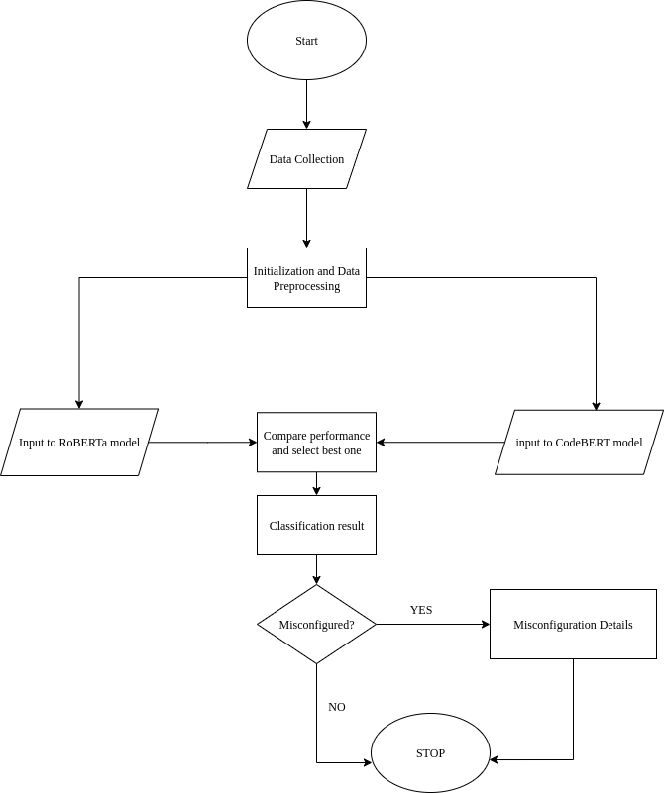
Methodology
System flow chart

Slide 12
Dataset Description
Source: Publicly available Dockerfiles from GitHub
Primary Corpus: Henkel et al. Dockerfile corpus (ICSE 2020)
  ~178,000 real-world Dockerfiles
Extended data: Additional Dockerfiles collected via GitHub Search API
Processing and labels: Dockerfiles parsed line by line; each instruction (e.g., FROM, RUN, COPY) labeled as correct or wrong for training and evaluation of NLP models.
Dataset Size:
  ~178,800 Dockerfiles
  ~1.6 million Dockerfile instructions
Notes:
We combined a well-established ICSE 2020 Dockerfile corpus with newer Dockerfiles from GitHub to capture both historical and recent Docker practices. This ensures relevance while maintaining research reliability.

Slide 13
Data Preprocessing
Model training strategy
Stage 1: Binary misconfiguration classification
  Correct vs wrong
Stage 2: Rule-specific misconfiguration classification
  Misconfigured instructions with rule id

Slide 14
Data Preprocessing
Data splitting
Stratified splitting into:
  Training: 80%
  Validation: 10%
  Test: 10%
Separate strategies for stage 1 and stage 2
Due to computational resource constraints, a representative subset of the dataset was used for training and evaluation.

Slide 15
Data Preprocessing
Data splitting
Aspect | Stage 1: Binary classification | Stage 2: Rule-level classification
Task | Correct vs Wrong | Rule-level misconfiguration classification
Initial data | ~1.6M instructions | Misconfigured instructions only
Data reduction and balancing method | Downsampled and selected 200K samples per class | Rare rules removed (<200 samples) and capped dominant rules (<=5K)
Final split | 80% / 10% / 10% (stratified) | 80% / 10% / 10% (rule-stratified)
Motivation | Computational feasibility | Fair multi-class learning and fair cimputational feasibility

Slide 16
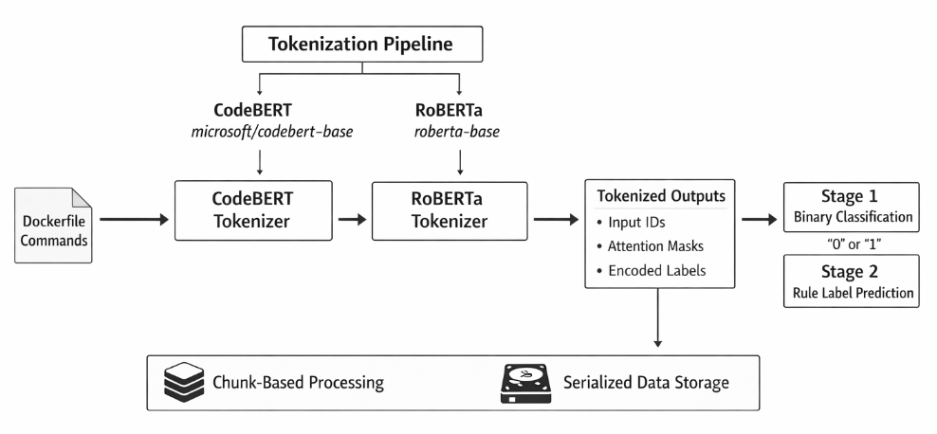
Data Preprocessing
Tokenization and encoding
Unified subword tokenization applied for both learning stages
Fixed input length of 256 tokens with truncation and padding
Training set only label encoding, with pre-tokenized inputs stored for efficient reuse

Slide 17
Data Preprocessing
Dataset summary
Aspect | Stage 1: Binary classification | Stage 2: Rule-level classification
Initial dataset | ~1.6M instructions | Same dataset
Classes | 2 (correct vs wrong) | 63 rules
Class balance | 2,00,000 per class | Filtered 200+ samples, capped at 5,000 per rule
Total samples used | 4,00,000 | 1,73,297
Training set (80%) | 3,20,000 | 1,38,637
Validation set (10%) | 40,000 | 17,330
Test set (10%) | 40,000 | 17,330
Purpose | Detect misconfiguration | Predict violated rule if misconfigured

Slide 18
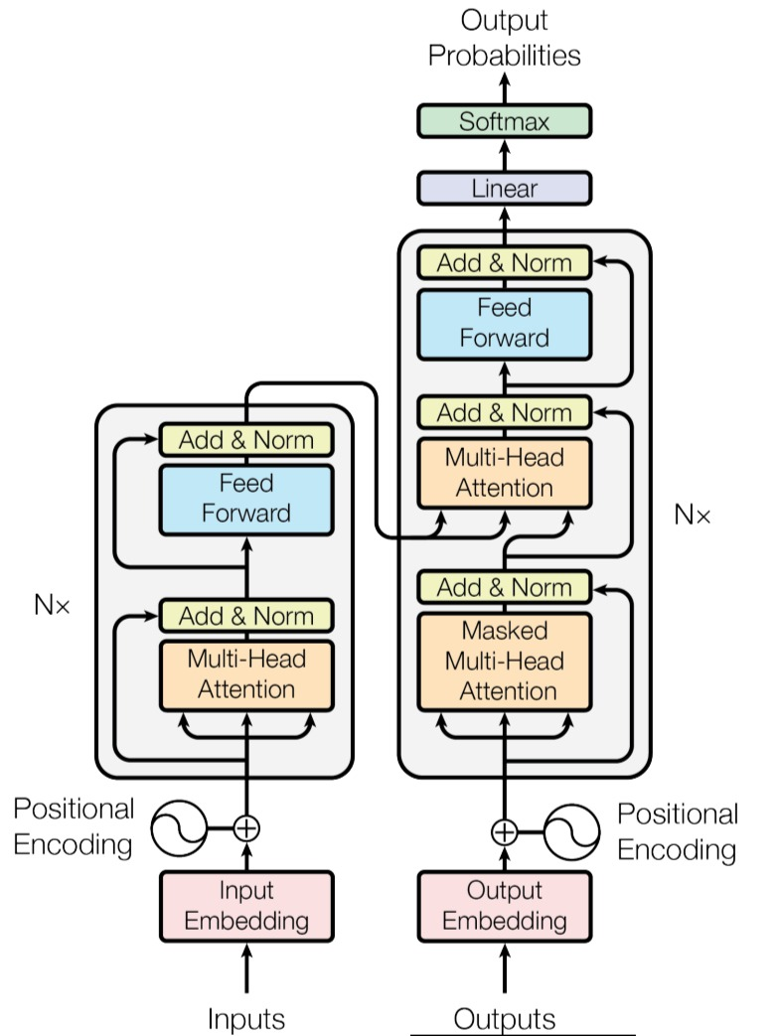
Description of Algorithms
Faster than RNNs/LSTMs: parallel training on large datasets
Attention mechanism: focuses on most relevant words in context
Encoder/Decoder: encoder for classification, both for translation
Self-attention: captures dependencies even across distant words
Positional encoding: keeps track of word order

Slide 19
Description of Algorithms
RoBERTa and CodeBERT
Encoder only transformer architecture
Optimized version of BERT with larger datasets and better training strategies
Dynamic masking: different tokens are masked in each epoch

Slide 20
Description of algorithms
RoBERTa and CodeBERT
Transformer encoder
Stack of self-attention layers producing contextualized token representations.
Input tokens => embedding vectors => processed by encoder layers.
Attention (Q,K,V) = softmax(QK^{T}/√d_{k})V
Where Q, K, V: query, key, value from embeddings and dk: dimension of key vectors
Classification head
The [CLS] token embedding from the encoder is passed through a feed-forward layer to produce a probability distribution over class labels, enabling classification of Dockerfiles as correct or misconfigured.
y = softmax(W. hCLS + b)
Where W,b = trainable parameters and y = probability distribution overs classes

Slide 21
Implementation Details
Model architecture and input processing
Pretrained models
RoBERTa-base (text-oriented)
CodeBERT-base (code-aware)
Tokenization
Model-specific tokenizers
Subword encoding
Maximum sequence length: 256 tokens
Input granularity
Dockerfile commands processed at line level
Output heads
Binary classifier (Stage 1)
Multi-class classifier (Stage 2)

Slide 22
Implementation Details
Training configuration and optimization
Optimizer: AdamW
Learning rate:
  Binary classification: 2 * 10⁻⁵
  Rule classfication: 5 * 10⁻⁵
Batch size: 32
Epochs: 3
Training strategy:
  Validation-based loss monitoring
  Gradient accumulation
Loss function:
  Binary classification: Cross-entropy loss
  Rule classification: Multi-class cross-entropy loss
Model persistence:
  Epoch-wise checkpointing for reproducibility
Notes:
Cross-entropy loss is well-suited for probabilistic multi-class classification and aligns with the softmax-based output layer used in both models.

Slide 23
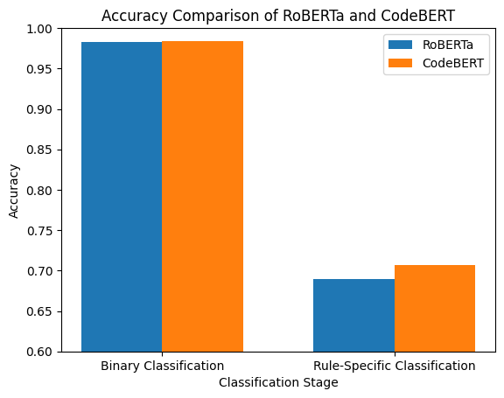
Result Analysis
Accuracy
Models Stages | RoBERTa | CodeBERT
Binary classification | 0.98 | 0.98
Multi class classification | 0.7048 | 0.7070

Slide 24
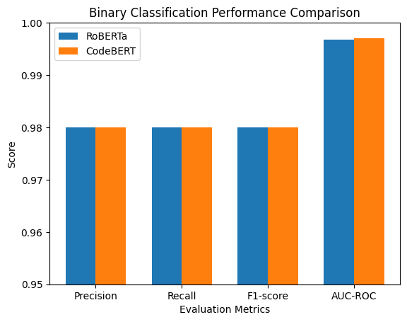
Result Analysis
Binary classification performance
Models Metrics | RoBERTa | CodeBERT
Precision | 0.98 | 0.98
Recall | 0.98 | 0.98
F1 score | 0.98 | 0.98
AUC-ROC | 0.9968 | 0.9970

Slide 25
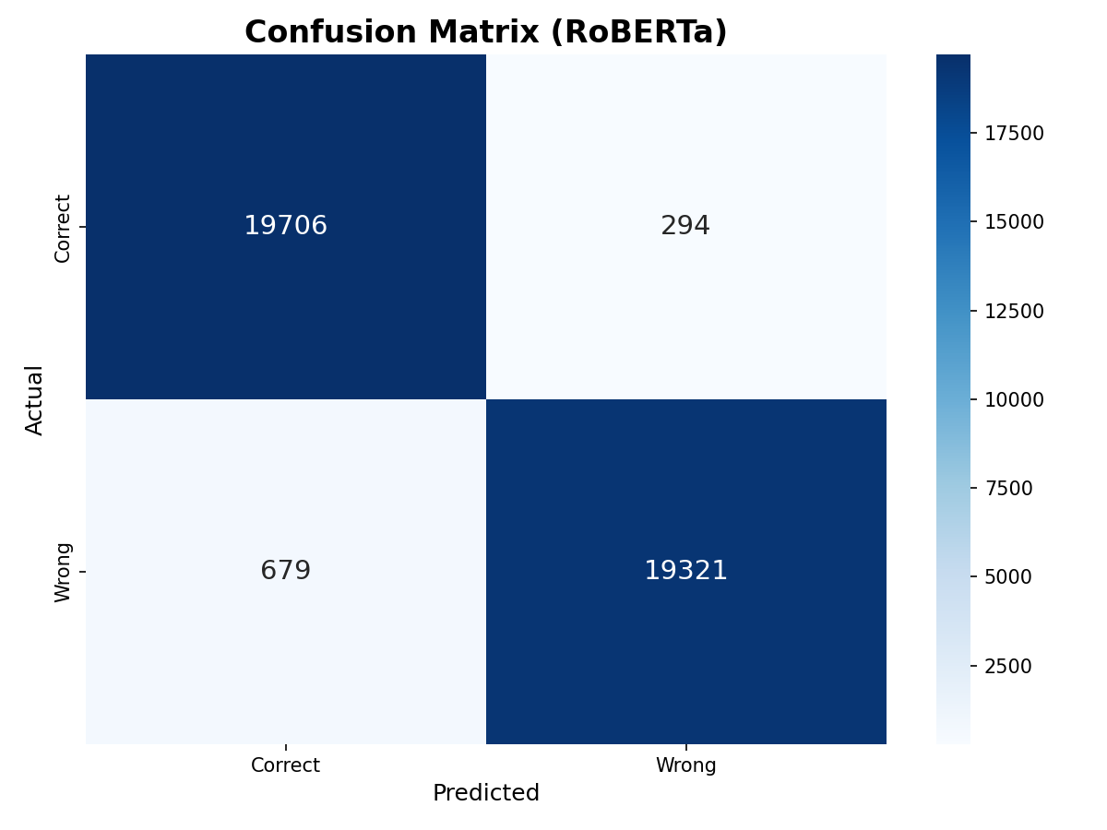
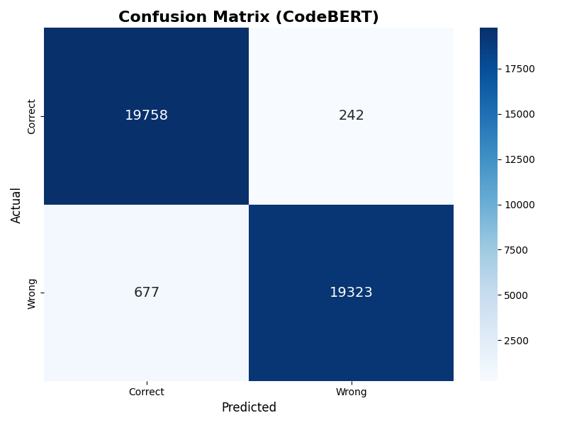
Result Analysis

Slide 26
Result Analysis
Rule(Multi) classification performance (Overall)
Models Metrics | RoBERTa | CodeBERT
Macro-averaged F1 | 0.7055 | 0.7136
Weighted-averaged F1 | 0.7013 | 0.7040
Top-1 accuracy | 0.7048 | 0.7070
Top-3 accuracy | 0.8901 | 0.8938

Slide 27
Result Analysis
Per class rule(multi) classification performance
Models Metrics | RoBERTa | CodeBERT
Total number of rules | 63 | 63
Average F1-score | 0.7055 | 0.7136
Number of rules with F1 > 0.8 | 21 | 21
Number of rules with F1 < 0.5 | 11 | 11

Slide 28
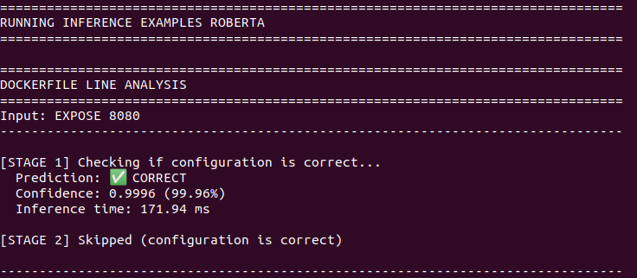
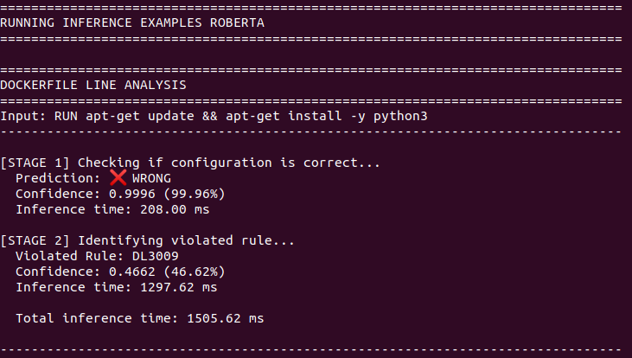
Inference
RoBERTa

Slide 29
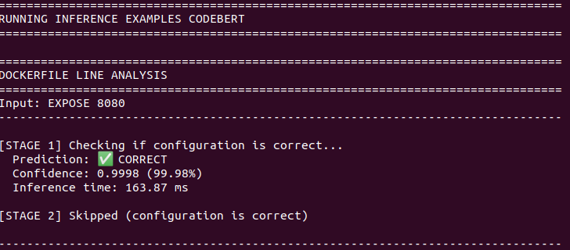
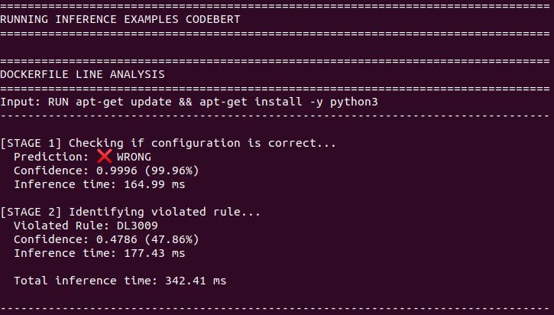
Inference
CodeBERT

Slide 30
Conclusion
For binary misconfiguration detection, both CodeBERT and RoBERTa achieve excellent and identical performance (≈98% accuracy), demonstrating strong and reliable classification capability.
In rule-specific misconfiguration classification, CodeBERT performs slightly better than RoBERTa, indicating its stronger ability to capture Dockerfile-specific and semantic patterns.
Model selection depends on application needs: both models are suitable for large-scale binary detection, while CodeBERT is more effective for detailed rule-level misconfiguration analysis.

Slide 31
Future Recommendation
Improve rule-specific classification using larger and more diverse datasets, including data augmentation for rare rules
Explore ensemble models or hybrid approaches combining transformers with rule-based heuristics
Integrate the proposed models into CI/CD pipelines for real-time misconfiguration detection
Extend the approach to other IaC technologies such as Terraform, CloudFormation, and Ansible

Slide 32
References
[1] S. Phillips, T. Zimmermann, and C. Bird, “Understanding and Improving Software Build Teams,” Proc. - Int. Conf. Softw. Eng., May 2014, doi: 10.1145/2568225.2568274.
[2] A. Vaswani et al., “Attention is All you Need,” in Neural Information Processing Systems, 2017. [Online]. Available: https://api.semanticscholar.org/CorpusID:13756489
[3] J. Henkel, C. Bird, S. K. Lahiri, and T. Reps, “Learning from, Understanding, and Supporting DevOps Artifacts for Docker,” 2020 IEEE/ACM 42nd Int. Conf. Softw. Eng., pp. 38–49, 2020, [Online]. Available: https://api.semanticscholar.org/CorpusID:211069127

Slide 33
References
[4] J. Henkel, D. Silva, L. Teixeira, M. d’Amorim, and T. Reps, “Shipwright: A Human-in- the-Loop System for Dockerfile Repair,” 2021 IEEE/ACM 43rd Int. Conf. Softw. Eng., pp. 1148–1160, 2021, [Online]. Available: https://api.semanticscholar.org/CorpusID:232045443
[5] T. Shabani, N. Nashid, P. Alian, and A. Mesbah, “Dockerfile Flakiness: Characterization and Repair,” 2025 IEEE/ACM 47th Int. Conf. Softw. Eng., pp. 1793–1805, 2024, [Online]. Available: https://api.semanticscholar.org/CorpusID:271855816
[6] D. W. Elliott, “Dockerfile Linting: Every time, Everywhere,” 2020, [Online]. Available: https://medium.com/@david.w.elliott/dockerfile-linting-every-time-everywhere-d8d271a1e650

Slide 34
References
[7] G. Rosa, S. Scalabrino, G. Robles, and R. Oliveto, Not all Dockerfile Smells are the Same: An Empirical Evaluation of Hadolint Writing Practices by Experts. 2024. doi:10.1145/3643991.3644905.
[8] Y. Zhou, W. Zhan, Z. Li, T. Han, T. Chen, and H. C. Gall, “DRIVE: Dockerfile Rule Mining and Violation Detection,” ACM Trans. Softw. Eng. Methodol., vol. 33, pp. 1–23, 2022, [Online]. Available: https://api.semanticscholar.org/CorpusID:254564701
[9] J. Henkel, C. Bird, S. K. Lahiri, and T. Reps, “ICSE 2020 Artifact for: Learning from, Understanding, and Supporting DevOps Artifacts for Docker.” Zenodo, 2020. doi: 10.5281/zenodo.3628771.

Slide 35
Thank you!!!

