Slide 1
Gold Price Prediction
Using Backpropagation algorithm
ETEG 425: Neural Network and Fuzzy logic
BY
Deepak Baral 42002

Slide 2
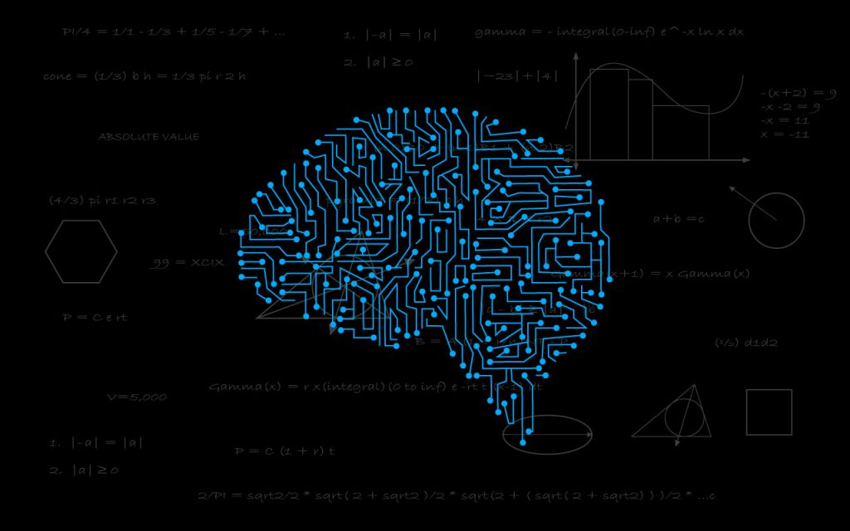
Table of Contents
INTRODUCTION
OBJECTIVES
NETWORK STRUCTURE
LITERATURE SURVEY
METHEDOLOGY
RESULT AND ANALYSIS
CONCLUSION

Slide 3
INTRODUCTION
Gold has been one of the major investment instruments for our economic society for many years.
It is perceived as the most reliable means of investment by people during a crisis.
It is very important to estimate gold prices not just for the investors who want to earn high profits from their investments but also from a economic aspect of a country as the gold price reveals the true state of the economy of a country.
The interest of investors in gold is shaped by the price of the gold which is a influence of various factors such as international oil prices, foreign exchange prices, interest rates, stocks, commodity prices and so on.
Any change in these factors affects the supply and demand of gold and consequently affects the price of gold in the market.

Slide 4
INTRODUCTION…
Due to the significance of gold it is very useful for investors to predict the price of gold based on the influencing factors provided.
Although gold price is influenced by various factors the most important factors that affect the price is the price of crude oil and the dollar to euro exchange rate price.
Hence in this mini project an efficient supervised learning backpropagation algorithm is used to predict the price of gold.

Slide 5
Objectives
To predict the price of gold.
To display the learning rate while training.

Slide 6
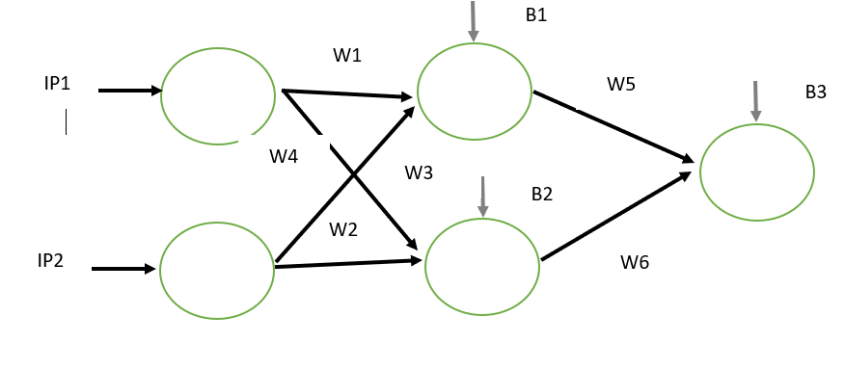
Network Structure
Consist three layers; input, hidden and output layers.
Input and output layers consist 2 neurons each while output contains single neuron.

Slide 7
Literature survey
Artificial Neural Network
An ANN is a network of hundreds or thousands of artificial neurons called processing units, which are interconnected by nodes
These processing units are made up of input, hidden and output units.
The input units receive various forms and structures of information based on an internal weighting system, and the neural network attempts to learn about the information presented to produce one output report.
Just like humans need rules and guidelines to come up with a result or output, ANNs also use a set of learning rules[1]

Slide 8
Literature survey…
Supervised Learning
As the name suggests, supervised learning takes place under the supervision of a teacher
During the training of ANN under supervised learning, the input vector is presented to the network, which will produce an output vector.
This output vector is compared with the desired/target output vector.
An error signal is generated if there is a difference between the actual output and the desired/target output vector
On the basis of this error signal, the weights would be adjusted until the actual output is matched with the desired output.[2]

Slide 9
Literature survey…
Backpropagation Algorithm
Back propagation is a systematic method for training multi-layer artificial neural networks.
It is a multi-layer forward network using extend gradient-descent learning rule, commonly known as back propagation (of errors) rule.
Back propagation provides a computationally efficient method for changing the weights in feed forward network, with differentiable activation function units, to learn a training set of input-output examples.
Being a gradient descent method, it minimizes the total squared error of the output computed by the network.
Backpropagation involves three phases, feedforward phase, Backpropagation phase and weight updating phase.[3]

Slide 10
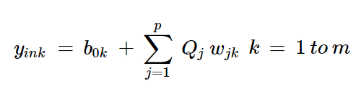


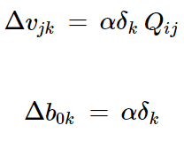
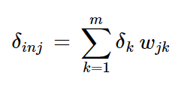

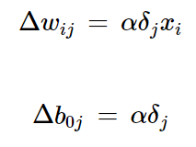
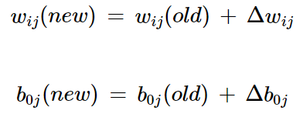
Literature survey…
Backpropagation Algorithm…
In feedforward phase the output is calculated by adding bias to multiple of input and weight and passing the output to non linear activation function.
In backpropagation phase the gradient of weight and bias are calculated in each weight and bias of output and hidden layer respectively.
In weight updating phase every weight and bias is updated for next operation.

Slide 11
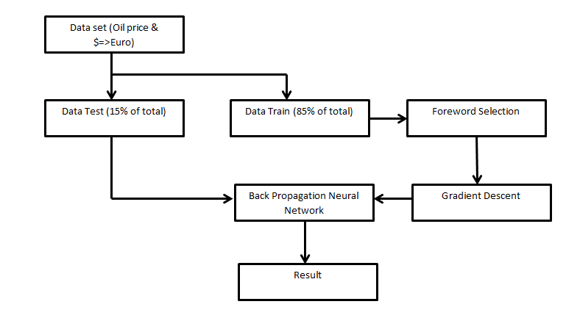
Block Diagram

Slide 12
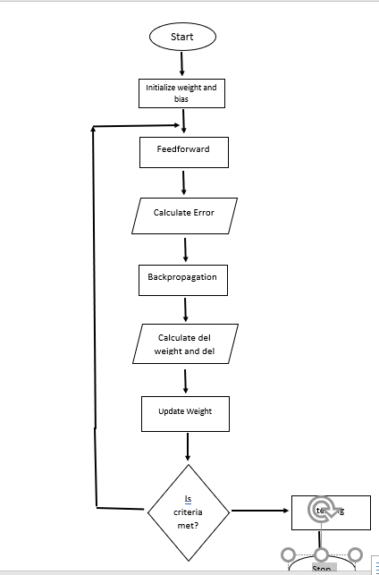
Flow Chart
N
Y
Testing

Slide 13
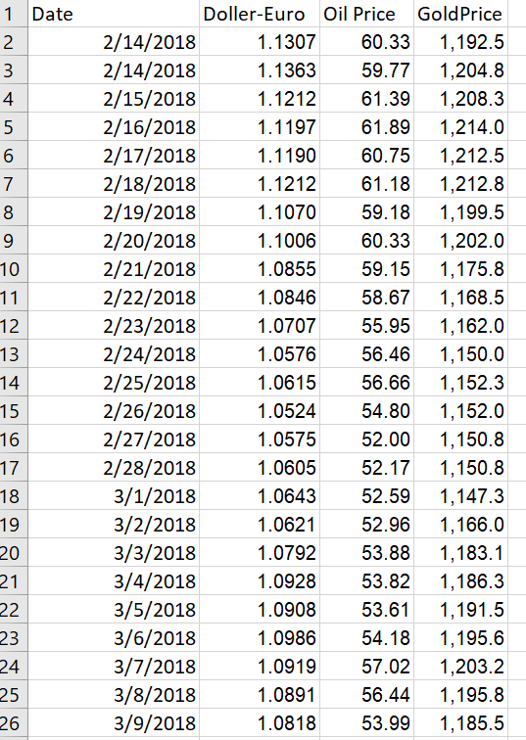
Result and Analysis
Data Format
Total of 951 data are taken from February 14, 2018 to
September 20, 2020.
Data was separated to testing and training by ratio of 85%:
15%.
the first column data is dollar to euro exchange price,
the second column data is crude oil price in barrel and
the third column is gold price per ounce in US dollar.
All the data are based on United States and are taken from
internet.

Slide 14
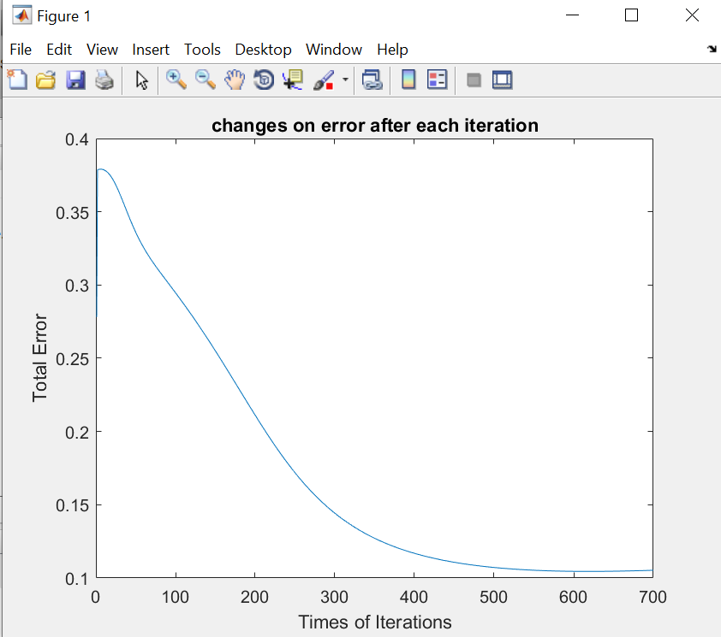
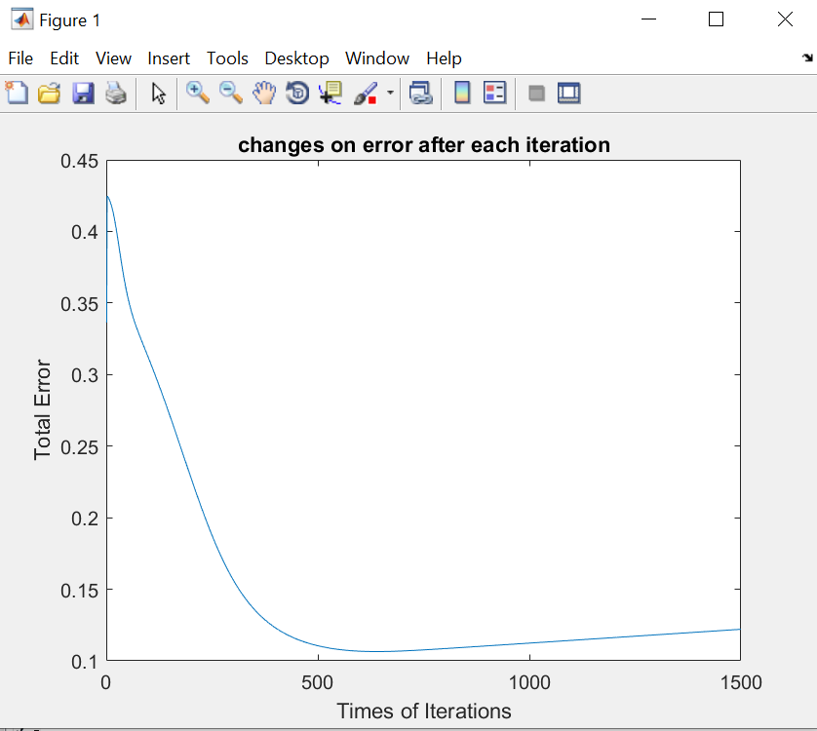
Result and Analysis…
Training
Global Minimum is obtained around 700 iterations, which is the stopping criteria.

Slide 15
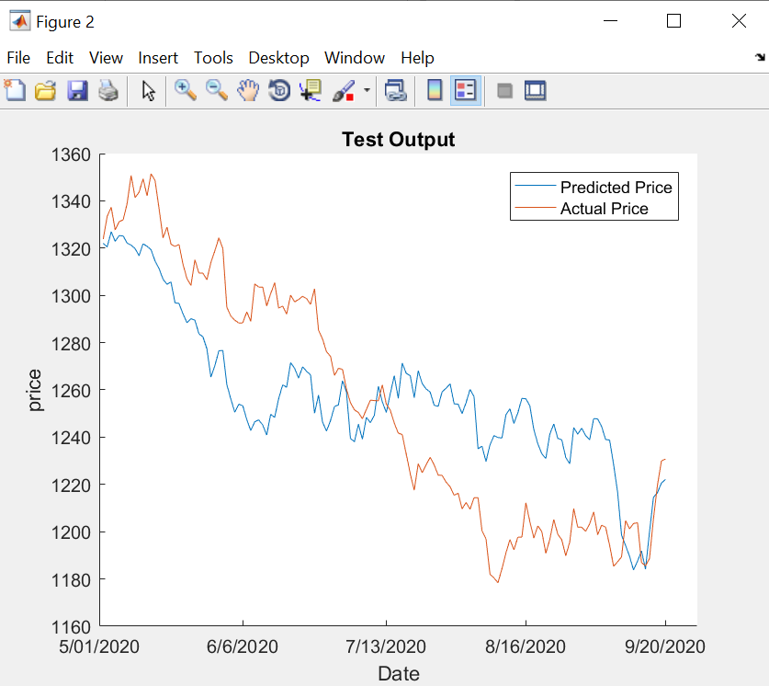
Result and Analysis…
Testing
After completing 700 iterations, weight
Was adjusted for the testing purpose.
The obtained result is as shown in figure
The obtained and predicted result only
Intersects at few points, which may be caused
Due to random nature of price of gold.
More accurate result can be obtained if
More factors influencing the prices are
considered.

Slide 16
Conclusion
Hence, in this project, the backpropagation algorithm was employed to predict the price of gold.
First the data was collected and fed to the neural network of two input, two hidden and one output layer.
Data was seperated to training and testing sets and the training was performed to adjust the weight with backpropagation algorithm.
Finally, the testing was performed with the adjusted weight and the result of training and testing was plotted.
Though a fairly accurate result was obtained as the gold price sometimes flatulates rapidly more accurate result can be obtained if proper data analysis technique is done or more factors influencing the price are considered.

Slide 17
References
[1] SN Sivananndam, S Sumathi, “ An introduction of Neural Network Using Matlab”, “McGrew Hill”, p. 283, April 2006
[2] Charu C. Aggarwal, “ Neural Networks and Deep Learning”, “Springer”, p. 316, 2010
[3] Trivedi, Pankaj, “Backpropagation”, Tutorialspoint, “https://www.tutorialspoint.com/artificial_neural_network/artificial_neural_network_supervised_learning.htm”, June 2014.

