Slide 1



Waste Classification Using CNN

Slide 2

Learning Objectives
Understand CNNs for Image Classification
Learn how Convolutional Neural Networks (CNNs) are applied to image classification tasks like waste sorting.
Build Interactive Web Apps with Streamlit
Gain hands-on experience in creating user-friendly web applications for real-time waste classification.
Waste Classification for Sustainability
Understand the significance of automated waste sorting in promoting recycling and environmental sustainability.
GOAL

Slide 3



Tools and Technology used
Python: Main programming language for implementing the model and frontend.
TensorFlow/Keras: Deep learning framework for building and training the CNN model.
TensorFlow Lite: Model optimization for deployment on edge devices with smaller size.
Streamlit: Framework for creating an interactive web app for real-time waste classification.
OpenCV/PIL: Libraries for image processing and manipulation.
Google Colab: Cloud platform for training the model with GPU support.
gdown: Tool to download models from Google Drive and use it on streamlit.

Slide 4


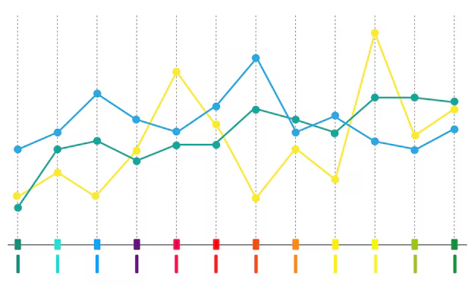
Methodology
Data Collection: Gathered labeled dataset of images classified as ‘Organic’ and ‘Recyclable’.
Preprocessing:
Model Architecture:
Model Training: Trained on the dataset using TensorFlow/Keras with techniques like data augmentation to reduce overfitting.
Images resized to 224x224 pixels.
Normalized pixel values (scaled to 0-1).
Split into training and test sets for model evaluation.
Built a Convolutional Neural Network (CNN) with multiple convolutional and pooling layers.
Used activation functions like ReLU and softmax for classification.

Slide 5



Methodology
Model Optimization: Converted the trained model to TensorFlow Lite format for faster inference and deployment.
Web Interface: Developed an interactive app using Streamlit where users upload images to classify as 'Organic' or 'Recyclable’.
Model Inference: The app uses TensorFlow Lite to perform inference on the uploaded image and returns classification results with confidence scores.

Slide 6
Problem Statement:
Automated Waste Classification for Enhanced Recycling Efficiency
Inefficient Manual Sorting: Current systems that rely on manual sorting for waste management are inefficient, expensive, and prone to errors.
Contamination and Reduced Recycling: Manual sorting contaminates recyclables, ultimately bringing down the recycling rates.
Increased Landfill Burden: Lower recycling rates further burden the landfill.

Slide 7
Solution:
A CNN-Based Waste Classification System
Proposed Solution: This project proposes developing an automated waste classification system.
Technology Used: The system will utilize Convolutional Neural Networks (CNNs).
Goals: The project aims to enhance the speed, accuracy, and efficiency of waste sorting.
Expected Outcomes: The project anticipates potentially higher recycling rates and a more sustainable waste management approach.

Slide 8
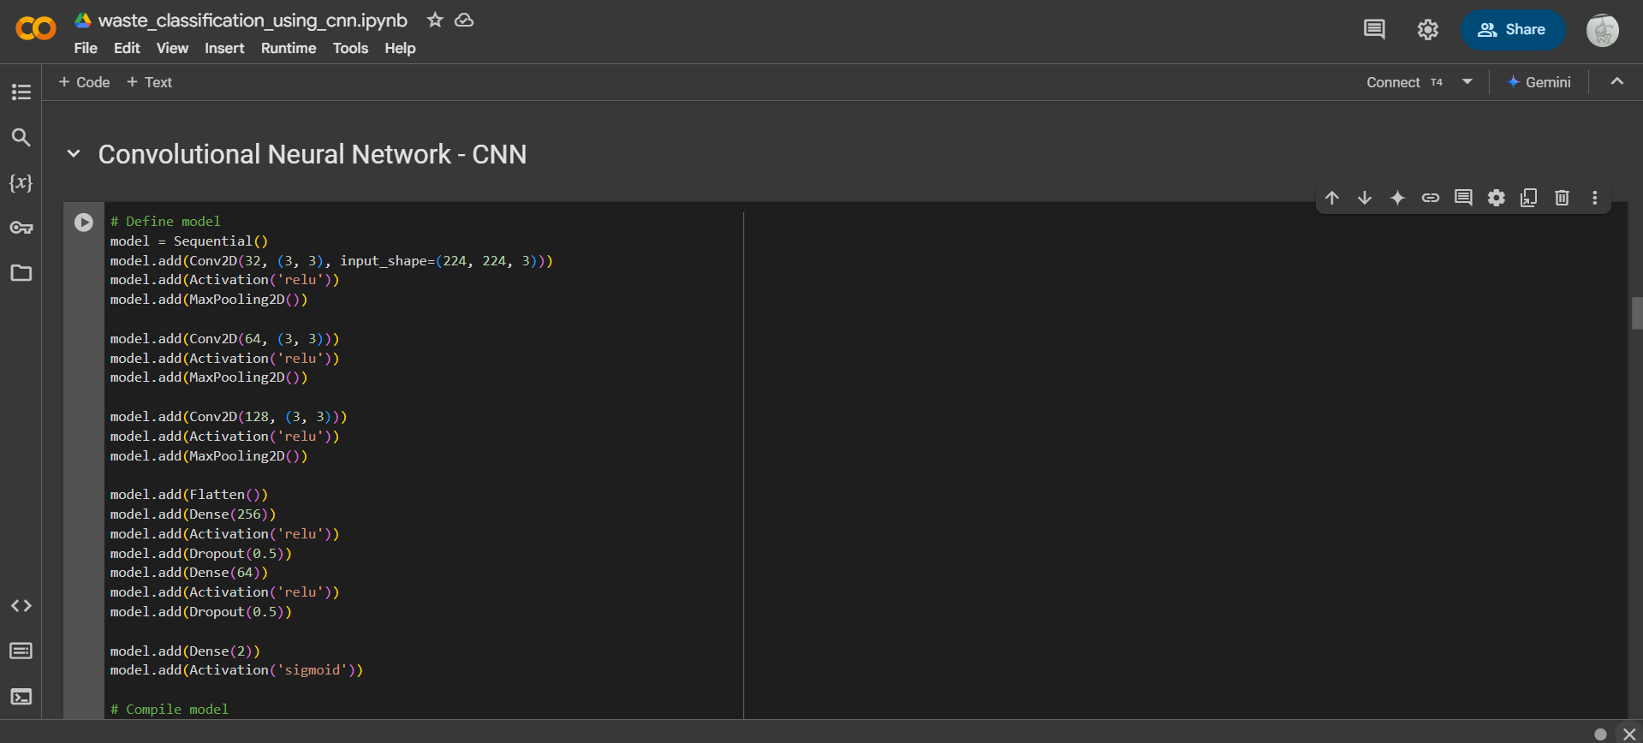
Screenshot of Output:

Slide 9
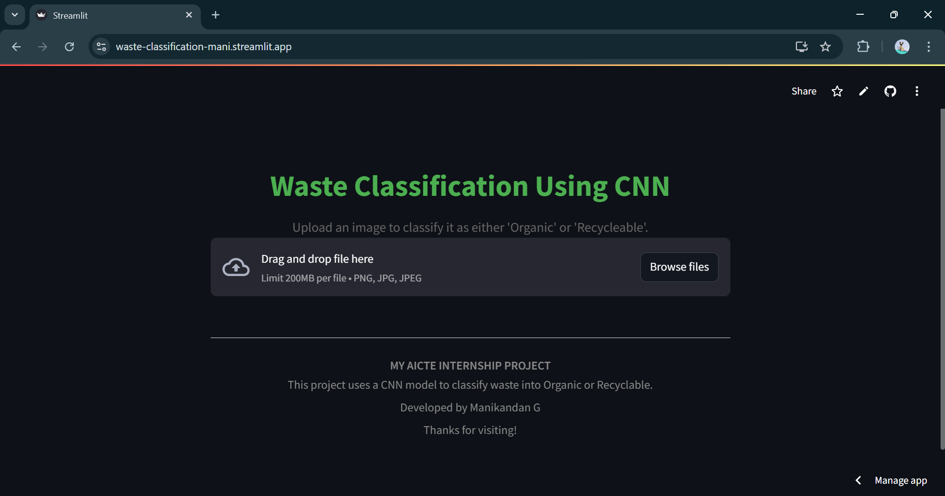
Screenshot of Output:

Slide 10
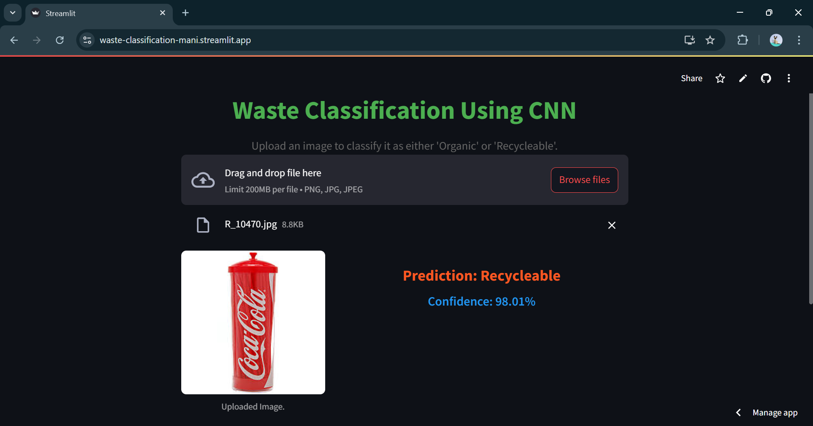
Screenshot of Output:

Slide 11
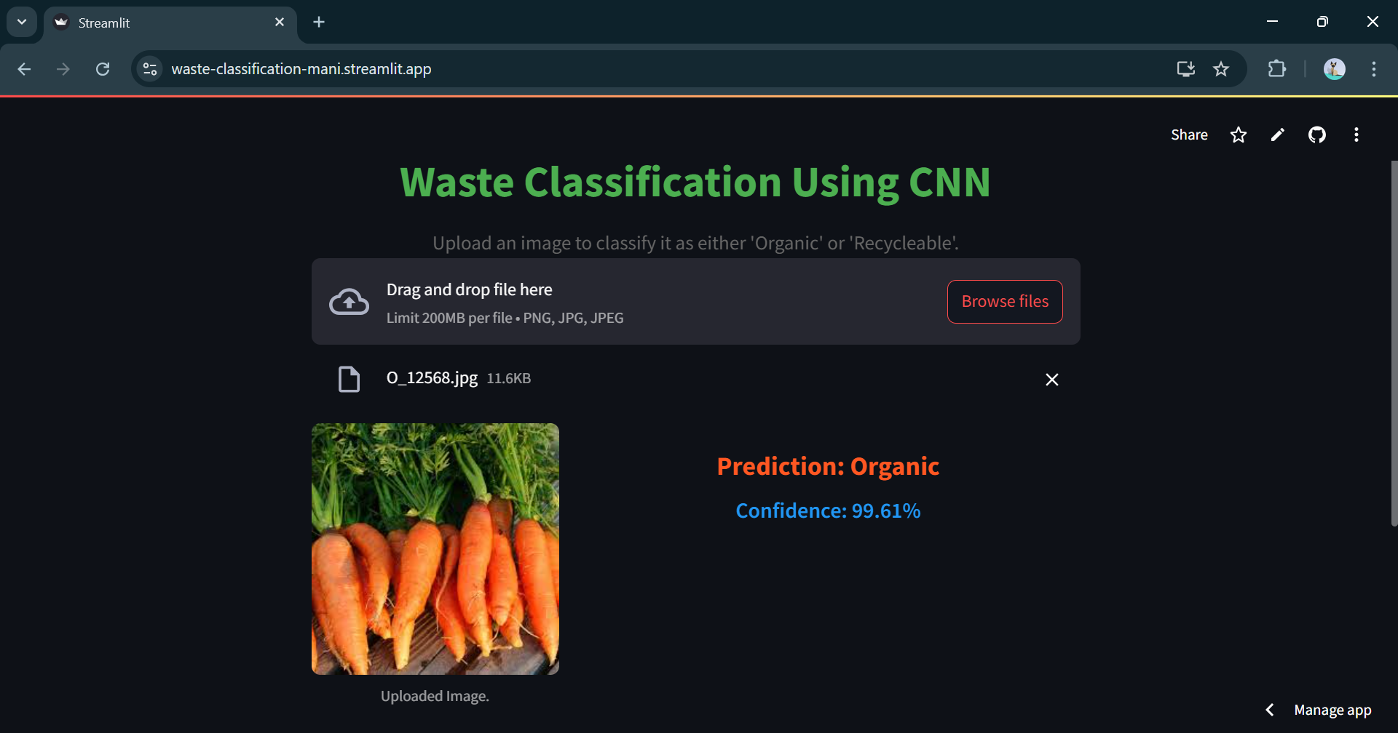
Screenshot of Output:

Slide 12
Conclusion:
In conclusion, this project presents a promising solution to the challenges that traditional waste management faces. This is through leveraging the power of Convolutional Neural Networks in the automated classification of waste. This would mean more efficient and environmentally responsible handling of waste, as well as a great push for recycling. Future research may focus on how to further improve the efficiency and environmental impact of automated waste management practices such as,
Integration with Robotics: The system can be integrated with robotic arms for fully automated sorting facilities.
Mobile Applications: Future development could include mobile apps for citizen-level waste identification and education.

