Slide 1

Real-time YouTube Captions to Sign Language Animation
Guide: Dr.G.Revathy
Designation: Assistant professor
Department: Computer science engineering
CSE AI&ML
Name: Deepak.D
Department: Computer science engineering
CSE AI&ML

Slide 2
Introduction
This project captures YouTube captions and dynamically converts them to sign language animations in real-time. It leverages a browser extension to capture video captions and sends the data to a Django backend for text processing and animation rendering. The main goal is to assist the hearing-impaired community by providing real-time sign language translations.

Slide 3
Architecture Overview
The project consists of two main components:
1. Browser Extension: Captures YouTube video captions in real time and sends them to the Django backend.
2. Django Backend: Receives the text, processes it, and returns the corresponding sign language animations.
The extension displays the sign language animations to users alongside the video in real-time.

Slide 4
Step 1 - Django Backend Setup
1. Install Django and set up the environment.
2. Run `python manage.py runserver` to start the server.
3. Ensure that the backend is configured to handle requests from the browser extension.
4. Set up `views.py` to handle POST requests and send the corresponding animations to the extension.

Slide 5
Step 2 - Browser Extension Setup
1. Install the `fixed_extension_v3.crx` browser extension in developer mode.
2. The extension listens to YouTube captions and sends text to the Django backend.
3. The extension communicates with the backend using the predefined API endpoint and fetches animation files based on the captions.

Slide 6
Step 3 - Backend Processing
The backend receives the captions, processes them using the following steps:
1. Tokenizes the text using `word_tokenize()`.
2. Matches each word with its corresponding animation file (e.g., 'hello' -> 'hello.mp4').
3. If a word has no matching animation, it is either skipped or handled differently.
4. Sends the animation files back to the extension.

Slide 7
Step 4 - Sign Language Animation Mapping
The `convert_to_sign_language.py` script is used to convert captions to animations:
1. Words are split and converted to lowercase.
2. Each word is matched with an animation (e.g., 'word.mp4').
3. If an animation is missing, it logs the error.
4. Returns the list of animation files to the browser extension.

Slide 8
Step 5 - Real-time Display
1. The extension displays the animations on the screen, synchronizing them with the captions from the video.
2. Users can view the animations in real time as captions are spoken in the video.
3. The system updates dynamically based on the speed of the video and the captions' text.

Slide 9
Challenges
1. Handling words without corresponding animations.
2. Ensuring that the animations remain synchronized with the video.
3. Optimizing performance for faster text processing and animation rendering.
4. Supporting a wide range of words and phrases.

Slide 10
Future Enhancements
1. Expanding the sign language animation library to support more words.
2. Enhancing performance for larger videos and faster real-time processing.
3. Implementing user controls for customization (e.g., playback speed, animation style).
4. Integrating the system with more video platforms beyond YouTube.

Slide 11
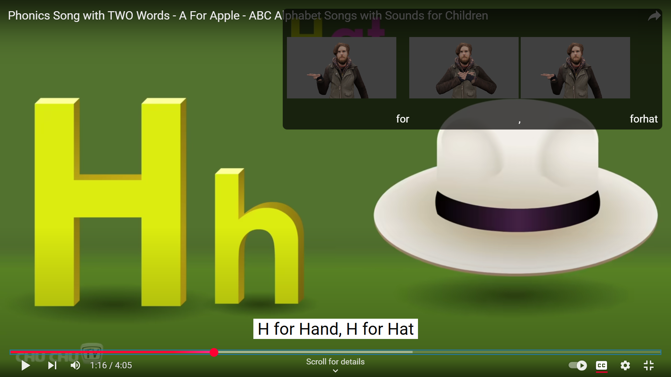
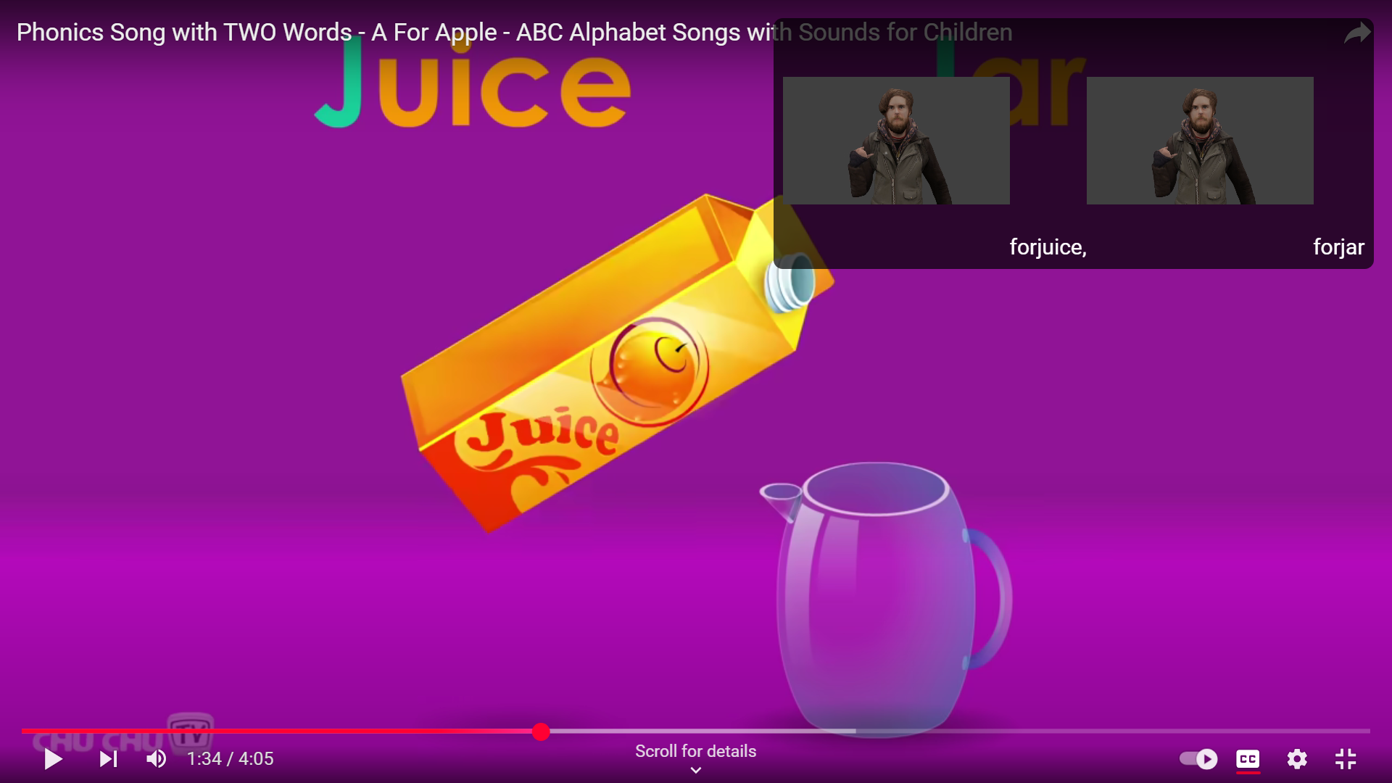
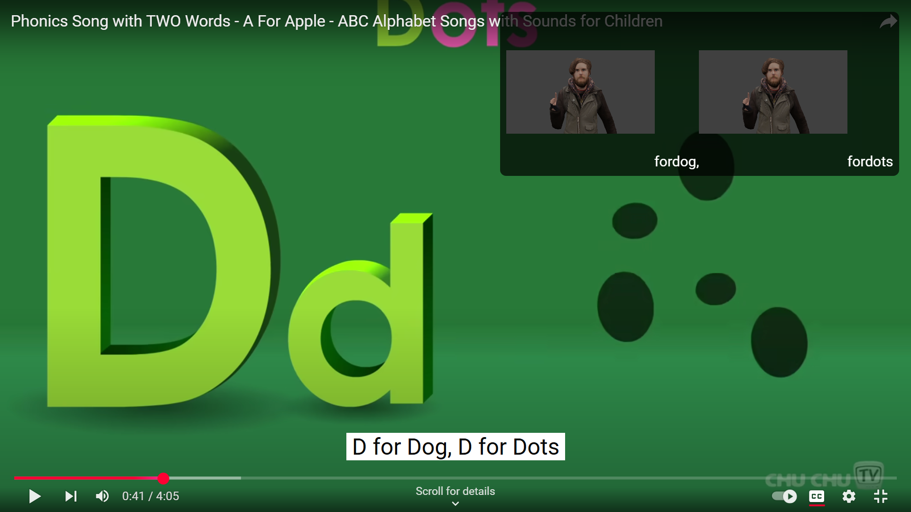
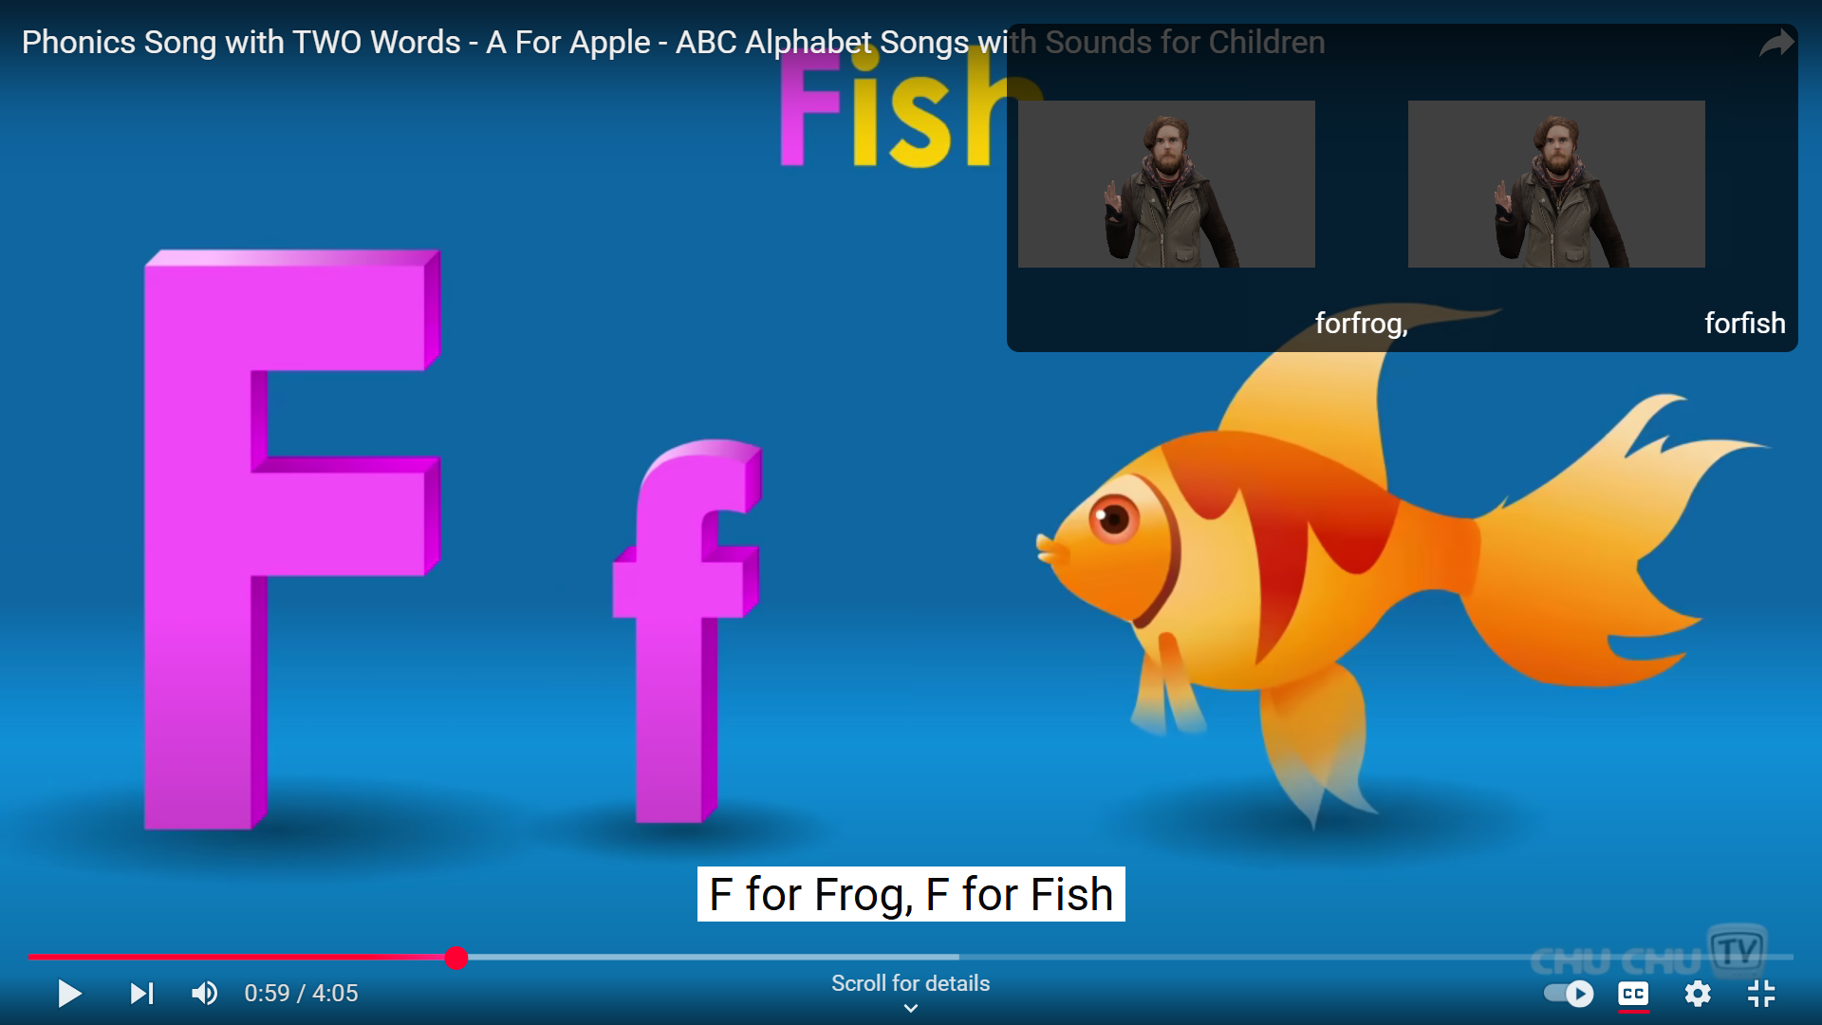
Sample Output

Slide 12
Conclusion
This project demonstrates the integration of real-time caption capture, text processing, and sign language animation rendering using a browser extension and Django backend. By translating YouTube captions into sign language animations, we aim to make online content more accessible for the hearing-impaired community.

