Slide 1


KDK College of Engineering, Nagpur Department of Computer Technology Session 2018-19
SOF
(Science of Fitness)
Presented by:
Amankumar Shahu -110
Akhilesh Jodh -107
Deepak Dhakate -120

Slide 2
CONTENTS
INTRODUCTION
PROBLEM DEFINITION
OBJECTIVES
LITERATURE SURVEY
METHODOLOGY
MODULE DESCRIPTION
PROJECT SNAPSHOTS
IMPLEMENTATION TOOLS
CONCLUSION
REFERENCES

Slide 3
Introduction
SOF (Science of Fitness) is an gym management system that provides a system which handles the information of the people coming to the gym and maintaining their health care.
It takes care of all their health information. It even maintains the data who joins the gym.
Data will be stored in the database. It also maintains gym records.

Slide 4
Problem definition
In existing systems, It utilizes a large amount of space for member and owner transaction information in paper files, sometimes manual calculation may be incorrect.
No security as data can be misplaced or damaged.
This gym management system helps the administration in speeding up the tasks at the same time reducing the complexity.

Slide 5
objective
The purpose or objective of this system is to digitalize and create an automated system. The system will perform the task like adding the new member to the gym, Removing the member or keeping the records and other things required in managing the gym properly.
This system does not only limit itself to the administration but also helps he members of the gym. The members can have options like attendance and fee payment, change batch request etc.
This will improve transparency between the members which is always a good quality in the system. It will also give the layer of security to the administration and users that only authorized users can access by their credentials.

Slide 6
LITERATURE SURVEY
Gym Management System of Taurama Fitness centre by Computer University Of Indonesia. Taurama Fitness centre is one of the few gym training centre in port Moresby, Papua New Guinea which was founded in 2009, by johnson Waldford. However , as off its experience, there are some major setbacks or problems that are encountered at Taurama Fitness centre. The setbacks or problems encountered are mainly related to member registration procedures and storing data contents. It was time consuming and inefficient.

Slide 7
METHODOLOGY
Topic Understanding:
It is vital that the field of application as introduced in the project may be totally a new field. So we carefully went through the project requirements to identify the requirements of the project.
Modular Break-Up Of The System:
Identify the various modules in the system.
List them in the right hierarchy.
Identify their priority of development.

Slide 8
Proposed project plan
MODULE DESCRIPTION
Homepage: Creation of the home page containing gym information along with registration form and also the login form for the user.
User Interaction: Collecting all information about the user and calculating BMI and allowing customer to select one of the workout fields. Considering the workout duration of the customer the payment will be done by him/her.
Information: It includes all the exercises and diet plans regarding the particular field selected by the customer. The customer can also go for the supplements which comes under veg/non-veg criteria regarding their workouts

Slide 9
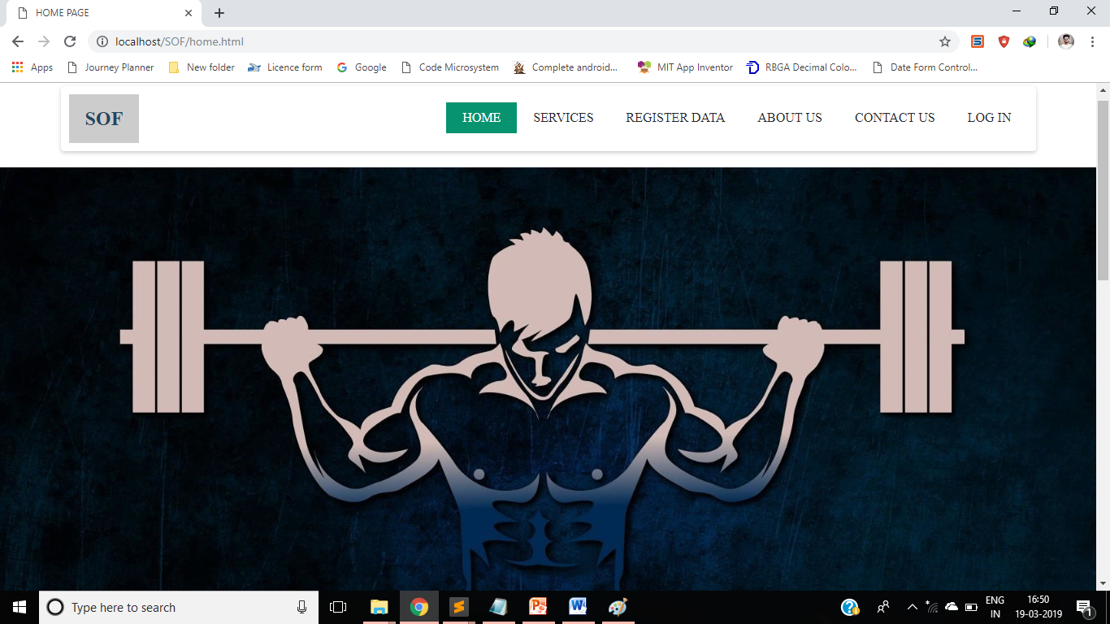
SNAPSHOTS

Slide 10
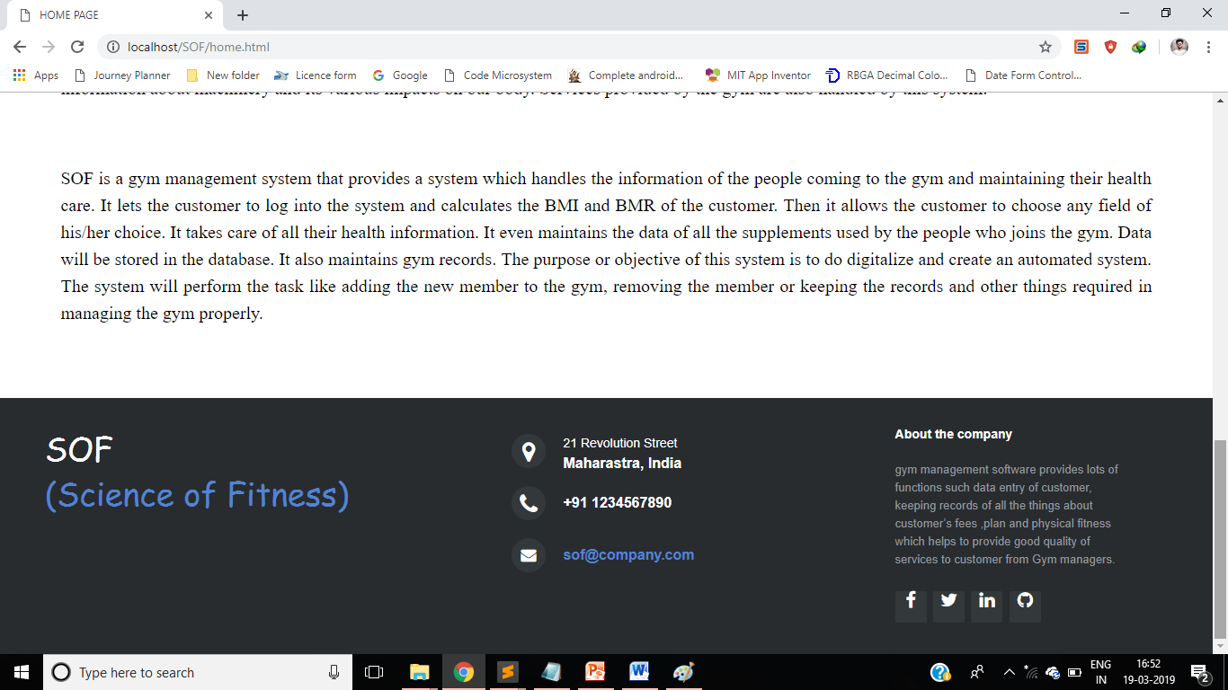
SNAPSHOTS

Slide 11
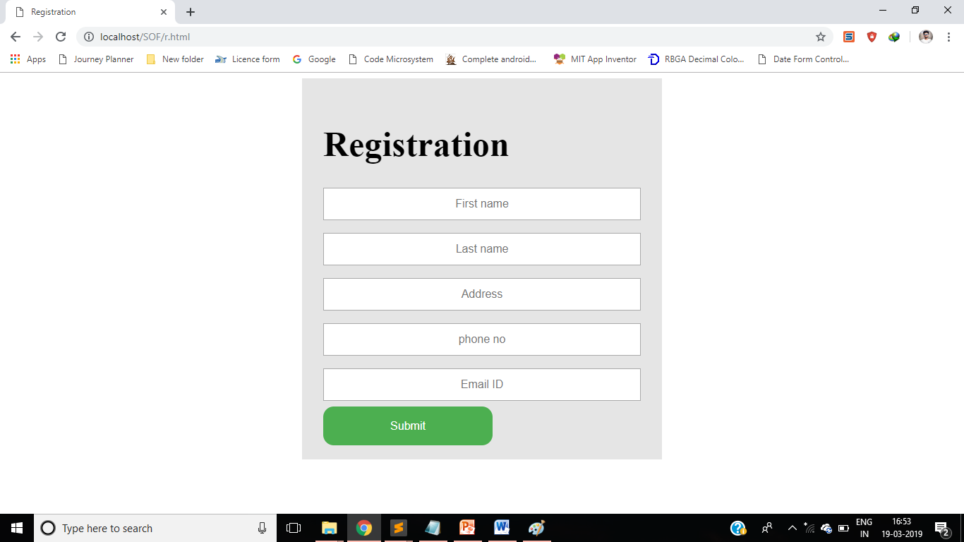
SNAPSHOTS

Slide 12
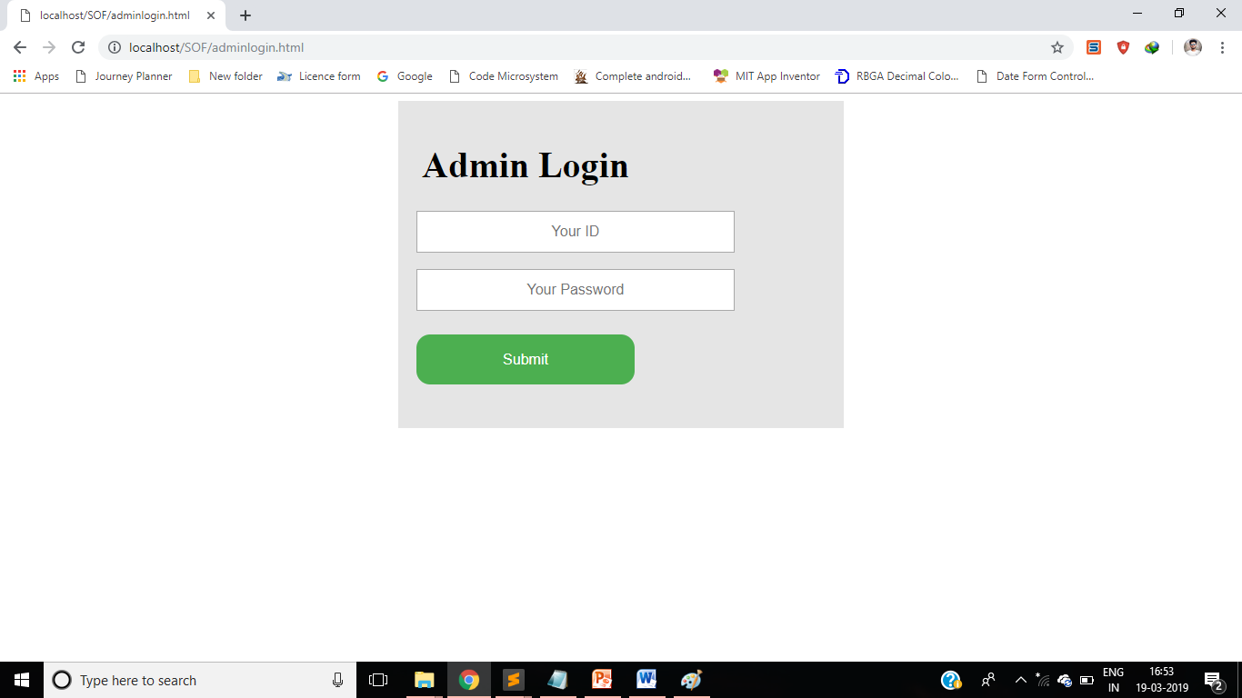
SNAPSHOTS

Slide 13
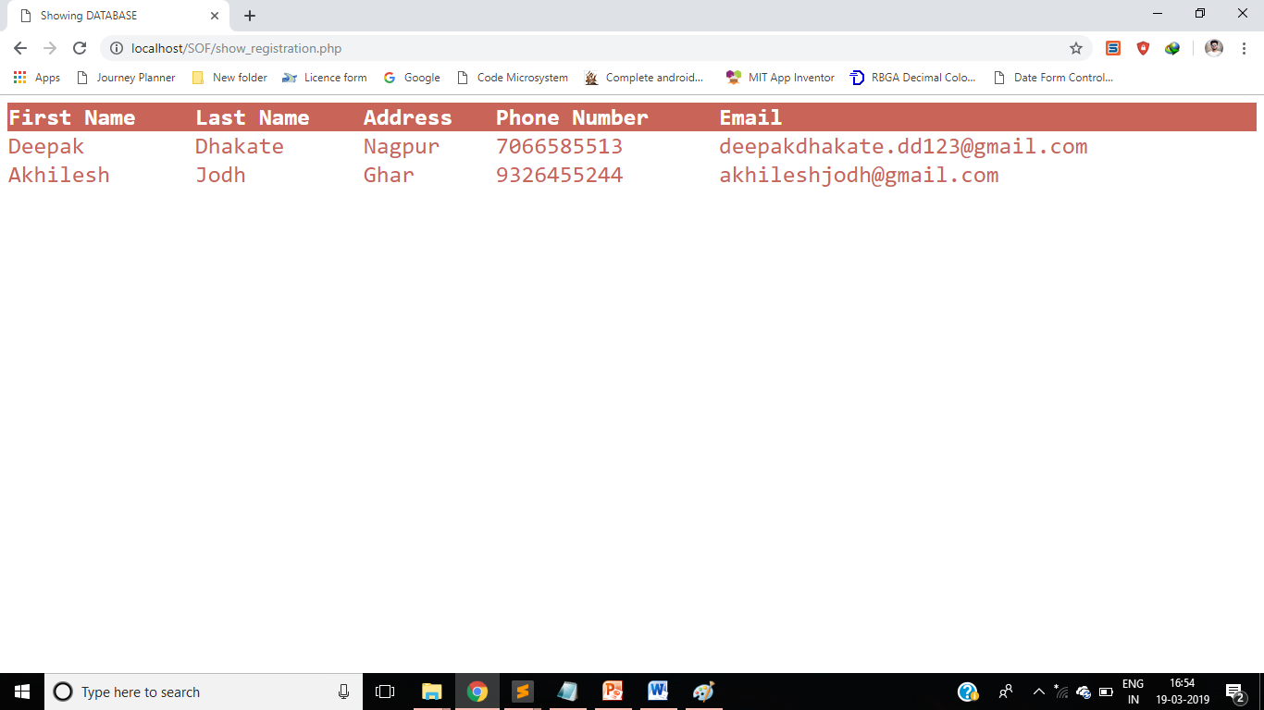
SNAPSHOTS

Slide 14
Implementation tools
Software:
Windows
Sublime Text
HTML & CSS
Hardware:
RAM: 512MB
Processor: Pentium IV
Disk Space: 2GB

Slide 15
CONCLUSION
The objective of the project was to build a program for maintaining the details of all the members. The security of the system is also one of the prime concerns.
There is always a room for improvement in any software, however efficient the system may be. The important thing is that the system should be flexible enough for the future modifications.
Goal achieved: The customer’s data is handled efficiently using this software.
User friendliness: Though the most part of the system is supposed to act in the background, efforts have been made to make the foreground interaction with user as smooth as possible. Also the integration of the existing system with the project has been kept in mind throughout the development phase.

Slide 16
REFERENCES
Gym Management System of Taurama Fitness centre by Computer University Of Indonesia. Taurama Fitness centre is one of the few gym training centre in port Moresby, Papua New Guinea which was founded in 2009, by johnson Waldford.

Slide 17
Thank you

