Slide 1
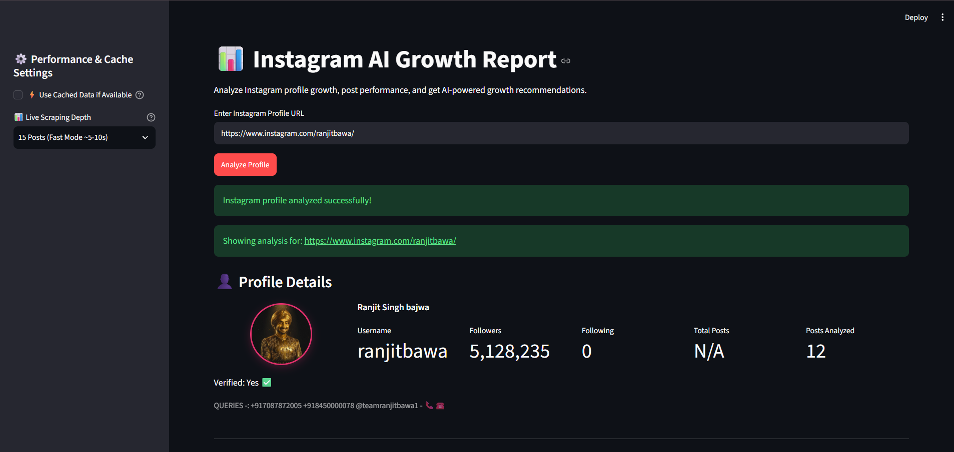
📊
INSTAGRAM AI
GROWTH REPORT
An AI-powered dashboard for profile analytics,
follower tracking and actionable growth insights
PROJECT PRESENTATION
Presented by: Deepak Garg
Python • Streamlit • Apify • Gemini

Slide 2
Project Overview
What the application is designed to do
Instagram AI Growth Report is a web application that analyzes a public Instagram profile and turns collected account/post data into understandable analytics and AI-generated growth suggestions.
PROFILE ANALYSIS
PERFORMANCE INSIGHTS
AI GROWTH ROADMAP
Collects profile information and a selected set of recent posts.
Summarizes engagement, content mix, top posts and follower changes.
Uses an LLM to generate data-informed suggestions and next steps.
INSTAGRAM AI GROWTH REPORT
02

Slide 3
Problem Statement
Why this project is useful
Creators and social media managers often need to inspect several metrics before understanding account performance.
Raw profile and post data can be difficult to interpret quickly.
Follower counts alone do not explain which content performs well or what action to take next.
Users need a single place to view key metrics, visual summaries and practical recommendations.
THE GAP
Data is available, but turning it into decisions takes time.
THE IDEA
Combine scraping, analytics and generative AI in one dashboard.
THE OUTCOME
A faster, more structured profile review.
INSTAGRAM AI GROWTH REPORT
03

Slide 4
Project Objectives
The main goals implemented in the application
01
Analyze a profile
Accept an Instagram profile URL and retrieve available profile information.
02
Measure content performance
Analyze selected recent posts and calculate useful engagement metrics.
03
Track follower movement
Store follower snapshots and compare values across recorded dates.
04
Generate recommendations
Use Gemini to produce tailored growth suggestions based on analyzed data.
05
Present insights clearly
Display metrics, charts and recommendations in a Streamlit dashboard.
INSTAGRAM AI GROWTH REPORT
04

Slide 5
Technology Stack
Tools and services used in the project
Python
Streamlit
Apify
Core programming language
Interactive web application and dashboard
Instagram data collection / scraping service
Google Gemini API
JSON
Charting module
AI-generated analysis and recommendations
Local storage for generated reports and follower snapshots
Visual representation of analytics and performance
INSTAGRAM AI GROWTH REPORT
05

Slide 6
High-Level System Architecture
Simplified view of how the main components work together
ANALYTICS
Calculates metrics
and prepares charts
USER
STREAMLIT UI
APIFY SCRAPER
OUTPUT
Enters Instagram
profile URL
Collects input and
shows results
Fetches profile and
recent post data
Dashboard
and report
GEMINI API
Profile + post data
Generates growth
recommendations
Analytics + AI output are combined in the dashboard
Note: This is a conceptual architecture diagram; internal function-level flow is simplified.
INSTAGRAM AI GROWTH REPORT
06

Slide 7
Application Workflow
From profile URL to insights
1
Enter profile URL
2
Scrape available profile and recent-post data
3
Process data and calculate analytics
4
Record follower snapshot for comparison
5
Generate recommendations using Gemini
6
Display metrics, charts and growth roadmap
The user can review the results in one dashboard after analysis completes.
INSTAGRAM AI GROWTH REPORT
07

Slide 8
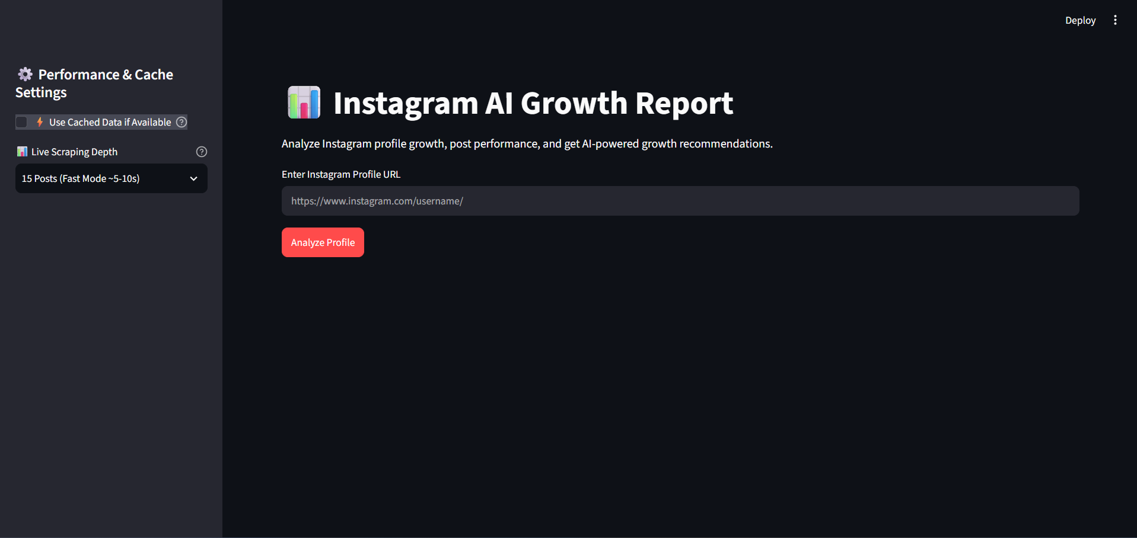
User Interface: Profile Input & Dashboard
The user starts by providing an Instagram profile URL
INSTAGRAM AI GROWTH REPORT
08

Slide 9
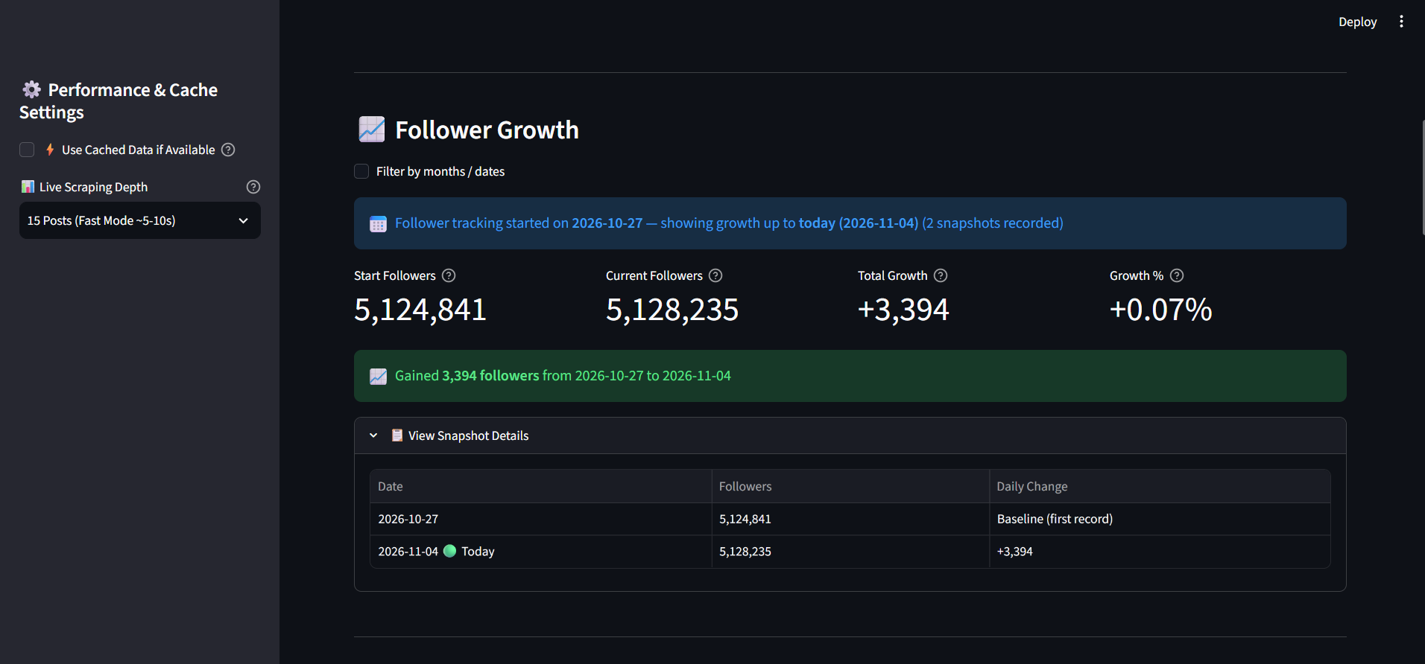
Profile Details & Follower Tracking
Key account metrics and recorded follower snapshots
INSTAGRAM AI GROWTH REPORT
09

Slide 10
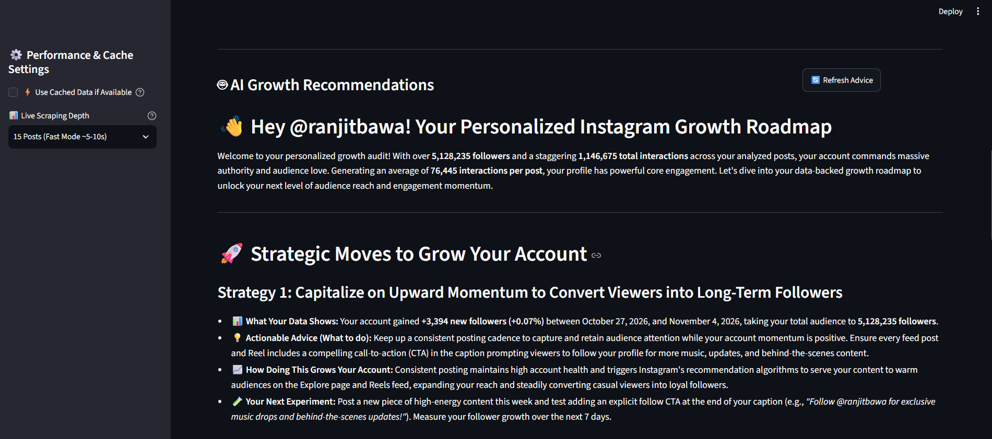
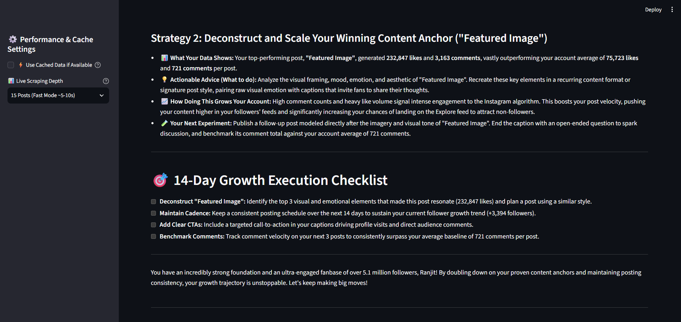
AI-Powered Growth Recommendations
Recommendations connect account data with practical next actions
INSTAGRAM AI GROWTH REPORT
10

Slide 11
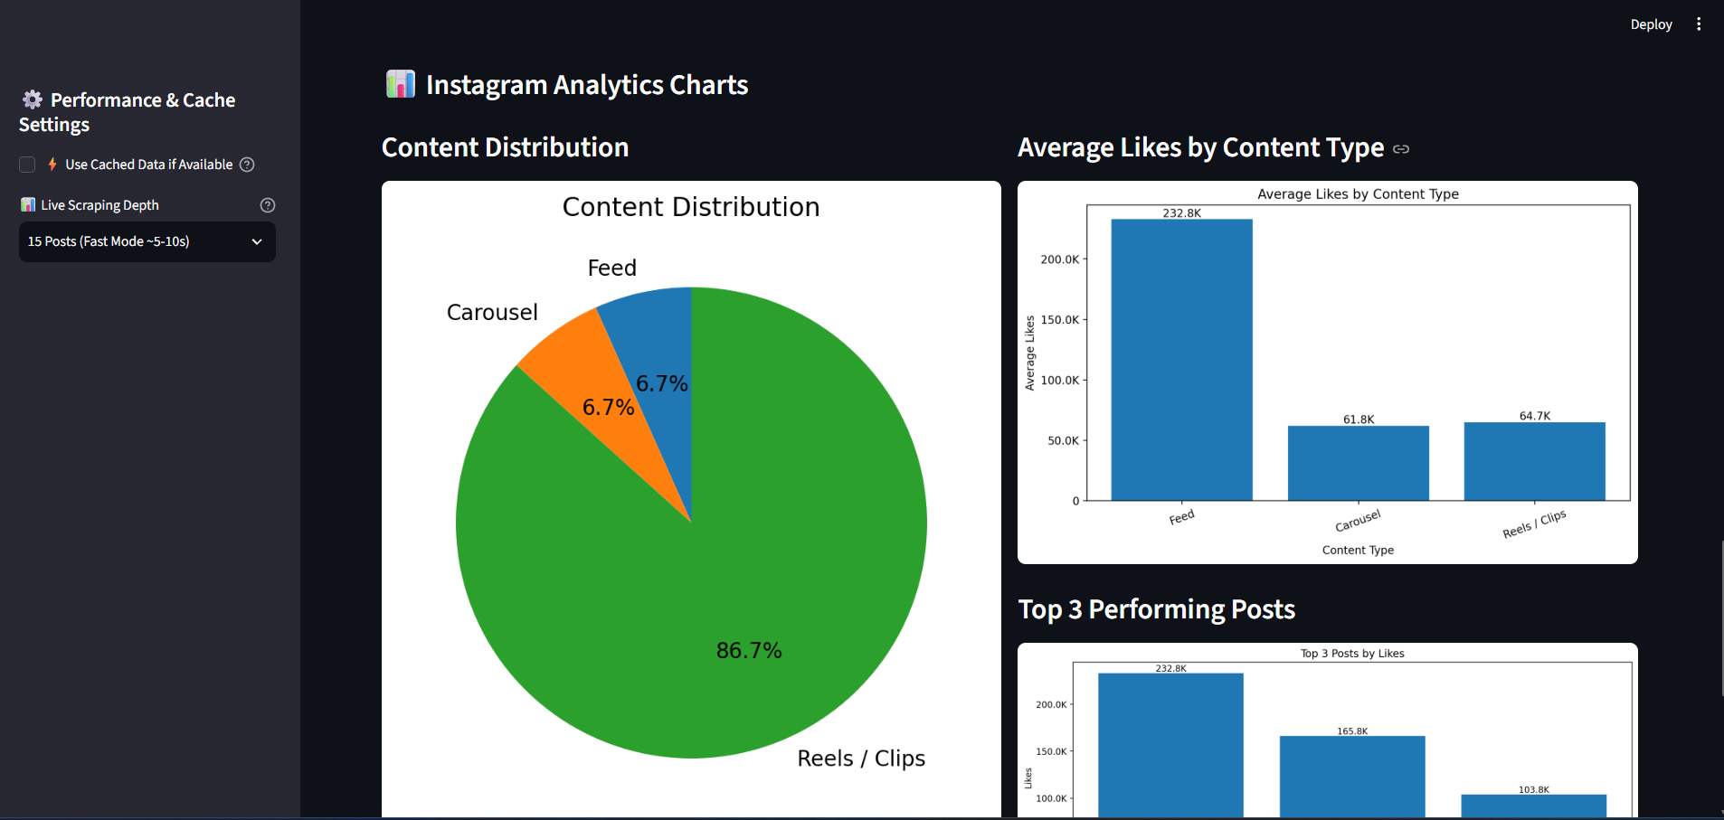
Instagram Analytics Charts
Visual summaries help compare content performance
Examples shown: content distribution, average likes by content type and top-performing posts.
INSTAGRAM AI GROWTH REPORT
11

Slide 12
Challenges & Important Considerations
Practical points learned while building the application
DATA AVAILABILITY
SCRAPING DEPENDENCY
Some profile fields may be unavailable from the scraper. The UI should show N/A rather than inventing values.
Data collection depends on the external scraping service and Instagram's availability or restrictions.
FOLLOWER HISTORY
AI OUTPUT QUALITY
Growth tracking becomes more meaningful as more dated snapshots are collected over time.
Recommendations should be treated as suggestions and reviewed against the actual account context.
The project analyzes the data collected at run time; it does not guarantee follower growth or access to private account information.
INSTAGRAM AI GROWTH REPORT
12

Slide 13
Future Scope & Conclusion
What can be improved next
MORE HISTORY
RICHER ANALYTICS
BETTER AI EVALUATION
Store longer-term snapshots and show daily / weekly / monthly trends.
Add reach, impressions and more detailed engagement comparisons where data is available.
Validate recommendations against historical outcomes and improve prompt/data quality.
CONCLUSION
The project brings Instagram profile data, performance analytics, follower tracking and generative-AI recommendations into one interactive dashboard.
THANK YOU • Questions?
INSTAGRAM AI GROWTH REPORT
13

