Slide 1


Slide 2
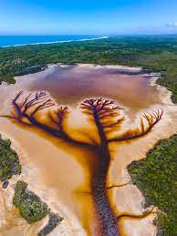

CAMPAIGN DETAILS OF
Site name : SECOND TEST
Media Type : Inflight Ads
SITE
Name : SECOND TEST
Media Type : Inflight Ads
City : Adivivaram
Location :
GEO Location :
Size : 100*100
Illumination : undefined
Price : 1000
Foot fall : 0

Slide 3


