Slide 1


Slide 2
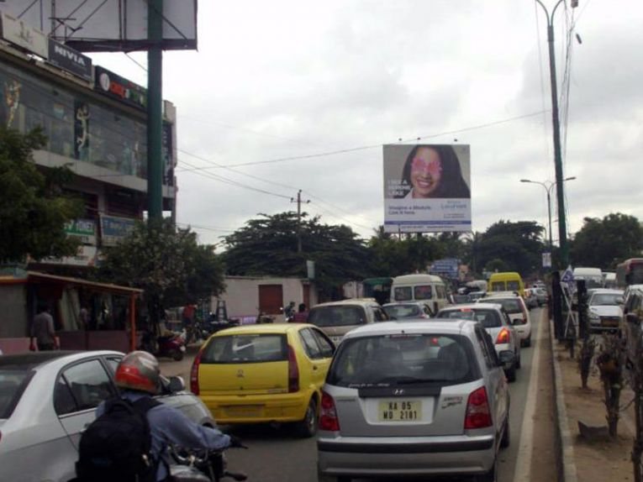

CAMPAIGN DETAILS OF
Site name : undefined
Media Type : hello
SITE
Name : undefined
Media Type : hello
City : delhi
Location : agra
GEO Location : nothing
Size : undefined*undefined
Illumination : illumination
Price : 5456
Foot fall : 1

Slide 3
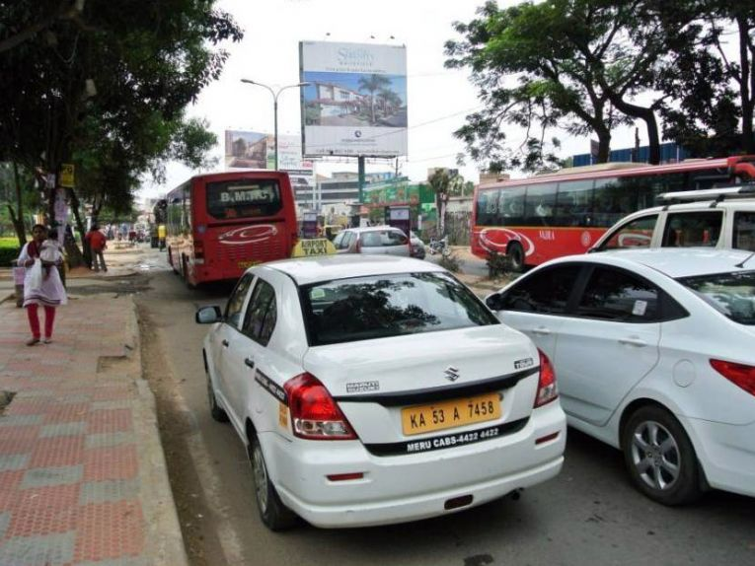
CAMPAIGN DETAILS OF
Site name : undefined
Media Type : who
SITE
Name : undefined
Media Type : who
City : who
Location : who
GEO Location : nothing
Size : undefined*undefined
Illumination : illumination
Price : 5456
Foot fall : 1

Slide 4


