Slide 1

CYBER ATTACKS
Be aware, be prepared, be safe.
PRESENTED BY
DINESH JEEV
Certified: CEH | CEC | ISO27001 Lead Audit | CISA |

Slide 2

AGENDA
Recap : On Previous Session
Types of Malware Attacks
Rootkits
Botnets
Fileless Malware
Mobile Malware
AGENDA

Slide 3
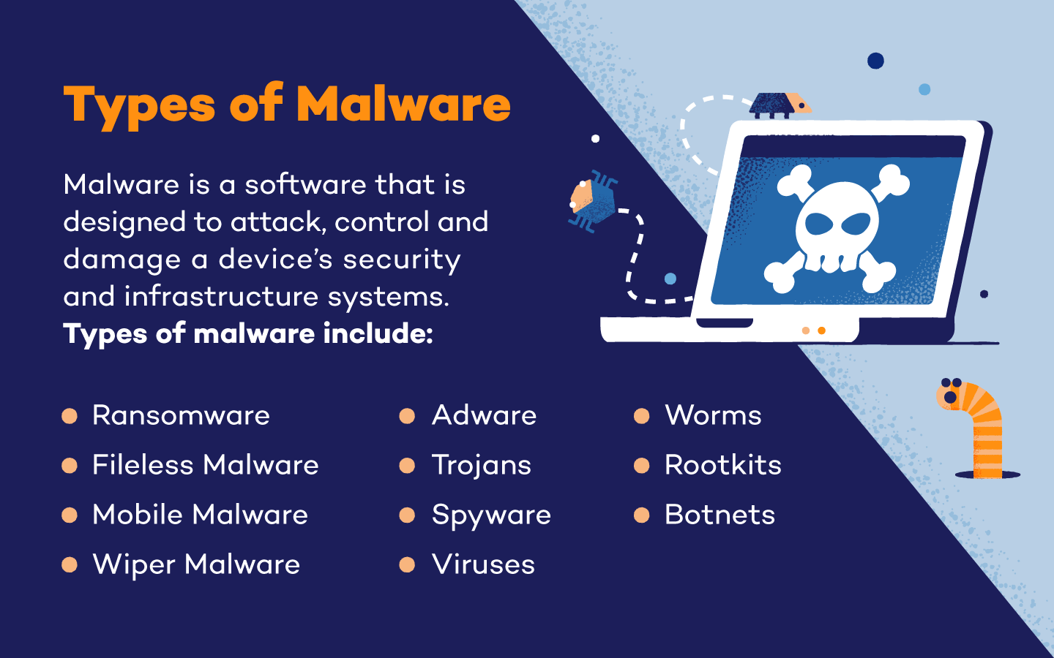

Slide 4

ROOT KIT
A rootkit is a type of malicious software that is designed to gain unauthorized access to a computer or system while hiding its presence from users and security tools.
Once installed, a rootkit often provides a stealthy and persistent way for attackers to maintain control over a compromised system, enabling them to execute malicious activities, hide other malware, and evade detection by antivirus or security software.

Slide 5
Possible signs of Rootkit Malware
Blue screen
Blue screens with white text or error messages are frequent (also referred to as “the blue screen of death”) while your computer constantly needs to reboot.
Unusual web browser behavior
Unrecognized bookmarks and redirections might be involved.
Slow device performance
You may find that your device takes a long time to start and performs slowly or freezes frequently. The device might also not respond to input from the mouse or keyboard.
Windows settings change without permission
The screensaver might change, the taskbar might disappear, or the date and time might display incorrectly – when you haven’t changed anything.
Web pages don’t function properly
Excessive network traffic results in intermittent web pages or network activity that does not function properly.

Slide 6
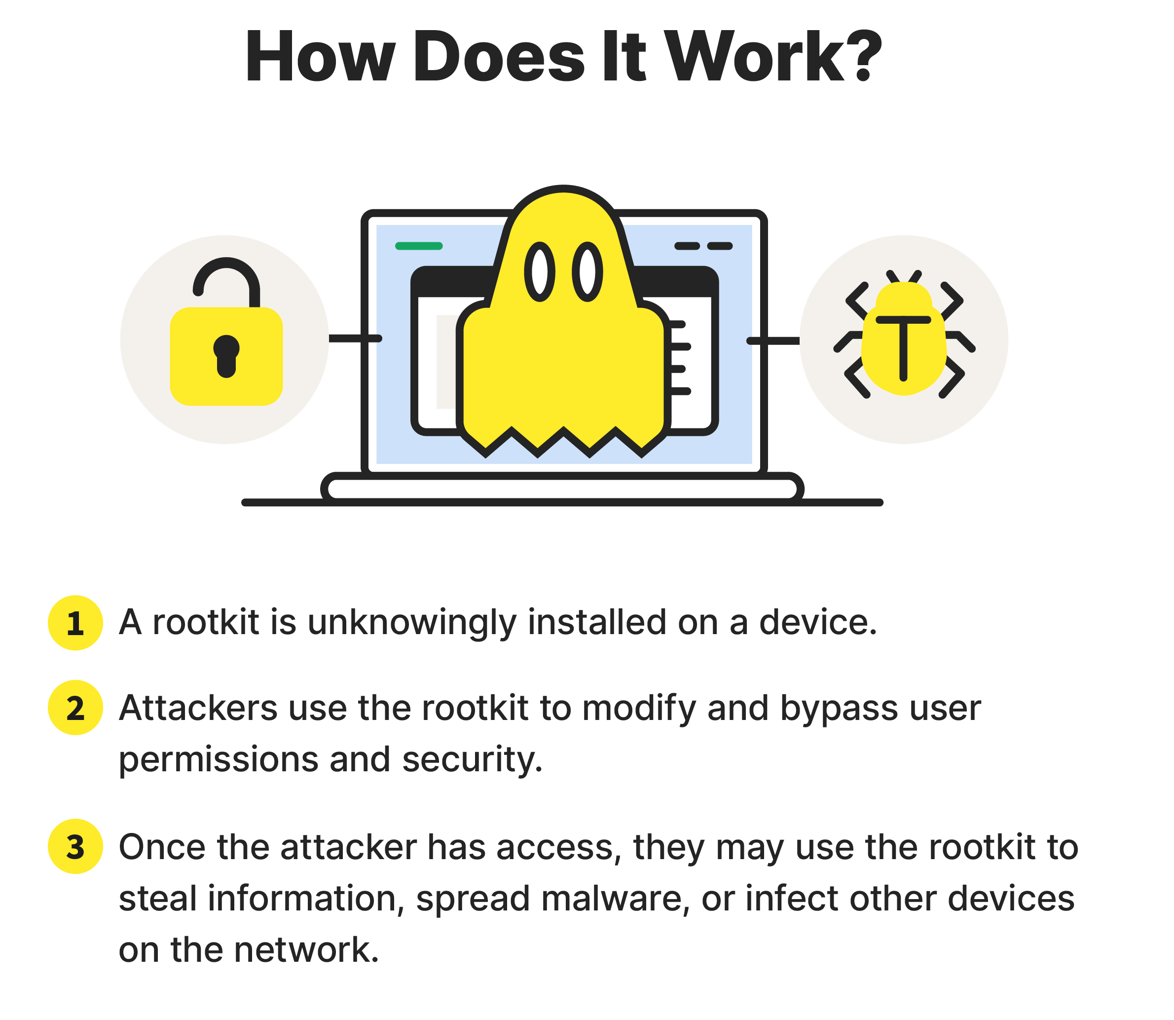
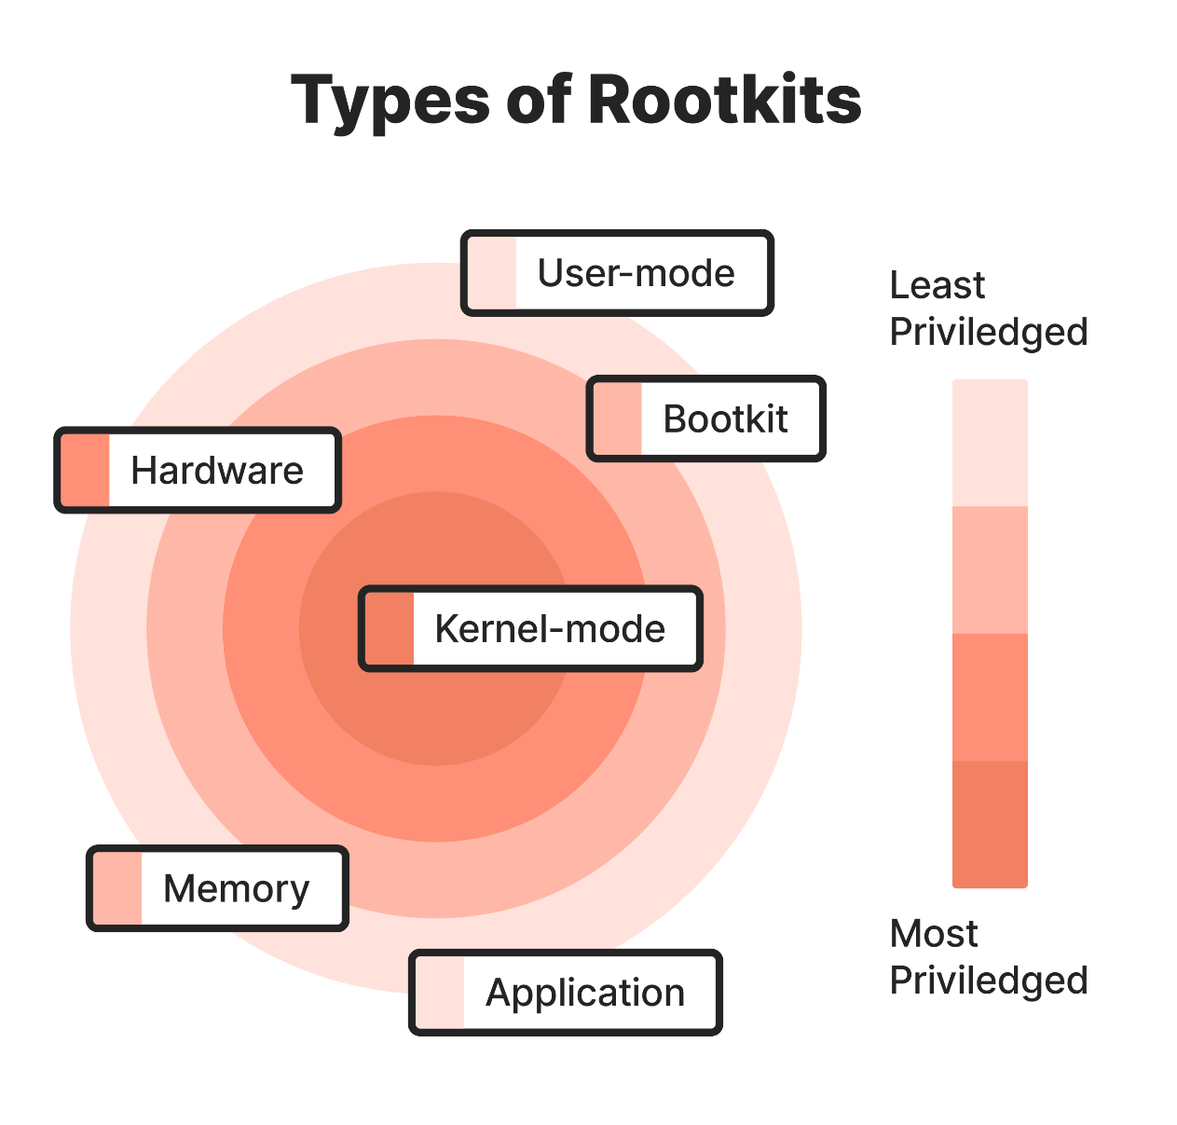

Slide 7
Types of Rootkits
Hardware or firmware rootkits are less common than other types, but they still pose a serious threat to internet security. These rootkits can damage your hard drive, router, or BIOS, which is the software installed on your computer’s motherboard.
Kernel-mode rootkits are among the most dangerous forms of this threat since they attack the kernel level of your operating system
Bootloader rootkits
In most computers, the bootloader mechanism is responsible for loading the operating system. Hackers use bootloader rootkits to replace your computer’s legitimate bootloader with a hacked one.
Application rootkits
A rootkit replaces your computer’s standard files with its own files, and in some cases, can even change how the applications work. Rootkits can infect programs like Microsoft Office, Notepad, or Paint.
Memory rootkits
The memory rootkit hides in your computer’s random-access memory (RAM) and uses the computer’s resources to carry out malicious activities in the background. These rootkits affect the performance of your computer’s RAM.

Slide 8
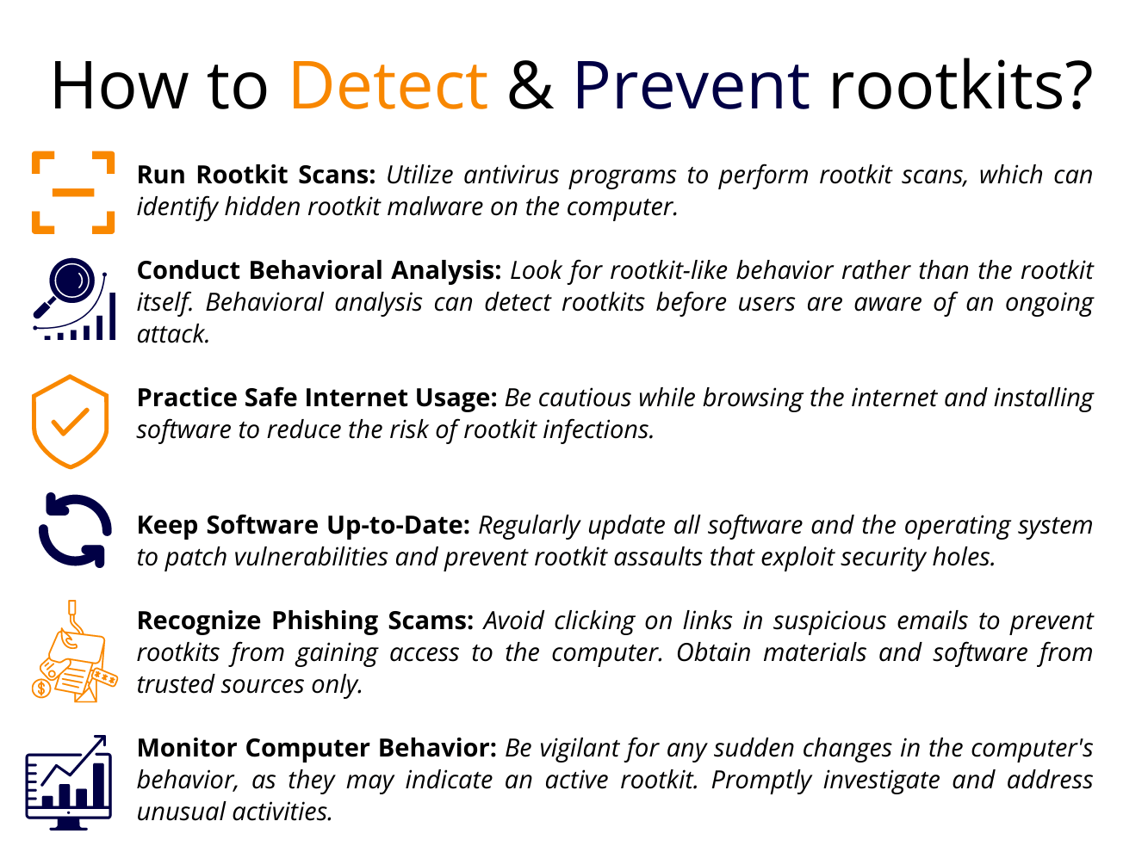

Slide 9
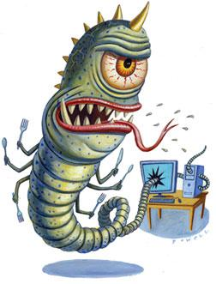
Real Time Example : Sony BMG Rootkit (2005)
In 2005, Sony BMG, a major record label, included a rootkit on some of its audio CDs as a copy protection measure.
The rootkit was installed on users' computers when they played the audio CDs on their Windows-based computers. It was not disclosed to users and was installed without their explicit consent.
The rootkit was intended to prevent unauthorized copying of the audio CDs. However, it had unintended consequences, creating serious security vulnerabilities on users' systems.

Slide 10

Impacts of Sony BMG Rootkit
The rootkit created security vulnerabilities that could be exploited by other malware, as it hid files and processes from the operating system and antivirus programs.
Once discovered, the use of a rootkit by a major corporation led to public outrage and legal action against Sony BMG for violating user privacy and computer security.
Sony BMG faced significant damage to its reputation and was forced to recall the affected CDs, provide removal tools, and settle class-action lawsuits.

Slide 11
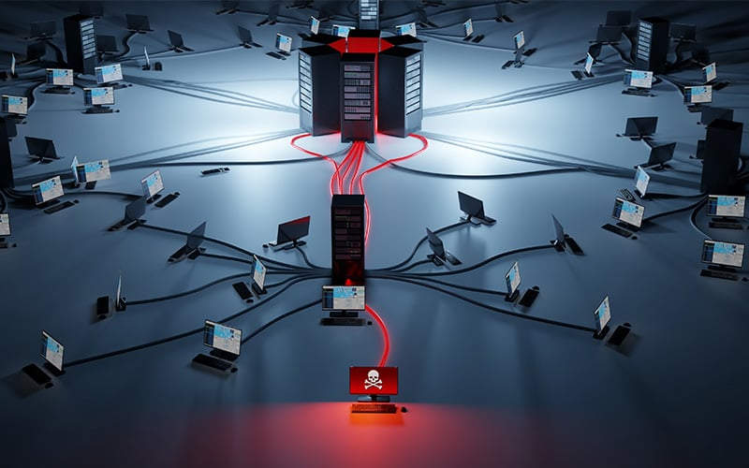
BOTNET

Slide 12
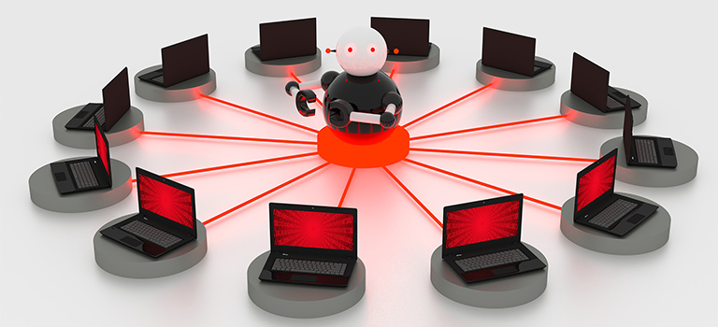
Botnet
A botnet is a network of compromised computers, often referred to as "bots" or "zombies," that are controlled by a single entity, the "botmaster" or "command and control server" (C&C server).
These compromised computers, known as bots, can be used collectively to carry out various malicious activities, such as launching distributed denial-of-service (DDoS) attacks, spreading malware, sending spam, or conducting coordinated cyber-attacks.

Slide 13
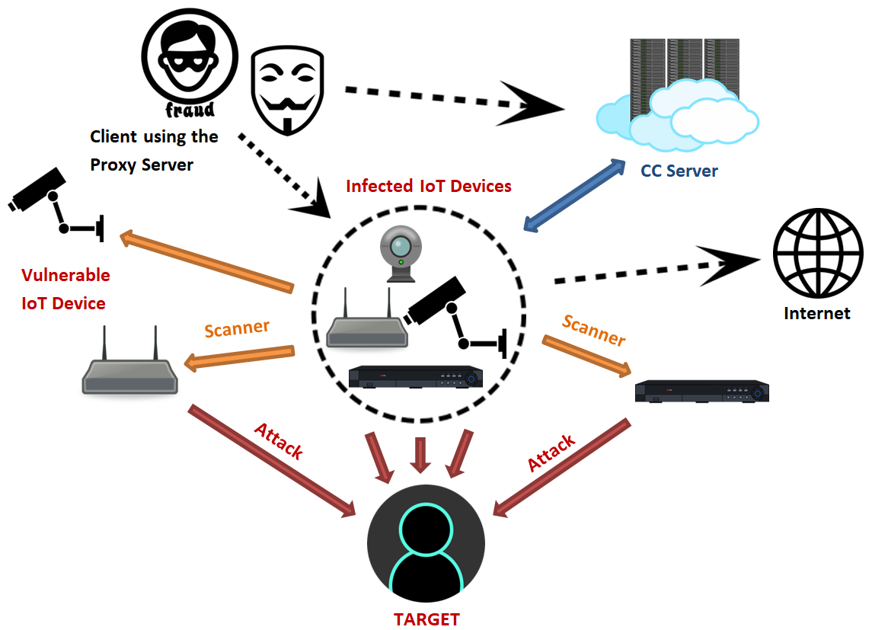
Mirai Botnet (2016)
The Mirai botnet, discovered in 2016, primarily targeted Internet of Things (IoT) devices, such as cameras, routers, and DVRs
Mirai spread by exploiting weak or default credentials on IoT devices. It scanned the internet for devices with known vulnerabilities and attempted to gain control over them.
Once infected, devices became part of the Mirai botnet, and the botmaster could issue commands to launch large-scale DDoS attacks.

Slide 14
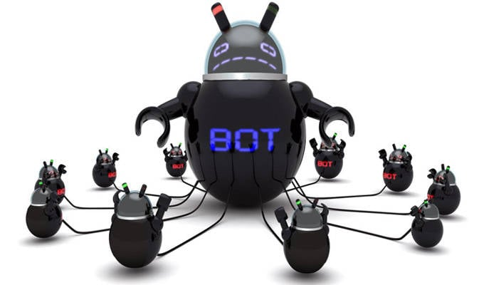
Impacts of Mirai Botnet
Mirai gained notoriety for its involvement in some of the largest DDoS attacks ever recorded. These attacks disrupted internet services for major websites and online services.
The incident highlighted the vulnerabilities of poorly secured IoT devices and the potential consequences when large numbers of these devices are hijacked.
Mirai's source code was later released online, leading to the creation of numerous derivative botnets, further exacerbating the problem.

Slide 15
Mitigations & Takeaways
Manufacturers and users of IoT devices were urged to enhance device security by changing default passwords, updating firmware, and implementing stronger access controls.
Internet service providers (ISPs) and cybersecurity organizations worked to monitor and filter malicious traffic associated with Mirai and its variants.
Mirai exploited the often lax security measures in IoT devices, highlighting the need for better security practices in the design and deployment of such devices.
Mirai demonstrated the power of a large botnet in orchestrating massive DDoS attacks, causing disruptions on a global scale.
The release of Mirai's source code highlighted the risk of malicious tools becoming widely accessible, leading to the proliferation of similar threats.

Slide 16
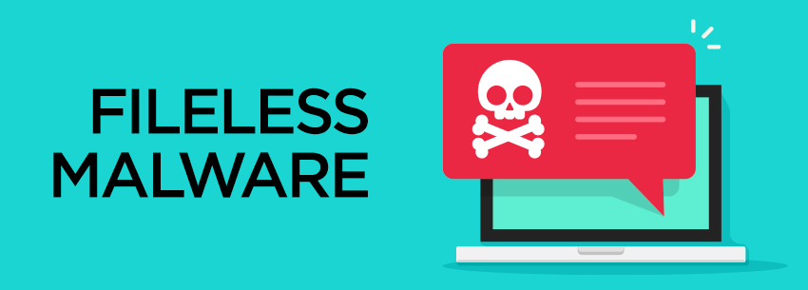

Slide 17

Fileless Malware
Fileless malware refers to malicious software that operates in a system's memory without leaving a footprint on the file system.
Unlike traditional malware that relies on files and executables, fileless malware leverages legitimate system tools and processes to
carry out its malicious activities.
This type of malware often exploits vulnerabilities in scripts, applications, or in-memory processes to avoid detection by traditional antivirus solutions.

Slide 18
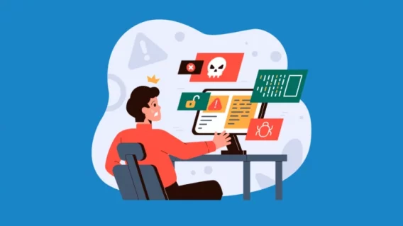
Real-Time Example: PowerShell-based Attacks
Fileless malware often utilizes PowerShell, a legitimate scripting language in Windows, to carry out malicious activities without relying on traditional malicious files.
In a fileless malware attack, the malicious code is injected directly into the memory of the PowerShell process, making it difficult to detect as it doesn't involve the creation of new files on the disk.
The attacker might use PowerShell to download additional malicious payloads from the internet, execute commands, or perform other malicious actions.

Slide 19
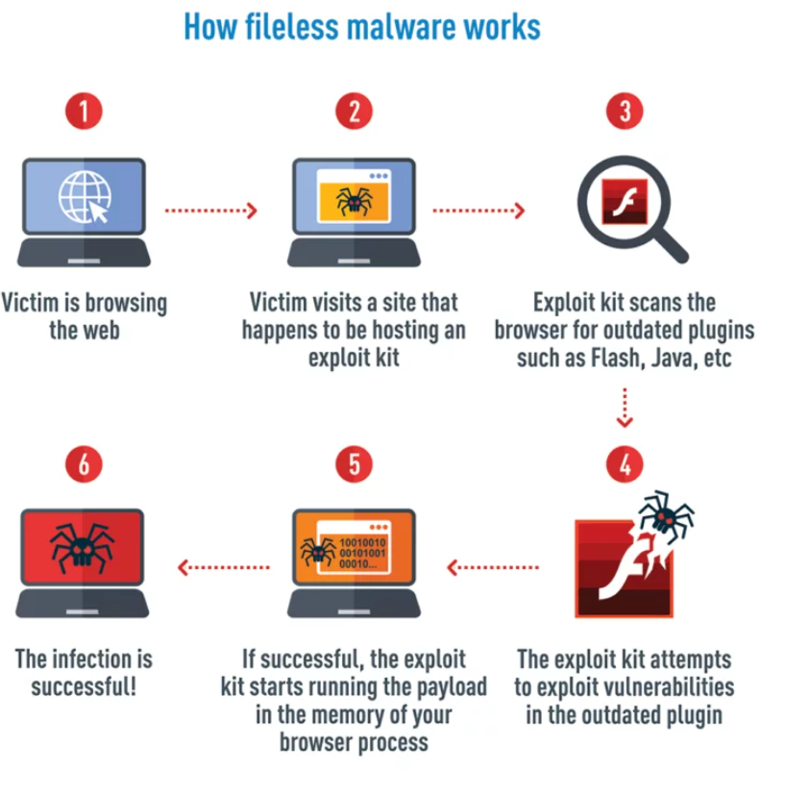

Slide 20
Impacts & Mitigation
Because fileless malware doesn't rely on traditional files, it can evade detection by signature-based antivirus solutions that typically look for known malicious files.
Fileless malware can be challenging to remove as it operates in memory and may not leave any persistent traces on the system's file system.
Security solutions need to focus on monitoring and analyzing the behavior of processes and scripts rather than relying solely on static file signatures.
Restricting the privileges of scripts and applications, such as PowerShell, can limit the potential impact of fileless malware.

Slide 21

The Rise of Mobile
Malwares

Slide 22
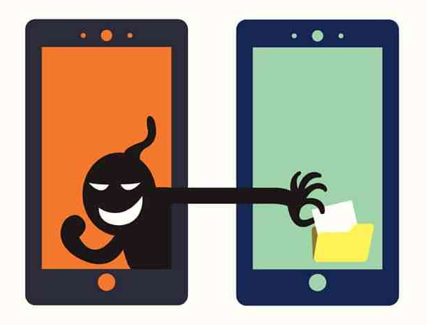
Mobile Malwares
Mobile malware refers to malicious software specifically designed to target mobile devices, such as smartphones and tablets.
These malicious programs can compromise the security and privacy of mobile users by exploiting vulnerabilities in mobile operating systems, applications, or by employing social engineering techniques.
Mobile malware can take various forms, including viruses, Trojans, ransomware, spyware, and adware, posing threats to both Android and iOS platforms.

Slide 23
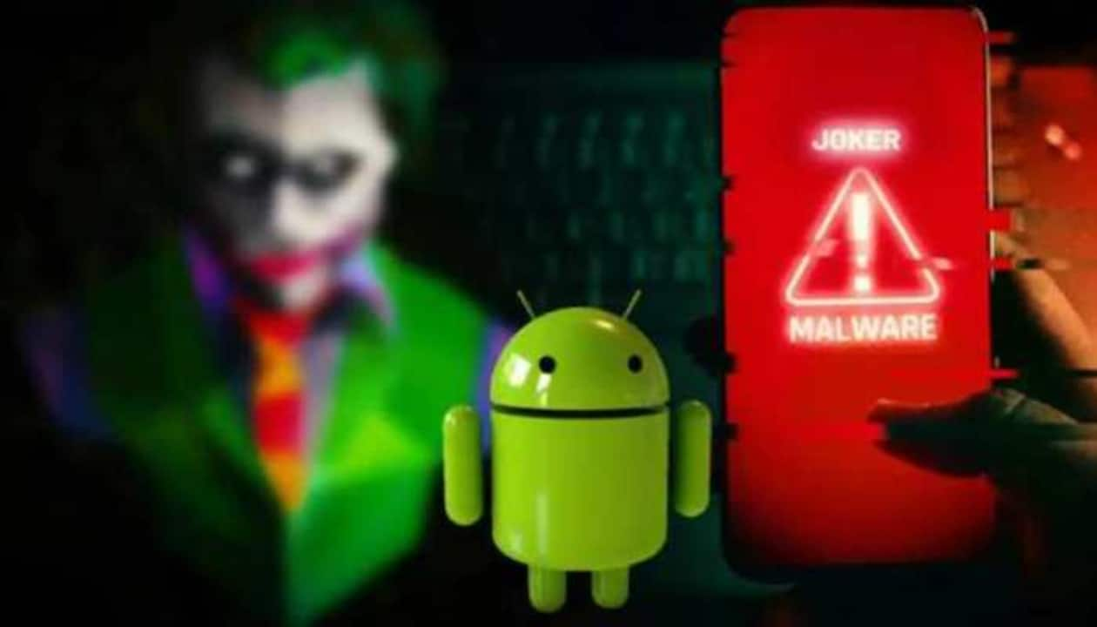
Real Time Example: Android Malware - Joker (2019-2020)
Joker is a family of Android malware that was distributed through malicious apps on the Google Play Store.
The malware operated by subscribing users to premium services without their consent, leading to financial losses.
Joker employed various techniques to avoid detection, including dynamically loading code, encrypting strings, and using steganography to hide malicious code.
Despite Google's efforts to secure the Play Store, Joker-infected apps managed to bypass security checks and were downloaded by thousands of users before being discovered and removed.

Slide 24
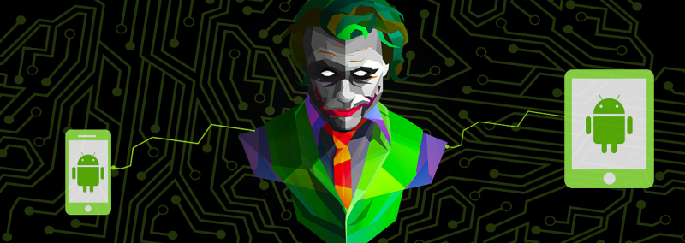
Mitigation
App Store Vigilance: Users are advised to download apps only from official app stores (Google Play for Android, App Store for iOS) to reduce the risk of downloading malicious software
Security Software: Installing reputable mobile security applications that can detect and block known malware threats.

Slide 25
Key Takeaways
App Store Risks: While official app stores implement security measures, some malicious apps can still slip through, emphasizing the need for users to be vigilant.
Financial Impacts: Mobile malware, like Joker, often targets users for financial gain, subscribing them to premium services without their knowledge.
Cross-Platform Concerns: While Joker primarily targeted Android devices, the incident highlights the importance of security measures for both Android and iOS platforms.
Mobile malware threats continue to evolve, and users need to stay informed about potential risks, practice secure mobile behavior, and use security solutions to mitigate the impact of these threats.

Slide 26


