Slide 1

Self Assessment
Interview Questionnaire & Discussion
PRESENTED BY
DINESH JEEV
Certified: CEH | CEC | ISO27001 Lead Audit | CISA |

Slide 2

AGENDA
Recap : Last Session
Cyber Security – Interview Questionnaire
Discussion on Answers
AGENDA

Slide 3
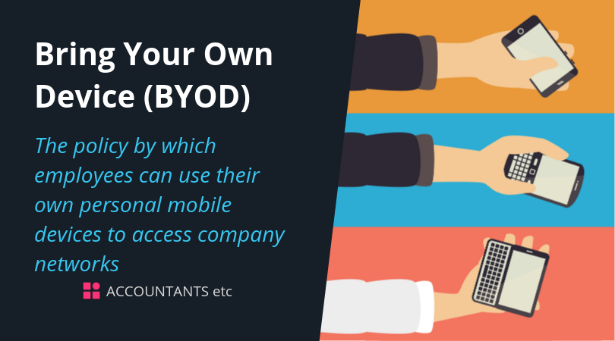
Cybersecurity Basics
Imagine a company just implemented a new BYOD (Bring Your Own Device) policy. What security measures would you recommend to ensure the safety of corporate data?

Slide 4
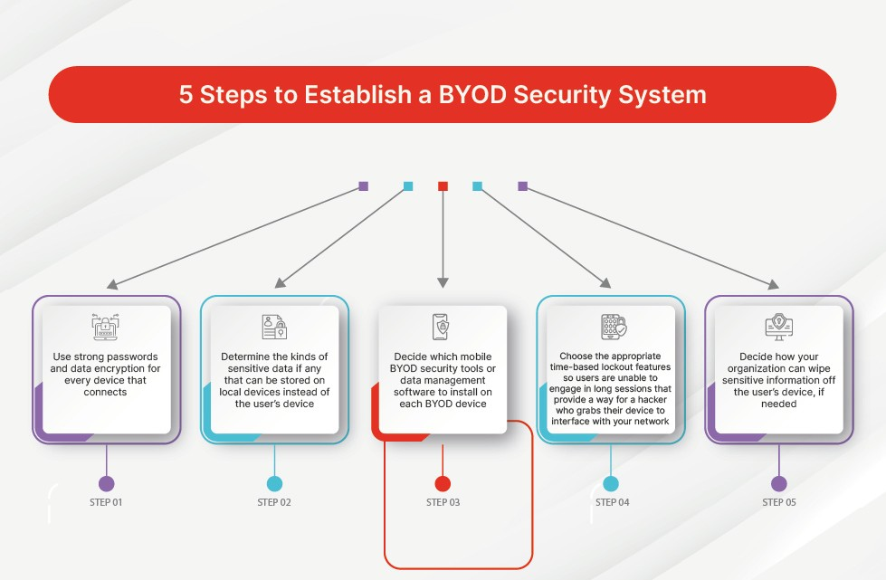

Slide 5
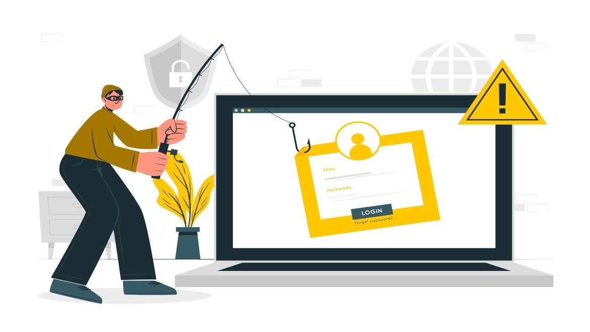
Phishing Scenarios
You receive an email from a colleague with an urgent request for sensitive information. What steps would you take to verify the legitimacy of the email before responding?

Slide 6

I would advise the user to verify the email sender's identity by cross-checking with known contact information or contacting the colleague through a different communication channel.
It's essential to remind users not to click on links or download attachments from unfamiliar or suspicious emails.

Slide 7

Phishing Awareness
A user clicks on a link in an email claiming to be from the IT department, leading to a phishing site. How would you educate the user to recognize such phishing attempts in the future?
ANSWER : I would conduct regular phishing simulation exercises to test and improve employees' ability to recognize phishing attempts.
In addition, continuous education programs can provide tips and examples of phishing scenarios to raise awareness.

Slide 8
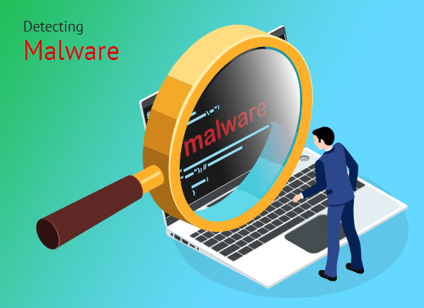
Malware Detection
A user reports a slow computer and unexpected pop-ups. How would you investigate and remediate a potential malware infection on their system?
Answer : I would isolate the affected system from the network, run a full antivirus scan, and remove the malware.
Post-incident, I would analyze how the malware entered the system and strengthen security measures to prevent future infections.

Slide 9
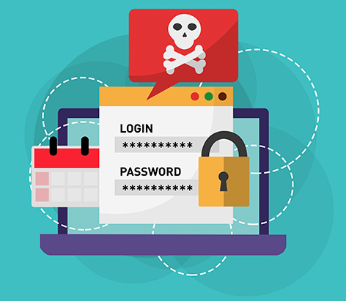
Ransomware Response
The organization's file server has been encrypted by ransomware. Describe the steps you would take to contain the incident and recover the data.
Answer : I would immediately disconnect affected systems from the network to prevent further spread, report the incident to law enforcement, and assess the organization's backup systems for data restoration.
The incident should be thoroughly investigated to identify the entry point and improve defenses.

Slide 10
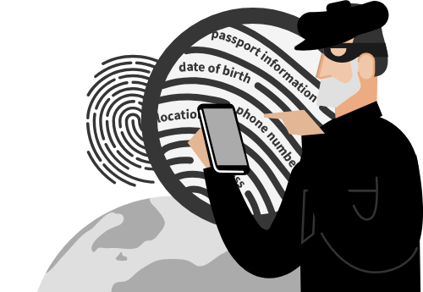
Social Engineering
An employee receives a phone call from someone claiming to be from IT support and asking for their login credentials. How would you train employees to handle such situations?
Answer: Employees should be trained to verify requests for sensitive information through a separate communication channel or by contacting the supposed requester using known contact information.
Regular security awareness training is crucial for recognizing and reporting social engineering attempts.

Slide 11

Insider Threats
A disgruntled employee is suspected of trying to steal sensitive company information. What measures would you put in place to monitor and mitigate insider threats?
Answer: Implementing user behavior analytics tools and closely monitoring employee activities can help identify potential insider threats.
Additionally, role-based access controls (RBAC) and periodic access reviews can limit the risk of unauthorized data access.

Slide 12
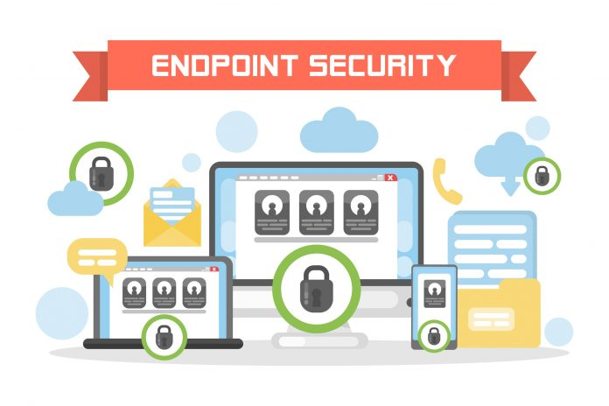
Endpoint Security
A remote worker's laptop is lost, potentially exposing sensitive company data. What measures would you recommend to secure endpoint devices and prevent unauthorized access?
Answer: Implement remote device management capabilities to locate and wipe the lost device if necessary.
Regularly update endpoint protection software and enforce security policies on all devices to prevent unauthorized access.

Slide 13
Endpoint Security
A remote worker's laptop is lost, potentially exposing sensitive company data. What measures would you recommend to secure endpoint devices and prevent unauthorized access?
Answer: Implement remote device management capabilities to locate and wipe the lost device if necessary.
Regularly update endpoint protection software and enforce security policies on all devices to prevent unauthorized access.

Slide 14
Endpoint Security
A remote worker's laptop is lost, potentially exposing sensitive company data. What measures would you recommend to secure endpoint devices and prevent unauthorized access?
Answer: Implement remote device management capabilities to locate and wipe the lost device if necessary.
Regularly update endpoint protection software and enforce security policies on all devices to prevent unauthorized access.

Slide 15

Wireless Security
An unauthorized device is connected to the company's Wi-Fi network. How would you identify and mitigate this security risk?
Answer: Identify the unauthorized device and block its access. Regularly update Wi-Fi passwords, use WPA3 encryption, and implement MAC address filtering to enhance wireless network security.

Slide 16
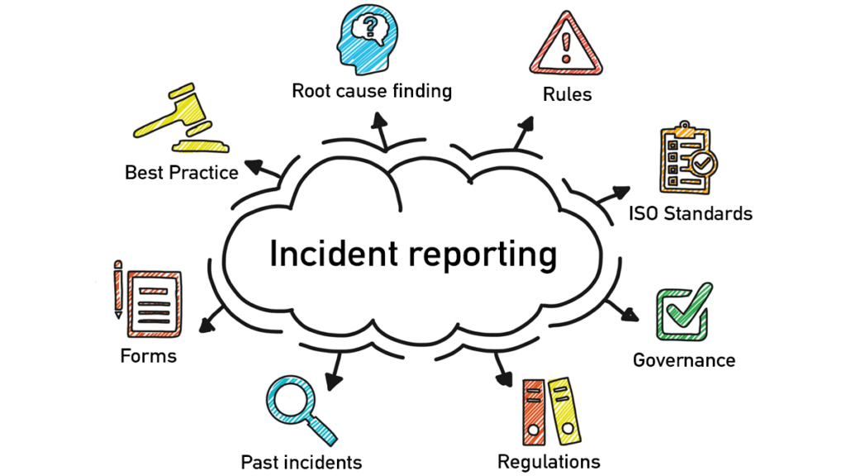
Incident Reporting
An employee suspects they have fallen victim to a phishing attack. What steps would you advise them to take, and how would you ensure timely reporting of such incidents?
Answer: Instruct the user to report the incident to the IT/security team immediately. Communicate the importance of timely reporting to facilitate a swift response and minimize potential damage.

Slide 17
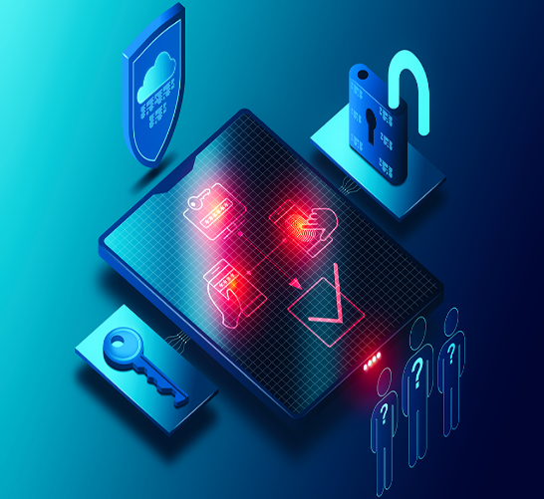
Multi-Factor Authentication (MFA):
Explain a situation where the implementation of multi-factor authentication could have prevented a security incident. How would you promote MFA adoption within an organization?
Answer: MFA adds an extra layer of security by requiring multiple forms of verification. Promoting MFA adoption involves educating users on its benefits, providing easy-to-follow setup instructions, and periodically reinforcing its importance.

Slide 18

IoT Security
The company has adopted IoT devices for various operations. How would you ensure the security of these devices and protect against potential vulnerabilities?
Answer: Implement security measures such as strong authentication for IoT devices, regular firmware updates, and network segmentation to isolate IoT devices from critical systems. Periodic security assessments should be conducted to identify vulnerabilities.

Slide 19
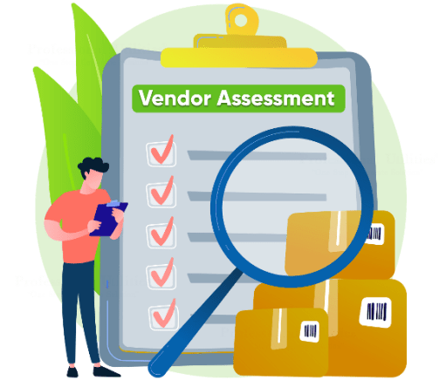
Supply Chain Security
A vendor that handles sensitive customer data suffers a data breach. How would you assess and mitigate the impact of this incident on your organization's security?
Answer: Assess the impact of the vendor's data breach on the organization and implement measures such as third-party risk assessments, contractual security requirements, and continuous monitoring of vendor security practices.

Slide 20

Mobile Device Security
An employee loses their company-issued mobile device. What measures would you implement to secure the device remotely and prevent unauthorized access to corporate data?
Answer: Remotely wipe the lost device if necessary, enforce strong password policies, and implement mobile device management (MDM) solutions. Regularly educate employees on secure mobile device practices.

Slide 21

Social Media Security
An employee inadvertently shares sensitive information about the company on social media. How would you educate employees on the importance of practicing good social media security hygiene?
Answer: Educate employees on the importance of not sharing sensitive information on social media platforms. Establish clear social media usage policies and conduct regular training to reinforce security practices.

Slide 22

Insider Threat Detection
An employee's behavior changes, and they start accessing sensitive information outside of their regular responsibilities. How would you employ behavioral analytics to detect and mitigate potential insider threats?
Answer: Use behavioral analytics tools to detect unusual employee behavior. Regularly review and update access controls, conduct periodic access reviews, and educate employees on the importance of secure data handling.

Slide 23
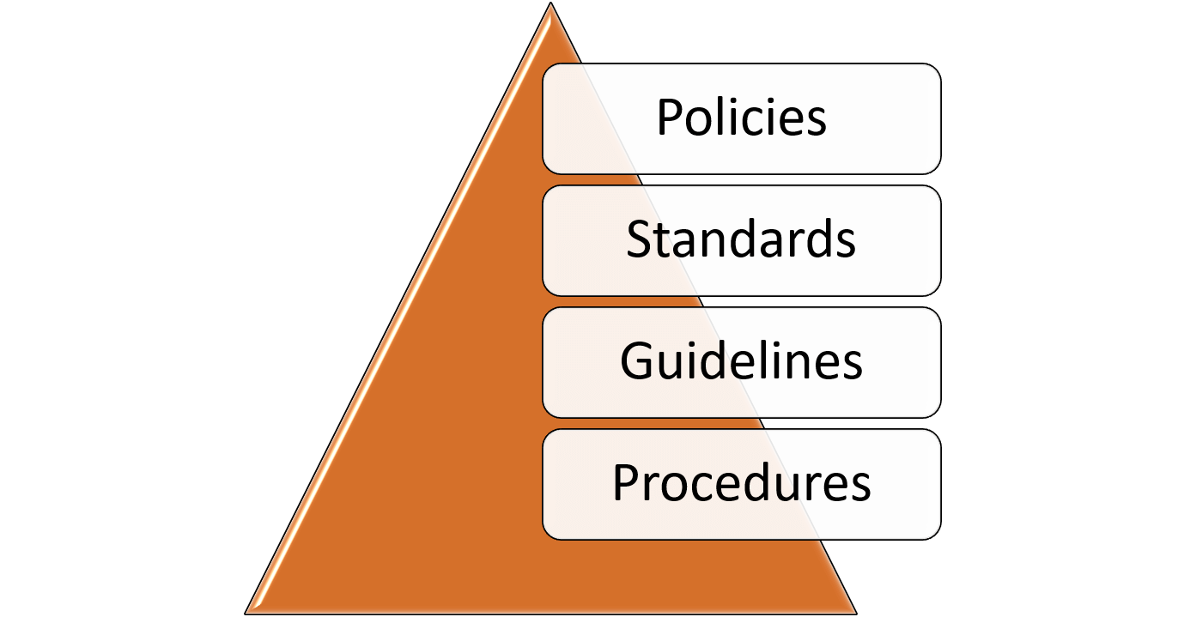
Security Policies & Procedures
A new employee joins the company. How would you ensure they are well-informed about the organization's security policies and procedures?
Answer: Provide new employees with comprehensive security onboarding, including an overview of security policies and procedures. Ensure employees understand their role in maintaining a secure work environment.

