Slide 1

Principles of Cryptography
Unlocking the art of deception.
PRESENTED BY
DINESH JEEV
Certified: CEH | CEC | ISO27001 Lead Audit | CISA |

Slide 2

Cryptography
In the field of technology, the term "cryptography" refers to secure information and communication methods that use fundamental mathematical concepts and a system of calculations based on rules, or "algorithms," to manipulate messages in ways that are difficult to read.
These algorithms are used in the generation of cryptographic keys, digital signatures, data privacy protection, online browsing on the internet, and the security of private transactions like debit and credit card purchases.

Slide 3
Significant features of Cryptography
Confidentiality: Information is only accessible by the intended recipient, and no one else is permitted access.
Integrity: Information cannot be modified while being stored or transferred between a sender and their intended recipient without the modification being detected.
Authentication: It can be determined who sent the message and who received it. Additionally, the information's origin and destination are verified.
Non-Repudiation: The information's the creator or sender cannot revoke their intention to send additional information.

Slide 4
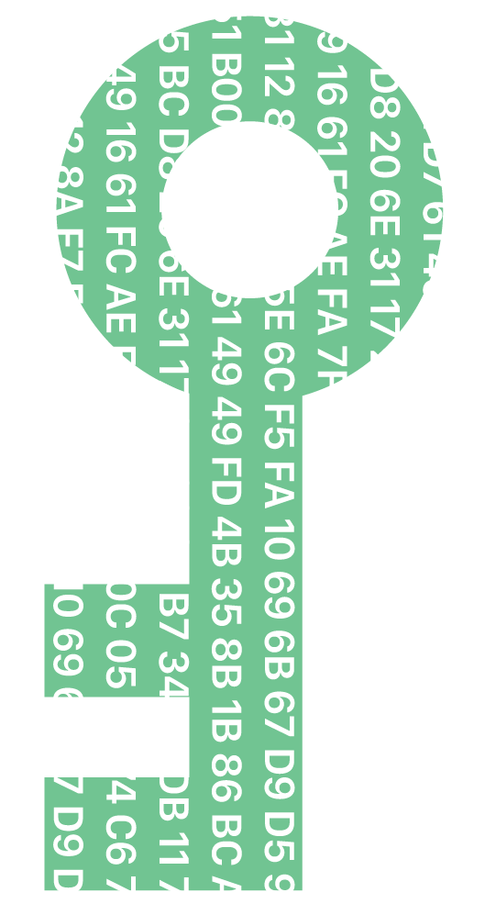
What is a key in cryptography?
A string of characters called a cryptographic key is used in an encryption method to change data so that it appears random.
In cryptography, a key is a piece of information (a string of bits or a numeric value) that is used to control the operation of a cryptographic algorithm.
Keys are essential for the functioning of cryptographic systems, as they determine the transformation of plaintext into ciphertext (encryption) and the reverse transformation of ciphertext into plaintext (decryption).

Slide 5
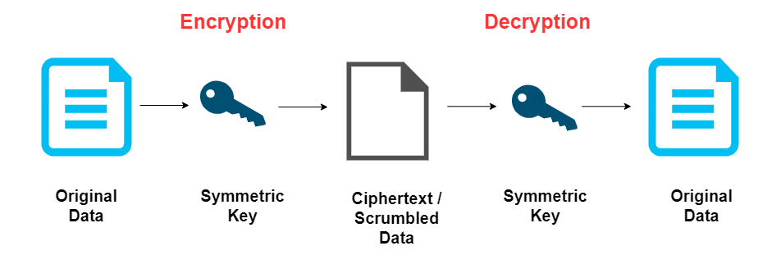
Types of keys in cryptography
Symmetric Keys:
Symmetric-key cryptography, also known as secret-key cryptography, uses a single key for both encryption and decryption.
How It Works: The same key is used by both the sender and the receiver to encrypt and decrypt the message. Since the same key is used for both operations, it must be kept secret.
Example: The Advanced Encryption Standard (AES) is a widely used symmetric encryption algorithm.

Slide 6
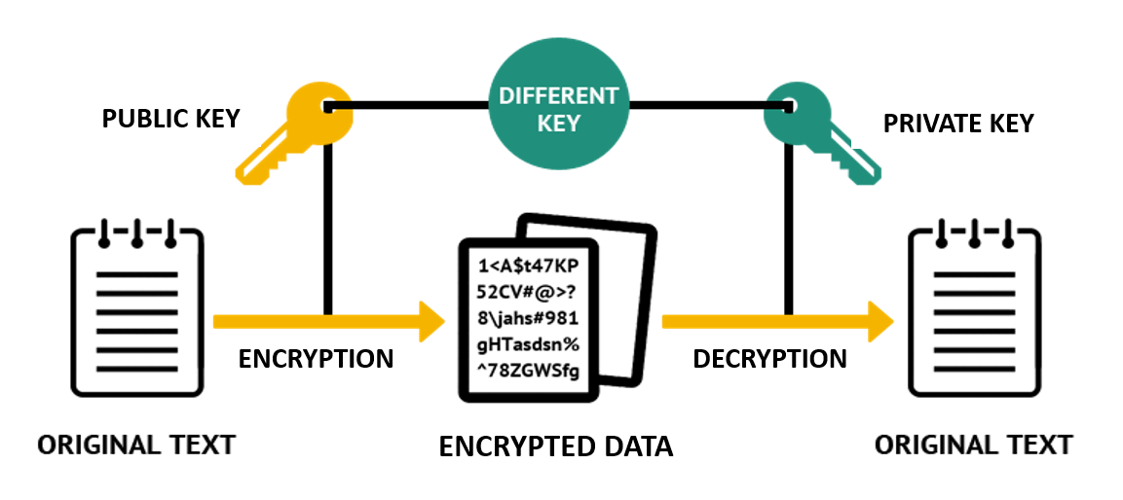
Types of keys in cryptography
Asymmetric Keys:
Asymmetric-key cryptography, also known as public-key cryptography, uses a pair of keys: a public key and a private key.
How It Works: The public key is shared openly, while the private key is kept secret. Messages encrypted with the public key can only be decrypted by the corresponding private key, and vice versa.
Example: The RSA (Rivest–Shamir–Adleman) algorithm is a popular asymmetric encryption algorithm.

Slide 7

Key Management
Key Generation: The process of creating cryptographic keys using algorithms.
Key Distribution: The secure sharing of keys between communicating parties.
Key Storage: Safeguarding keys to prevent unauthorized access.
Key Exchange: The secure transfer of keys between parties.
Key Rotation: Periodic changing of keys for added security.

Slide 8

Key Length
The length of a key is crucial for the security of cryptographic systems. Longer keys generally provide greater security, as they increase the difficulty of brute-force attacks. Key length is typically measured in bits.
In summary, keys play a fundamental role in cryptography, influencing the security and effectiveness of cryptographic algorithms.
Proper key management is essential to maintaining the confidentiality, integrity, and authenticity of information in secure communication and data protection systems.

Slide 9
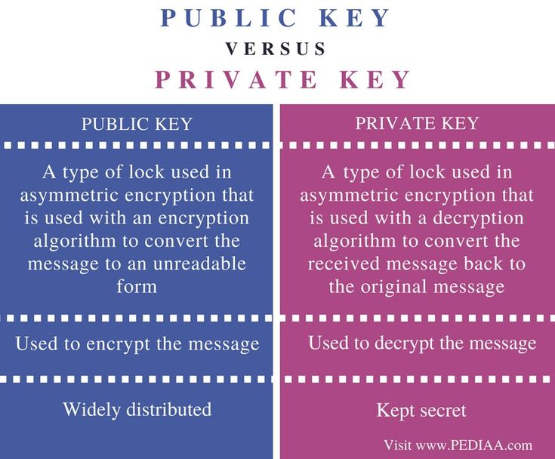

Slide 10

ENCRYPTION
The Art of Deception

Slide 11
What is ENCRYPTION?
Data can be scrambled using encryption so that only authorized parties can decipher it.
Technically speaking, it is the process of changing plaintext that can be read by humans into cipher text, which is unreadable text.
In simpler terms, encryption changes readable data to make it seem randomized. A cryptographic key, or collection of numbers that the sender and the recipient of an encrypted message both agree upon, is needed for encryption.

Slide 12
What is DATA ENCRYPTION?
Data encryption is the process of taking the information or text that you need and converting it into a code (also known as "cipher text") that only those with the right key can decipher. The data needs to be converted back or decrypted in order to be usable.
Because encryption prevents unauthorized individuals from viewing the relevant and often sensitive information we communicate over the internet and through technological means, it is essential.
The decryption of the data requires a key, which only authorized individuals will possess. However, keep in mind that even encrypted information can occasionally be deciphered by people with sufficient knowledge or resources, some of whom might have evil intentions

Slide 13
How data encryption works?
The word "plaintext" or "cleartext" refers to the data that needs to be encrypted. The plaintext must be transmitted using specific encryption techniques, which are essentially mathematical operations on unprocessed data.
The plaintext is transformed into the encrypted data, sometimes referred to as ciphertext, using the specified key and an appropriate encryption technique. The recipient receives the ciphertext instead of the plaintext thanks to insecure communication connections.
The intended recipient can employ a decryption key to restore the ciphertext to its plaintext form after it has arrived at their location. This decryption key, which may or may not be the same as the key used to encrypt the communication, must always be kept a secret.

Slide 14
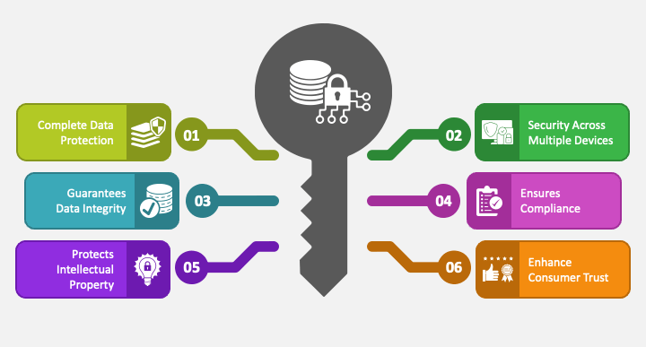
Benefits of Data Encryption

Slide 15
Types of Data Encryption Techniques
Symmetric Encryption
The sender and the receiver need to have access to the same key in order to use this technique, which is also known as private-key cryptography or a secret key algorithm.
Therefore, before the message can be encrypted, the recipient needs to have the key. Since there is less chance of a third party infiltration, closed systems are the ideal prospects for this technique.
Symmetric encryption is quicker than asymmetric encryption, which is a plus. On the downside, both parties must ensure that the key is safely stored and only accessible to the appropriate software.

Slide 16
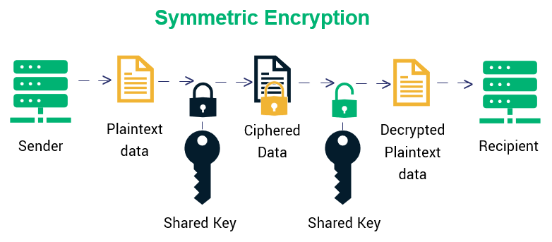

Slide 17
Asymmetric Encryption
This technique, also known as public-key cryptography, encrypts data using two keys—a public key and a private key—that are mathematically linked. It doesn't matter which key you chose first; the user uses one for encryption and the other for decryption
As the name suggests, everyone may access the public key, however the intended recipients are the only ones who have access to the private key, which they require to decode the messages.
The "asymmetric" aspect stems from the fact that both keys are just pairs of huge numbers that aren't identical but are coupled with one another.

Slide 18
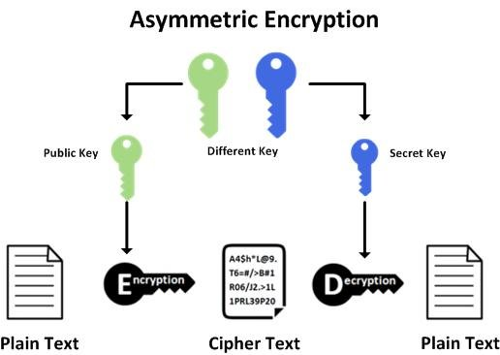

Slide 19
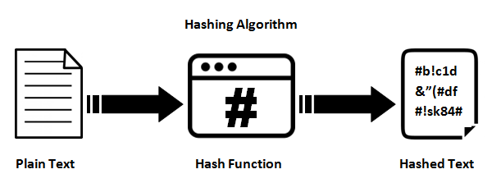
What is Hashing?
For a set of data or message, hashing creates a unique signature of a fixed length. Due to each message's unique hash, even little modifications to the data may be easily tracked.
Hashing makes it impossible to reverse or decrypt data once it has been encrypted. Hashing is therefore limited to data verification.

Slide 20
Although many internet security professionals don't even think of hashing as a true encryption technique, the distinction is sufficiently hazy to allow the classification to continue.
In the end, it's a powerful technique to demonstrate that the data hasn't been altered. After reviewing the various data encryption methods, let's move on to learning the various encryption algorithms.

Slide 21
Encryption Algorithm
Encryption Algorithm are used to convert the data into ciphertext using encryption methods.
Data can be altered predictably by an algorithm using the encryption key, making the encrypted data appear random; yet, the encrypted data can be decrypted and returned to plaintext using the decryption key.
We will discuss about five most significant & common algorithm that were in the market and used.

Slide 22
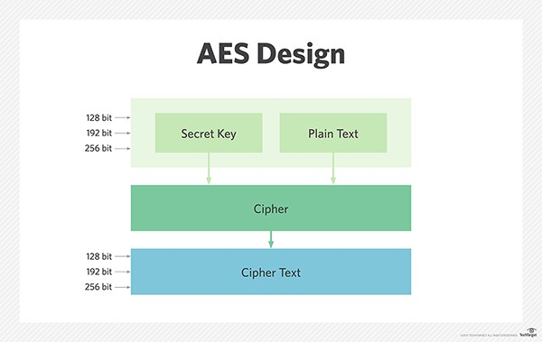
AES: The Advanced Encryption Standard (AES)
The Advanced Encryption Standard (AES) is the The United States government and other organizations both employ a trusted standard algorithm.
AES uses 192- and 256-bit keys for very demanding encryption tasks even though it is incredibly effective in the 128-bit variant.
It is sometimes referred as SP Network, substitution-permutation network. It is made up of a number of interconnected operations, such as permutations and substitutions, which involve rearranging bits to create different combinations of inputs and outputs.

Slide 23
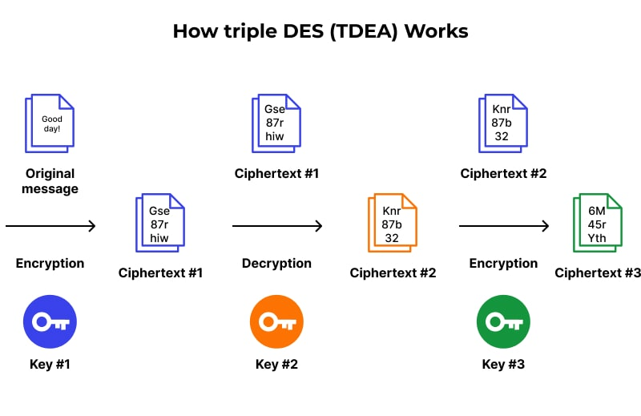
Triple DES: The Data Encryption Standard (DES)
The Data Encryption Standard (DES) algorithm was replaced by Triple DES after hackers discovered a way to compromise DES.
TripleDES, which is frequently used to encrypt UNIX passwords and ATM PINs, runs the DES algorithm three times on each data block.

Slide 24
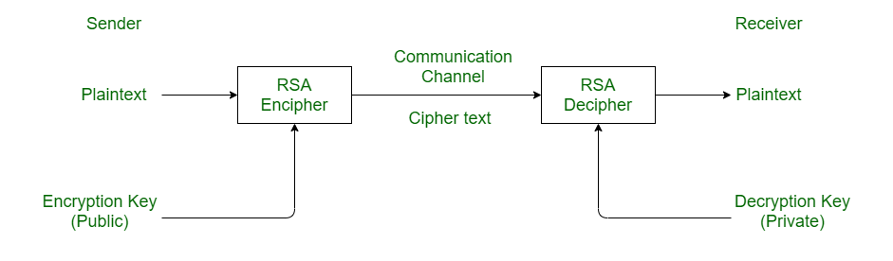
RSA Rivest-Shamir-Adleman (RSA) algorithm
The industry standard for encrypting data sent over the internet is the asymmetric public-key encryption method known as RSA.
RSA encryption is strong and dependable because it generates a huge amount of inactive information that frustrates would-be hackers and makes them spend a lot of time and effort trying to break into systems.

Slide 25
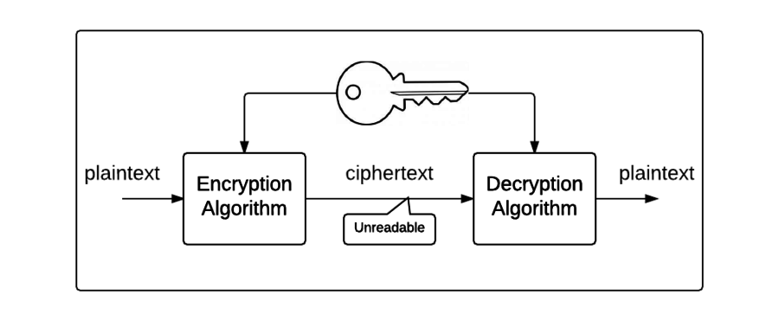
BLOWFISH ALGORITHM
Another algorithm intended to take the role of DES is blowfish. This symmetric benefit splits messages into 64-bit segments and then individually encrypts each one.
Blowfish has a reputation for being quick, adaptable, and unbreakable. It is free because it is in the public domain, which increases its popularity.
Blowfish is frequently used in password management programs, e-commerce platforms, and payment security.

Slide 26
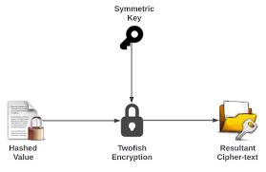
TWOFISH ALGORITHM
Blowfish's replacement is Twofish. Its symmetric encryption decodes 128-bit data blocks and is license-free. Twofish is a symmetric key block cipher with a block size of 128 bits and key sizes up to 256 bits. Additionally, regardless of the key size, Twofish always encrypts data in 16 rounds.
Twofish is one of the fastest of its kind and is ideal for both software and hardware contexts. This technique is utilized by many file and folder encryption software programs today.

Slide 27
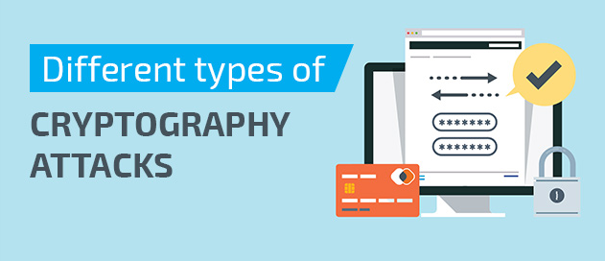

Slide 28
Types of cryptography attacks
These attacks can be broadly categorized into six groups based on the type of cryptographic system in use and the information provided to the attacker:
Brute force attack
Ciphertext-only attack
Chosen ciphertext attack
Known plaintext attack
Key and algorithm attack

Slide 29

Brute force attack
In a cryptographic system, public and private keys are crucial for encrypting and decrypting data. An encrypted message or piece of data is decoded using a variety of private keys in a brute force assault.
There are 256 (or 28) potential keys if the key size is 8 bits. To use this attack tactic, the cybercriminal needs to be familiar with the algorithm, which is typically available as open-source software.

Slide 30
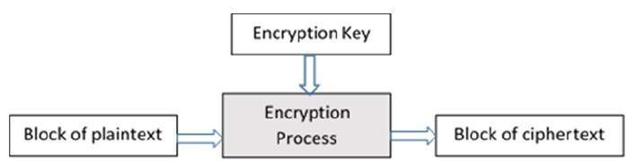
Ciphertext-only attack
The cybercriminal can select any plaintext data to access the ciphertext in this attack strategy. It makes it easier for the attacker to figure out the encryption key.
The differential cryptanalysis carried out on block cyphers is a well-known illustration of this kind of attack.
Block Cipher

Slide 31
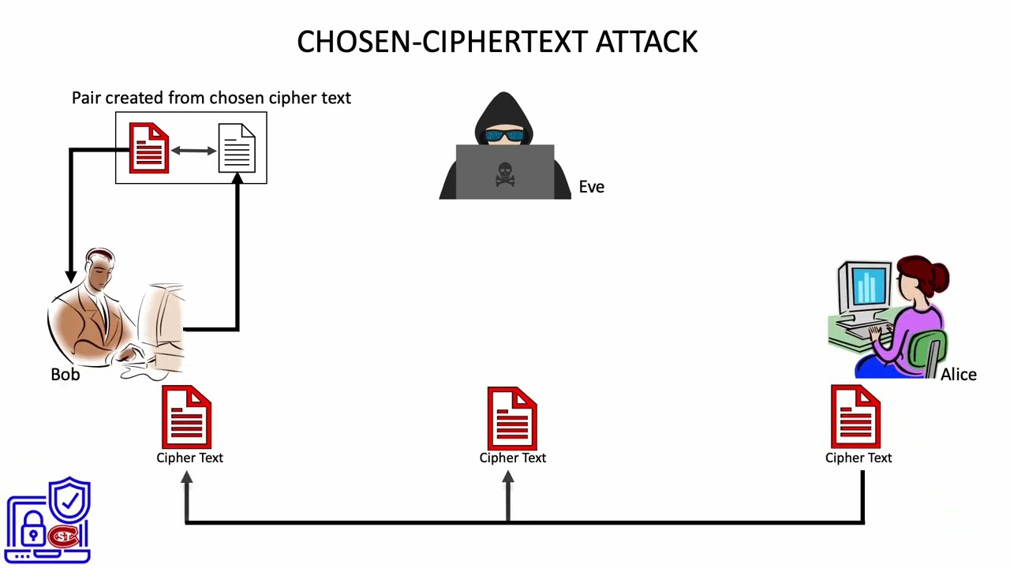
Chosen ciphertext attack
In this attack model, the online criminal examines a selected ciphertext that matches the plaintext. A secret key or information about the system are what the attacker is attempting to get.
The attacker tries to determine the key by examining the selected ciphertext and comparing it to the plaintext. RSA encryption in earlier versions was vulnerable to this attack.

Slide 32
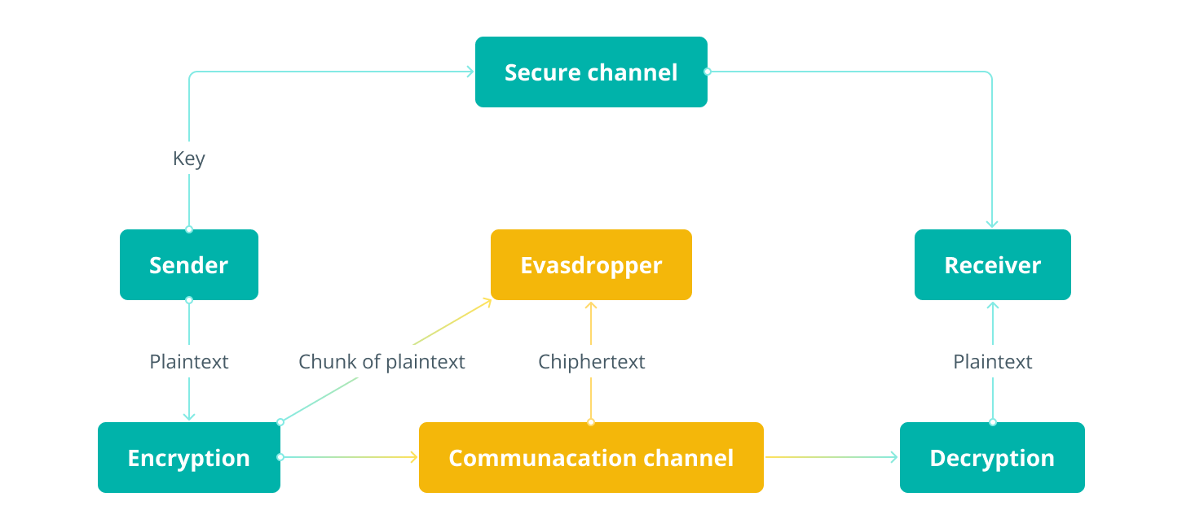
Known plaintext attack
In this attack method, the cybercriminal uses information gathering tactics to discover or obtain some of the ciphertext's plaintext. One such instance is linear cryptanalysis in block cyphers.

Slide 33
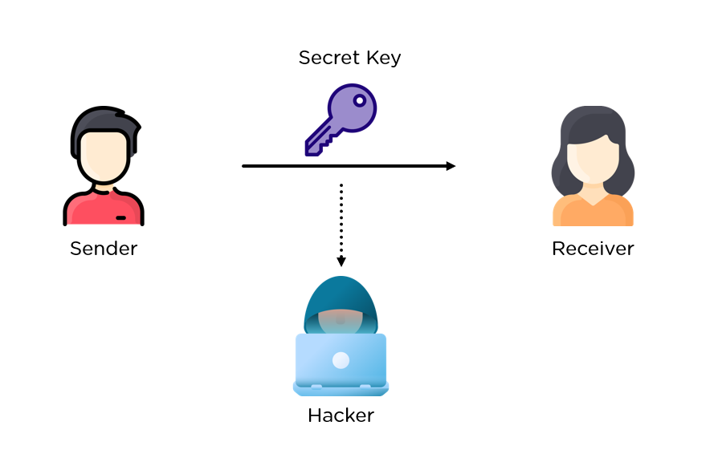
Key and algorithm attack
Here, the attacker examines the cryptographic technique in an effort to determine the key that was used to encrypt or decode the data.

Slide 34


