Slide 1


CROSS-UTILITY SMART CAMPUS RESOURCE MONITOR: INTEGRATED ENERGY COMPETITION AND WATER LEAKAGE DETECTION
CSA0925 – PROGRAMMING IN JAVA Name of the Student: G SAI DEEPAK (192311432) I MD INTHIAZ (192521360)
Guided by :
Dr. Sivasankar C

Slide 2
Problem Background
Application Domain • Smart Campus Management • Energy Monitoring • Water Resource Management Current Scenario • Electricity wastage • Water leakages • Manual monitoring • No centralized monitoring Need • Reduce energy use • Detect leaks early • Centralized monitoring Target Users • Administration • Students • Maintenance
Need for the Project
Enable citizens to report issues easily.
Prioritize repairs based on severity.
Improve response time.
Increase transparency and accountability.
Target Users
Citizens
Municipal Authorities
Maintenance Teams
City Administrators
Notes:
Image source: https://pub.mdpi-res.com

Slide 3
Problem Statement
Problem Definition • Energy wastage • Water leakages • No integrated monitoring Expected Impact • Lower energy use • Early leak detection • Faster maintenance
Limitations of Current Systems
Manual and time-consuming process.
No centralized reporting platform.
Poor citizen participation.
Limited tracking and transparency.
Expected Impact
Faster issue reporting and response.
Priority-based repair planning.
Better resource utilization.
Improved citizen satisfaction and safer communities.
Notes:
Image source: https://www.mdpi.com

Slide 4
Objectives
Primary Objective Develop an integrated smart campus monitoring system. Measurable Objectives • Monitor energy • Detect leakages • Alerts • Dashboard
Notes:
Image source: https://www.mdpi.com

Slide 5
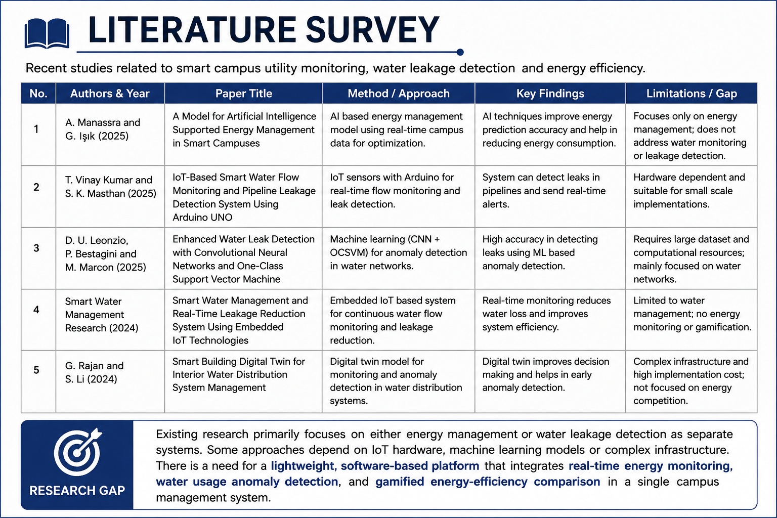
Notes:
Image source: https://pub.mdpi-res.com

Slide 6
Existing vs Proposed System
Existing System | Proposed System
Manual inspections | Citizen-based reporting
Delayed issue detection | Real-time reporting
No severity prioritization | AI-based severity scoring
Limited tracking | Live repair status tracking
Advantages • Integrated monitoring • Real-time alerts • Sustainability Existing: Manual Proposed: Automated integrated system
Notes:
Image source: https://pub.mdpi-res.com

Slide 7
Requirements
Functional • Monitor electricity • Detect leaks • Alerts Hardware ESP32, Sensors Software HTML,CSS,JS,Python,MySQL
Software Requirements
Frontend: HTML, CSS, JavaScript
Backend: Python (Flask/Django)
Database: MySQL
Tools: VS Code, Git
Dataset / APIs
OpenStreetMap / Google Maps API
GPS Location API
Municipal infrastructure datasets
Image dataset for damage classification (if AI is used)
Notes:
Image source: https://pub.mdpi-res.com

Slide 8
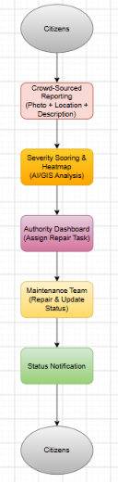
Architecture
Block Diagram
Workflow
Citizen reports an issue.
System analyzes severity and location.
Heatmap identifies priority areas.
Authority assigns repair work.
Maintenance team updates status.
Citizen receives progress updates.
Module Description
Reporting Module: Submit geotagged complaints.
Severity & Heatmap Module: Prioritize issues based on impact.
Action Tracking Module: Monitor repair progress and notify users.
Notes:
Image source: https://pub.mdpi-res.com

Slide 9
Planning
WBS Requirement Analysis Design Development Testing Deployment Risks Sensor failure, Network issues
Risk Analysis
Risk | Mitigation
Incorrect reports | Verification & image validation
GPS/Location errors | Accurate geotagging APIs
Low user participation | Simple and user-friendly app
Server downtime | Regular backup & cloud hosting
Notes:
Image source: https://pub.mdpi-res.com

Slide 10
Expected Outcomes
Deliverables Monitoring system Dashboard Documentation Benefits Reduced wastage Early leak detection Lower cost
Notes:
Image source: https://www.mdpi.com

Slide 11


