Slide 1
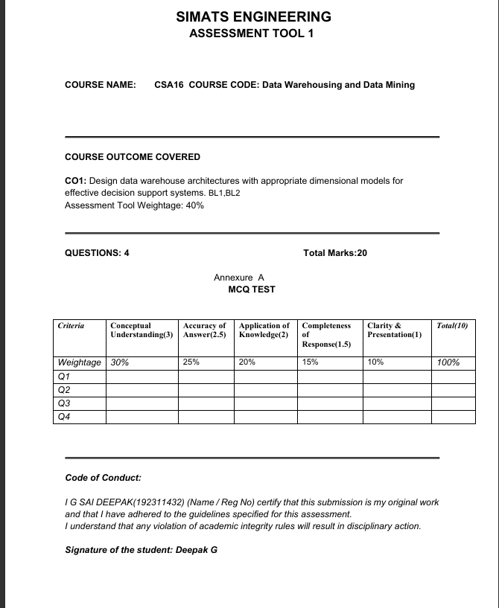

Slide 2

CSA1603 – DATA WAREHOUSE AND DATA MINING
Inside the Data Cube
A Journey Through OLAP Operations
How analysts roll up, drill down, slice, dice, and pivot their way to insight
G SAI DEEPAK
Reg No: 192311432
Course: CSA1603 – Data Warehouse and Data Mining

Slide 3
What Is OLAP?
One dataset, viewed from every angle
Online Analytical Processing lets business users explore data stored as a multidimensional cube — not a flat spreadsheet.
Dimensions — Time, Product, Region — the ways you slice the business
Measures — Sales, Profit, Quantity — the numbers you're analyzing
THE DATA CUBE
Hierarchies — Day → Month → Year, or City → State → Country
X – Time
Y – Product
Z – Region
Every query touches multiple dimensions at once — giving answers a flat table never could.

Slide 4


Roll-Up & Drill-Down
Climbing and descending the concept hierarchy
ROLL-UP
DRILL-DOWN
Aggregates detailed data by climbing up a concept hierarchy, or by reducing the number of dimensions — turning granular rows into a summarized view.
The reverse of roll-up — navigates from summarized data toward finer detail, revealing the lower levels of a hierarchy on demand.
City
Year
State
Quarter
Country
summarized →
→ more detail
Month

Slide 5


Slice & Dice
Carving a smaller, sharper view out of the cube
SLICE
DICE
Fixes one dimension to a single value, cutting a single flat “slice” out of the cube — e.g. Sales where Year = 2025.
Fixes two or more dimensions to specific values, producing a smaller sub-cube — e.g. Sales where Region = South AND Product = Electronics.
Year = 2025 → one full slice selected
Region + Product fixed → sub-cube selected

Slide 6

Pivot (Rotate)
Same data, a completely new perspective
Pivot rotates the data axes of the cube to display an alternative orientation — for instance, swapping what appears in the rows versus the columns of a report. The underlying data never changes, only the vantage point.
BEFORE — rows = Region
AFTER — rows = Product
Product → columns
Region → columns
North
Laptops
South
Phones
East
Tablets
Analysts use pivot to compare the same figures across different report layouts without re-querying the warehouse.
Why it matters
A single pivot can turn a Region-first report into a Product-first report in seconds — no rebuilding the query, no waiting on IT.

Slide 7



From Raw Data to Real Decisions
Why OLAP operations matter in the real world
Seconds
Multi-Angle
Faster
to re-view data — not days of re-querying
insight from one cube, endless perspectives
business decisions, backed by live detail
Roll-up, drill-down, slice, dice, and pivot are the five moves that turn a static warehouse into a living conversation with the data — every rotation of the cube reveals a question the business didn’t know it could ask.
G Sai Deepak | Reg No: 192311432 | CSA1603 – Data Warehouse and Data Mining

