Slide 2
ASCENDING ORDER EXP NO: 13
AIM: To compute ascending order of an array using 8085 processor.
ALGORITHM:
1) Initialize HL pair as memory pointer. 2) Get the count at memory and load it into C register 3) Copy it in D register (for bubble sort (N-1)) times required). 4) Get the first value in A register. 5) Compare it with the value at next location. 6) If they are out of order, exchange the contents of A register and memory. 7) Decrement D register content by 1 8) Repeat step 5 and 7 till the value in D register become zero. 9) Decrement the C register content by 1. 10) Repeat steps 3 to 9 till the value in C register becomes zero.
PROGRAM:
LOOP: LXI H,3500 MVI D,00 MVI C,05 LOOP1: MOV A,M INX H CMP M JC LOOP2 MOV B,M MOV M,A DCX H MOV M,B INX H MVI D,01 LOOP2: DCR C JNZ LOOP1 MOV A,D RRC JC LOOP HLT

Slide 3
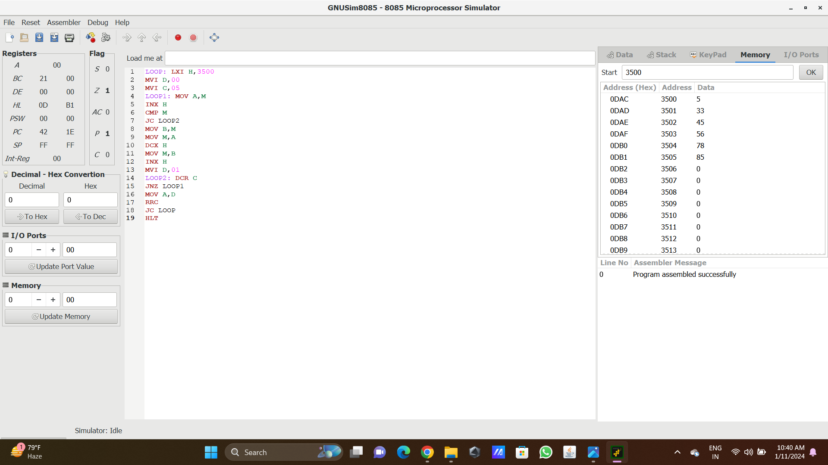
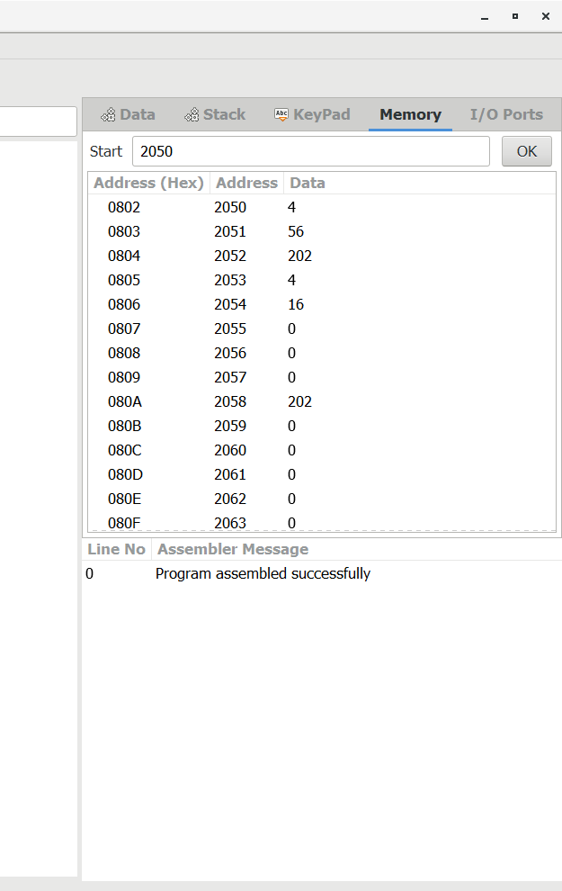
Input
output

Slide 4
RESULT: Thus the program was executed successfully using 8085 processor simulator.

