Slide 1


High Clouds
Airlines
Presented By : Group 3

Slide 2


Team Member
SHAIK MOHAMMED GHOUSE
Keyur Prakash Shivgan
Abdulkadir Siddiqui
Paresh Uttam Ruke
Deepak Suresh Gupta
V.V.Varaprasad kotte
Marupuru Praveena

Slide 3
Introduction
Comprehensive Analysis of Flight Operations Data Gaining insights into routes, carriers, and passenger trends.
Focus on Key Metrics Examining top routes, passenger preferences, and operational efficiency.
Data-Driven Optimization Using insights to improve airline performance and strategy.
Actionable Recommendations Delivering solutions to enhance efficiency and customer satisfaction.
Goals 2
Goals 4

Slide 4

Data Overview
The dataset used for analysis contains detailed flight operation records.
Data includes thousands of flights with key metrics and parameters.
Focus on analyzing top-performing routes and passenger trends.
Key metrics used for analysis include:
Carrier Name
From-To City (Route)
Number of Flights
Load Factor (Passenger vs. Seat Availability)
Passenger Preferences

Slide 5

Objectives
Assess Load Factor Efficiency: Understand how well airlines are utilizing their seating capacity across different carriers and time periods.
Monitor Passenger Trends: Analyze passenger distribution by distance (short, medium, and long-haul flights) to identify demand patterns and improve route planning.
Optimize Flight Schedules: Compare weekday vs. weekend performance to identify opportunities for increasing demand during low-traffic periods.
Track Carrier Performance: Benchmark airline performance in terms of transported passengers and load factor, identifying high-performing carriers and those needing improvements.
Identify Seasonal Trends: Highlight quarterly fluctuations in load factors, enabling better planning for peak and off-peak seasons.

Slide 6
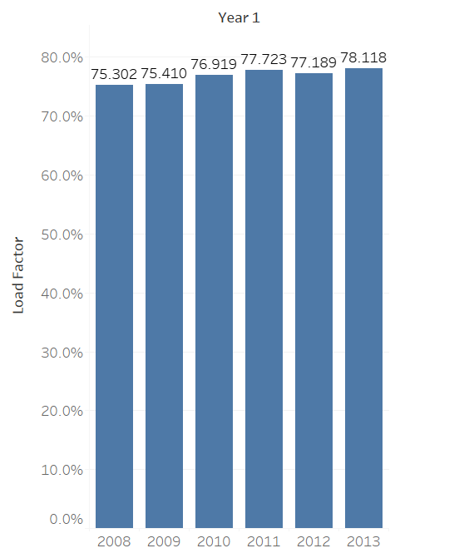
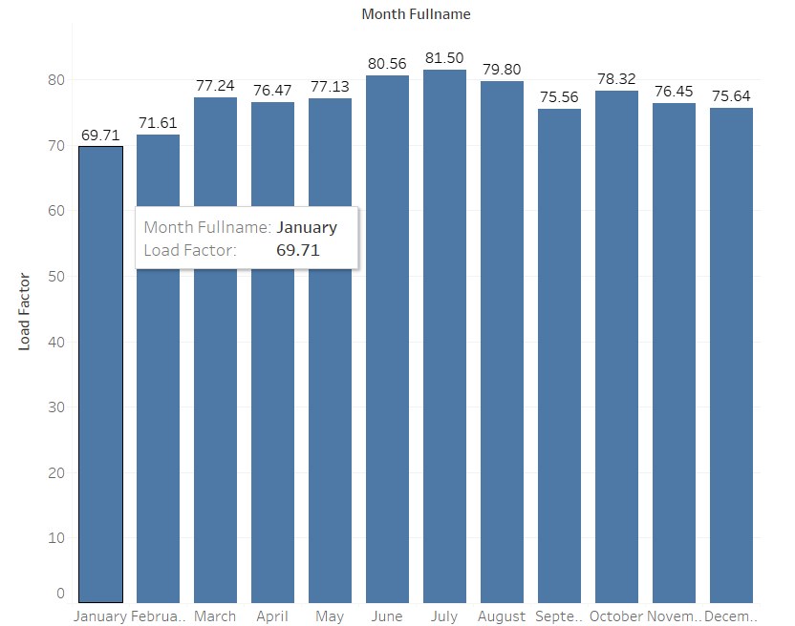
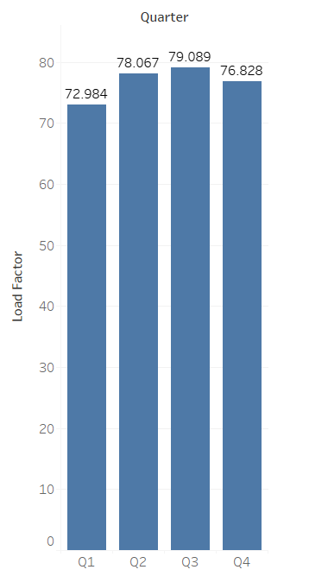
KPI’s
Find the load Factor percentage on a yearly , Quarterly , Monthly basis
A magazine is a periodical publication, which can either be printed or published electronically.
A magazine
monitor finances
A magazine is a periodical publication, which can either be printed or published electronically.

Slide 7
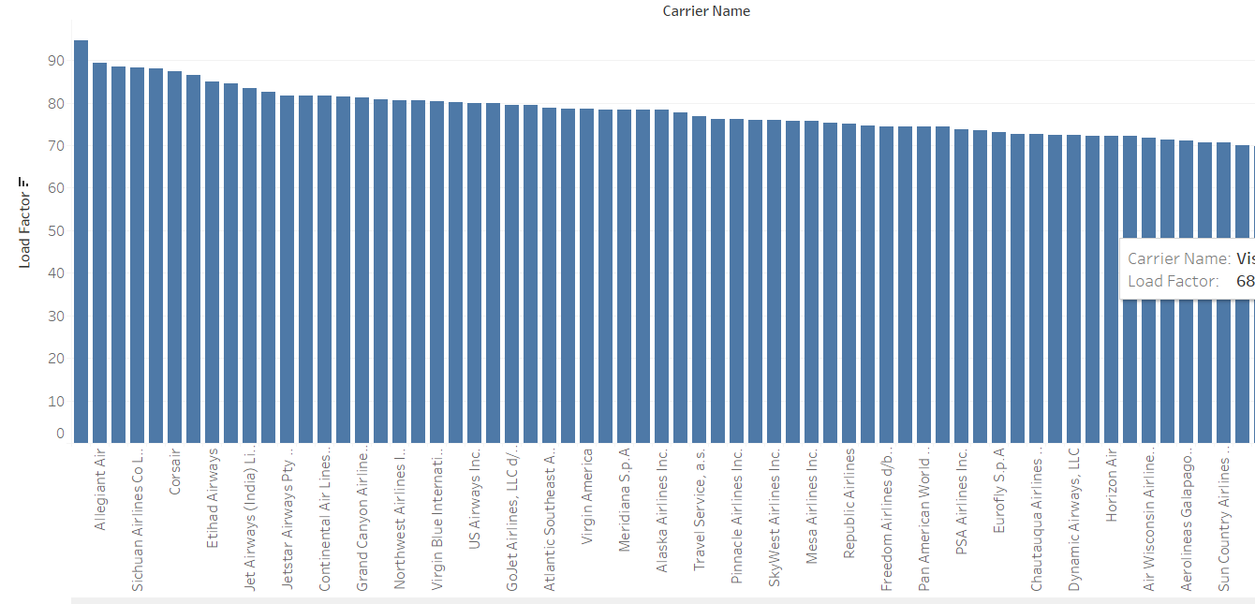
KPI’s
Find the load Factor percentage on a Carrier Name basis
View More

Slide 8
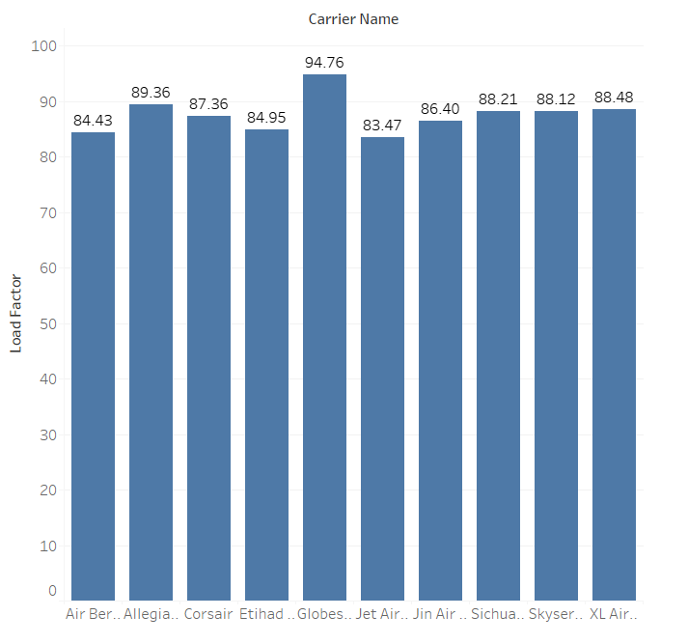
KPI’s
Identify Top 10 Carrier Names based passengers preference
View More

Slide 9
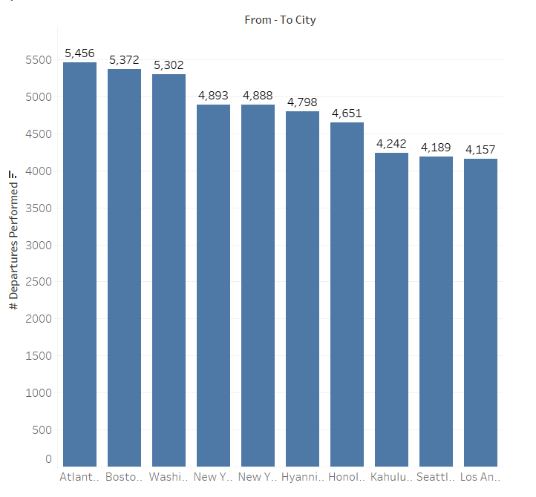
KPI’s
Display top Routes based on Number of Flights

Slide 10
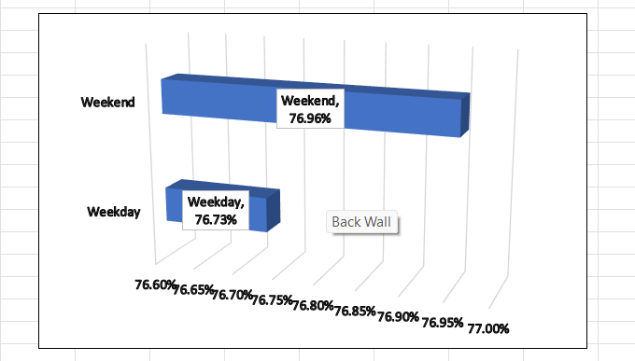
KPI’s
Identify the how much load factor is occupied on Weekend vs Weekdays.

Slide 11
KPI’s
Identify number of flights based on Distance group

Slide 12
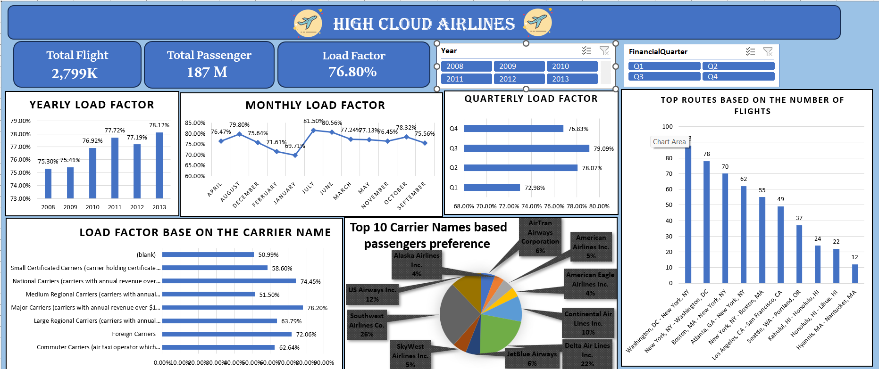
Excel Dashboard

Slide 13
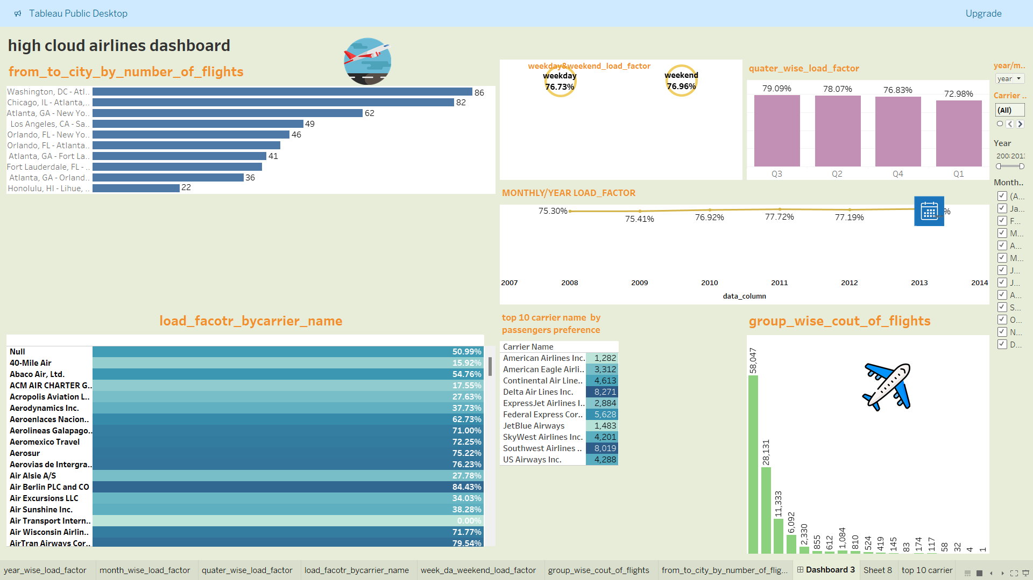
Tableau Dashboard

Slide 14
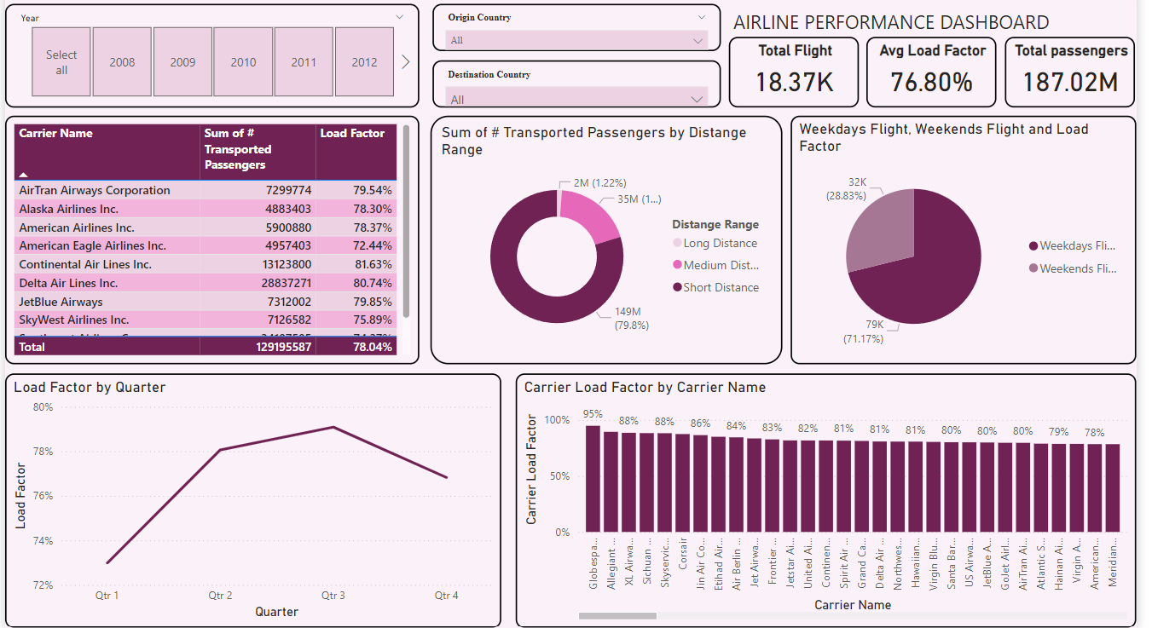
Power BI Dashboard

Slide 15
Insights
The analysis conducted using the dataset revealed the following key insights:
Load Factor Trends:
Identified seasonal and monthly variations in load factors, helping to pinpoint peak travel periods.
Carrier-wise load factor analysis highlighted operational inefficiencies and top-performing carriers.
Passenger Preferences:
Discovered the top 10 carriers based on passenger preferences, providing insights into customer loyalty and popular choices.
Route Performance:
Identified high-demand routes (from-to city pairs) with the maximum number of flights, which can guide resource allocation.
Travel Patterns:
Observed higher load factors during weekends compared to weekdays, suggesting a preference for leisure travel on weekends.
2021
2019
2020

Slide 16
Insights
5. Flight Volumes by Distance:
Short-haul routes had the highest frequency of flights, indicating strong demand for regional connectivity.
These insights help airlines optimize flight operations, focus on profitable routes, and improve passenger satisfaction.
2019

Slide 17
Recommendation
Target Low-Performing Carriers:Focus on improving the load factor for carriers like SkyWest Airlines through marketing, promotions, and optimized route planning.
Enhance Long-Distance Flight Occupancy:Evaluate pricing strategies and promotional campaigns to increase demand for long-distance flights.
Optimize Weekend Demand:Develop targeted promotions to boost weekend flight bookings, such as discounts or packages for leisure travelers.
Seasonal Adjustments:Align flight schedules and capacities with the seasonal demand trends observed across quarters.

Slide 18
Conclusion
Load Factor Significance: The Load Factor is a vital metric for assessing how efficiently an airline utilizes its seating capacity, directly influencing profitability.
Optimization Strategies: Implementing dynamic pricing, refining flight schedules, and enhancing customer experience are effective strategies to improve load factors.
Revenue Impact: A higher load factor leads to better resource utilization, thereby maximizing revenue potential.
Operational Efficiency: Improving load factors contributes to operational efficiency, reducing costs associated with underutilized capacity.
Continuous Monitoring: Regular analysis of load factors enables proactive adjustments, ensuring the airline remains responsive to market demands.

Slide 19
Thank You

