Slide 1


Sales Metrics and Market Trends
A Data-Driven Approach to Understanding Sales Dynamics
SPACE For Early Childhood Education
Business Analytics internship

Slide 2

Agenda
1
2
3
Dashboard Components KPIs
Visualizations
Insights and Analysis

Slide 3

Introduction
To analyze sales performance and identify actionable insights through key metrics and visualizations, helping businesses make informed decisions and drive growth.
Data Overview:
Two datasets: Details.csv and Orders.csv
Merged using Order ID to create a unified dataset
Tools Used:
Python (Pandas, Matplotlib, Seaborn) for analysis and visualization

Slide 4

Problem Statement
Businesses require insights into sales performance to identify growth opportunities, address underperforming areas, and make informed decisions. This project aims to analyze key sales metrics, market trends, and customer satisfaction to provide actionable insights through a comprehensive dashboard for better strategic planning and revenue growth.

Slide 5

Objectives
The primary objective of this is to assist the analyze sales data and provide actionable insights for improving business performance and decision-making :-
Monitor overall sales performance through key metrics.
Identify high-performing and underperforming regions.
Understand customer satisfaction to enhance user experience.
Highlight trends in product categories and seasonal sales patterns.
Provide a visual representation of market share and geographic distribution.

Slide 6
Key Performance Indicators (KPIs)
Total Sales: ₹437771
Average Sales per Region:-
Customer Satisfaction Score: 85%
High-Performing Region:
Uttar Pradesh with Average Sales of ₹440.94
Low-Performing Region:
Goa with Average Sales of ₹155.93

Slide 7
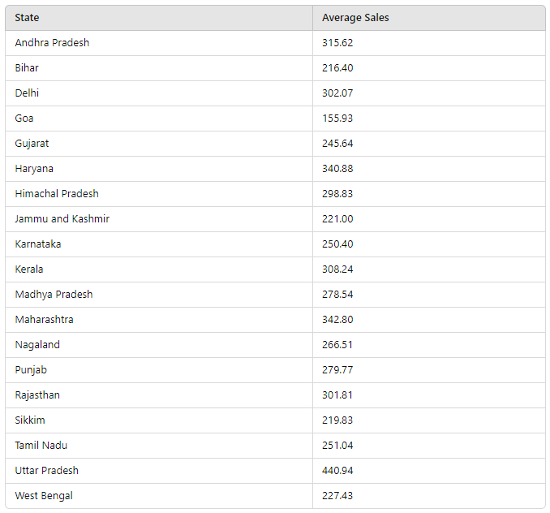
Average Sales per Region:-
Average Sales per Region:-
High-Performing Region:
Uttar Pradesh with Average Sales of ₹440.94
Low-Performing Region:
Goa with Average Sales of ₹155.93

Slide 8

Visualizations
Bar Chart: Sales by Product Category.
Column Chart: Monthly Sales Trends.
Donut Chart: Market Share by Region.
Map: Sales Distribution by Geography.
Slicer: Filter by Date Range, Product Category, and Region.

Slide 9
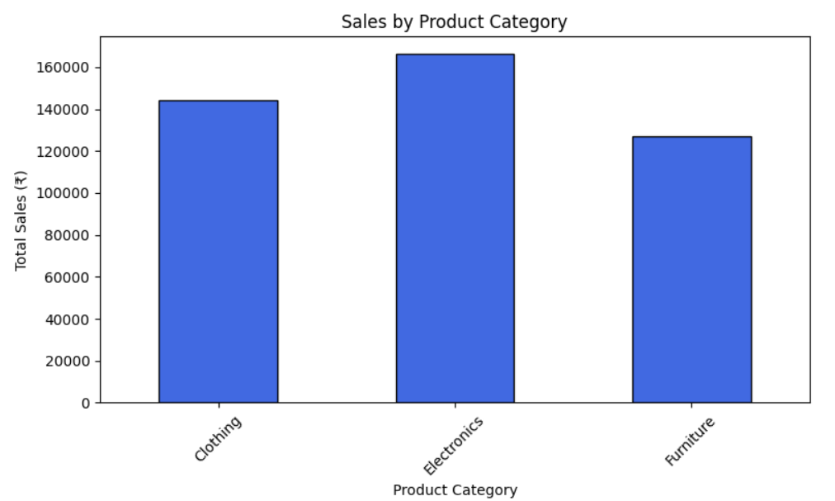
Bar Chart:
Sales by Product Category.
Category with Highest Sales: Electronics - ₹166,267
Category with Lowest Sales: Furniture - ₹127,181
Fig. (1)

Slide 10
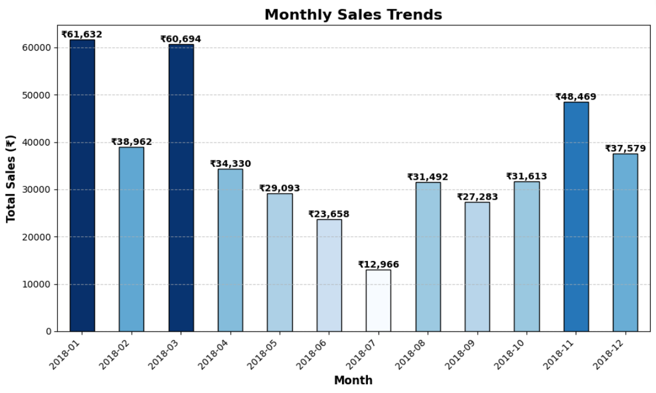
Column Chart:
Monthly Sales Trends.
Month with Highest Sales: January - 2018-01 - ₹61,632
Month with Lowest Sales: July - 2018-07 - ₹12,966
Fig. (2)

Slide 11
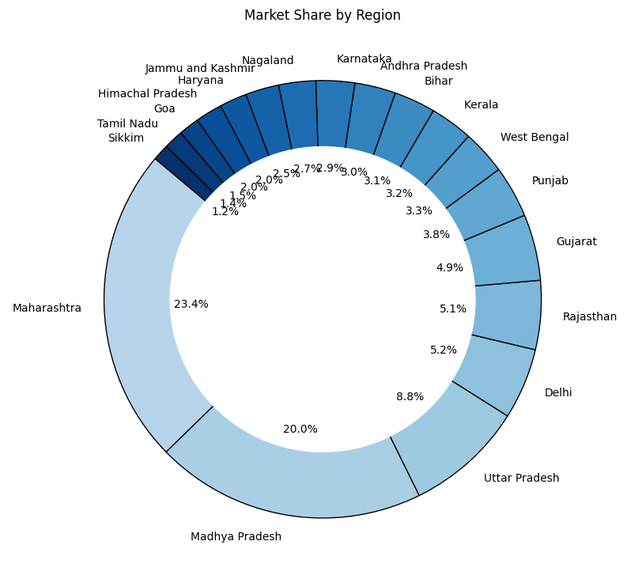
Donut Chart:
Market Share by Region.
Region with Highest Market Share:
Maharashtra - ₹102,498 (23.4%)
Region with Lowest Market Share:
Sikkim - ₹5,276 (1.2%)
Fig. (3)

Slide 12
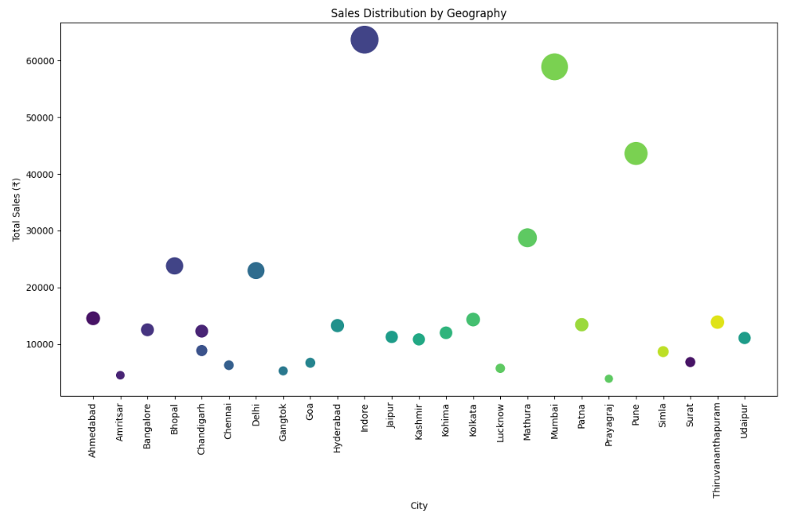
Map:
Sales Distribution by Geography.
City with Highest Sales: Indore in Madhya Pradesh - ₹63680
City with Lowest Sales: Prayagraj in Uttar Pradesh - ₹3889
Fig. (4)

Slide 13
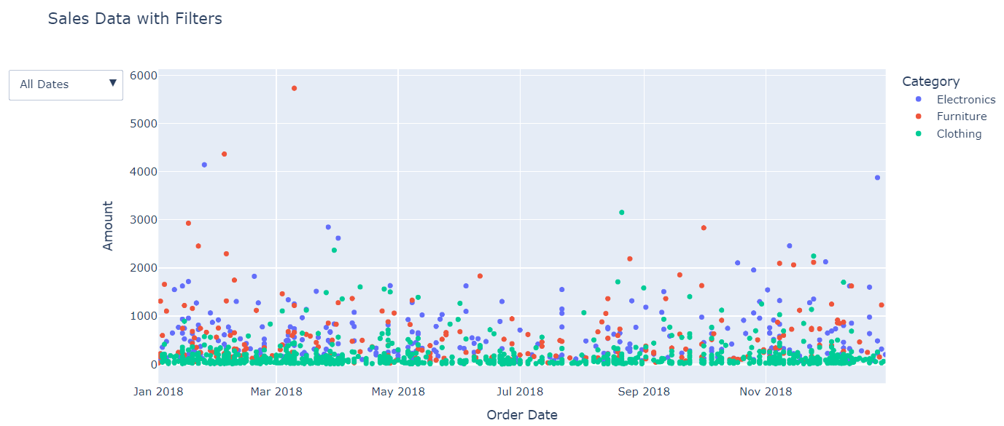
Slicer:
Filter by Date Range, Product Category, and Region.
Fig. (5)

Slide 14
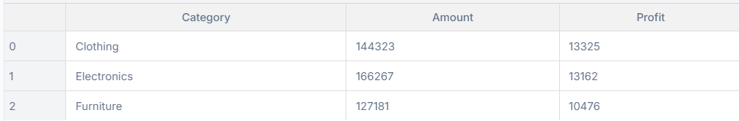
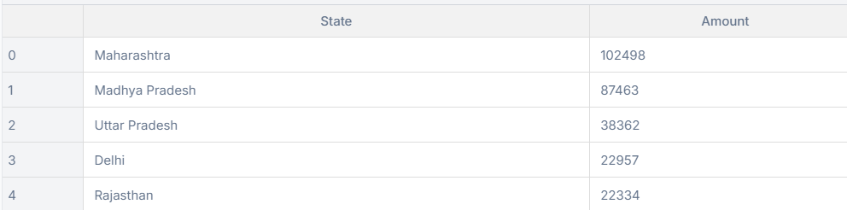
Slicer:
Top 5 States by Sales
Top 5 States by Sales

Slide 15
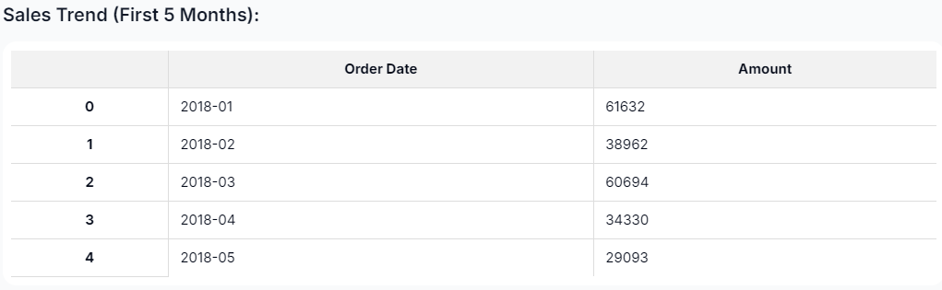
Slicer:
Sales Trend (First 5 Months):

Slide 16
Insights and Analysis
Total Sales: Monitor overall performance and growth.
Average Sales per Region: Identify high-performing regions and areas needing improvement.
Customer Satisfaction Score: Track customer feedback and satisfaction levels.
Sales by Product Category: Determine which product categories are driving sales.
Monthly Sales Trends: Analyze seasonal trends and sales patterns.
Market Share by Region: Understand your market position in different regions.
Sales Distribution by Geography: Visualize geographic sales performance and identify potential markets.

Slide 17
Total Sales:
Monitor overall performance and growth.
Total Sales: ₹437771
Customer Satisfaction Score:-
Satisfaction levels :- 85%

Slide 18
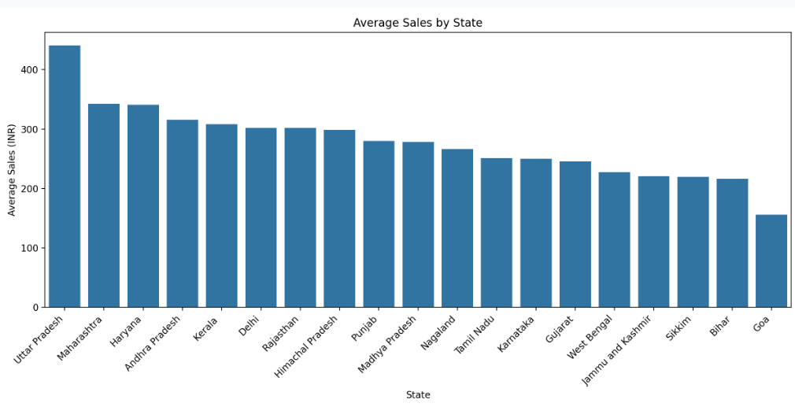
Average Sales per Region:
Identify high-performing regions and areas needing improvement.
Fig. (6)

Slide 19
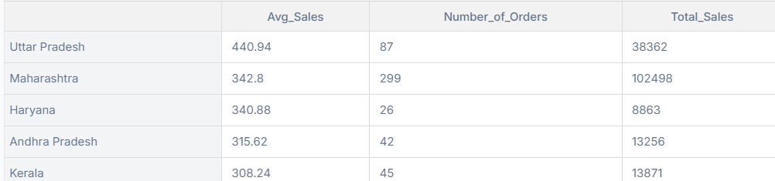
Average Sales per Region:
Identify high-performing regions and areas needing improvement.
Key findings:
Uttar Pradesh has highest average order value (₹440.94)
Maharashtra leads in total sales volume with 299 orders
Significant variation in order volumes across states

Slide 20
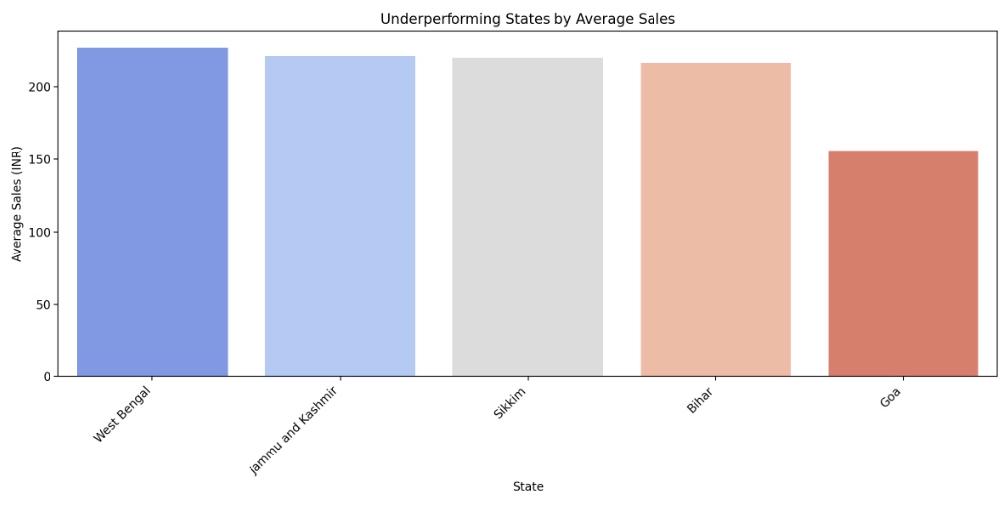
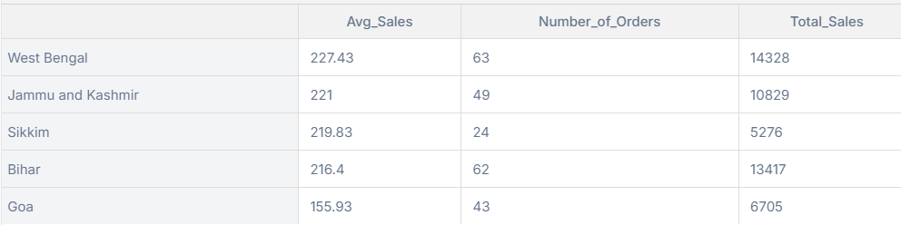
Average Sales per Region:
Identify areas needing improvement :-
These states, such as Goa and Bihar, have the lowest average sales and may require targeted strategies to improve performance.
Fig. (7)

Slide 21
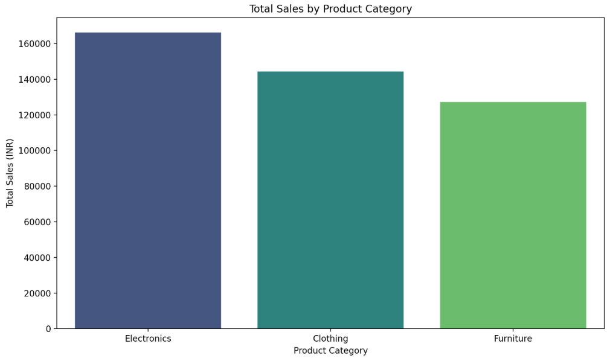
Sales by Product Category:
Determine which product categories are driving sales.
Fig. (8)

Slide 22
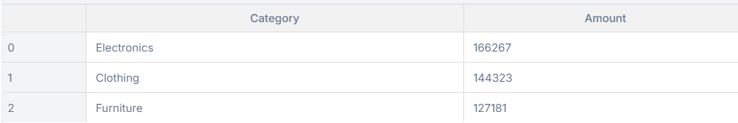
Sales by Product Category:
Determine which product categories are driving sales.
Electronics is the top-performing category,
followed by :-
Clothing and Furniture.

Slide 23
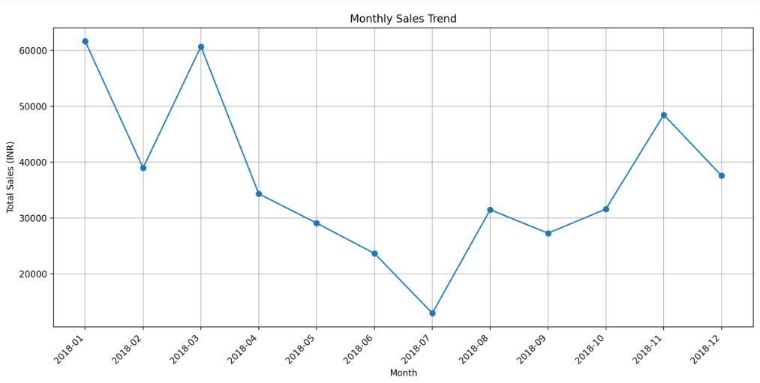
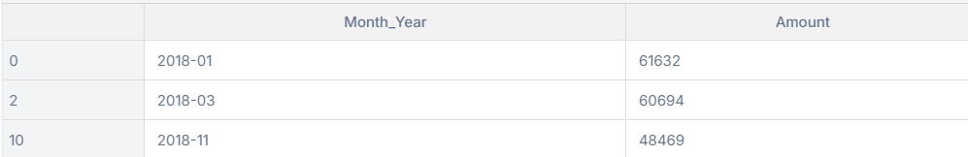
Monthly Sales Trends:
Analyze seasonal trends and sales patterns.
The analysis reveals strong sales performance in January and March 2018, with a notable peak in January (61,632 INR) Key insights:
Strongest sales in Q1 (January-March 2018)
January had highest revenue at 61,632 INR
March followed closely with 60,694 INR
November showed a secondary peak at 48,469 INR
Clear dips in sales during mid-year months (May-July)
Fig. (9)

Slide 24
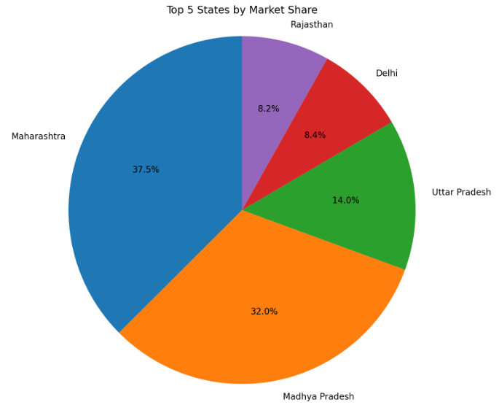
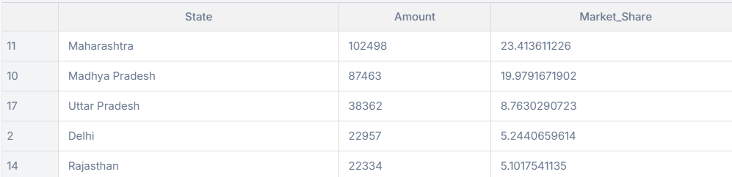
Market Share by Region:
Understand your market position in different regions.
Maharashtra leads with the
highest market share (23.4%),
followed by
Madhya Pradesh (19.98%).
Fig. (10)

Slide 25
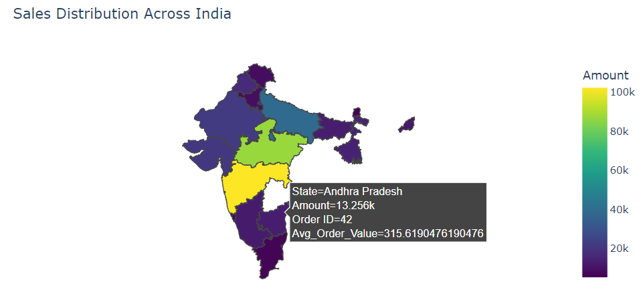

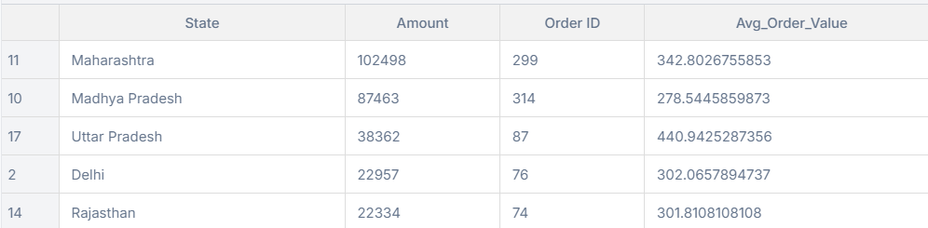
Sales Distribution by Geography:
Visualize geographic sales performance and identify potential markets.
This data suggests focusing on high-performing states for further growth while exploring strategies to improve sales in underperforming regions.
Identify potential markets.
Maharashtra
Madhya Pradesh
Uttar Pradesh
Delhi
Rajasthan
Fig. (11)

Slide 26

Conclusion
The analysis of sales trends across various dimensions—payment modes, product categories, geographical regions, and customer purchasing patterns—provides valuable insights into business performance. By identifying high and low performers, we can implement targeted strategies to optimize sales, improve customer engagement, and drive growth across different areas of the business.
Sales by Payment Mode: Digital payment methods like credit cards or digital wallets may be more popular and contribute significantly to sales. Underperforming modes can be boosted with targeted promotions.
Sales by Product Category: High-performing categories drive revenue, while low performers may need product improvements or better marketing efforts.
Geographical Distribution: Focus on high-sales regions for expansion and marketing, while addressing challenges in low-performing areas through localized campaigns or better distribution.
Customer Purchasing Patterns: High-value customers can be rewarded with loyalty programs, while low-engagement customers can be targeted with personalized offers to increase retention.
Recommendations:
Leverage strengths in high-performing regions and categories.
Optimize underperforming payment methods with incentives.
Improve customer retention through loyalty programs and personalized offers.
Use targeted marketing campaigns to address both high and low-performing areas.

Slide 27


