Slide 1

Visualization and Analysis – Tutorial Presentation for Feedback Date:
Group Id: A113 Name of Student Presenting: Deepak

Slide 2
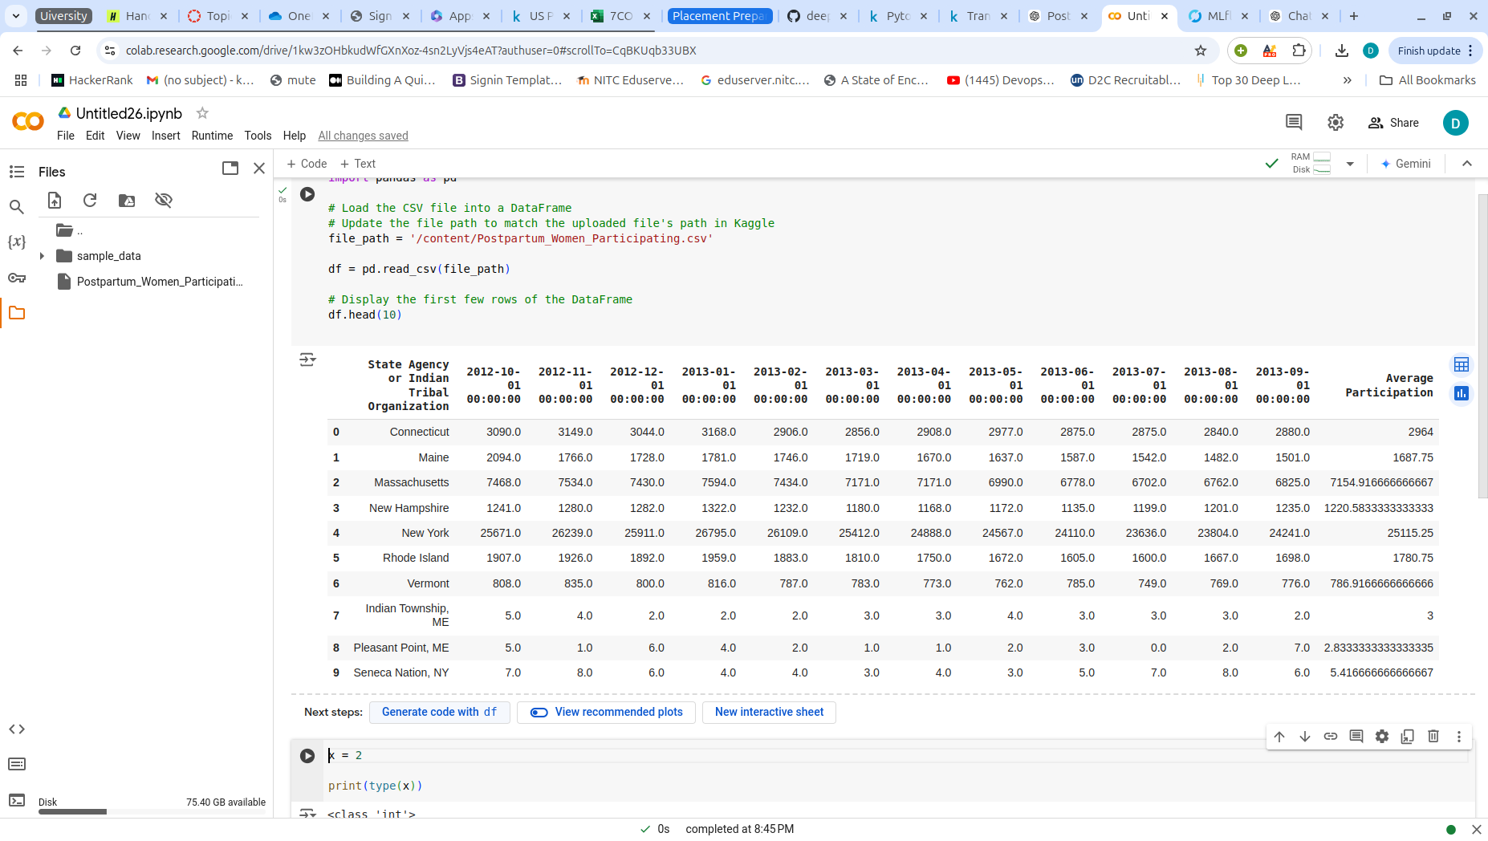
We are using the dataset DS080,Postpartum_Women_Participating.csv to answer our Research Question
"Is there a correlation between time (from October 2012 to September 2013) and the average fund allocation across states?"
DataSet have 92 Rows.
Dependent variable: Average fund Allocation
Independent Variable: States name

Slide 3
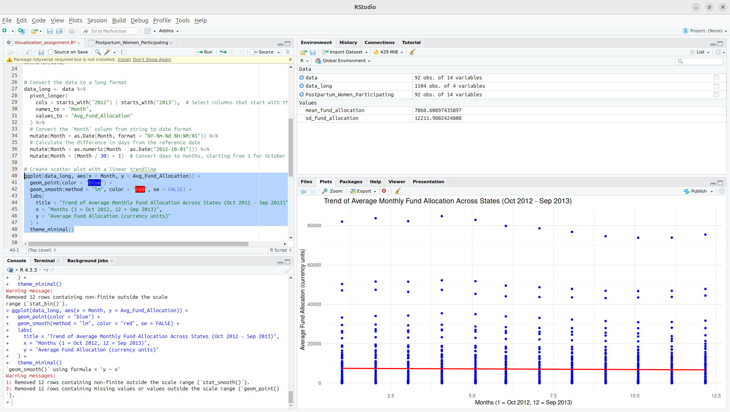
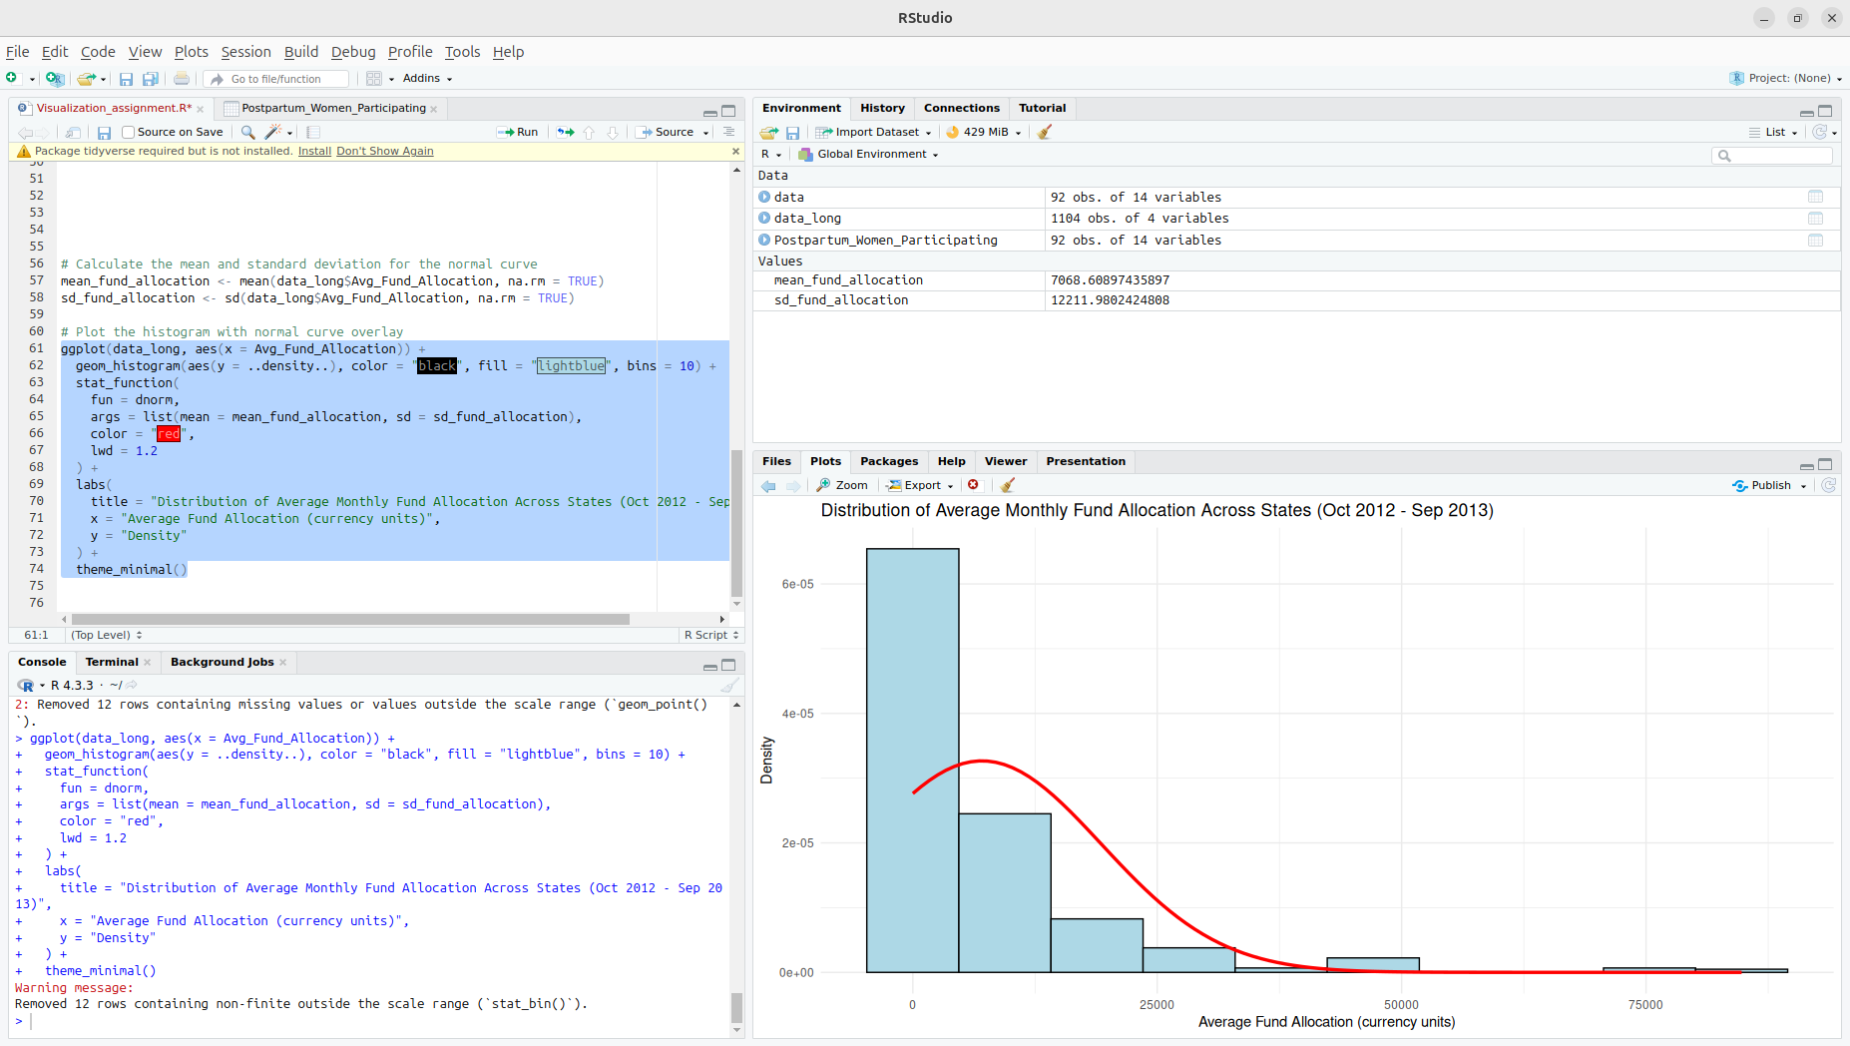

Slide 4
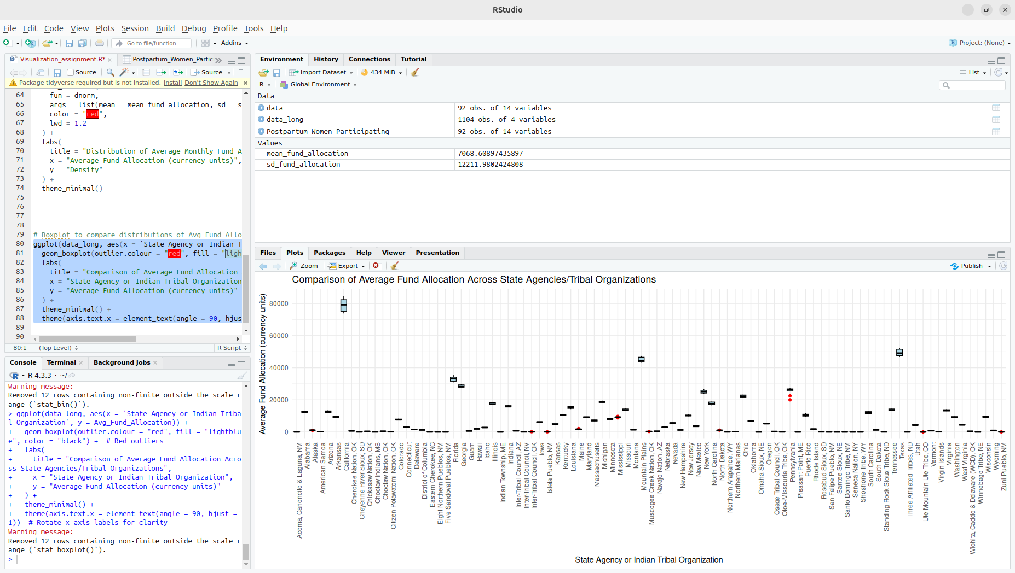
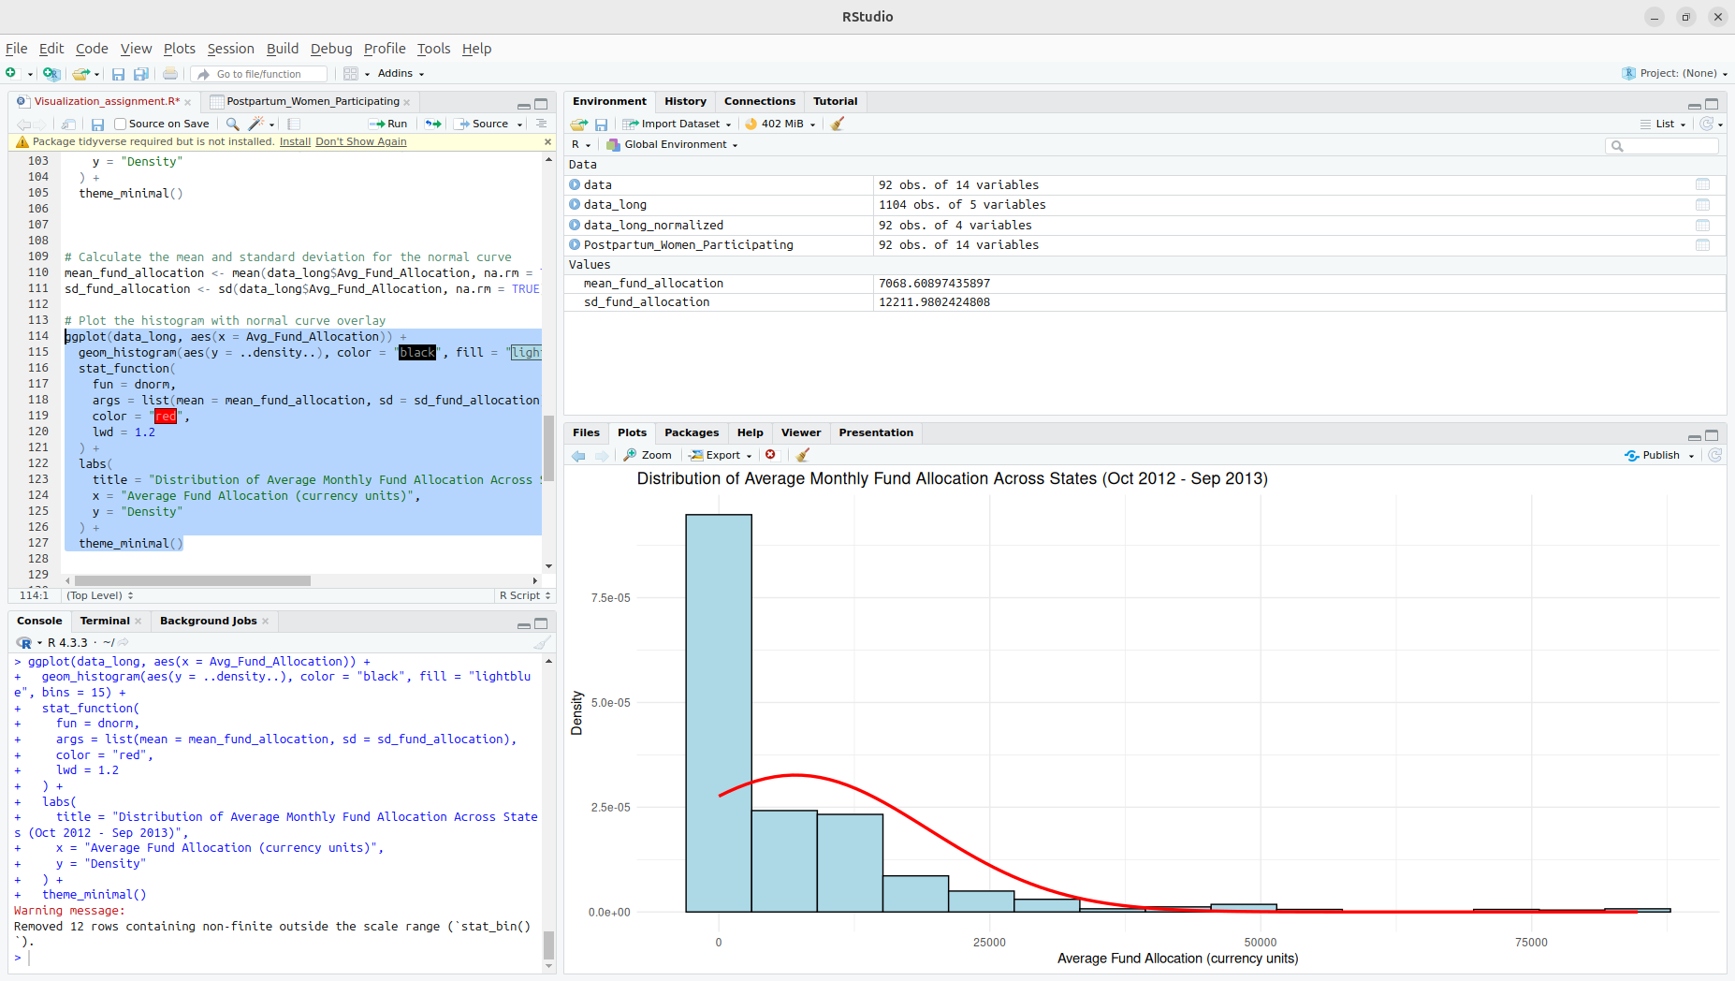

Slide 5
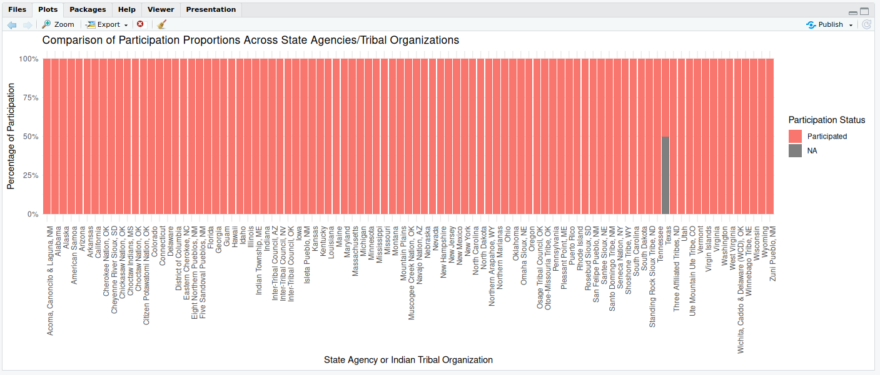

Slide 6
Here is a Histogram showing the frequencies of our dependent variable to include the normal curve overlay.
Our RQ asks about Correlation
For example:
The normal curve overlay does not follow the shape of the underlying data, so for our analysis we use the non-parametric test for correlation that does not assume normality: Spearman’s Rho or Kendal’s Tau
6
Notes:
6

Slide 7
Here is a Histogram showing the frequencies of our dependent variable to include the normal curve overlay (shown in blue).
Our RQ asks about Differences in means/ medians
For example:
The normal curve overlay does not follow the shape of the underlying data, so we use the non-parametric test that does not assume normality: Wilcoxon also known as the Mann Whitney U Test.
7

Slide 8
R Script and Results (For ALL types of test) – The Analysis
PRE 7COM1079-2022 Student Group No: ?????
8
R-code :
spearman_result <- cor.test(data_long$Month, data_long$Avg_Fund_Allocation, method = "spearman")
Notes:
8

Slide 9
R Script and Results (For ALL types of test) – The Analysis
PRE 7COM1079-2022 Student Group No: ?????
9
Test-Statistic value = 220069524
p-value = 0.6437
The value of p-value (0.6437) is greater than 0.05, the result is not significant means there is no statistically significant correlation between the Month and Avg_Fund_Allocation.
The p-value is greater than 0.05, we fail to reject the null hypothesis.
The result Suggest that there is no monotonic relationship between the Month variable (which represents time) and the Average Fund Allocation.
Notes:
9

Slide 10
R Script and Results (For ALL types of test) – The Analysis
PRE 7COM1079-2022 Student Group No: ?????
10
median_value <- median(data_long_clean$Avg_Fund_Allocation, na.rm = TRUE)
data_long_clean <- data_long_clean %>%
mutate(group_combined = ifelse(Avg_Fund_Allocation >= median_value, "GroupA", "GroupB"))
# check if we have two groups
table(data_long_clean$group_combined)
# Filter data to include only GroupA and GroupB
data_two_groups <- data_long_clean %>%
filter(group_combined %in% c("GroupA", "GroupB"))
# Check that filtering worked correctly
table(data_two_groups$group_combined)
# Perform the Wilcoxon test only if there are two groups
if (length(unique(data_two_groups$group_combined)) == 2) {
wilcoxon_result <- wilcox.test(Avg_Fund_Allocation ~ group_combined, data = data_two_groups)
print(wilcoxon_result)
} else {
print("Data does not contain exactly two groups.")
}
Notes:
10

Slide 11
R Script and Results (For ALL types of test) – The Analysis
PRE 7COM1079-2022 Student Group No: ?????
11
Test-Statistic value = 298116
p-value = 2.2e-16
Yes, the result is statistically significant because the p-value is less than 0.05.
I will reject the null hypothesis because the p-value is much smaller than the commonly used significance level of 0.05.
The result suggests that there is a significant difference in the distribution of the Avg_Fund_Allocation between GroupA and GroupB(On median Avg fund allocation bases).This could imply that the two groups have different needs, priorities, or contexts that influence how funds are distributed.
Notes:
11

