Slide 1

Visualization and Analysis – Tutorial Presentation for Feedback Date:
Group Id: A113 Name of Student Presenting: Deepak

Slide 2
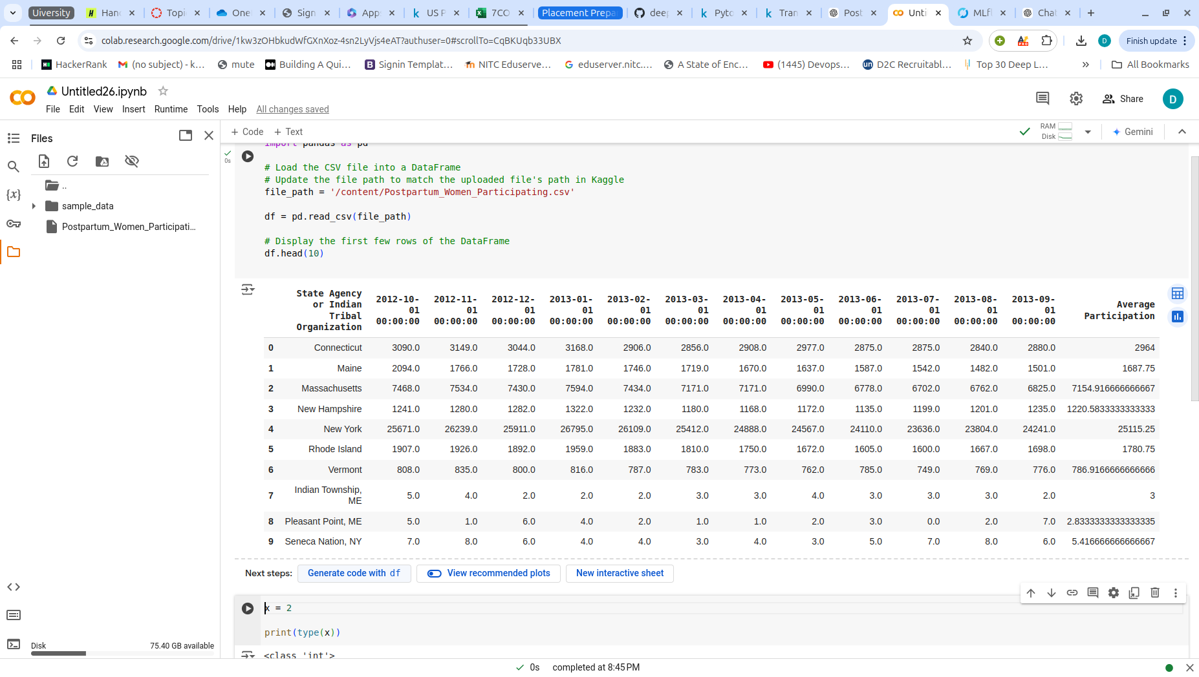
We are using the dataset DS080,Postpartum_Women_Participating.csv to answer our Research Question
"Is there a correlation in the monthly average fund allocation to postpartum women over the period from October 2012 to September 2013 across all states?"
DataSet have 92 Rows.
Dependent variable: Monthly Average fund Allocation(Numerical)
Independent Variable: Time(Interval)

Slide 3
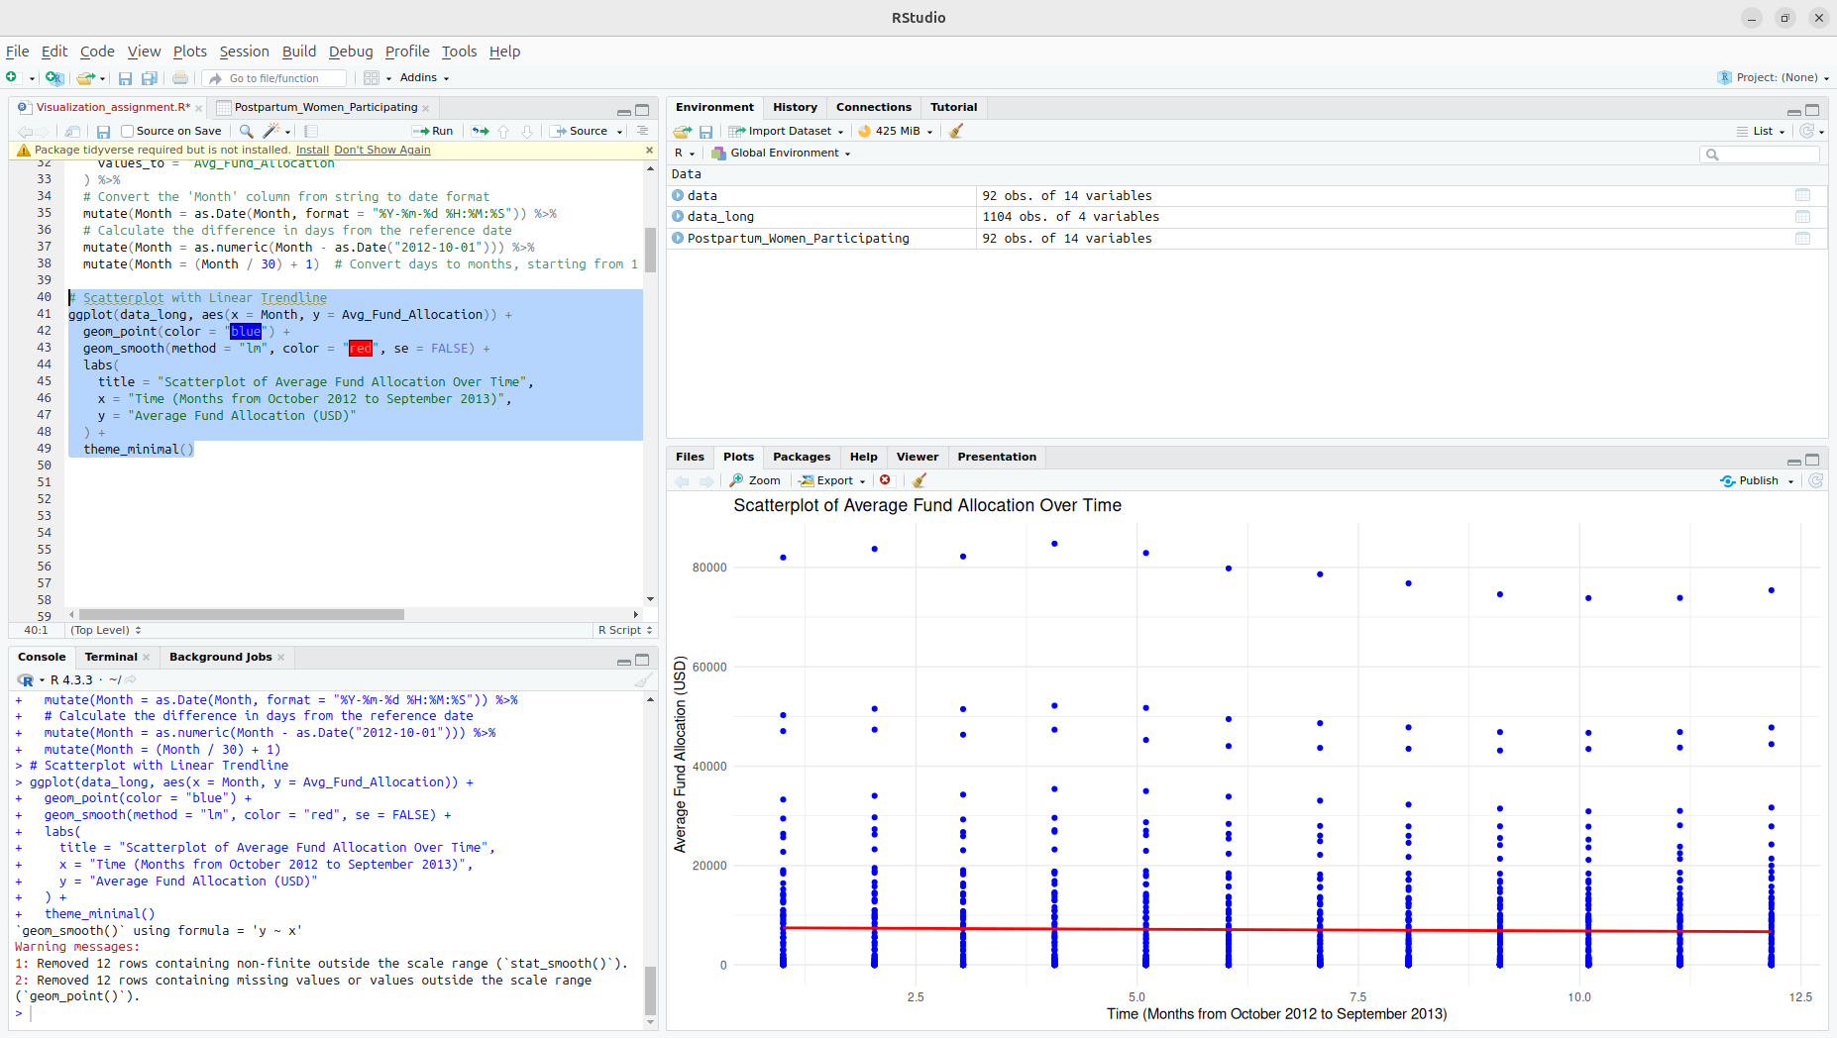
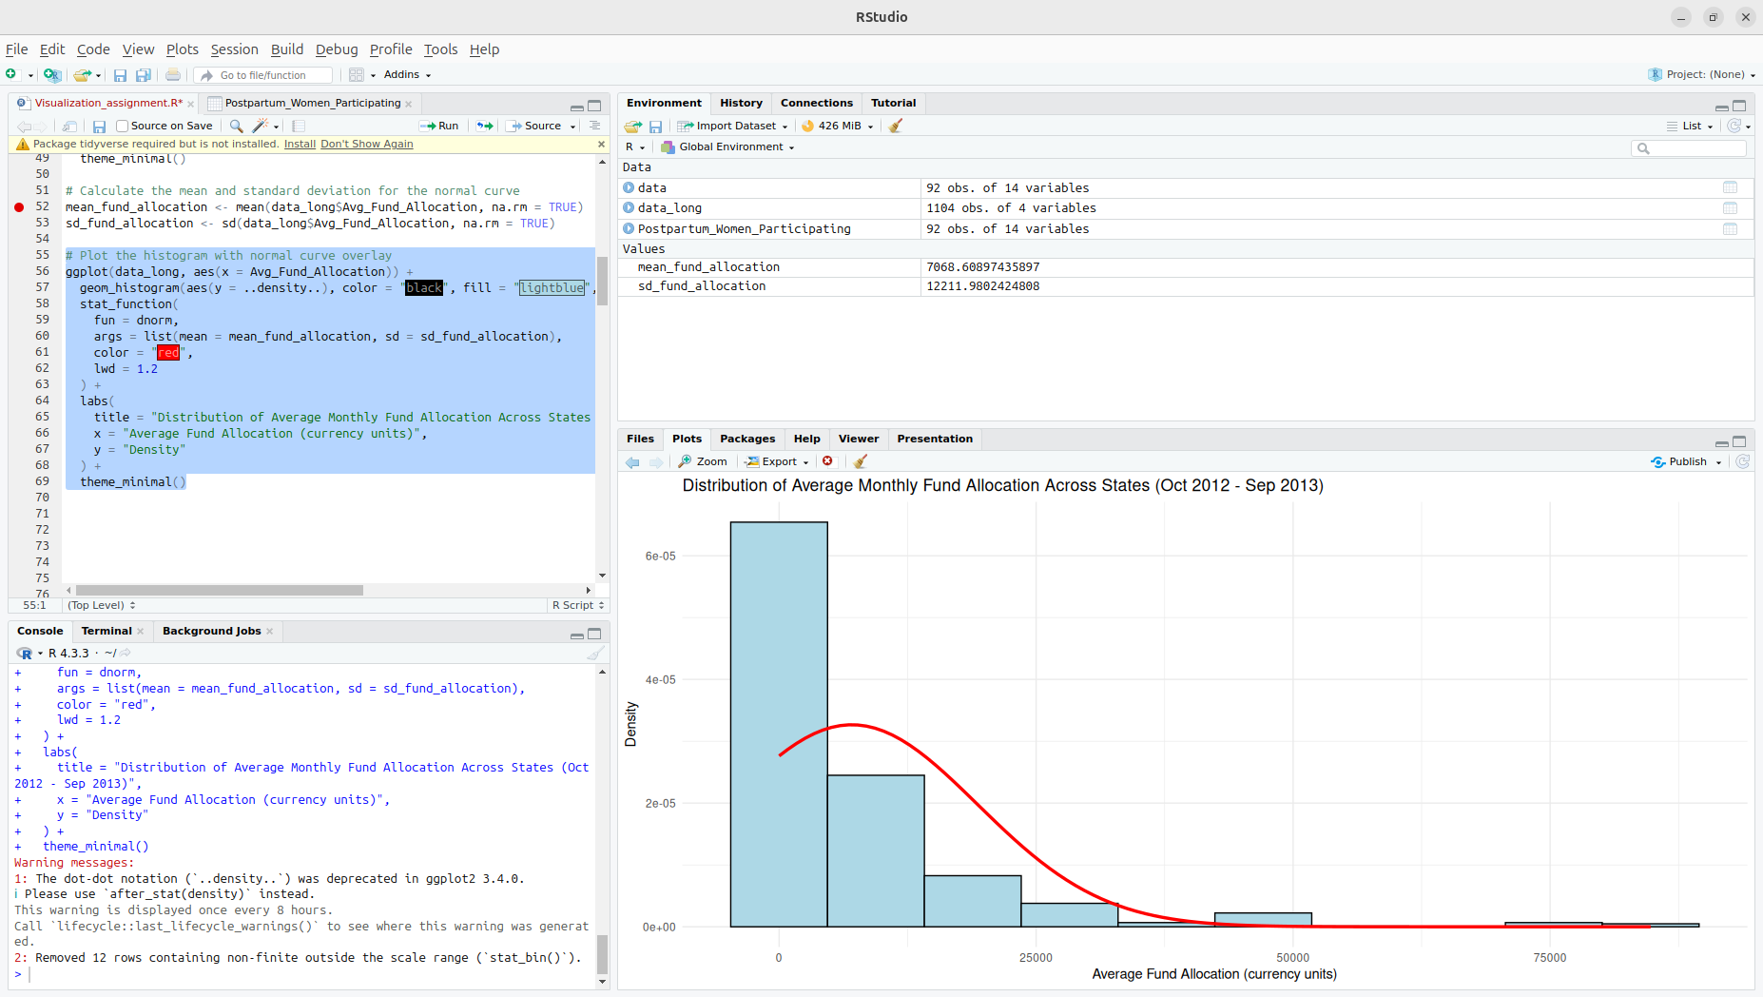

Slide 4
Here is a Histogram showing the frequencies of our dependent variable to include the normal curve overlay.
Our RQ asks about Correlation
For example:
The normal curve overlay does not follow the shape of the underlying data, so for our analysis we use the non-parametric test for correlation that does not assume normality: Spearman’s Rho
4
Notes:
4

Slide 5
R Script and Results (For ALL types of test) – The Analysis
PRE 7COM1079-2022 Student Group No: ?????
5
R-code :
spearman_result <- cor.test(data_long$Month, data_long$Avg_Fund_Allocation, method = "spearman")
Notes:
5

Slide 6
R Script and Results (For ALL types of test) – The Analysis
PRE 7COM1079-2022 Student Group No: ?????
6
Test-Statistic value = 220069524
p-value = 0.6437
The value of p-value (0.6437) is greater than 0.05, the result is not significant means there is no statistically significant correlation between the Month and Avg_Fund_Allocation.
The p-value is greater than 0.05, we fail to reject the null hypothesis.
The result Suggest that there is no monotonic relationship between the Month variable (which represents time) and the Average Fund Allocation.
Notes:
6

