Slide 1
Instructions for the Research Question Demos
You have 3 minutes to present – be ready to share your screen, practice first. We can only offer you one opportunity to present so please make the most of it.
Research Questions are dependent on the variables and datatypes you have in your chosen dataset. Before going ahead with defining your Research Question, your dataset DSXXXX must match your assigned Dataset, I.e., did you check the dataset assignment list on Slack (Announcements)? Your group number must be assigned to the dataset you are referencing here.
The next few slides give you three alternatives for how to define your research question and hypotheses. You will select only one type of research question. Before presenting DELETE all the texts that are either instructions or options you do not use (including this slide). You can then enlarge your selection.
We will send you instructions as to how to sign up. Sign up early. When the space runs out, we cannot issue any further. DO NOT SIGN UP unless you can attend. All the group members should attend but select one person to present.
We look forward to giving you feedback. You will not be graded on this presentation but if you do not attend and you booked a space you are preventing someone else presenting and are going against our module values. This will be reflected in your peer evaluation.

Slide 2

Research Question – Tutorial Presentation for Feedback Date:
Group Name: A113 Name of Student Presenting: Deepak

Slide 3
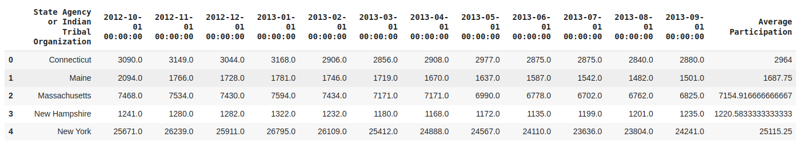
There are 93 rows in our dataset.

Slide 4
Our Research Question is
"Is there a difference in the mean of the average fund allocation (dependent interval variable) between high-funding states and low-funding states (independent nominal variable)?"

Slide 5
Null Hypothesis (H₀): "There is no difference in the mean of the average fund allocation between high-funding states and low-funding states."
Alternative Hypothesis (H₁): "There is a difference in the mean of the average fund allocation between high-funding states and low-funding states."

