Slide 1

Research Question – Tutorial Presentation for Feedback Date:
Group Name: A113 Name of Student Presenting: Deepak

Slide 2
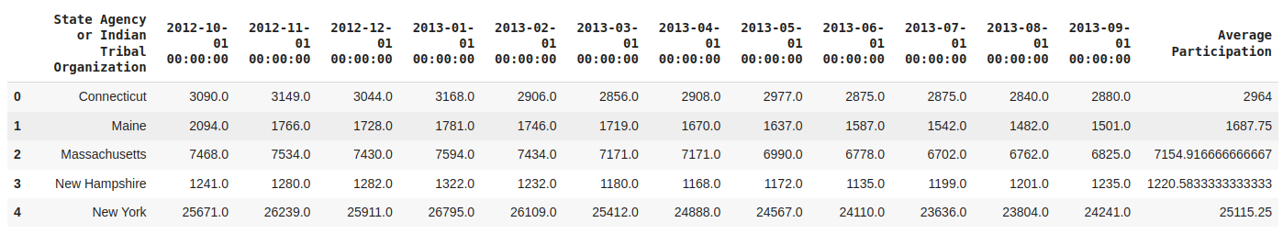
There are 92 rows in our dataset.

Slide 3
Our Research Question is
"Is there a correlation between time (Independent variable)(from October 2012 to September 2013) and the average fund (Dependent variable)allocation across states?"

Slide 4
Null Hypothesis (H₀): "There is no correlation between time (from October 2012 to September 2013) and the average fund allocation across states."
Alternative Hypothesis (H₁): "There is a correlation between time (from October 2012 to September 2013) and the average fund allocation across states."

