Slide 1

Research Question – Tutorial Presentation for Feedback Date:
Group Name: A113 Name of Student Presenting: Deepak

Slide 2
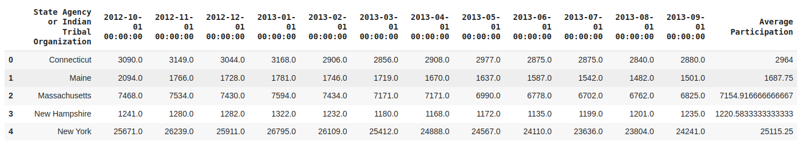
There are 93 rows in our dataset.

Slide 3
Our Research Question is
"Is there a difference in the mean of the average fund allocation(dependent interval variable) across all states (Independent Nominal variable) in time of one year from 01-10-2012 to 01-09-2013?"

Slide 4
Null Hypothesis (H₀): "There is no difference in the mean of the average fund allocation to all states between 01-10-2012 and 01-09-2013."
Alternative Hypothesis (H₁): "There is a difference in the mean of the average fund allocation to all states between 01-10-2012 and 01-09-2013."

