Slide 1

Research Question – Tutorial Presentation for Feedback Date:
Group Name: A113 Name of Student Presenting: Deepak

Slide 2
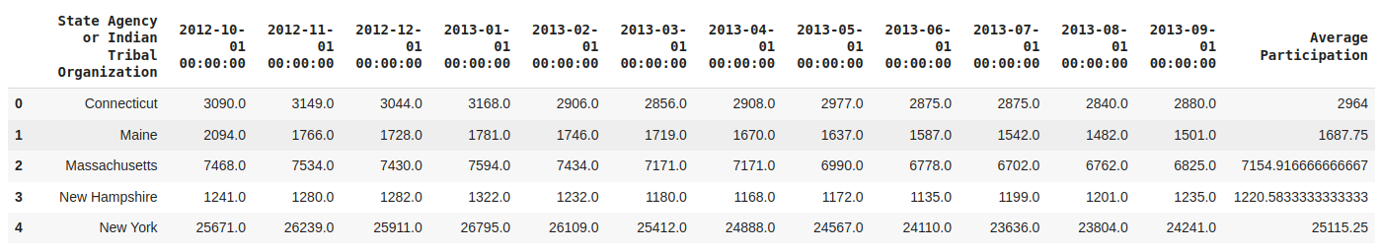
There are 92 rows in our dataset.

Slide 3
Our Research Question is
"Is there a correlation in the monthly average fund allocation to postpartum women over the period from October 2012 to September 2013 across all states?"

Slide 4
Null Hypothesis (H₀): "There is no correlation between time (October 2012 to September 2013) and the monthly average fund allocation to postpartum women."
Alternative Hypothesis (H₁): "There is a correlation between time (October 2012 to September 2013) and the monthly average fund allocation to postpartum women."

