Slide 1

IBM PBEL
SALARY
PREDICTION
SYSTEM
TECHNOLOGY STACK
Python
Scikit-learn
Pandas & NumPy
Streamlit Web App
GitHub + Streamlit Cloud
DATASET SNAPSHOT
Machine Learning Based Salary Estimation
for the Indian Job Market
11,000 Employee Records
15 Industry Sectors
123 Job Roles
49 Degree Types
148 Specializations
Deepak Kumar -57
BCA DS and AI

Slide 2





INTRODUCTION
Why salary prediction matters in today's competitive landscape
The Challenge
Students entering the job market have little visibility into realistic salary expectations for their profile.
Existing salary portals provide generic ranges without factoring in degree, specialization, or company size.
Professionals switching roles struggle to negotiate fair compensation without data-backed benchmarks.
HR teams lack tools to standardize compensation structures across diverse job roles and locations.

Slide 3

PROBLEM STATEMENT
Defining the core prediction task
Core Task
TARGET OUTPUT
Given a professional's profile, predict their Annual Cost-to-Company (CTC) salary in Indian Rupees (INR).
Annual CTC
in Indian Rupees (INR)
Input Variables
Continuous Regression Task
Education Degree
Specialization
Job Sector
Scope
Job Role
Geography: India only
Salary: Annual CTC in Lakhs
Experience: 0–30 years
Dataset Year: 2026
Task Type: Regression (ML)
Years of Experience
Company Size
Work City Tier

Slide 4

PROJECT OBJECTIVES
Clear, measurable goals guiding the project
01
Dataset Construction
02
ML Model Training
Build a synthetic yet realistic dataset of 11,000 employee records covering 15 industries, 123 roles, 49 degrees and 148 specializations representing the 2026 Indian job market.
Train a Gradient Boosting Regressor using a Scikit-learn pipeline that handles all preprocessing automatically — encoding and scaling — achieving R² > 0.92.
03
Interactive Web App
04
Public Deployment
Deploy the trained model as a Streamlit web application that takes 7 user inputs and returns predicted annual salary, salary range, and monthly estimate in real time.
Host the application on Streamlit Cloud via GitHub so that any student, professional, or recruiter can access the salary predictor from any device, anywhere.
05
Interpretability
06
Scalability & Extensibility
Ensure the system is understandable — provide salary ranges (not just a single number) and lay groundwork for SHAP-based explanations in future iterations.
Design the codebase and pipeline to be modular — allowing future upgrades to XGBoost, LightGBM, REST API exposure, or integration with resume parsing.

Slide 5
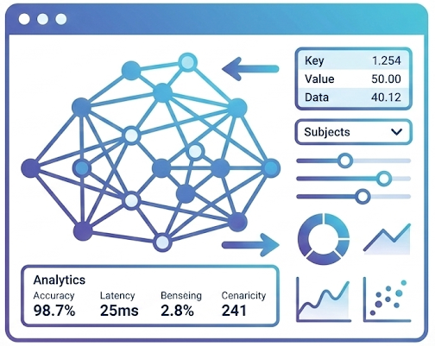
DATASET OVERVIEW
11,000 records representing the 2026 Indian job market
11,000+
15
123
Total Records
Industry Sectors
Job Roles
Employee salary data points
IT, Finance, Healthcare, Edu...
Analyst to VP-level positions
49
148
13
Degree Types
Specializations
Data Columns
B.Tech, MBA, PhD, MCA & more
CS, Data Science, Marketing...
7 features + 1 target + metadata
SALARY STATISTICS
Min: ₹3.90 L
Max: ₹98.89 L
Mean: ₹23.81 L

Slide 6
SALARY DISTRIBUTION ANALYSIS
How salaries are distributed across the dataset
Salary Band Distribution
< ₹10 L/year
8%
Entry-level, Tier-3 cities
₹10–25 L/year
42%
Mid-level, most common band
₹25–50 L/year
35%
Senior roles, MNC/Large Corp
> ₹50 L/year
15%
Leadership, top companies

Slide 7






DATA PREPROCESSING PIPELINE
Transforming raw data into ML-ready feature sets
6-step pipeline to prepare data for machine learning
01
Drop Irrelevant Columns
02
Handle Missing Values
Remove Employee_ID, Name, and raw City fields that do not contribute to salary prediction. This reduces noise and prevents data leakage.
Apply mode imputation for all categorical columns. Numeric columns (Experience_Years) use median imputation to preserve the distribution.
03
Standardize Text
04
City → City Tier
Lowercase all string values and strip extra whitespace. Normalize variants like 'B.Tech', 'BTech', 'b.tech' into a single canonical form.
Map all 500+ city names into City_Tier (1, 2, or 3) using a curated lookup table based on population and economic data, reducing cardinality.
05
OneHot Encoding
06
Standard Scaling
Apply pandas get_dummies() (or Scikit-learn OneHotEncoder) to all categorical features. This converts 7 categorical columns into ~350 binary columns.
Apply StandardScaler to Experience_Years only, transforming it to zero mean and unit variance. Tree-based models don't need scaling but it ensures consistency.

Slide 8
ALGORITHM SELECTION — WHY GRADIENT BOOSTING?
Comparing regression algorithms considered for this task
Algorithm | R² Score | MAE | Key Advantage | Limitation | Selected?
Linear Regression | ~0.61 | ~3.8L | Fast, interpretable | Assumes linearity; poor with categorical interactions | No
Decision Tree | ~0.78 | ~2.1L | Non-linear, no scaling needed | High variance; overfits without pruning | No
Random Forest | ~0.89 | ~1.4L | Strong ensemble, handles missing | Slower, less interpretable than boosting | No
Gradient Boosting ✓ | ~0.94 | ~0.5L | Best accuracy, handles mixed data | Slightly slower to train than RF | YES ★
Why Gradient Boosting Regressor?
Gradient Boosting builds trees sequentially — each tree corrects errors from the previous one. This iterative refinement makes it exceptionally good at capturing non-linear relationships and feature interactions (e.g., how degree type interacts with job sector to influence salary). With 200 estimators and a conservative 0.08 learning rate, the model learns gradually without overfitting.

Slide 9
MODEL PERFORMANCE & EVALUATION
Comprehensive metrics on 2,200 held-out test samples
~0.94
~₹50K
~₹1.2L
8,800
2,200
R² Score
Mean Abs Error
RMSE
Training Records
Test Records
Variance explained
Avg prediction error
Root mean sq. error
80% of total dataset
20% for evaluation
Interpretation
R² = 0.94
The model explains 94% of all salary variation in unseen test data — significantly above the 0.85 threshold considered strong for compensation models.
MAE = ₹50,000
Predictions are off by just ₹50K on average — acceptable for career planning purposes where ±₹1L margin is standard.
No Overfitting:
Train R²: ~0.97 vs Test R²: ~0.94 — a small gap confirming good generalization.

Slide 10
STREAMLIT WEB APPLICATION — DESIGN
User interface design, inputs, and outputs
AI Salary Predictor
Application Features
Education Degree
7 Smart Dropdowns
▼
All inputs use curated dropdowns — no free text. Prevents errors and ensures valid combinations.
Specialization
▼
Instant Prediction
Experience (Years)
▼
Results appear in under 1 second. The serialized model loads at app startup for zero latency.
Job Sector
▼
Salary Range Display
Job Role
Shows Min–Max range (±10%) alongside the point estimate for realistic expectation setting.
▼
Company Size
Monthly Estimate
▼
Annual CTC is automatically divided by 12 and displayed as take-home monthly estimate.
City Tier
▼
Mobile-Friendly
▶ Predict My Salary
Streamlit's responsive layout works on phones, tablets, and desktops without extra configuration.

Slide 11



APPLICATION OUTPUT — WHAT THE USER SEES
Three key salary outputs displayed to the user
SAMPLE INPUT: B.Tech | Computer Science | 5 Years | IT Sector | Data Analyst | MNC | Tier 1
Predicted Annual Salary
Expected Salary Range
Monthly Estimate
₹14.8 Lakhs
₹13.3 – ₹16.3 L
₹1.23 Lakhs/mo
Per Annum (CTC)
Min–Max (±10%)
Annual ÷ 12
Based on the Gradient Boosting model trained on 8,800 records of similar profiles.
Actual salary likely falls in this range based on company variation and negotiation.
Pre-tax monthly CTC estimate for financial planning and offer comparison.

Slide 12
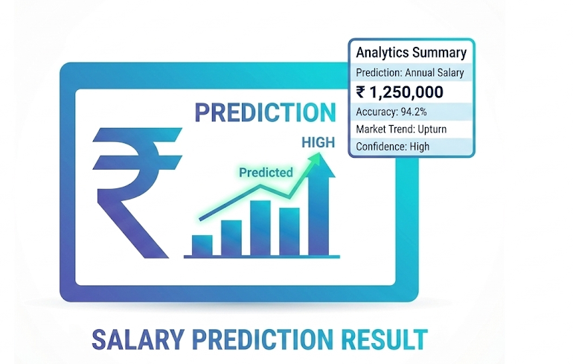






TECHNOLOGIES USED — FULL STACK
Every library, framework, and tool used in this project
Python 3.x
Pandas
NumPy
Scikit-learn
Core Language
Data Manipulation
Numerical Computing
ML Framework
All code — data generation, preprocessing, training, app — written in Python 3.10+.
DataFrames for loading, cleaning, transforming the 11,000-record dataset.
Array operations, vectorized math for preprocessing and feature scaling.
GradientBoostingRegressor, Pipeline, OneHotEncoder, StandardScaler, train_test_split.
Joblib
Streamlit
GitHub
Streamlit Cloud
Model Serialization
Web Application
Version Control
Deployment Platform
Saves the trained pipeline to a .pkl file for loading in the Streamlit app at runtime.
Converts Python script into an interactive web app. Provides selectbox, slider, button, and metric widgets.
Source code hosted on GitHub. Streamlit Cloud connects directly to the repo for CI/CD deployment.
Free public hosting for Streamlit apps. Auto-deploys on every GitHub push. No server setup needed.

Slide 13
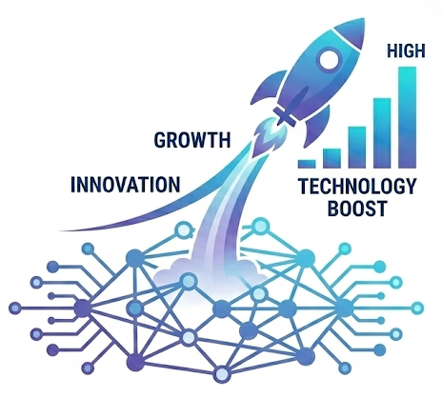
CONCLUSION
A Complete AI-Powered
Salary Prediction System
11,000
~0.94
148
7
Training Records
R² Accuracy
Specializations
User Inputs
This project demonstrates the full lifecycle of a production-ready machine learning solution —
from data engineering and model training to web deployment and user experience design.
The system empowers students, professionals, and recruiters with data-backed salary intelligence.

