Slide 1


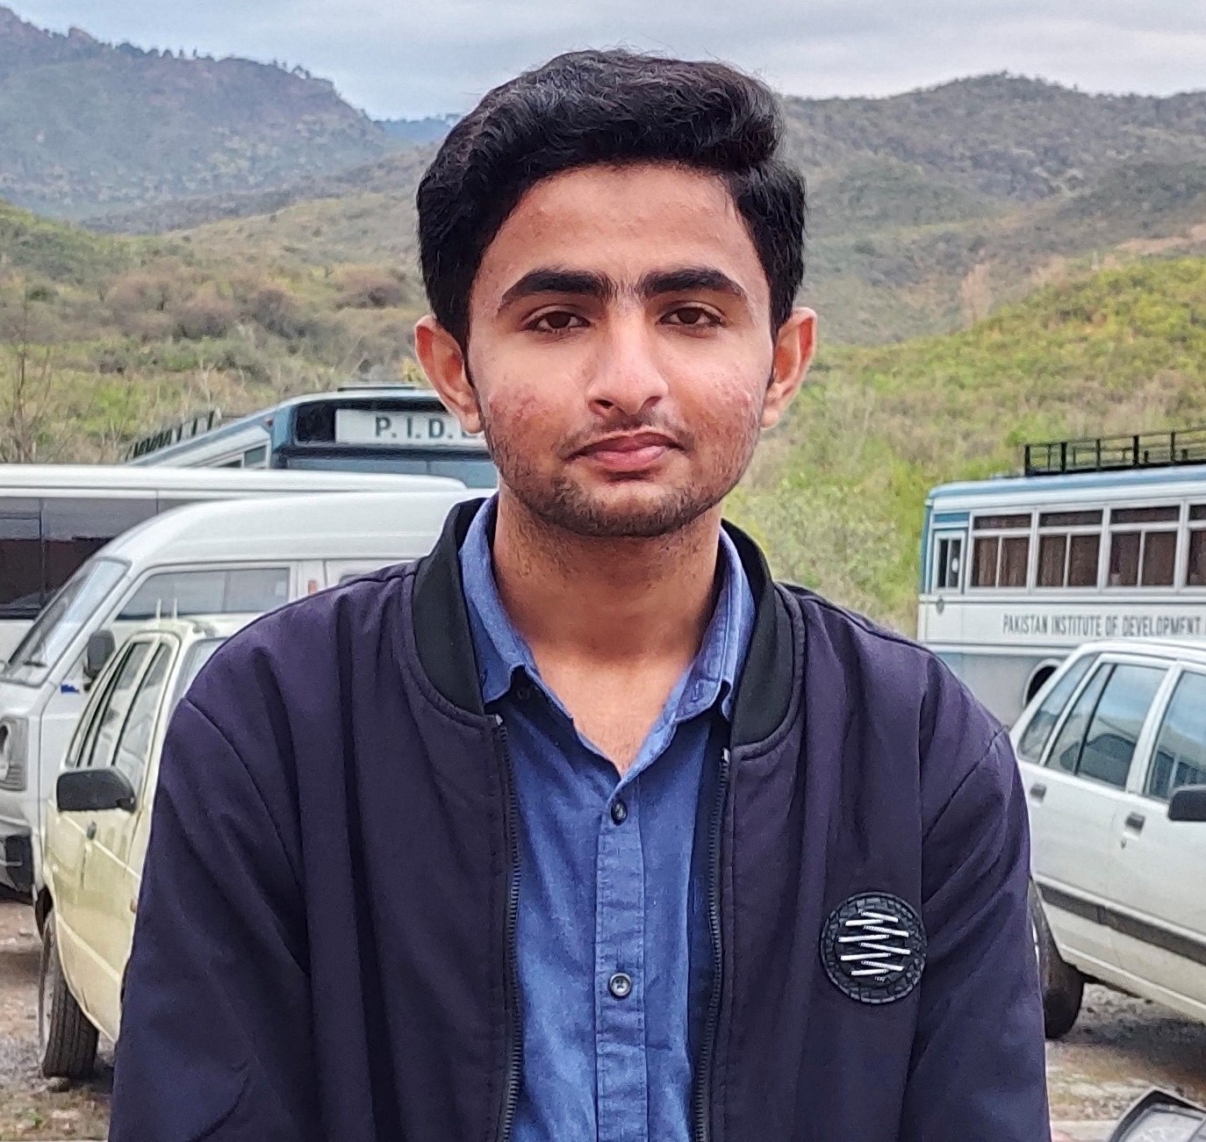
Team
Malik Rashid Ali SP21-BCS-041
M. AHMAD RAZA SP21-BCS-003
DEEPAK KUMAR SP21-BCS-017

Slide 2
Problem Statement
Huge communication gap between two people.
Global connection from strangers.
Structured directions from one person to another

Slide 3
Agenda
Friends got connected irrespective of their cultures, ethnicity and any value.
Suggestions from friends of friends.
A structured shortest path decided from one city to another.

Slide 4

DATA STRUCTURES WE USED
Array
Linked list
2D Array
Queue
Graph

Slide 5
ALGORITHMS WE USED
Searching
Matrix Sequential Search
Dijkstra’s
Graph Traversals

Slide 6
Features from our project
End on end and user to user Interaction.
User's can post anything, can see all posts of themselves and also others. User's can also like the posts of other users.
User's can also get suggestion of adding friends of friends

Slide 7
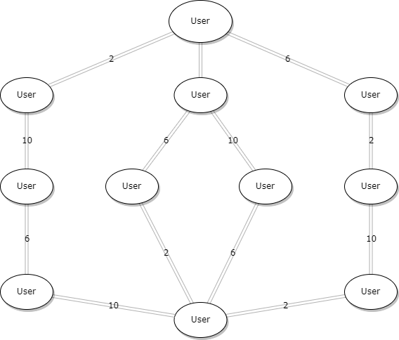
Visual Representation

Slide 8
LET’S HAVE A REAL-TIME DEMO

Slide 9

Any Question?

Slide 10




Thank you

