Slide 1
Automatic Cardiac Arrhythmia Classification Using SVM
Guide Name:
Prof. Pooja Mishra
Team Members:
BACO19178 Nikita Sonar
BBCO19174 Siddhesh Chavan
BACO19148 Ankita Thorat
BACO19174 Deepak Mustare

Slide 2
Contents
Problem Statement
Objective
Introduction
Existing System
Literature Survey
Disadvantages
Proposed Algorithm
Advantages
System Architecture
UML diagrams
System Requirements
PERFORMANCE ANALYSIS
OUTPUTS
Conclusion
FUTURE SCOPE
References

Slide 3
What is Cardiac Arrhythmia?
A heart arrhythmia (uh-rith-me-uh) is an irregular heartbeat.
Heart rhythm problems (heart arrhythmias) occur when the electrical signals that coordinate the heart's beat, don’t function properly.
Arrhythmias can be an emergency, or they could be harmless.

Slide 4
Problem Statement
Cardiac Arrythmia occurs when electrical impulses in the heart do not function properly. Many factors can affect your heart’s rhythm, such as having had a heart attack, smoking, congenital heart defects, and stress. Some substances or medicines may also cause arrhythmias.

Slide 5
Objectives
To classify different types of Cardiac arrythmia.
To prevent the chances for cardiac arrythmia to happen.
Describe the broad categories of arrhythmias.
To obtain the typical electrocardiographic features and treatment options for arrhythmias.

Slide 6
Introduction
A thorough investigation of the electrocardiogram (ECG) segment offers a structural instruction about cardiac patients, widely employed in clinical procedures for arrhythmia identification.
Usually, the ECG signs of cardiac disease do not appear within a short ECG recording period. They require a prolonged recording and monitoring of more than one day.
This lengthens and complicates cardiologists’ interpretation of ECG charts.
Thus, numerous advancements in recent years have been made to ECG signals to decrease mortality and assist cardiologists in making timely, efficient, and accurate decisions.
Early recognition of cardiac arrhythmia is critical to effective investigation and treatment.

Slide 7
Existing Systems
The existing system for classifying cardiac arrhythmias may involve manual interpretation and analysis of electrocardiogram (ECG) signals by cardiologists or healthcare professionals.
In the absence of an automated system, the existing system relies on the expertise of cardiologists or trained healthcare professionals to visually inspect and interpret ECG signals.
They analyze the waveform patterns, abnormalities, and other features to identify and classify different types of cardiac arrhythmias.

Slide 8
Literature Survey
Sr. No | Title | Author / Year of publication | Description | Methods | Drawbacks
1. | A Classifying Normal Sinus Rhythm and Cardiac Arrhythmias in ECG Signals Using Statistical Features in Temporal Domain | Mavera Mazhar, Usman Akram , Shoab A. Khan. / 2020 | Some arrhythmias including ventricular fibrillation and premature ventricular contraction can be fatal if not dealt on time. | Using a novel statistical feature set of ECG signals in time domain | The data should be homogeneous and uniform.
2. | Cardiac Propagation Pattern Mapping with Vector Field for Helping Tachyarrhythmias Diagnosis Clinical with Tridimensional Electro-Anatomical Mapping Tool | Corentin Dallet, Caroline Roney, Ruairidh Martin / 2021 | In clinics, VT and AT are diagnosed by studying activation time maps that depict the propagation of the activation wavefront on the cardiac mesh. | Locally characterize the activation wavefront propagation for clinical data. | Need high level of hardware to match the system requirement.

Slide 9
Literature Survey
Sr. No | Title | Author / Year of publication | Description | Methods | Drawback
3. | A Telemetry system for the Study of Spontaneous Cardiac Arrhythmias | Dennis L. Rollins / 2019 | To study arrhythmias in animal models, an eight-channel implantable radio telemetry system has been developed to record continuously cardiac electrograms over a period of weeks to months, with maintenance restricted to changing batteries. | Data are read into the parallel port of the computer, buffered, then transmitted over the WLAN to the laboratory network where it can be analyzed and archived. | Need real-time data and internet connection to work.
4. | Comparison of Arrhythmia Prevalence in NUVANT Mobile Cardiac Telemetry System Patients in the US and India | Jonathan M. Engel, Niranjan Chakravarthy / 2020 | Presentation of specific arrhythmia types was similar across populations except for atrial fibrillation and flutter. | Analysis of a sample of 2231 US and 1053 Indian NUVANT patients has revealed interesting statistics on the prevalence of various cardiac arrhythmias in the patient populations of the two nations | Study will not be up to date as this data will not be relevant as the time passes.

Slide 10
Disadvantages of existing systems
Time-Consuming Process: The manual analysis of ECG signals in the existing system is a time-consuming process.
Limited Scalability: The existing system may have limitations in handling a high volume of ECG data efficiently. It may not be equipped to handle the increasing demand for arrhythmia classification or real-time analysis of ECG signals.
Potential for Human Errors: Due to the manual nature of the existing system, there is a risk of human errors in the interpretation and classification of cardiac arrhythmias.
Lack of Automation: The existing system lacks automation in arrhythmia classification. This reliance on manual analysis increases the workload for healthcare professionals and may lead to inconsistencies in the diagnostic process.

Slide 11
Proposed Algorithm
SVM Algorithm:
Import the dataset. (https://www.kaggle.com/datasets/bulentesen/cardiac-arrhythmia-database)
Explore the data to figure out what they look like.
Pre-process the data.
Split the data into attributes and labels.
Divide the data into training and testing sets.
Train the SVM algorithm.
Make some predictions.

Slide 12
Advantages
Automated Diagnosis: The project provides an automated arrhythmia detection system, reducing the dependence on manual interpretation by cardiologists.
User-Friendly Interface: The integration of Tkinter GUI framework provides a user-friendly interface for interacting with the arrhythmia classification system.
Potential for Real-Time Monitoring: The project lays the foundation for potential real-time monitoring of cardiac arrhythmias.
Basis for Further Development: The project can serve as a starting point for future enhancements and research in arrhythmia classification.

Slide 13
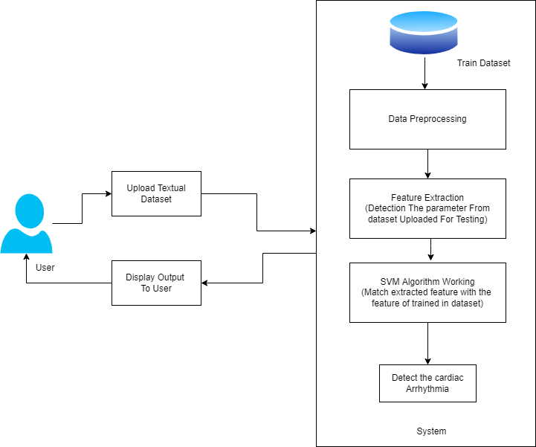
System Architecture

Slide 14
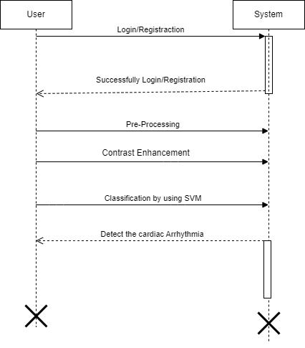
UML Diagrams
Sequence Diagram

Slide 15
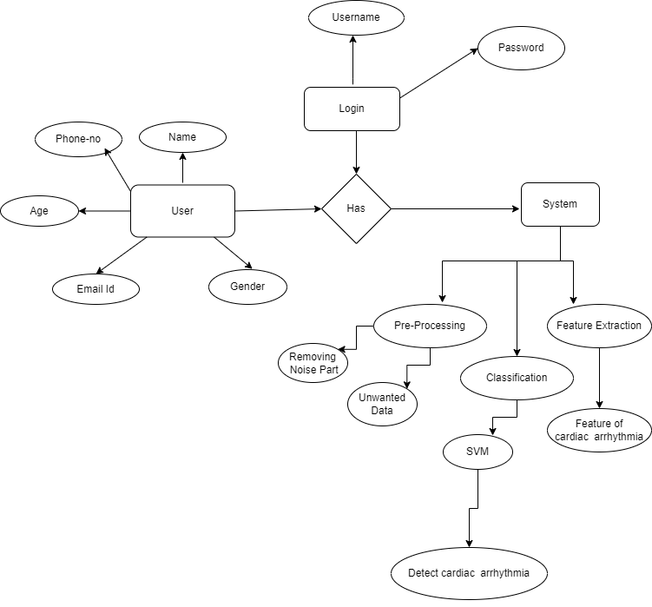
Entity-Relationship Diagram

Slide 16
System Requirements
Software Requirements:
Operating System: Windows 11
Programming Language: Python
IDE: Spyder
Framework: Tkinter
Hardware Requirements:
Processor: Intel Core i5
RAM: 8 GB or Higher
Hard Disk: 20 GB or Higher

Slide 17
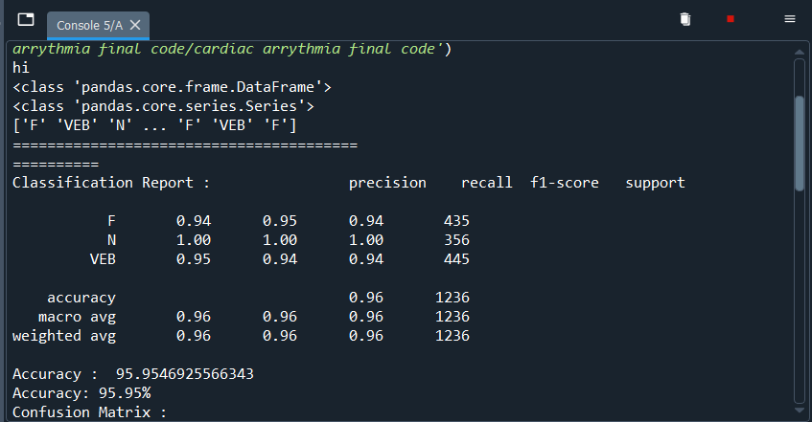
Performance Analysis
1) SVM

Slide 18
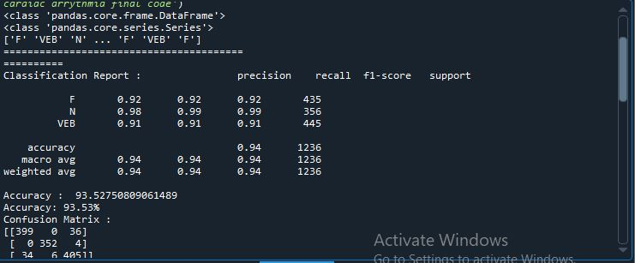
Performance Analysis
2) Naive Bayes

Slide 19


OUTPUTS

Slide 20
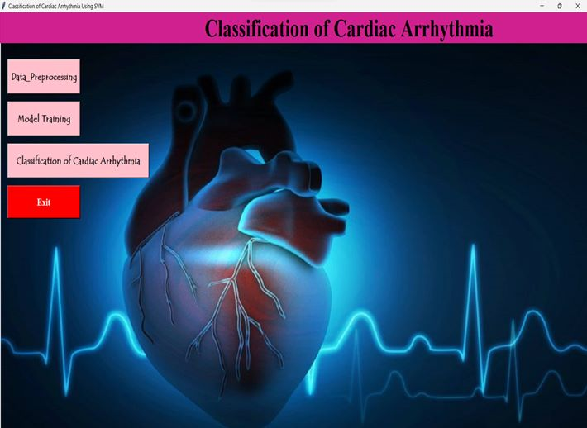


Slide 21
Conclusion
In conclusion, the project aims to develop an accurate and user-friendly system for classifying different types of cardiac arrhythmias.
By integrating a Support Vector Machine (SVM) algorithm with a Tkinter graphical user interface (GUI), the project addresses the need for efficient arrhythmia diagnosis and classification.

Slide 22
FUTURE SCOPE
Future work can involve expanding the classification system to cover a broader range of arrhythmias, including rare or atypical ones.
The proposed model can be useful for long-term ECG monitoring using single-lead wearable devices in clinical settings in the future.

Slide 23
References
Machine Learning based Cardiac Arrhythmia detection from ECG signal IEEE Xplore Part Number: CFP20P17-ART; ISBN: 978-1-7281-5821-1
ECG Arrhythmia Classification with Support Vector Machines and Genetic Algorithm, 978-0-7695-3886-0/09 $26.00 © 2009 IEEE
SVM based Methods for Arrhythmia Classification in ECG 978-1-4244-9034-/10/$26.00©2010 IEEE
Arrhythmia Discrimination Using Support Vector Machine
Machine Intelligent Diagnosis of ECG for Arrhythmia Classification Using DWT, ICA and SVM Techniques, 978-1-4673-6540-6/15/$31.00 ©2015 IEEE
Classification of Cardiac Arrhythmia using Kernelized SVM, IEEE Xplore Part Number: CFP20J32-ART; ISBN: 978-1-7281-5518-0
A. B. de Luna, P. Coumel, and J. F. Leclercq, “Ambulatory sudden cardiac death: Mechanisms of production of fatal arrhythmia on the basis of data from 157 cases,” Amer. Heart J., vol. 117, pp. 151–159, 1989. CA: Wadsworth, 1993, pp. 123–135.
J. F. Leclercq, P. Coumel, P. Maison-Blanche, B. Cauchemez, M. Zimmermann, F. Chouty, and R. Slama, “Mise en evidence des mecanismes d ´ eterminants ´ de la mort subite,” Arch Mal Coeur, vol. 79, pp. 1024–1033, 1986.

Slide 24
Thankyou!

