Slide 1

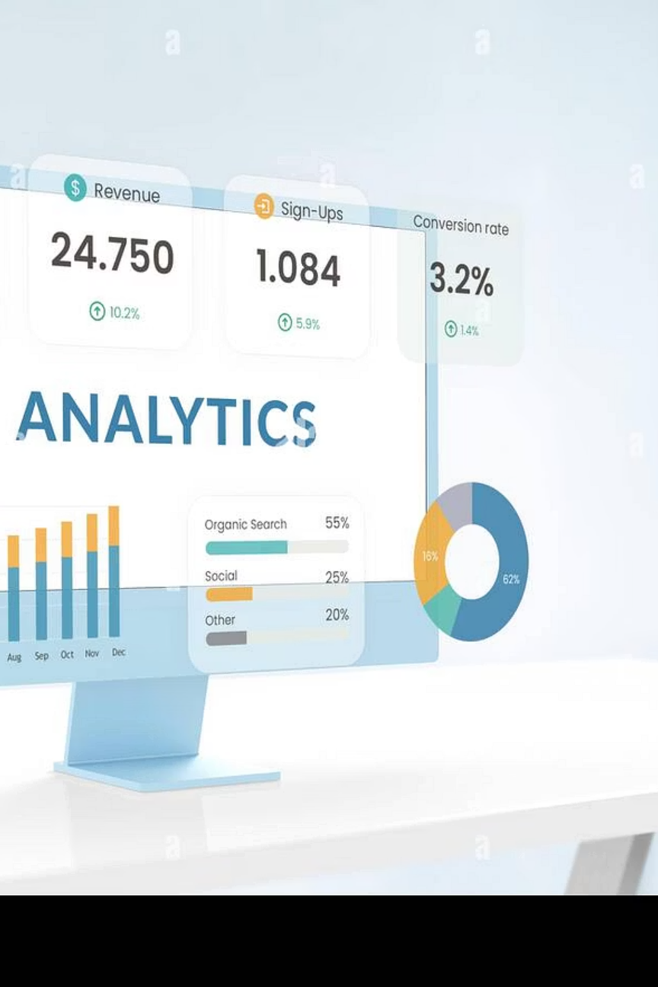

Customer Shopping Behavior Analysis
Uncovering spending patterns, customer segments, product preferences, and subscription behavior from 3,900 transactions to guide strategic business decisions.
Notes:
1

Slide 2
Dataset at a Glance
3,900
18
Transactions
Features
Rows of purchase data analyzed
Columns covering demographics, purchases & behavior
4
37
Categories
Missing Values
Clothing, Accessories, Footwear, Outerwear
In Review Rating column only
Notes:
2

Slide 3

Data Preparation in Python
01
02
Load & Explore
Clean & Engineer
Imported dataset with pandas; used df.info() and .describe() for structure review.
Imputed missing Review Ratings with category median; created age_group and purchase_frequency_days columns.
03
Standardize & Load
Renamed columns to snake_case; dropped redundant promo_code_used; loaded into PostgreSQL.
Notes:
3

Slide 4
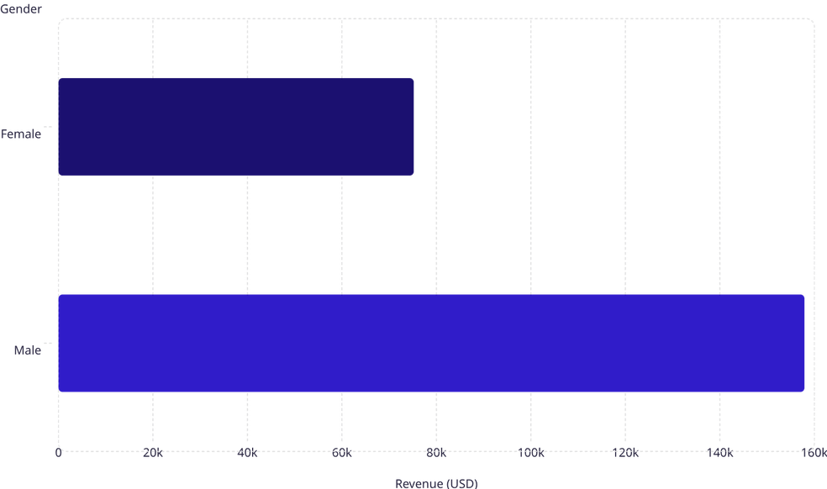

Revenue & Spending Insights
Key Findings
Male customers generated $157,890 vs. $75,191 for female customers — more than double the revenue.
Express shipping users spend slightly more ($60.48) than Standard shipping users ($58.46), suggesting a premium-buyer profile.
839 discount users still spent above average — discounts don't always reduce basket size.
Notes:
4

Slide 5
Top-Rated Products
Product
Avg. Rating
Discount-Dependent Products
These items had the highest share of discounted purchases:
Gloves
3.86
Sandals
3.84
Product
Discount Rate
Boots
3.82
Hat
50.00%
Hat
3.80
Sneakers
49.66%
Skirt
3.78
Coat
49.07%
Sweater
48.17%
Pants
47.37%
Notes:
5

Slide 6


Customer Segmentation
Segment Breakdown
The vast majority of customers (3,116 / 80%) are classified as Loyal, with 701 Returning and only 83 New customers.
Loyal·79.9%
Among repeat buyers (>5 purchases), 958 subscribe vs. 2,518 who don't — a significant conversion opportunity.
·79.9%
·
Returning·17.97%
·17.97%
·
New·2.13%
·2.13%
·
Subscribers average $59.49 spend vs. $59.87 for non-subscribers — nearly identical, suggesting loyalty isn't driven by spend alone.
Notes:
6

Slide 7
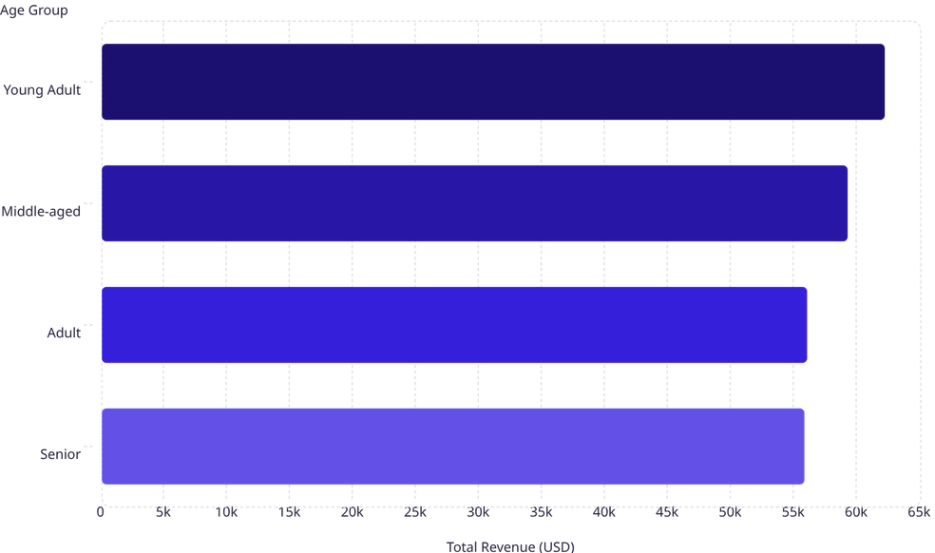
Revenue by Age Group
Age-Driven Spending
62.1k
Young Adults lead revenue at $62,143, followed closely by Middle-aged at $59,197.
59.2k
Revenue is relatively balanced across all age groups, with a spread of only ~$6,400 from top to bottom — indicating broad demographic appeal.
56k
55.8k
Notes:
7

Slide 8
Top Products by Category
👗 Clothing
💍 Accessories
Blouse — 171 orders
Pants — 171 orders
Shirt — 169 orders
Jewelry — 171 orders
Sunglasses — 161 orders
Belt — 161 orders
👟 Footwear
🧥 Outerwear
Sandals — 160 orders
Shoes — 150 orders
Sneakers — 145 orders
Jacket — 163 orders
Coat — 161 orders
Notes:
8

Slide 9
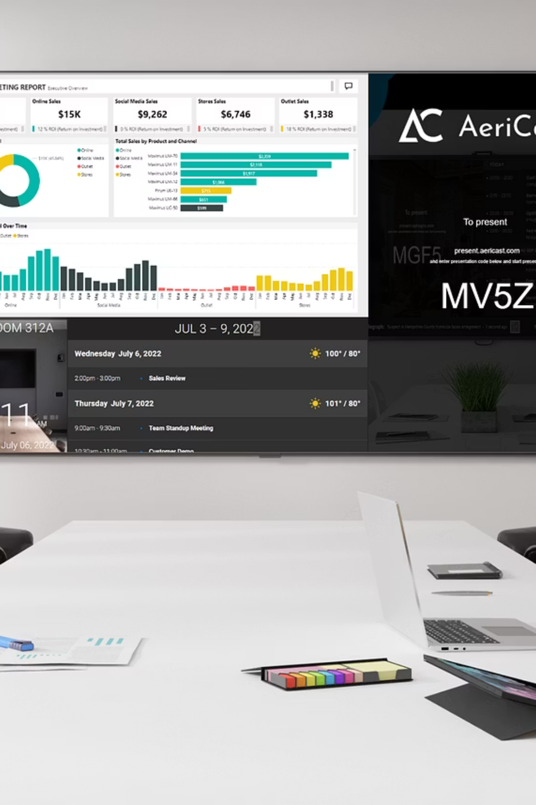
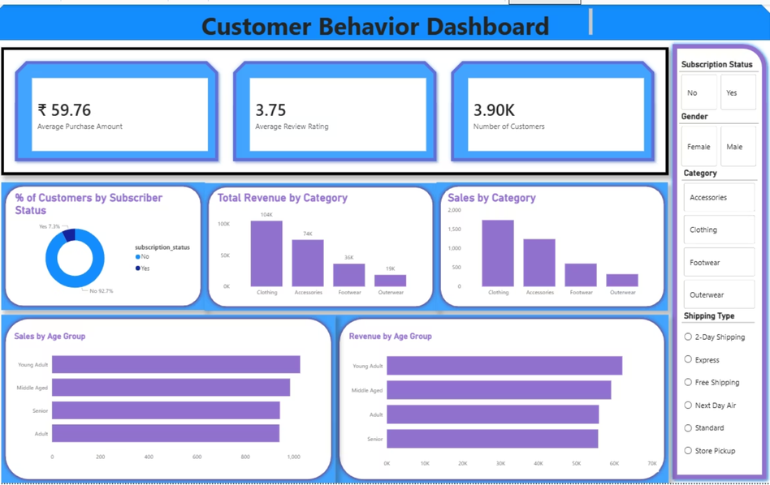
Power BI Dashboard
3.9K
Customers
$59.76
Avg. Purchase
3.75
Avg. Rating
27% / 73%
Subscribers vs. Non
Notes:
9

Slide 10
Business Recommendations
Boost Subscriptions
Loyalty Programs
Review Discount Policy
Promote exclusive benefits to convert the 73% non-subscriber base.
Reward repeat buyers to retain and grow the Loyal segment.
Balance promotional discounts with margin control — especially for Hat, Sneakers, and Coat.
Product Positioning
Targeted Marketing
Highlight top-rated (Gloves, Sandals) and best-selling items in campaigns.
Focus on Young Adults and Express-shipping users — the highest-revenue segments.
Notes:
10

