Slide 1
University College Of Engineering Nagercoil
By
Deepakraj G
Reg No: 962821104026
Id: au962821104026
E-Mail:deepakraj2672004@gmail.com Final Project

Slide 2
PROJECT TITLE
STOCK PRICE PREDICTION USING LSTM NEURAL NETWORKS MARKET

Slide 3


AGENDA
1. PROBLEM STATEMENT
2. PROJECT OVERVIEW
3. END USERS
4. MY SOLUTION
5. MODELLING
6. RESULTS
7. CONCLUSION CONCLUSION
3/21/2024 Annual Review

Slide 4

PROBLEM STATEMENT
The stock market is characterized by its inherent volatility and complexity, making accurate predictions of stock prices a challenging task.​
However, with the advent of advanced machine learning algorithms like Long Short-Term Memory (LSTM), there is an opportunity to develop predictive models that can capture the temporal dependencies and nonlinear relationships within stock price data.
3/21/2024 Annual Reiew

Slide 5

PROJECT OVERVIEW
The Intelligent Stock Market Analysis System is a comprehensive project aimed at providing investors and traders with powerful tools for analyzing and​
interpreting stock market data.​​
Leveraging cutting-edge technologies such as machine learning and natural language processing, this system offers advanced features to facilitate informed decision-making in the dynamic world​
of stock trading.​​

Slide 6
THE END USERS:
1.Investors​
2.Traders​
3.Financial Analysts​
4.Brokers
3/21/2024 Annual Review

Slide 7

INTRODUCTION TO LSTM NEURAL NETWORKS
LSTM stands for Long Short-Term Memory, a type of recurrent neural network (RNN) architecture.
Developed to address the vanishing gradient problem in traditional RNNs, which hinders learning long-term dependencies.
Key Components of LSTM
Input Gate: Controls the flow of information into the cell.
Forget Gate: Modulates the retention of information from the previous cell state.
Cell State: Carries information over time and is regulated by gates.
Output Gate: Controls the information flow from the cell to the output.

Slide 8
Application Of LSTM
Stock Price Prediction: Forecasting future stock prices based on historical data.
Natural Language Processing: Generating coherent text and understanding context in language models.
Speech Recognition: Transcribing speech into text with improved accuracy.
Limitations and Challenges
Complexity: LSTM models can be computationally expensive to train and deploy.
Overfitting: Prone to overfitting, especially with small datasets.
Interpretability: Understanding the inner workings of LSTM models can be challenging.

Slide 9

SOLUTION:
Data Collection and Preprocessing​
Feature Engineering​
Model Building​
Model Training​
Model Evaluation.​
Fine-Tuning and Optimization​
Deployment and Monitoring​
Risk Management​
Documentation and Reporting​
Continuous Improvement
3/21/2024 Annual Review

Slide 10
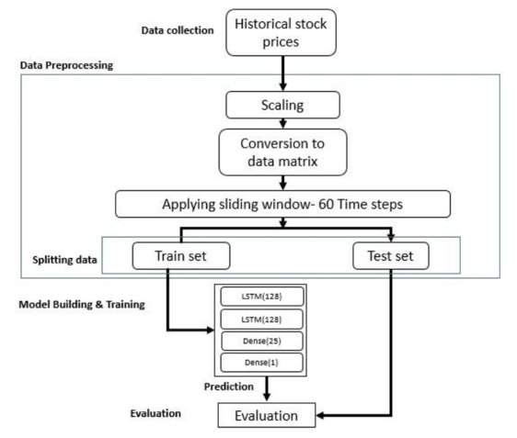
MODELLING
Data Collection and Preprocessing​
Feature Selection and Engineering​​
Data Sequencing​ Model Architecture​ ​
Compile the Model​​
Model Training​ ​
Model Evaluation​ ​
Hyperparameter ​
Tuning​ Prediction​
​ Iterative Improvement

Slide 11
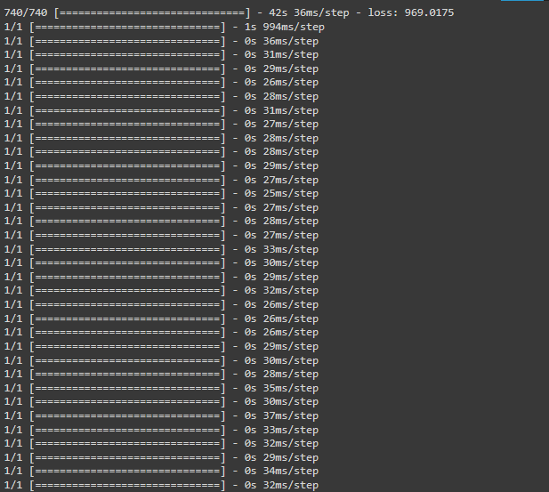
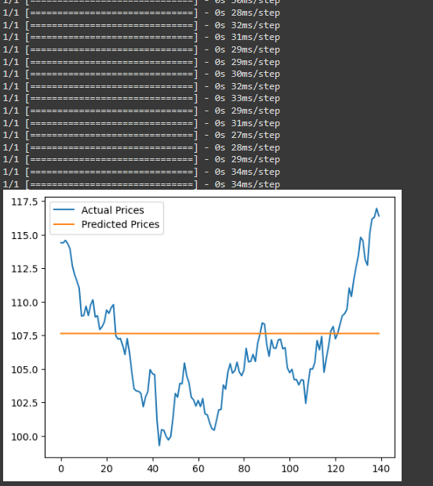
RESULTS
Demo Link
3/21/2024 Annual Review

Slide 12
Conclusion
In the dynamic realm of stock trading, LSTM neural networks shine as potent tools for predicting future price movements. Our journey through developing an LSTM model showcased its prowess in capturing intricate patterns within historical data, offering insights crucial for informed decision-making.​
While the road to accurate predictions is paved with challenges like overfitting and data scarcity, LSTM's ability to discern long-term dependencies empowers traders to navigate market fluctuations with confidence.​
Though not a crystal ball, LSTM models stand as invaluable allies in the quest for profitable trades.​

Slide 13
THANK YOU

