Slide 1





GOVERNMENT COLLEGE OF ENGINEERING,SALEM _ 636 011
“A massive industry relevant skill enhancement initiative for the youth of Tamil Nadu.”
An Autonomous Institution , Affiliated to Anna University Chennai,
Approved by AICTE, Accredited by NAAC

Slide 2




A Full Stack project report on ONLINE SHOPPING
APPLICATION
Submitted by
DEEPAK RAJAN K [2021006]
MOHANKUMAR G [2021021]
SURYA R [2021042]
DEEPAK RAJAN K [2021006]
MOHANKUMAR G [2021021]
SURYA R [2021042]

Slide 3

OBJECTIVE
To shop wile in the comfort of your own home, without having to step out of the door.
Sell at lower rate due to less over head.
Provide home delivery free of cost.
Secured Transaction.

Slide 4
SOFTWARE REQUIREMENT
Visual Studio Code
Node JS
Angular

Slide 5
PROJECT DESIGN
● RELIABILITY :
- Error avoidance
- Error detection and correction
- Error tolerance
● MAINTENANCE

Slide 6
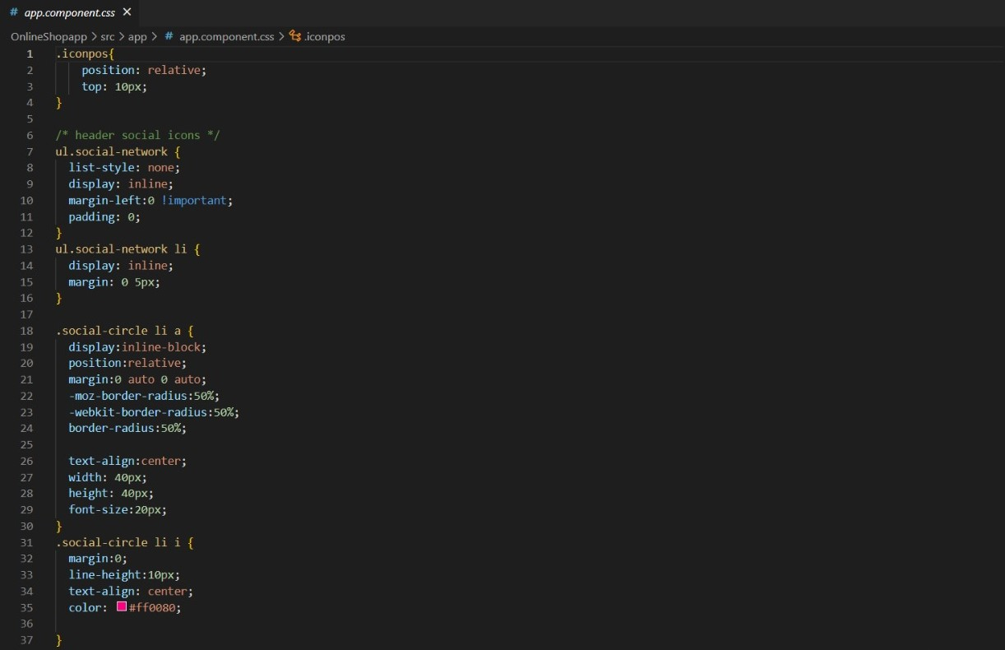
CODE SNIPPET:

Slide 7
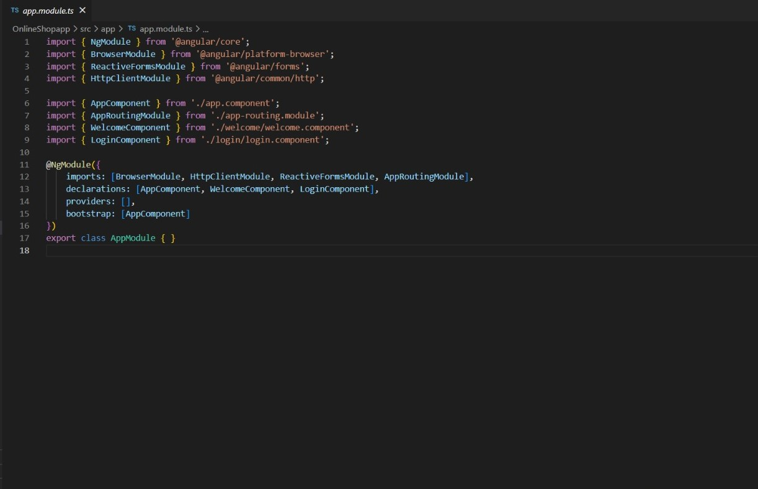

Slide 8
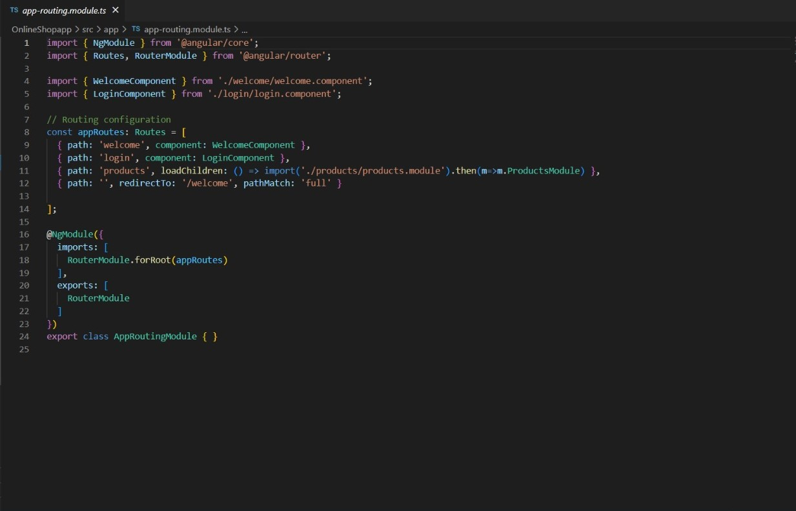

Slide 9
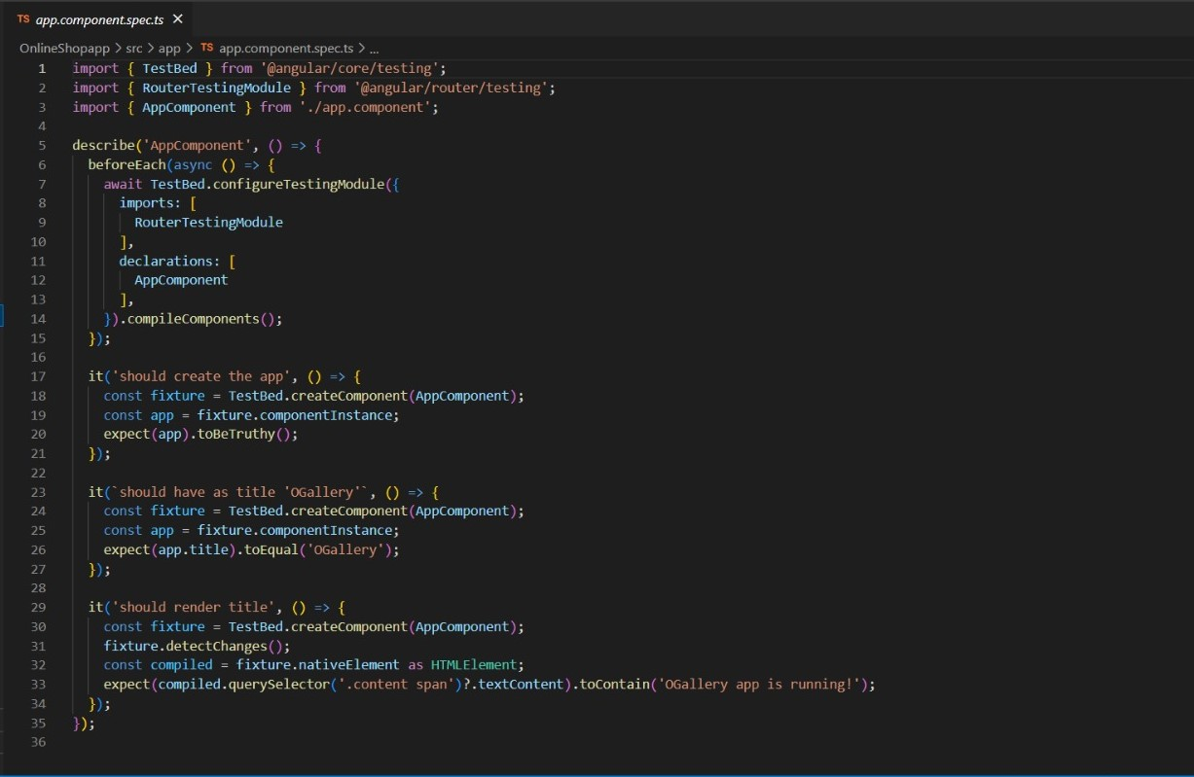

Slide 10
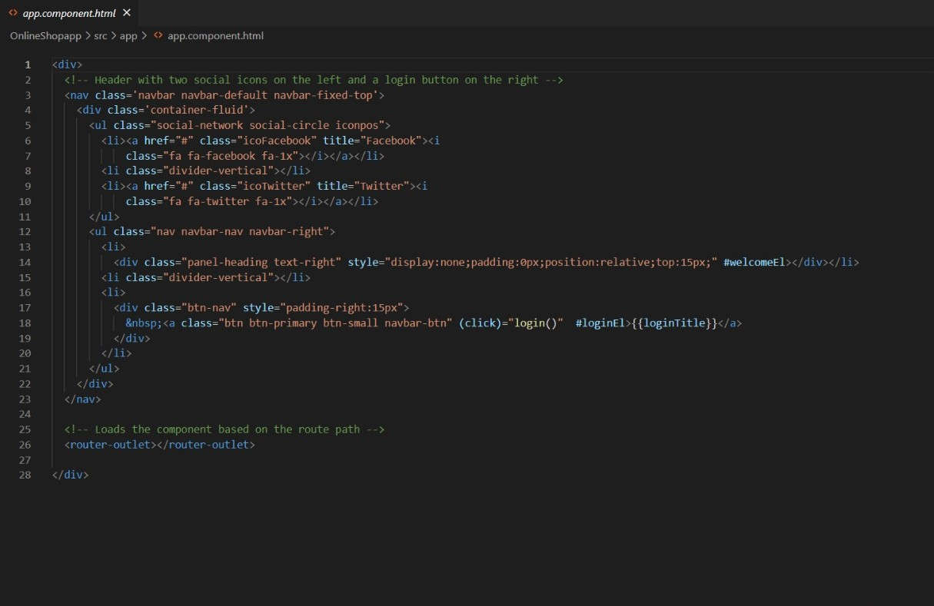

Slide 11
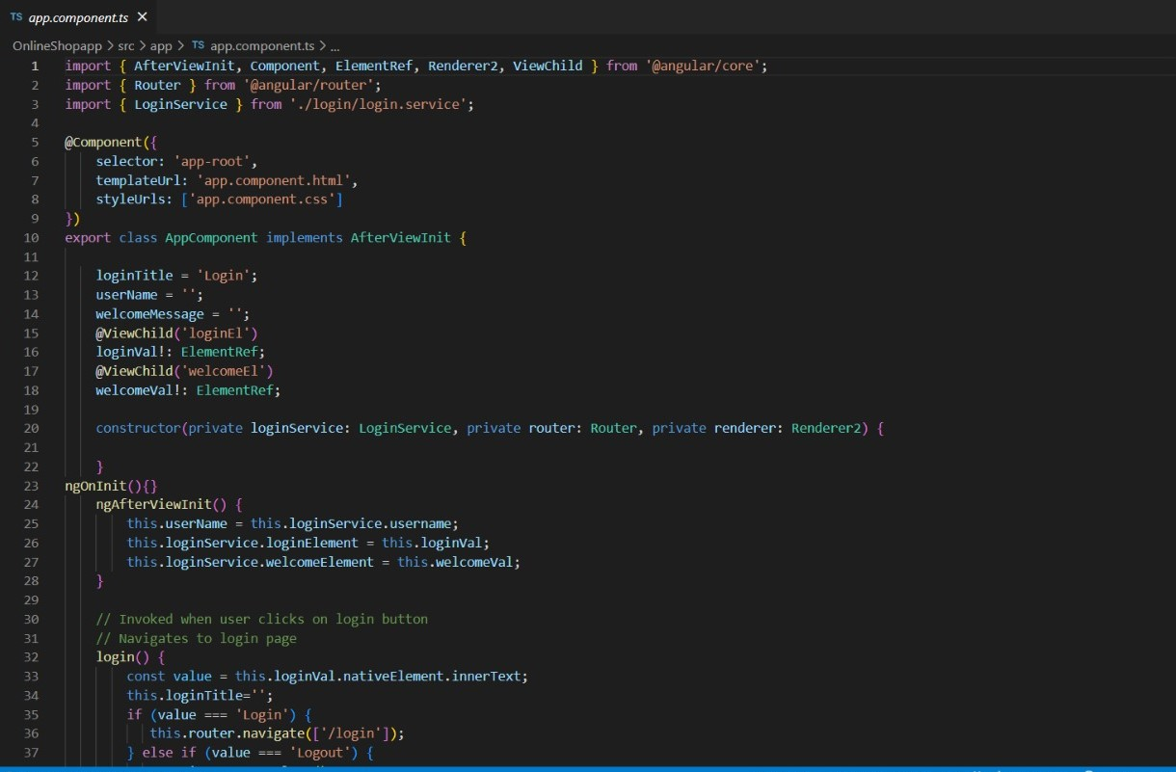

Slide 12
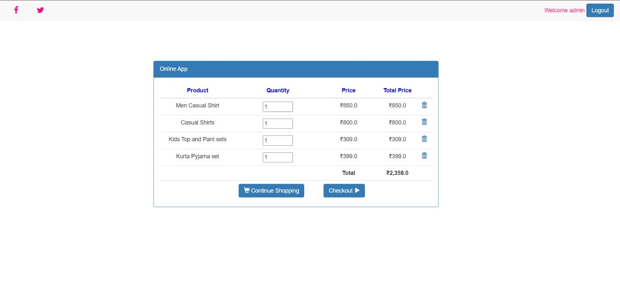
OUTPUT

Slide 13
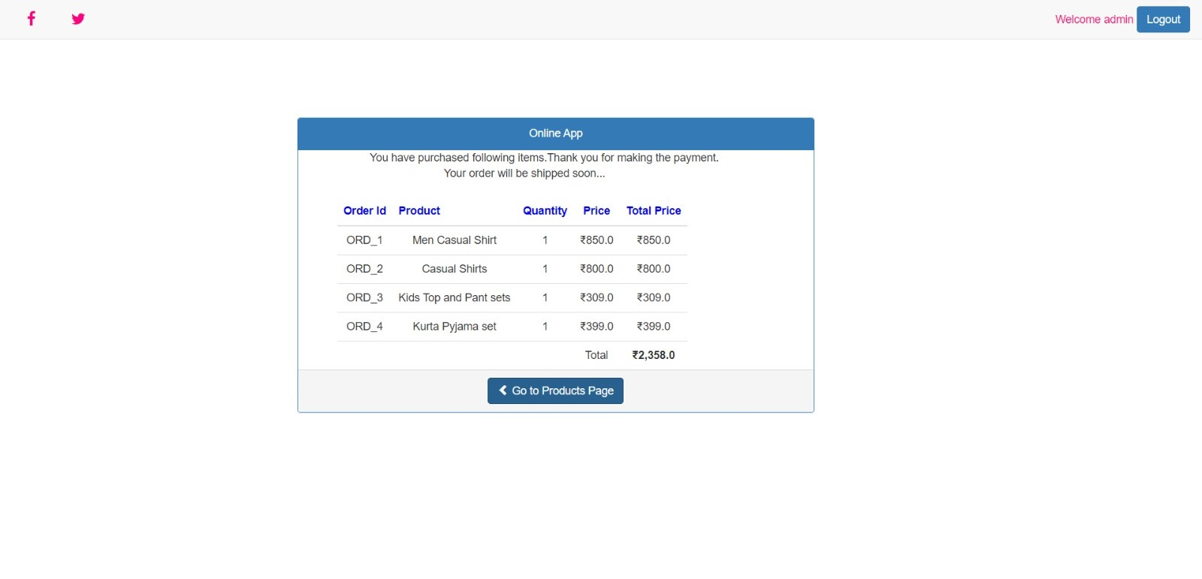

Slide 14
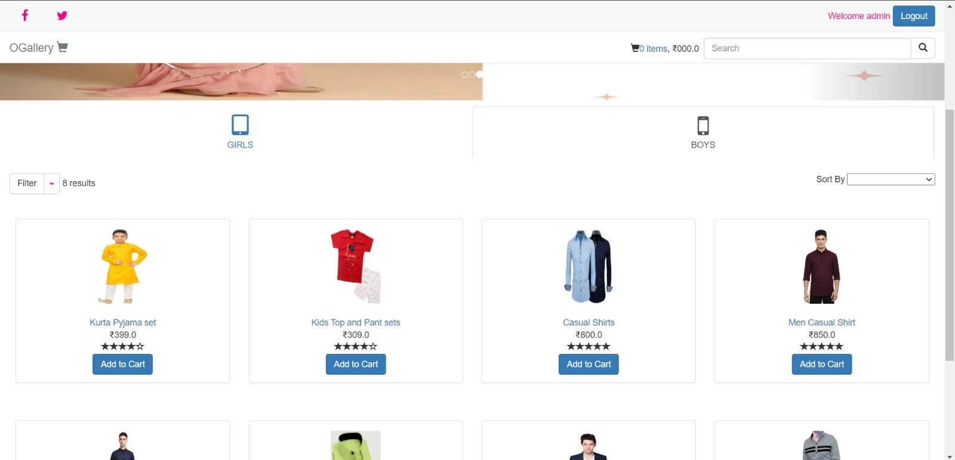

Slide 15
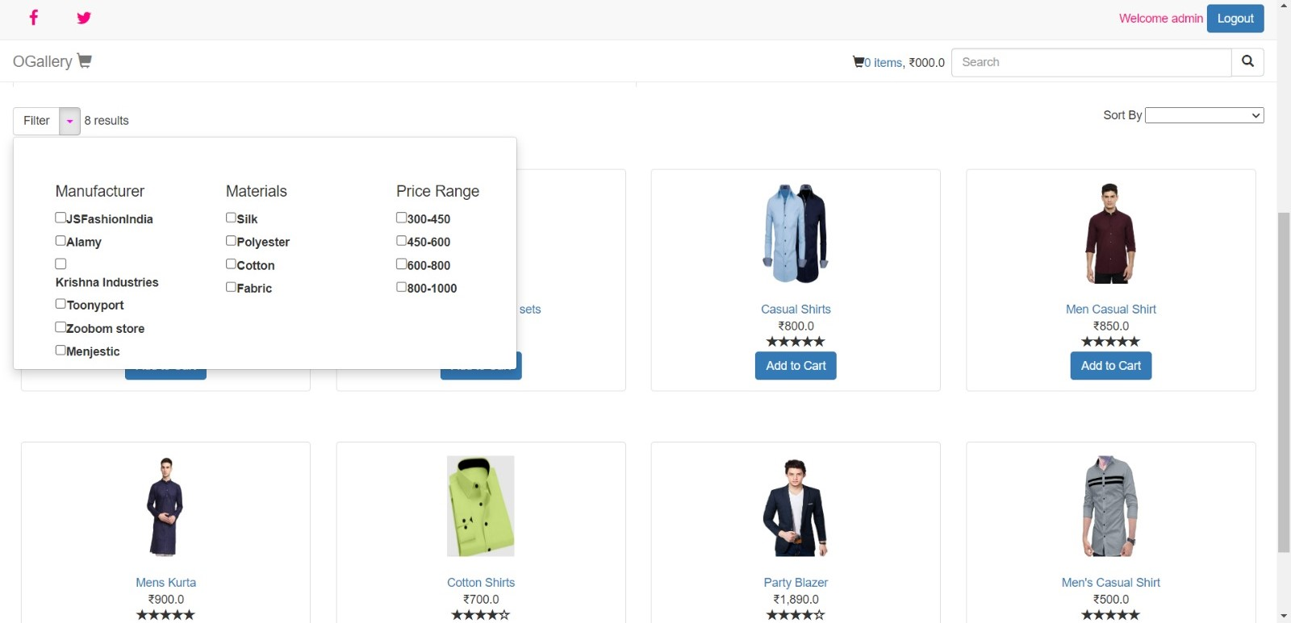

Slide 16
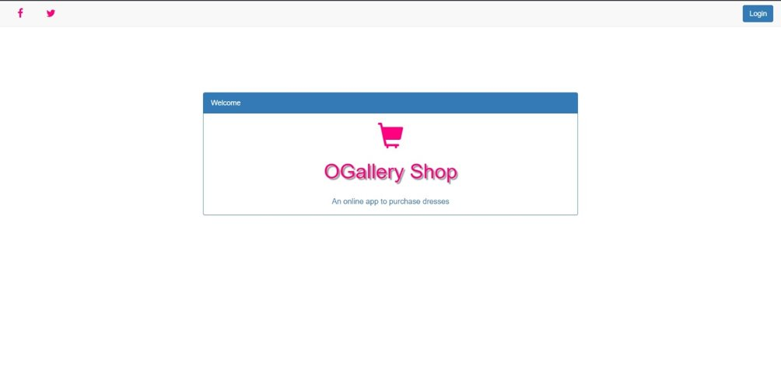

Slide 17
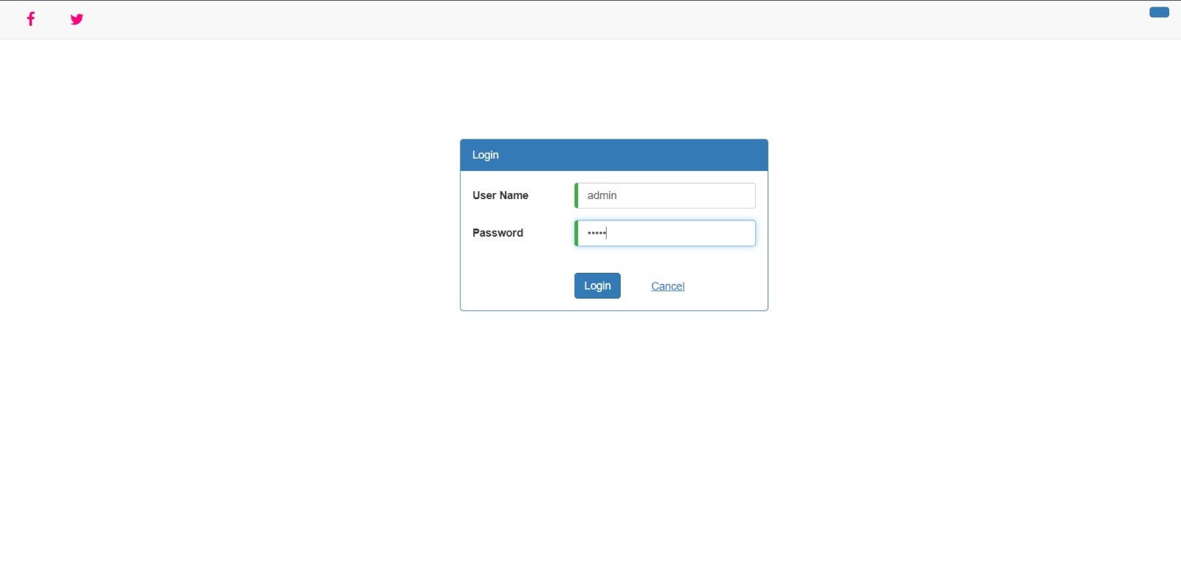

Slide 18
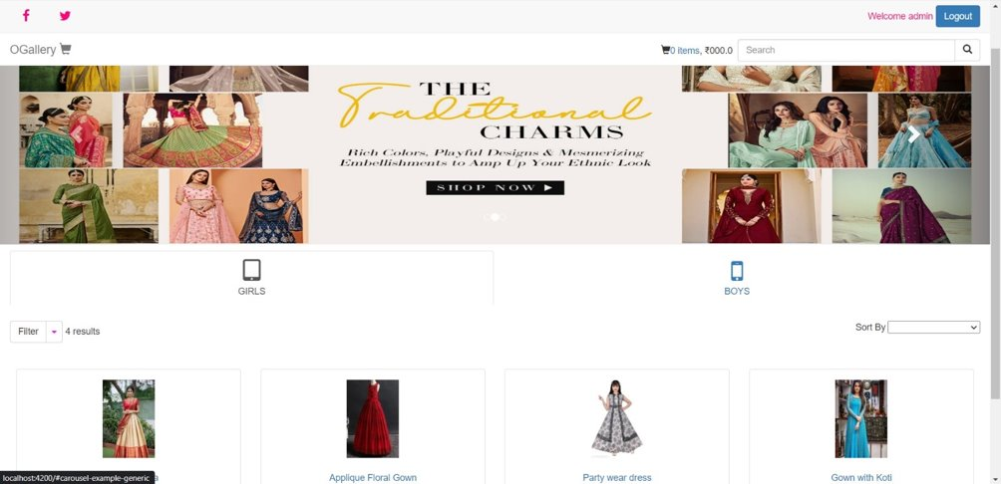

Slide 19


CONCLUSION :
● Angular - Capable and beneficial to front-end
development.
● Angular JS - Simplicity
● Angular technology - Single page web application,
Comprehensive tools
MVC architecture.

