Slide 1
ADTA 5550 Final Project

Slide 2
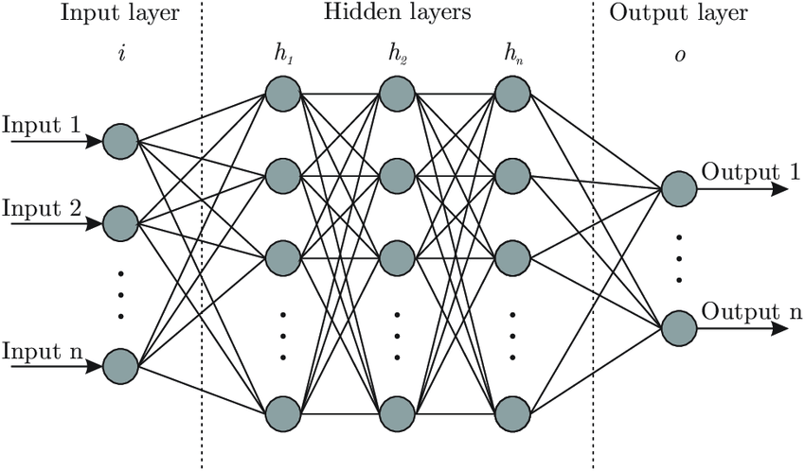
Deep Learning?
Deep Learning is a subfield of machine learning concerned with algorithms inspired by the structure and function of the brain called artificial neural networks.

Slide 3



Where to find Datasets for DL?
There are many platforms that provide datasets for Deep learning algorithms. Some of them are Dataset search, Kaggle and Github.
There are also few datasets provided by Python libraries.
For Examples, MNIST dataset can be imported onto the working notebook through TensorFlow library.

Slide 4
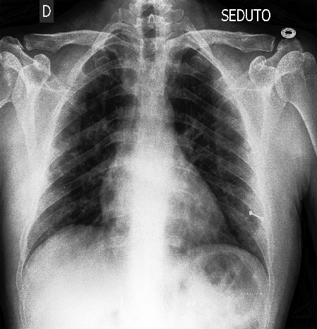
Interesting Sample Data explored for DL
Name of the dataset- ‘Covid-19 Image dataset’
The data contains 137 cleaned images of COVID-19 and 317 in total containing viral pneumonia and normal chest X-rays structured into the test and train directories.
The data has been retrieved form Kaggle platform.
The dataset is being maintained by author named ‘Pranav Raikote’. Below is the link to the data.
https://www.kaggle.com/pranavraikokte/covid19-image-dataset#
Nearly 238 images are in JPEG (Joint Photographic Expert Group), 68 images are in JPG format and 11 images are in PNG (Portable network graphics) format.
All the diseases effect the lungs; hence it becomes easy to detect it using an X-ray scanned at chest region. A deep learning model trained with these images helps us in easy detection of the disease.

Slide 5
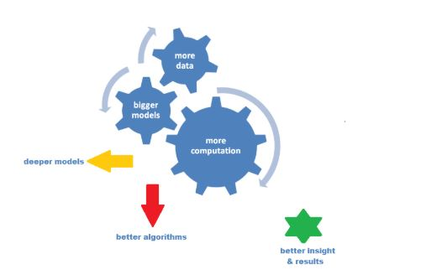
Deep Learning Architectures?
Multilayer Perceptron Neural Network (MLPNN)
Backpropagation
Convolutional Neural Network (CNN)
Recurrent Neural Network (RNN)
Long Short-Term Memory (LSTM)
Generative Adversarial Network (GAN)
Restricted Boltzmann Machine (RBM)
Deep Belief Network (DBN)

Slide 6
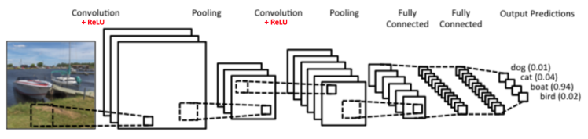
Convolutional Neural Network
Convolutional Neural Networks (ConvNets or CNNs) are a category of Neural Networks that have proven very effective in areas such as image recognition and classification.
ConvNets have been successful in identifying faces, objects and traffic signs apart from powering vision in robots and self driving cars.

Slide 7
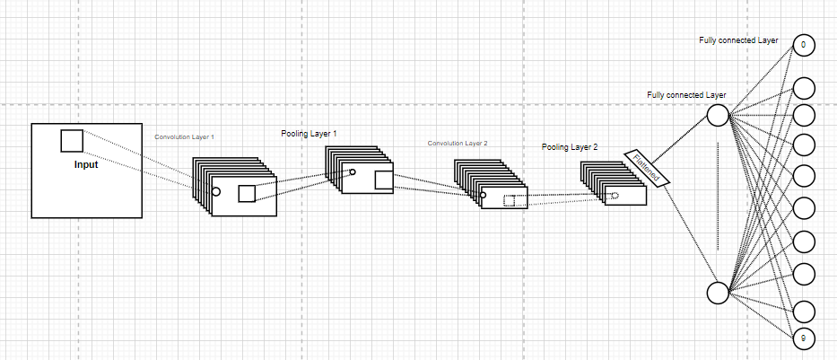
Model with 2 CNN Layers
Here first convolution layer has been built using ReLU as activation function.
Created first pooling layer that works along with convolution layer.
Above steps are repeated, making 2 convolution and 2 pooling layers in total.
Flattening layer has been created to reshape output data from pooling layer 2.
Created a fully connected layer that accepts output from flattening layer.
Above step is repeated to add few more fully connected layers.
A dropout layer has been created to drop some of the inputs the model received.
A fully connected final output layer is created that accepts the outputs from dropout layer as its inputs. This layer gives us the final output.
Loss function is created to compute SoftMax cross entropy between the labels and the predicted outputs.
An optimizer is created to optimize the network. An AI trainer is created to train the network.

Slide 8
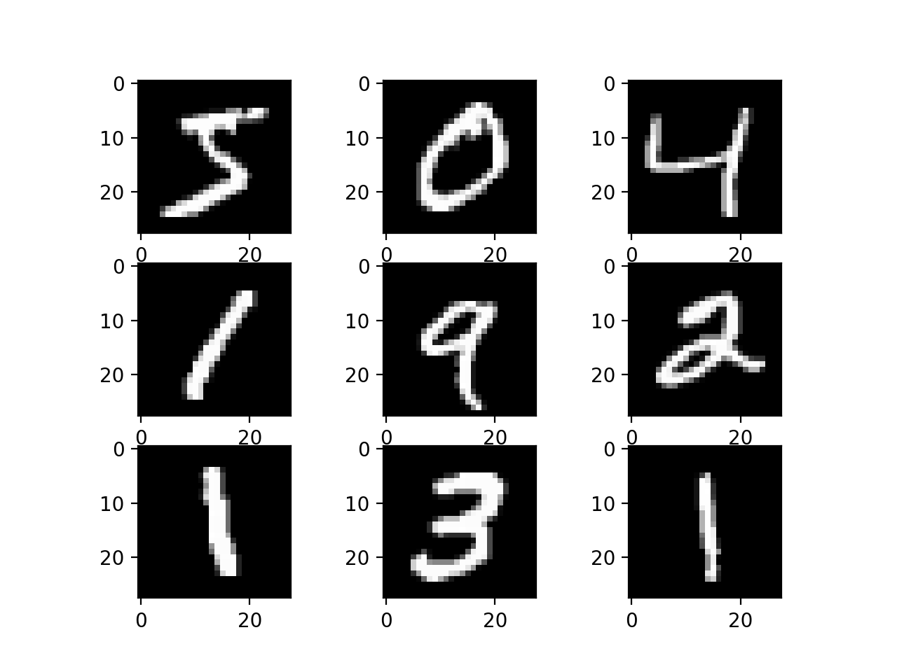
MNIST dataset
MNIST dataset has retrieved from TensorFlow library.
MNIST is a handwritten digits’ dataset which consists of 60,000 images, including 50,000 training images and 10,000 test images. The input images are of size 28*28.

Slide 9
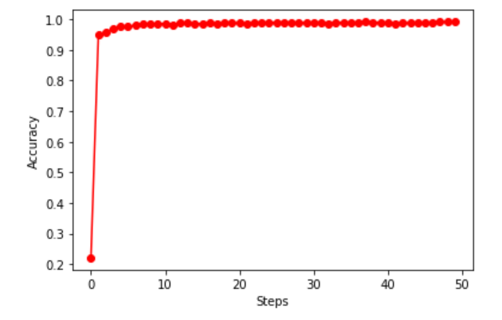
Results of 2 Layered CNN on MNIST
Accuracy of 99.16 % is achieved.
Total number of steps are 5000.
On each step the model is trained with 50 images.
The accuracies are calculated by testing on every 100th step.

Slide 10
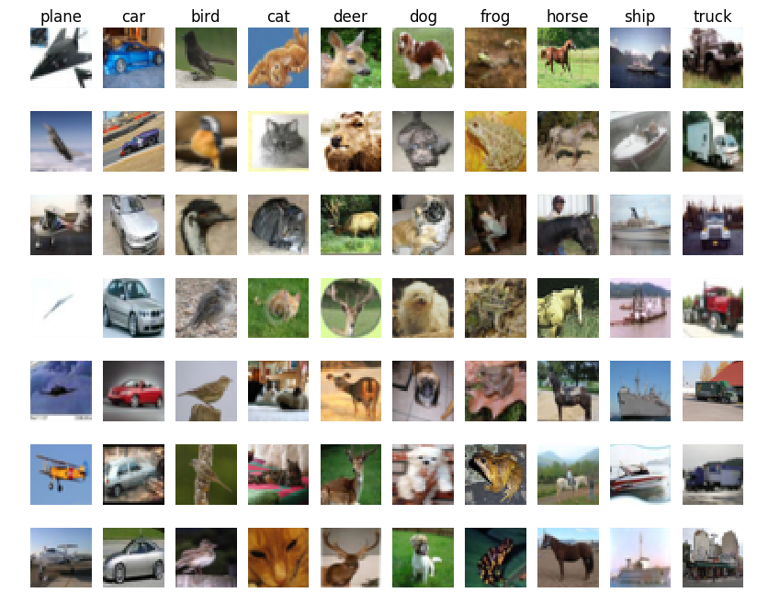
CIFAR Dataset
CIFAR10 is an image classification dataset which consists of 50,000 images which includes 45,000 training images and 5,000 test images. The images are 32*32 size.

Slide 11
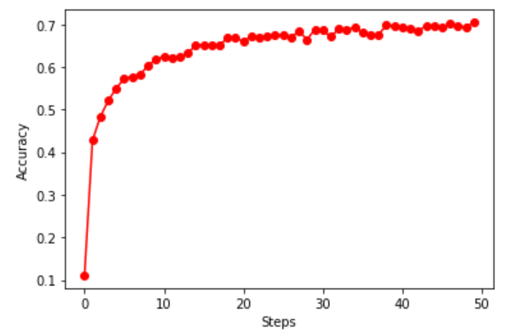
Results of 2 Layered CNN on CIFAR
The accuracy gained on CIFAR is 70.43 %
Total number of steps are 5000.
On each step the model is trained with 100 images.
The accuracies are calculated by testing on every 100th step.

Slide 12
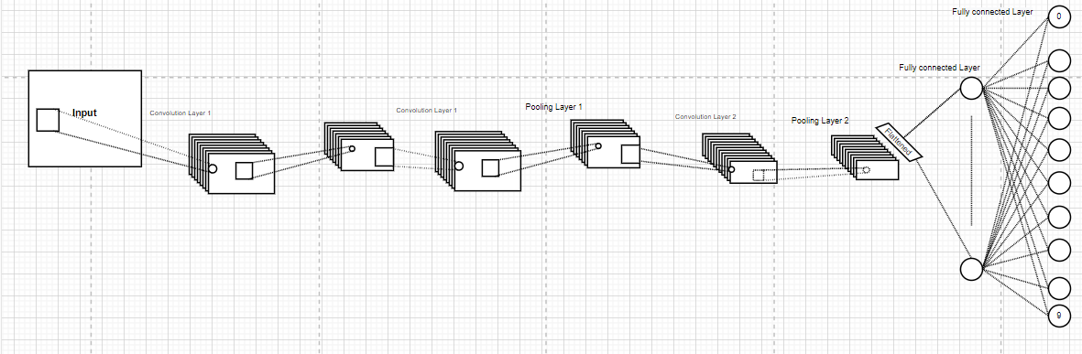
CNN Model re-designed for accuracy Improvement
Here first convolution layer has been built using ReLU as activation function.
Created first pooling layer that works along with convolution layer.
Above steps are repeated twice, making 3 convolution and 3 pooling layers in total.
Flattening layer has been created to reshape output data from pooling layer 3.
Created a fully connected layer that accepts output from flattening layer.
Above step is repeated to add few more fully connected layers.
A dropout layer has been created to drop some of the inputs the model received.
A fully connected final output layer is created that accepts the outputs from dropout layer as its inputs. This layer gives us the final output.
Loss function is created to compute SoftMax cross entropy between the labels and the predicted outputs.
An optimizer is created to optimize the network. An AI trainer is created to train the network.

Slide 13
Proposed New Model
Parameters | Designed model on CIFAR | RE-designed Model on CIFAR
Number of steps | 5000 | 8000
Number of CNN layers | 2 | 3
Number of training images in each step | 100 | 100
Final Accuracy | 70.43 | 73.90

Slide 14
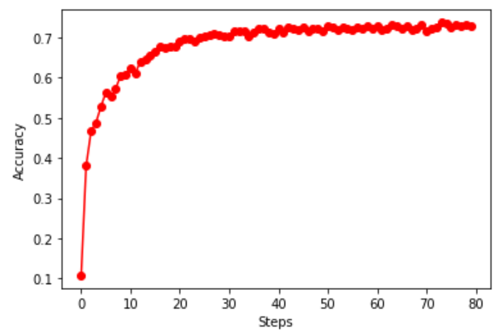
Results of 3 Layered CNN on CIFAR
The accuracy gained on CIFAR is 73.90 %
The accuracies are calculated by testing on every 100th step.
Total number of steps are 8000.
On each step the model is trained with 100 images.

Slide 15
Conclusion
We can conclude that accuracy of the model increases on increasing the CNN layers (depends on the data we have considered) and certain level of hyper tuning the model will also result in increased accuracy. Sometimes no matter how many layers we may add and how much level of tuning we perform the accuracy might not change.

