Slide 1
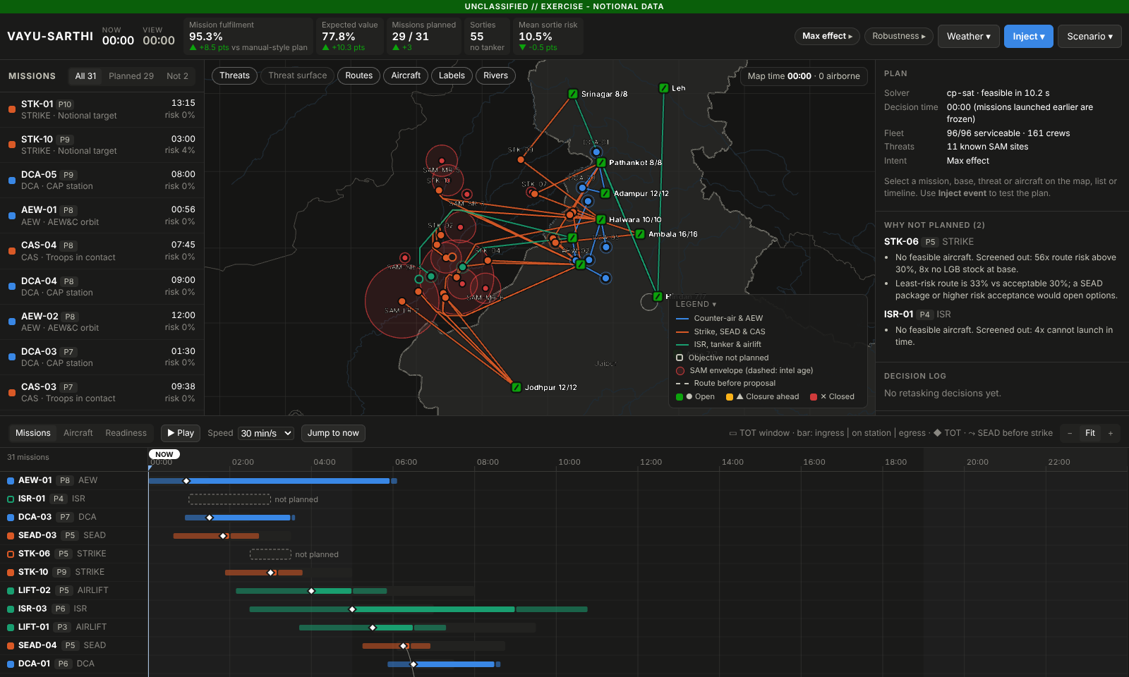
UNCLASSIFIED // EXERCISE · NOTIONAL DATA
SMART INDIA HACKATHON 2026 · IDEA PRESENTATION
VAYU-SARTHI
An explainable decision engine that plans air operations, predicts disruption and re-plans in seconds, changing as little as possible. The commander decides.
Problem Statement ID
26250
Problem Statement title
Air Power: Dynamic Air Operations & Resource Optimisation
Organisation
Ministry of Defence · Defence Services Staff College
Working prototype: common operational picture, synchronisation matrix and KPIs for a 31-mission day.
Theme
Transportation & Logistics
MEASURED ON THE PROTOTYPE
+12.4 pts
mission fulfilment vs a manual-style plan
PS category
Software
Team ID
________
−66%
aircraft reassigned on a retask vs re-planning from scratch
Team name
________
70%
of fog hours forecast (raw weather model: 26%)

Slide 2
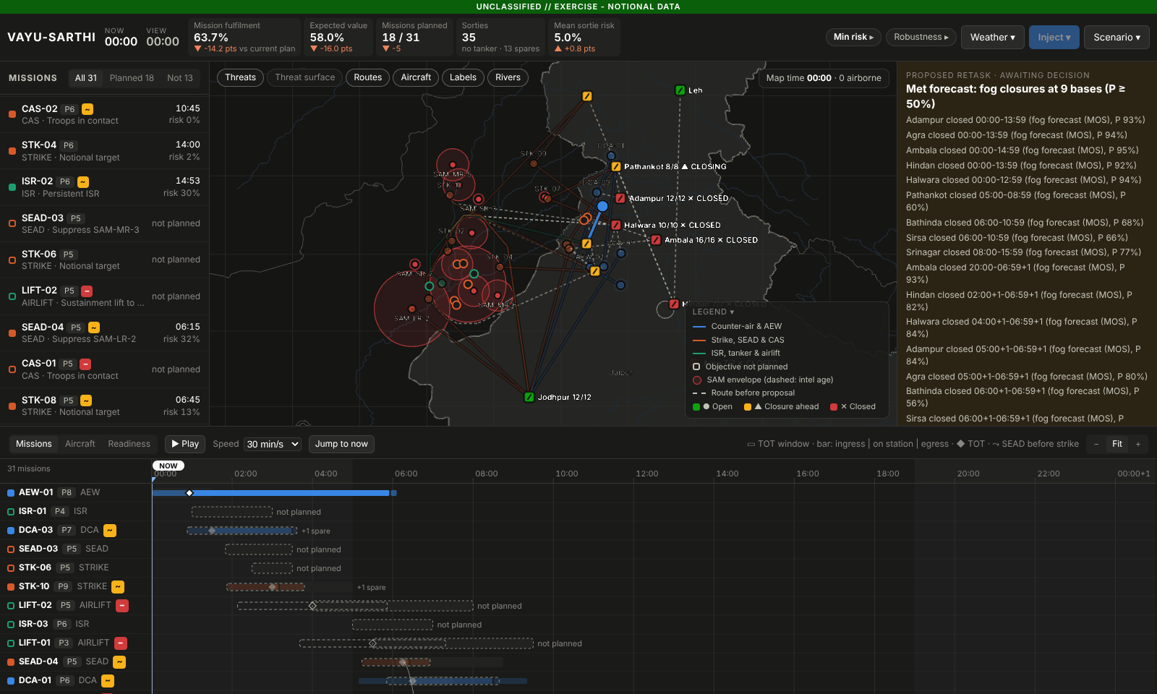
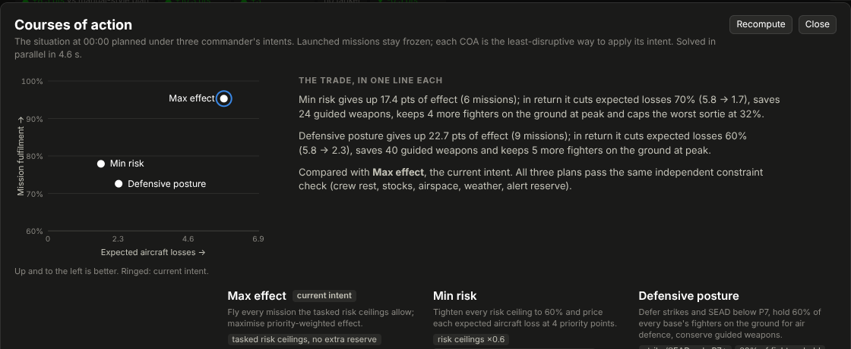
UNCLASSIFIED // EXERCISE · NOTIONAL DATA
PROPOSED SOLUTION
Plan, predict, re-plan in seconds, and explain every change
WHAT IT IS
A decision-support system for the air staff. It fuses aircraft, crews, weapons, tankers, weather, threats and airspace into one picture, and computes the best air tasking plan. When something changes it proposes the smallest set of changes that recovers the most mission value, as a reviewable diff. A human approves every change.
HOW IT ADDRESSES THE PROBLEM STATEMENT
▪ Dynamic retasking: churn-penalised re-optimisation; launched missions frozen; 12.8 vs 37.5 aircraft reassigned for a fogged base, in 1.7 s.
▪ Resource optimisation: one model across aircraft, crew fatigue, weapons, tankers, weather, threats and alert reserve.
▪ Weather: fog forecast trained on real airport observations (Brier skill +44%), turned into probabilistic base closures.
▪ Uncertainty: 2,000 simulated days, single points of failure, ground spares from idle aircraft.
▪ Commander's intent: three courses of action side by side, each trade in one sentence.
Fog forecast → proposed retask: diff, naive re-plan comparison, KPI deltas, approve / reject.
INNOVATION AND UNIQUENESS
▪ A minimal-disruption diff, not a fresh plan · one integrated optimiser, not seven silos
▪ Why not, and what it would take, for every unplanned mission · intel-age-aware routing · COAs
▪ Air-gapped and indigenous · the same engine plans flood relief (HADR)
VAYU-SARTHI · SIH 2026 · PS 26250
Courses of action: one situation, three intents, each trade in one line.

Slide 3
UNCLASSIFIED // EXERCISE · NOTIONAL DATA
TECHNICAL APPROACH
Technical approach: an optimiser with a dashboard on top
OBSERVE
FUSE
PREDICT
DECIDE
EXPLAIN
ACT
Data adapters
World state
Predictive layer
Optimiser
Explain + verify
Commander
aircraft · crews · stocks · met · intel · airspace
one typed model, timestamps, notional data
fog MOS · P(serviceable) · crew fatigue · intel age
threat-aware routing · CP-SAT allocation · minimal-disruption retask · COAs · spares
reason codes · independent validator · Monte Carlo
diff + KPIs → approve / reject → ATO change orders, audit log
↺ Events (weather, unserviceability, pop-up threats, new tasking) re-enter the loop; every proposal waits for a human decision.
TECHNOLOGIES
KEY METHODS
Decision engine
Python 3.13 · Google OR-Tools CP-SAT · NumPy / SciPy (Dijkstra) · Pydantic
▪ CP-SAT with optional intervals for aircraft, crews and tankers; cumulative alert-reserve floor; time-on-target domains from crew rest, night currency and base closures
▪ Retask objective rewards keeping what is planned, weighted by time to launch (×1 planned, ×3 briefed, ×8 armed); launched missions are frozen
▪ Threat hazard field with intel-age envelope growth and SEAD suppression; Dijkstra plus any-angle smoothing
▪ Two-process fatigue model gives each crew's fit time windows
▪ One mission-success model (serviceability with spares, tankers, SEAD before strike, ingress risk) drives both the expected-value KPI and the Monte Carlo
Service
FastAPI (REST); one process serves API and UI; runs offline on one laptop
User interface
React 19 + TypeScript · deck.gl map with an offline basemap (India's official boundary) · Zustand
Prediction
Logistic MOS on Open-Meteo NWP, labelled with IEM METAR; held-out winter validation
Assurance
30 engine tests · independent constraint validator · Playwright browser end-to-end test
VAYU-SARTHI · SIH 2026 · PS 26250

Slide 4
UNCLASSIFIED // EXERCISE · NOTIONAL DATA
FEASIBILITY AND VIABILITY
Feasibility and viability: the prototype already works
MEASURED RESULTS (NOTIONAL SCENARIOS, LAPTOP CPU)
RISKS AND HOW WE HANDLE THEM
Metric | Baseline | VAYU-SARTHI
Priority-weighted fulfilment · 20 scenarios | 85.1% manual-style | 97.5%
Expected mission value on the day | 65.3% | 78.8%
Aircraft reassigned, base fogged · 8 scenarios | 37.5 naive re-plan | 12.8 in 1.7 s
Fog hours forecast · held-out winter | 26% raw model | 70% (AUC 0.91)
Bad-day (p05) success · ground spares | 66.9% | 69.9%, 0 flying changes
Expected losses · Min-risk COA | 5.81 Max effect | 3.01
HADR relief tonnage · 20 scenarios | 81.6% manual-style | 94.5%
Classified data, legacy systems
Adapter per source behind one world model; notional data until access; IACCS/AFNet are adapters, not a rewrite.
Trust in machine advice
Nothing changes without approval; a reason for every decision; independent validator; DRDO ETAI principles.
Theatre scale
Large-neighbourhood search and decomposition by sector and time; retask touches only the affected missions.
Every plan in the tests and benchmarks passes an independent constraint checker (crew rest, stocks, reserve, weather, airspace). Plans in 4–10 s for 35–40 missions; retasks in 1–3 s.
Model drift (weather, maintenance)
Probabilities, not yes/no; calibrated and verified; retrained per region and season.
Degraded links (DDIL)
Runs air-gapped; an edge node per base syncs on reconnect.
VAYU-SARTHI · SIH 2026 · PS 26250

Slide 5
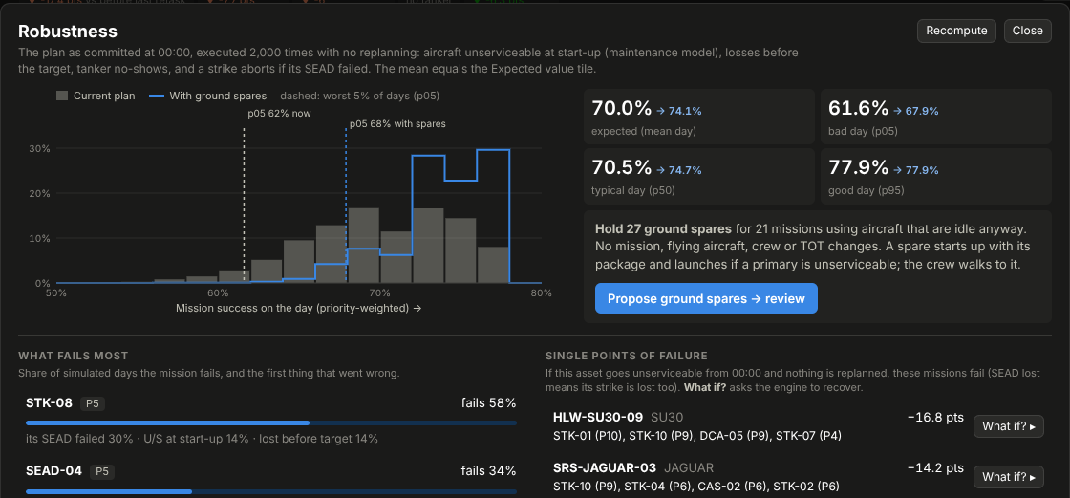
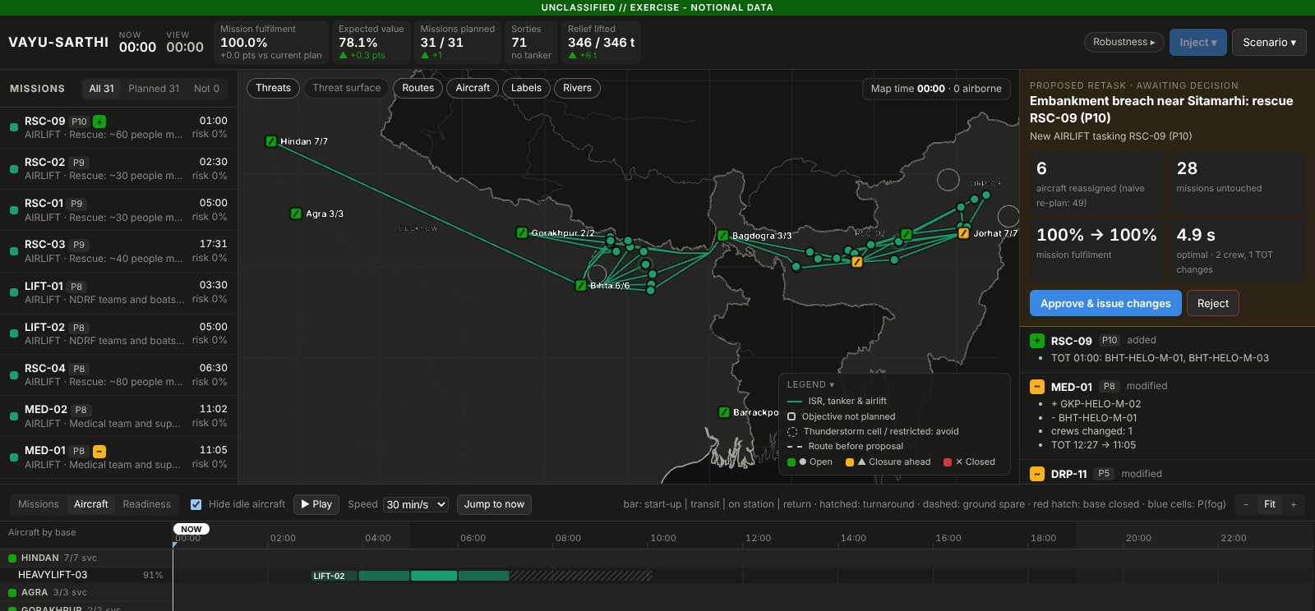
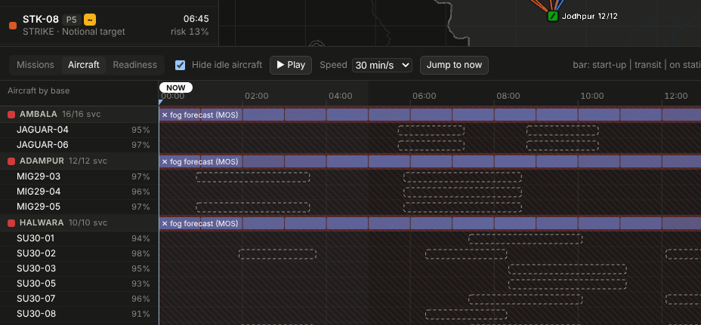
UNCLASSIFIED // EXERCISE · NOTIONAL DATA
IMPACT AND BENEFITS
Impact and benefits
Operational
Resources and cost
National and dual-use
▪ Re-planning goes from hours to seconds, and the plan stays stable: one third of the changes
▪ More mission value from the same fleet: +12.4 pts fulfilment
▪ Safer: crew fatigue, night currency and threat risk are constraints, not afterthoughts
▪ A known bad day: what fails, why, and which aircraft the plan leans on
▪ Sorties, tanker sorties and guided weapons are used only where they buy effect
▪ Commander's intent trades effect for losses and stocks explicitly (Min risk: half the expected losses)
▪ Idle aircraft become ground spares at no cost to the plan
▪ Same engine for flood relief: 81.6% → 94.5% of relief tonnage with the same fleet
▪ Rescues first; helicopters where there is no runway; flights stay in Indian airspace
▪ Indigenous and air-gapped: no foreign cloud or map service; runs on one laptop
Who uses it: air tasking order cells at Air HQ and Commands, base operations, air defence controllers, and NDMA / state disaster-response coordination during HADR.
Robustness: 2,000 simulated days, with and without spares
Flood relief: a breach becomes a P10 rescue
Aircraft lanes: closures, turnarounds, changes
VAYU-SARTHI · SIH 2026 · PS 26250

Slide 6
UNCLASSIFIED // EXERCISE · NOTIONAL DATA
RESEARCH AND REFERENCES
Research and references
PROBLEM AND CONTEXT
▪ IAF AI decision-support tools for IACCS (IDRW, idrw.org/?p=383033)
▪ DRDO ETAI framework for trustworthy AI in defence (IndiaAI, 2024)
▪ DARPA Adapting Cross-Domain Kill-Webs (darpa.mil)
▪ Kessel Run: KRADOS and Slapshot, ATO in the cloud (Air & Space Forces Magazine)
▪ Flexible Use of Airspace in India (ICAO APAC IP08, 2023)
METHODS
▪ Perron & Didier, CP-SAT / Google OR-Tools (developers.google.com/optimization)
▪ Glahn & Lowry (1972), Model Output Statistics, J. Applied Meteorology 11
▪ Borbély (1982), two-process model of sleep regulation, Human Neurobiology 1
▪ SAFTE fatigue model overview (ICAO FRMS)
▪ Minimal-deviation rescheduling under disruption (METU, naval task groups)
DATA (PUBLIC)
▪ Open-Meteo historical forecast and forecast APIs (open-meteo.com)
▪ Iowa Environmental Mesonet METAR archive (mesonet.agron.iastate.edu)
▪ Natural Earth boundaries, India point of view (naturalearthdata.com)
▪ Airfield and district headquarters coordinates (public)
THIS SUBMISSION
▪ Working prototype: engine, map, synchronisation matrix, retask review, why-not and what-it-would-take, fog forecast, COAs, robustness, HADR
▪ Design and roadmap: docs/PLAN.md · all scenario data notional
VAYU-SARTHI · SIH 2026 · PS 26250

