Slide 1

SMART INDIA HACKATHON 2026
VAYU-SARTHI
Plans the air tasking day, and re-plans it in seconds when something changes, moving as few aircraft as possible.
Problem Statement ID – 26250
Problem Statement Title – Air Power: Dynamic Air Operations & Resource Optimisation
Theme – Transportation & Logistics
PS Category – Software
Team ID –
Team Name – NexaBuild

Slide 2
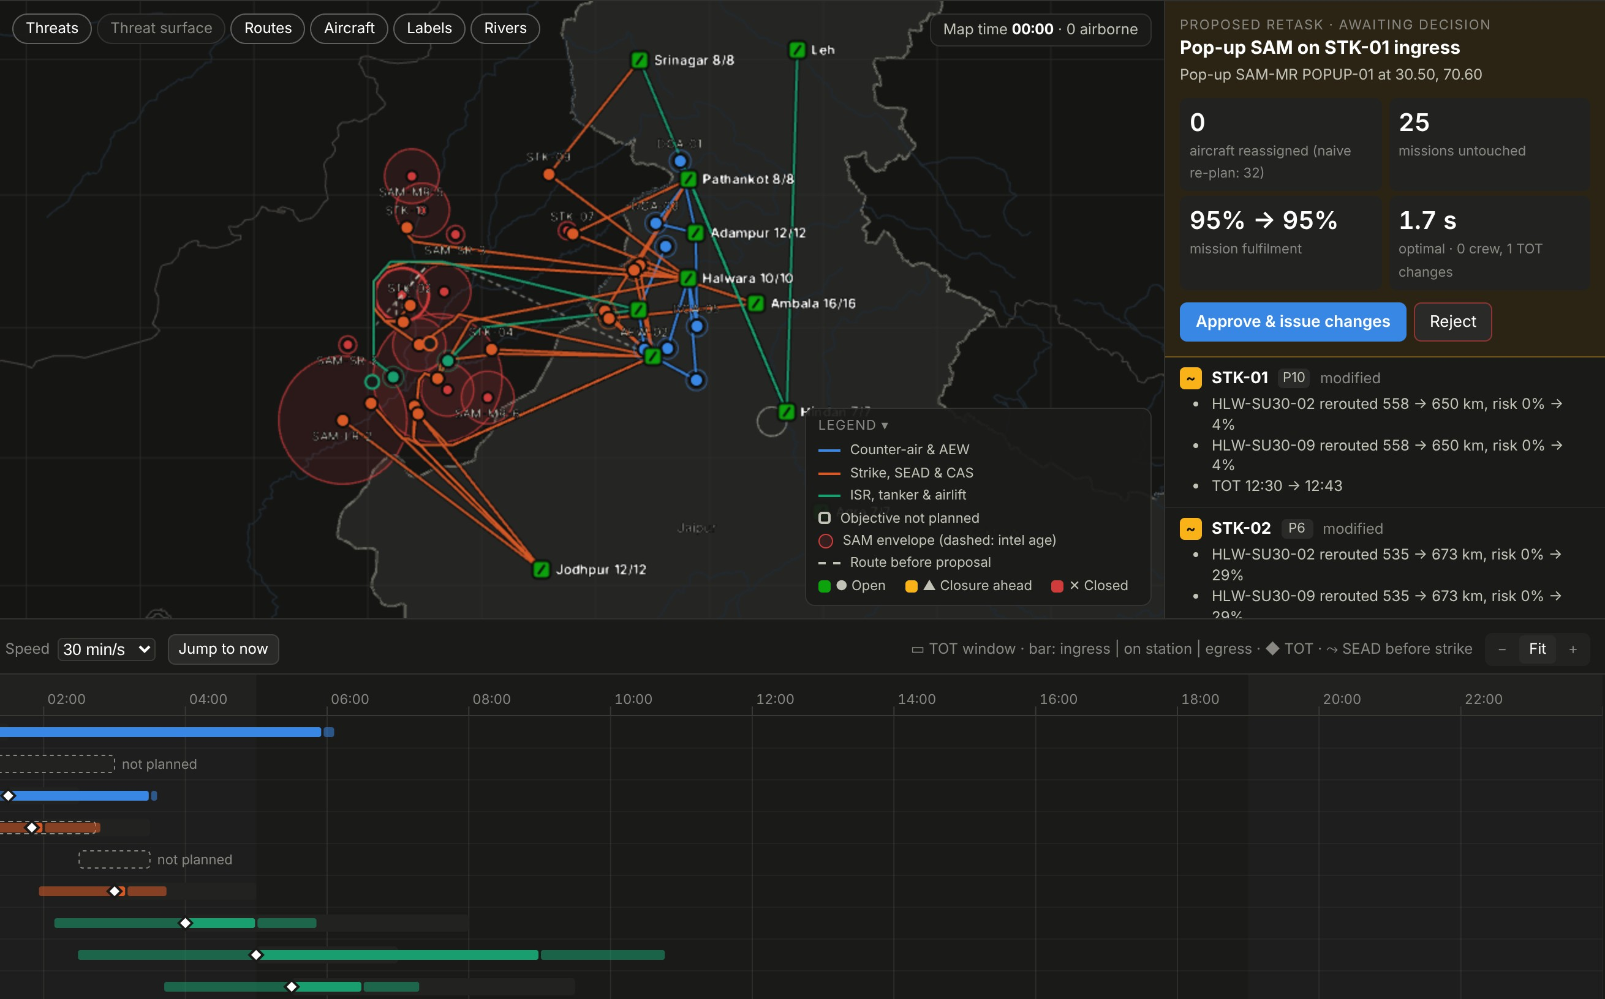
VAYU-SARTHI
NexaBuild
Proposed Solution (Describe your Idea/Solution/Prototype)
1
Detailed explanation of the proposed solution
One live picture: aircraft, crews, weapons, weather, threats
Builds the full air tasking plan for the day in under 10 s
When something changes, proposes the smallest fix as a diff
The commander approves or rejects; nothing moves on its own
2
1
3
2
How it addresses the problem
The problem asks for | What VAYU-SARTHI does
Dynamic retasking | Re-plans in ~3 s; the rest of the plan stays put
Resource optimisation | One model: aircraft, crew rest, weapons, tankers, reserve
Weather, uncertainty | Fog forecast from real airport data; 2,000 simulated days
Decision support | Gives a reason for each choice; a human approves it
4
3
Innovation and uniqueness of the solution
Changes as little as possible: a diff, not a brand-new plan
Says what it would take to fit any mission it had to drop
Plain-language copilot that answers only from the engine
Runs offline on one laptop; also plans flood and earthquake relief
1
A SAM pops up on STK-01's route; old routes show dashed
2
Proposal: 2 strikes re-routed, 0 aircraft swapped (a fresh re-plan swaps 32)
3
The commander approves or rejects, 1.7 s after the alert
4
Synchronisation matrix: every sortie's timing, before and after

Slide 3









TECHNICAL APPROACH
NexaBuild
Technologies to be used (e.g. programming languages, frameworks, hardware)
DECISION ENGINE
FORECASTING
SERVICE
INTERFACE
COPILOT · HARDWARE
Python 3.13 · Google OR-Tools CP-SAT · NumPy / SciPy
Open-Meteo weather model + airport METARs → fog model (logistic MOS)
FastAPI REST service · Pydantic data model
React + TypeScript · deck.gl map, offline, India's official boundary
Local open-weight LLM via Ollama (optional) · one laptop, no internet
Methodology and process for implementation (Flow Charts/Images/ working prototype)
INPUTS
Aircraft status
Crew rosters
Weapons & stocks
Weather
Threat intel
Airspace
New tasking
1
Something changes
2
Check what is possible
3
Find the smallest fix
4
Explain and double-check
5
Commander decides
Fog forecast, an aircraft goes U/S, a pop-up SAM or new tasking
Which aircraft, crews, weapons and safe routes can still make each mission
Most mission value, with a penalty on every change to the current plan
A reason for each change, an independent rule checker, 2,000 simulated days
Approve: change orders go out. Reject: nothing moves
event feed · fog model
routing · fatigue model
Google OR-Tools CP-SAT
validator · Monte Carlo
map + timeline UI · audit log
e.g. a SAM pops up on STK-01's route
routes re-drawn around the new threat
2 strikes re-routed, 0 aircraft swapped
fulfilment stays at 95% (fresh re-plan: 32 swaps)
ready for a decision 1.7 s after the alert
The next event goes round the same loop. Missions already airborne stay frozen.
Built and working: 55 automated engine tests · a browser test that clicks through the whole flow · every plan passes the independent rule checker

Slide 4
FEASIBILITY AND VIABILITY
NexaBuild
Analysis of the feasibility of the idea
Potential challenges and risks | Strategies for overcoming these challenges
Real data is classified; legacy systems such as IACCS | One adapter per data source behind one world model; notional data until access is granted
Commanders may not trust machine advice | A reason for every choice, a human approves every change, an independent checker (DRDO ETAI principles)
Theatre scale: 100+ missions a day | ~40 missions plan in 4–10 s today. Next: large-neighbourhood search, split by sector and time
Forecasts drift with season and region | Probabilities, not yes/no; tested on a held-out winter; retrained per region and season
Network cut off (degraded links) | Runs fully offline today. Next: a node at each base that syncs when the link returns
2.8 s
−71%
70%
to re-plan when the busiest base fogs in
aircraft moved vs a fresh re-plan (14.5 vs 49.5)
of fog hours forecast (raw weather model: 26%)
Already built and tested: engine, map, timeline, copilot; 55 tests
Every plan passes an independent rule checker (crew rest, stocks, weather, airspace)
Open-source stack on one laptop, offline: no licence or cloud cost

Slide 5




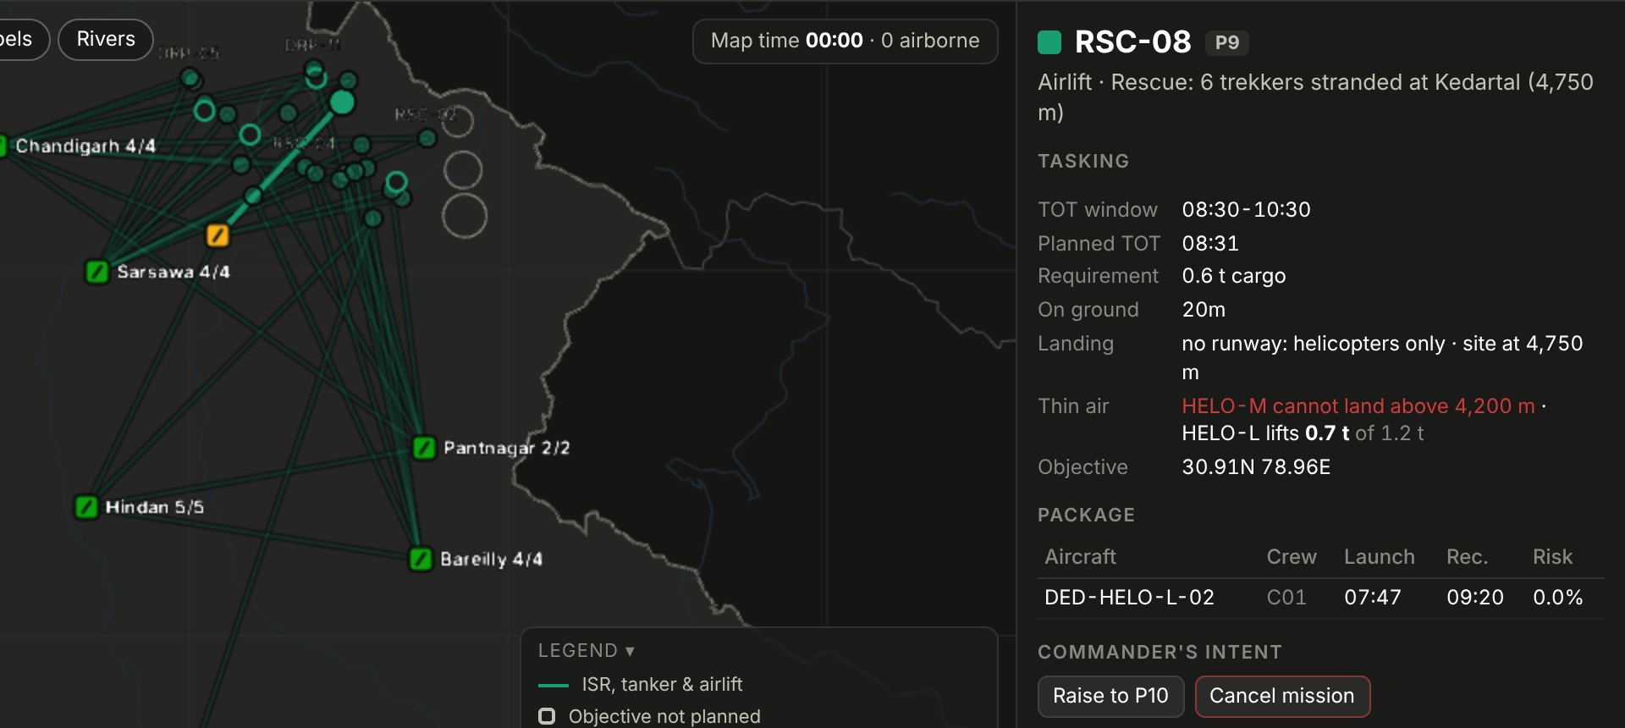
IMPACT AND BENEFITS
NexaBuild
Potential impact on the target audience
Air tasking cell, Air HQ and Commands
Squadrons and base operations
Aircrew
NDMA and state disaster response
Seconds, not hours
−71% churn
Rested crews
+12.9 pts relief
to re-plan after fog, an aircraft going U/S or a pop-up threat
14.5 aircraft moved instead of 49.5 when a base fogs in
rest, fatigue and night currency are hard rules in every plan
of requested flood-relief tonnage lifted by the same fleet
Benefits of the solution (social, economic, environmental, etc.)
Operational
+12.4 pts mission fulfilment from the same aircraft and crews
Economic
Open-source, one laptop, no licences; idle aircraft become ground spares at no cost
Social
Flood and earthquake relief planned rescues-first: 94.5% and 88.1% of relief lifted
Environmental
Every sortie carries a cost in the plan, so none is flown without need
Strategic
Indigenous and air-gapped: no foreign cloud, model or map service
Same engine, earthquake relief: thin air at 4,750 m rules out the medium helicopter

Slide 6
RESEARCH AND REFERENCES
NexaBuild
Details / Links of the reference and research work
Reference | Link | What we took from it
1 IAF AI decision-support tools for IACCS (IDRW) | idrw.org/?p=383033 | Where a tool like this would plug in
2 DRDO ETAI framework for trustworthy AI in defence (2024) | indiaai.gov.in | Human approval, reasons, independent checks
3 Kessel Run KRADOS and Slapshot: ATO in the cloud (USAF) | airandspaceforces.com | What exists abroad; the gap is minimal-change retasking
4 DARPA Adapting Cross-Domain Kill-Webs (ACK) | darpa.mil | A decision aid to task and retask quickly
5 Google OR-Tools, CP-SAT constraint solver | developers.google.com/optimization | The planning and retasking engine
6 Glahn & Lowry (1972), Model Output Statistics, J. Appl. Meteor. 11 | doi.org/10.1175/1520-0450(1972)011 | How the fog forecast is built
7 Borbély (1982), two-process model of sleep; SAFTE in ICAO FRMS | icao.int (FRMS modelling) | Crew fatigue and rest windows
8 Minimal-deviation rescheduling under disruption (METU) | avesis.metu.edu.tr | A penalty on changing the current plan
9 Open-Meteo forecasts · IEM METAR archive · Natural Earth (India view) | open-meteo.com · mesonet.agron.iastate.edu | Real weather, airport observations, maps
10 Flexible Use of Airspace in India (ICAO APAC IP08, 2023) | icao.int | Airspace that opens and closes in the day
Our prototype (open source): github.com/DeepakSinghhh/Air-power-Dynamic · all scenario data is notional; maps use India's official boundary

