Slide 1

SMART INDIA HACKATHON 2026
Q-GreenFleet
Quantum-inspired fuel prediction & green fleet optimization
Problem Statement ID – 26138
Problem Statement Title – Quantum-Inspired Fuel Consumption Prediction and Green Fleet Optimization
Theme – Clean & Green Technology
PS Category – Software
Team ID –
Team Name (Registered on portal) –
Problem statement by Egreen Quanta · Smart India Hackathon 2026
Notes:
Q-GreenFleet predicts every ship's fuel burn and re-plans the whole fleet for the lowest fuel, emissions and cost that still meet cargo, schedule and emission rules. Fill in Team ID and Team Name.

Slide 2












Q-GREENFLEET
Your Team Name
Proposed Solution (Describe your Idea/Solution/Prototype)
One decision engine that predicts every ship's fuel burn and re-plans the whole fleet (vessel mix, capacity, speed, fuel and shore power) for the lowest fuel, emissions and cost that still meet cargo demand, schedules and emission rules.
DETAILED EXPLANATION OF THE PROPOSED SOLUTION
1 PREDICT Q-PHYS model
2 OPTIMISE QMOEA-H engine
3 DECIDE Dashboard + report
Fuel in t/day for any ship from speed, load, weather and vessel type: physics + tensor-network ML, with a 90 % confidence band.
Chooses vessel mix, capacity, speed, fuel (VLSFO, LNG, methanol, ammonia, H₂) and shore power per route. Minimises fuel, emissions and cost.
Trade-off curve, a recommended plan explained in plain words, CII / FuelEU / ETS checks, scenario lab and a one-click report.
HOW IT ADDRESSES THE PROBLEM
INNOVATION AND UNIQUENESS OF THE SOLUTION
Shipping emits ~2.9 % of global GHG; fleets are still planned by rules of thumb
Ship-level fuel model, 3.3 % error
Tensor-network fuel model
QMOEA-H optimiser
New fuels change cost, range and true well-to-wake emissions
14 fuels & pathways scored well-to-wake
Quantum many-body maths (MPS) on a physics prior; certified monotone in speed
Qudit registers, superposition crossover and δ-well tunnelling for mixed decisions
IMO CII, FuelEU Maritime and EU ETS tighten every year to 2050
Rules built into the optimiser, 2025–2050
QUBO + quantum annealing
Proven, not claimed
~10²² possible fleet plans for just 12 services, before choosing speeds
Quantum-inspired search, checked vs exact optimum
Path-integral simulated annealer today; the same QUBO runs on D-Wave
Benchmarked vs NSGA-II/III, MOPSO and an exact MILP (1–3 % gap)
Notes:
Three steps: predict (Q-PHYS), optimise (QMOEA-H), decide (dashboard and report). The problem rows map each pain point to what the prototype does about it.

Slide 3







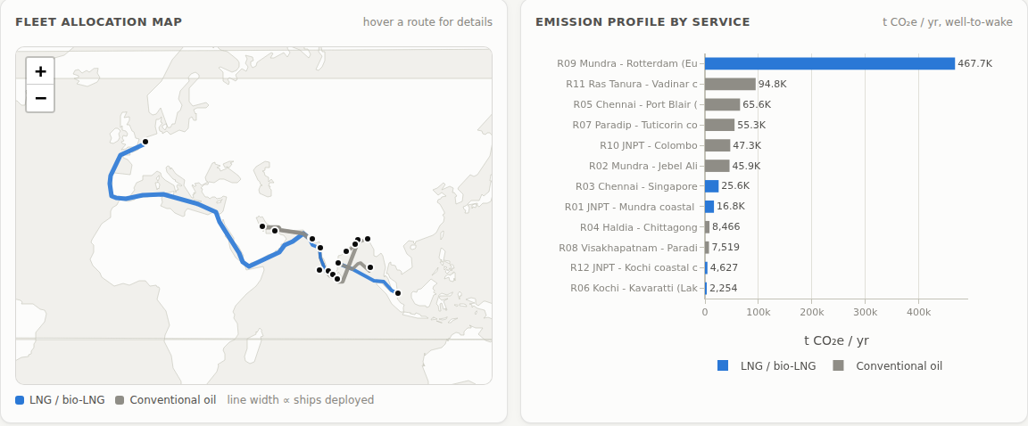


TECHNICAL APPROACH
Your Team Name
Technologies to be used
Methodology and process for implementation
languages · frameworks · hardware
flow chart · working prototype
Core & data
1 Data
2 Physics & rules engine
3 Q-PHYS prediction
Python 3.11 · NumPy · pandas · searoute
Prediction (ML)
FuelCast · EU MRV · operator logs · physics-based synthetic fleet
IMO GHG4 power · Kwon weather · SFOC · well-to-wake · CII / FuelEU / ETS
QIEA features ▸ QPSO-tuned monotone GBM ▸ MPS tensor net ▸ conformal band
LightGBM · scikit-learn · own MPS tensor network
Quantum-inspired & exact
pymoo · PuLP/CBC MILP · OpenJij · dimod (D-Wave)
6 Platform
5 Decision analytics
4 Fleet optimisation
Backend
FastAPI ▸ React dashboard ▸ maps & emission profiles ▸ report
Knee-point plan · plain-language why · Monte Carlo risk · MACC · 2025–2050
QMOEA-H Pareto search · exact MILP check · QUBO + simulated quantum annealing
FastAPI · Uvicorn · live jobs over SSE
Frontend
React · TypeScript · Vite · Plotly · Leaflet
WORKING PROTOTYPE
DevOps
Built and running today (India & EU networks)
Docker · GitHub Actions CI · pytest · Playwright
Live Pareto front, fleet map, emission profiles
71 automated tests · CI green
Hardware
~55,000 fleet plans evaluated per second
Any laptop CPU. No GPU, no qubits needed
One command: docker compose up
Notes:
Left: the stack by layer. Right: the six-stage pipeline as built, and a screenshot of the running dashboard (fleet allocation map and emission profile by service).

Slide 4



FEASIBILITY AND VIABILITY
Your Team Name
ANALYSIS OF THE FEASIBILITY OF THE IDEA
3.3 %
55k/s
1.4 s
71
0
fuel prediction error (MAPE) on held-out voyages
fleet plans evaluated per second on an ordinary CPU
to solve the India network exactly (MILP), our accuracy yardstick
automated tests, CI green, one-command Docker run
GPUs or qubits needed today; D-Wave-ready later
POTENTIAL CHALLENGES AND RISKS
STRATEGIES FOR OVERCOMING THESE CHALLENGES
Little real data for LNG, ammonia and H₂ ships
Physics prior + fleet head: 6.0 % error even on unseen vessel types; loaders for FuelCast, EU MRV and operator logs
ML can output unphysical fuel curves that an optimiser exploits
Booster certified non-decreasing in speed; 90 % conformal intervals flag uncertainty
Fuel prices and regulations keep shifting
Scenario lab (2025–2050, prices, carbon, Red Sea, monsoon) + Monte Carlo robustness; factors in editable YAML
Quantum hardware is still immature
Quantum-inspired algorithms run on normal CPUs now; the same QUBO runs on D-Wave later
Very large fleets (100+ routes) converge more slowly
Every instance certified by the exact MILP; warm starts and adaptive rates on the roadmap
Viability: SaaS or on-premise licence for fleet operators and ports. On the India network one avoided FuelEU penalty ($21.7 M a year) plus a 25 % lower fleet cost far outweighs running costs; the stack is open source and CPU-only.
Notes:
The prototype already exists, so feasibility is shown with measured numbers. Each risk is paired with the mitigation that is built in or planned.

Slide 5







IMPACT AND BENEFITS
Your Team Name
INDIA 2030 CASE STUDY · 12 SERVICES
POTENTIAL IMPACT ON THE TARGET AUDIENCE
Shipping lines & fleet operators
SCI, coastal and near-sea lines: lower fuel bills, CII / FuelEU compliance, ready reports
Ports: Sagarmala & Harit Sagar green ports
plan shore power and green-fuel bunkering demand
Regulators: DG Shipping, MoPSW
evidence for policy; test 2025–2050 pathways before they bind
Green H₂ / ammonia hubs: Kandla, Tuticorin, Paradip
see when and where green-fuel demand arrives
−59 % GHG
−52 % fuel
BENEFITS OF THE SOLUTION
1.23 Mt CO₂e a year avoided
297 kt a year less fuel (HFO-equivalent)
Environmental
Economic
Social
1.23 Mt CO₂e a year less on 12 services
Shore power on 10 services: cleaner port air
Clear pathway to LNG and e-ammonia by 2050
$179 M a year lower fleet cost
No FuelEU penalty; smaller EU ETS bill
Less stranded-asset risk as rules tighten
Backs Maritime India Vision 2030 and net zero 2070
Skills and jobs in green-fuel shipping
Healthier air in port cities
−25 % cost
12/12 CII A–B
$179 M a year lower fleet cost
services compliant (1 of 12 today); $0 FuelEU penalty
Notes:
Numbers are from the recommended plan on the India 2030 network (QMOEA-H, 8,000 evaluations) against current practice: VLSFO at the fastest schedule-feasible speed, no shore power.

Slide 6




RESEARCH AND REFERENCES
Your Team Name
OUR RESEARCH & EXPERIMENTS
Details / Links of the reference and research work
MARITIME PHYSICS & REGULATION
1. IMO (2020). Fourth IMO GHG Study: bottom-up ship power and fuel model
2. Regulation (EU) 2023/1805, FuelEU Maritime, Annex II well-to-wake factors
3. IMO MEPC.353(78), MEPC.338(76), MEPC.400(83): CII reference lines & reduction factors
4. Directive (EU) 2023/959: EU ETS extended to shipping
5. Kwon, Y. J. (2008). Speed loss due to added resistance in wind and waves. The Naval Architect
ALGORITHMS
6. Stoudenmire & Schwab (2016). Supervised learning with tensor networks. NeurIPS
7. Sun, Feng & Xu (2004). PSO with particles having quantum behavior. IEEE CEC
8. Han & Kim (2002). Quantum-inspired evolutionary algorithm. IEEE Trans. Evol. Comput.
9. Martoňák, Santoro & Tosatti (2002). Quantum annealing by path-integral Monte Carlo. Phys. Rev. B 66
10. Lucas (2014). Ising formulations of many NP problems. Frontiers in Physics
11. Deb et al. (2002). NSGA-II. IEEE Trans. Evol. Comput.
12. Angelopoulos & Bates (2021). A gentle introduction to conformal prediction. arXiv:2107.07511
DATA & INDIAN POLICY
13. FuelCast dataset (huggingface.co/datasets/krohnedigital/FuelCast); EU MRV / THETIS-MRV (EMSA)
14. MoPSW (2023). Harit Sagar Green Port Guidelines; Maritime India Vision 2030
Prediction: 3.29 % MAPE vs 5.28 % LightGBM; Wilcoxon p ≤ 0.001 on 20 ships
Exact gap: 1.1 % fuel · 3.1 % GHG · 3.2 % cost from the MILP optimum
QUBO + SQA: our path-integral annealer best in 4 of 6 cases; every plan feasible
Honest limit: MOPSO leads on loose 50–100-route networks: on our roadmap
Prototype code & benchmark reports: github.com/DeepakSinghhh/PS-138
Icons: UIcons by Flaticon (flaticon.com) · Line Awesome by Icons8 (icons8.com)
Notes:
The chart is the headline optimisation benchmark (8,000 plan evaluations per run). Full tables, statistical tests and figures are in reports/ in the repository.

