Slide 1
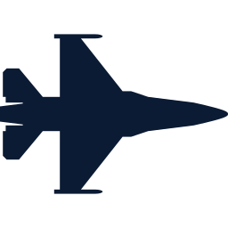
SMART INDIA HACKATHON 2026
PROBLEM STATEMENT ID
26249
TATPAR
PROBLEM STATEMENT TITLE
Air Power – Predictive Maintenance & Fleet Availability
तत्पर · “ever-ready”
ORGANISATION
Ministry of Defence · Defence Services Staff College
Readiness Assurance Platform for Air Fleets
THEME
Transportation & Logistics
Others predict failures. TATPAR assures readiness.
PS CATEGORY
Software
TEAM ID
To be filled
AI prognostics · sustainment digital twin · fleet optimisation · offline & sovereign
TEAM NAME
To be filled
Notes:
Title slide in the SIH template order. Fill Team ID and Team Name before exporting to PDF.

Slide 2



Proposed Solution
TATPAR joins health monitoring, technical records, spares and repair-agency data, then plans flying, maintenance and spares so that the required number of aircraft is mission-capable on the day of need — with stated confidence.
“How many aircraft on day D — and how sure?”
Readiness Forecast
A Fleet Twin of aircraft, spares, BRD/HAL repair pipeline, bays and manpower runs 200 Monte-Carlo futures → P10–P90 aircraft per day and P(meet task).
What is unique
Twin of the sustainment system — not a 3D model of one aircraft
Plans backwards from the requirement — each action scored by P(meet), checked against hidden truth
Live data fabric — HUMS, tech log, IMMOLS, BRD/HAL imports change the plan
Calibrated RUL — conformal 90 % intervals + engine-module attribution
Multi-echelon spares (VARI-METRIC); NFF, rogue-unit & cannibalisation analytics
Offline, federated, signed ledger; Indian base dust from real CAMS data
“What must I do today to have N ready?”
Readiness-Backward Planner
Optimises flying hours per tail, check timing, spares transfers, depot priority and cannibalisation; shows each action’s readiness gain; a human approves.
“Where is readiness lost — and why?”
Readiness-Loss Waterfall
Aircraft-days lost to spares, scheduled and unscheduled work, depot and manpower, with the days each lever could recover.
PS ASKS → TATPAR
AI/ML predictive maintenance
calibrated engine RUL, LRU survival, NFF & rogue units
IoT / aircraft health monitoring
HUMS downloads imported live via an edge gateway
Digital twin
Fleet Twin of aircraft, spares, BRD/HAL, bays, crews
Integrated analytics platform
4 data sources joined; 8-board ops room; signed ledger
Notes:
Every other PS-26249 team answers 'which aircraft might fail'. TATPAR answers the three commander questions.

Slide 3
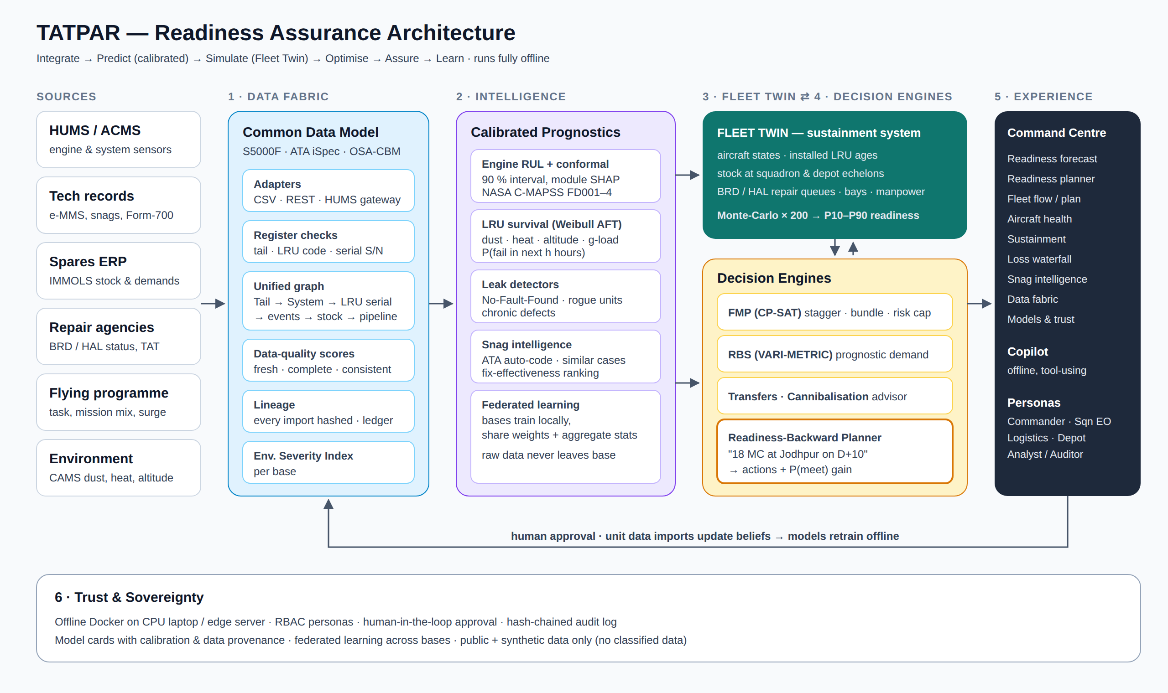
Technical Approach
Technology stack
Prognostics
LightGBM quantile + conformal (CQR), SHAP, Weibull AFT (lifelines)
Twin & optimisation
NumPy Monte-Carlo Fleet Twin, OR-Tools CP-SAT, VARI-METRIC
Data in
CSV contracts + REST for HUMS, tech log, IMMOLS, BRD/HAL; HUMS edge gateway
Platform
FastAPI · React + TypeScript · ECharts · Parquet (Postgres/TimescaleDB in production)
Data
NASA C-MAPSS, MaintNet logbooks, CAMS dust, notional synthetic fleet
Deploy
Docker, fully offline on CPU laptop / edge server
Integrate
Predict
Simulate
Optimise
Approve
Learn
Notes:
Six layers: data fabric, intelligence, fleet twin, decision engines, experience, trust. Unit data (HUMS, tech log, IMMOLS, BRD/HAL) is imported against published contracts and changes beliefs and the plan; models retrain offline.

Slide 4
Feasibility & Viability
+20 pts
Challenge / risk | Mitigation built into TATPAR
No access to real IAF data | Public data + synthetic fleet with hidden ground truth; data contracts let a unit import its own HUMS, e-MMS, IMMOLS, BRD exports
Trust in AI recommendations | Calibrated intervals; planner checked against hidden truth; human approval; signed ledger
Classified, air-gapped networks | Fully offline (Docker); federated learning shares only weights + aggregate statistics
Messy legacy records | Row-by-row validation with reasons; data-quality scores; every import hashed and logged
Optimisation run-time | CP-SAT plans a squadron in 0.3–3.5 s, same plan on every machine
mission-capable in the prototype’s Fleet Twin: 57.7 → 77.9 %, same fleet & spares budget; +16 to +26 under every changed assumption (notional)
90 %
calibrated engine-RUL interval coverage on NASA C-MAPSS test sets (82.7 % before conformal calibration)
0–3 months · Pilot
One squadron's historical HUMS, e-MMS and IMMOLS exports mapped onto the contracts; models retrained; recommendations in shadow mode
3–9 months · One station
Daily signal, planner and orders in use; BRD/HAL status feed; MC rate measured against the station's own baseline
9–18 months · Command
All bases; federated learning over AFNET; PKI-signed ledger; integration with IMMOLS / e-MMS
0
cloud dependencies — runs air-gapped on a CPU laptop or edge server; public + synthetic data only
Cost (indicative): one CPU edge server per station (~₹3–5 lakh); open-source stack, no licence fees. Built and tested: 8-board ops room, 50 backend tests + 24 browser checks in CI · github.com/DeepakSinghhh/air-power
Notes:
Feasible today: every building block exists in open-source tooling; the novelty is in combining them around readiness.

Slide 5








Impact & Benefits
~40 %
20–50 %
≈ 13
of fighters reported unserviceable at any time (post-Op Sindoor commentary, Swarajya 2025)
of avionics removals end as No-Fault-Found — wasted spares and repair slots (Raza 2018)
more aircraft mission-capable every day from a 64-aircraft fleet in the prototype twin — same spares budget (notional data)
Who benefits
Operational
More aircraft from the same fleet; surge plans with known odds
Commander
N aircraft on day D, with a stated confidence
Economic
≈13 aircraft of availability ≈ ₹14,600 cr of new airframes at the 2024 HAL price (illustrative); spares bought for availability per rupee
Squadron Engineering Officer
Which tails fly, which go in, what to bundle
Strategic
Sovereign, offline software; supply-risk visibility for indigenisation
Logistics Officer
What to stock, move or expedite — and where
Safety & people
Fewer cannibalisations; chronic defects caught early
BRD / Depot
Which repairs add the most readiness first
Notes:
The first two figures are from open sources (see references). The third is measured in the TATPAR prototype on a notional fleet: +20.2 ± 0.5 points over one year, 24 hidden-truth futures. Rupee figure: MoD–HAL contract of Dec 2024, ₹13,500 crore for 12 Su-30MKI with associated equipment (₹1,125 crore each) × 13; illustrative only.

Slide 6
Research & References
IAF context
Operations research
Prognostics & AI
Business Standard (2014) — Su‑30MKI serviceability 48–55 %
CAPS Issue Brief 08/25 — AI in IAF logistics, IMMOLS, e-MMS
The Week (Aug 2026) — ML for Sukhoi and Tejas fleets, edge AI
Defense Mirror — 11 BRD Ojhar Su‑30MKI overhaul
Swarajya (2025) — Op Sindoor: ~40 % unserviceable
MoD–HAL contract, 12 Su‑30MKI, ₹13,500 cr (Dec 2024)
Kozanidis — Flight & maintenance planning, Hellenic AF
Peschiera et al. — Long-term FMP, French AF (arXiv 2001.09856)
Mattila & Virtanen (2014) — Fighter maintenance sim-optimisation
Sherbrooke — VARI-METRIC, Operations Research (1986)
GAO-02-86 — Military aircraft cannibalisations
Saxena et al. (2008) — NASA C-MAPSS turbofan dataset
LSTM quantile + conformal RUL — Sensors 26(7) 2249 (2026)
Federated RUL prognostics — arXiv 2506.00499
MaintNet aviation logbooks — COLING 2020
DST-Group-TR-3367 — dust-driven engine degradation
Raza, Aerospace 5(2):38 (2018) — avionics NFF 20–50 %
Gap analysis: 7 public PS-26249 projects reviewed (NIRANTAR, AERO-READY, AeroTwin-AI, AirPower, SIH_249, PREDIX, VAYU SEWA) — none model flight & maintenance planning, multi-echelon sparing or probabilistic readiness. Prototype figures use a notional fleet; no classified data.
Notes:
Full link list in docs/01-research.md.

