Slide 1
BLOCKCHAIN
AN INTRODUCTION

Slide 2
What did we see so far?
Client - Server Architecture

Slide 3
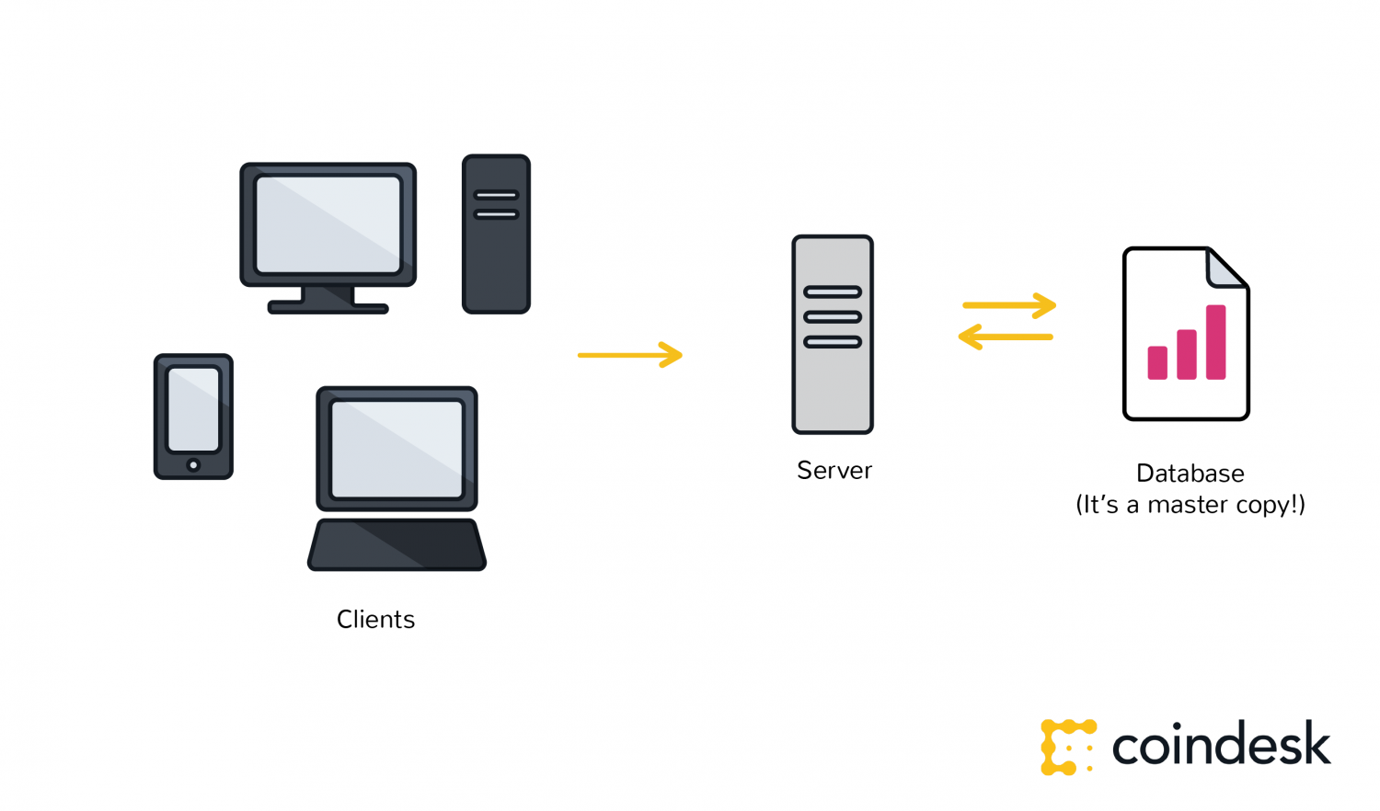
Centralized Computing

Slide 4
Disadvantages
Single point of failure
Vulnerable to cyber attacks
Requires large data storage
Low local availability
Transactions are pricey
Mark will sell our data, lol

Slide 5
Only Superman can save Us

Slide 6
Our Superman is
Decentralized Computing

Slide 7
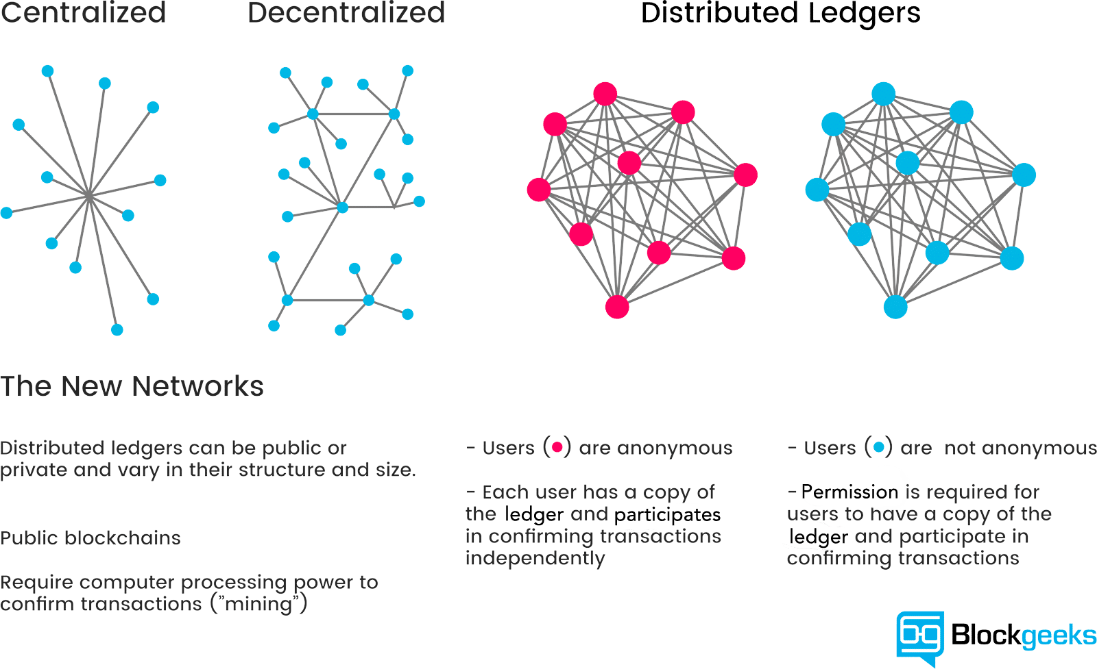
Every node in the network acts as a server

Slide 8
Advantages
No single point of failure
No need to trust a third party like Facebook or Google
Less censorship of data
Immune to several cyber attacks
Transactions are almost instant
Better data availability
A platform for creators
P.S. Mark cannot sell your data
And more

Slide 9
Blockchain is an implementation of Decentralization

Slide 10
It is
A distributed ledger system
A chain of blocks that contain data
Peer-to-peer
Similar to BitTorrent network
It was created by Satoshi Nakamoto
No one knows who he/she is

Slide 11
Warm up
Alice wants to send money to Bob who is far away.
She is busy, so she has to get a messenger.
But since she is sending a briefcase full of money along the with the key, she cannot trust the messenger.
What would Alice do?

Slide 12
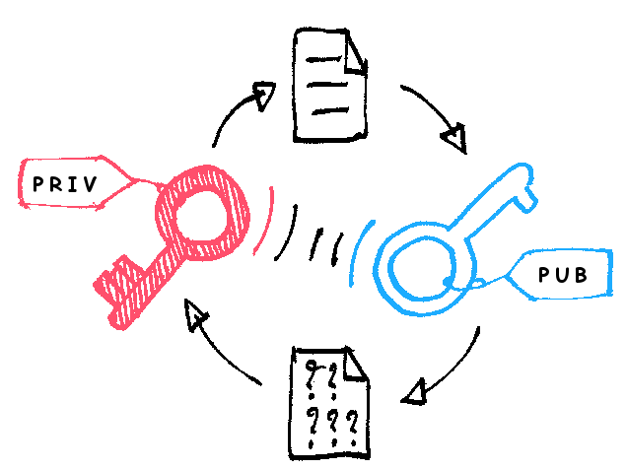

Slide 13
So how does a blockchain work?

Slide 14
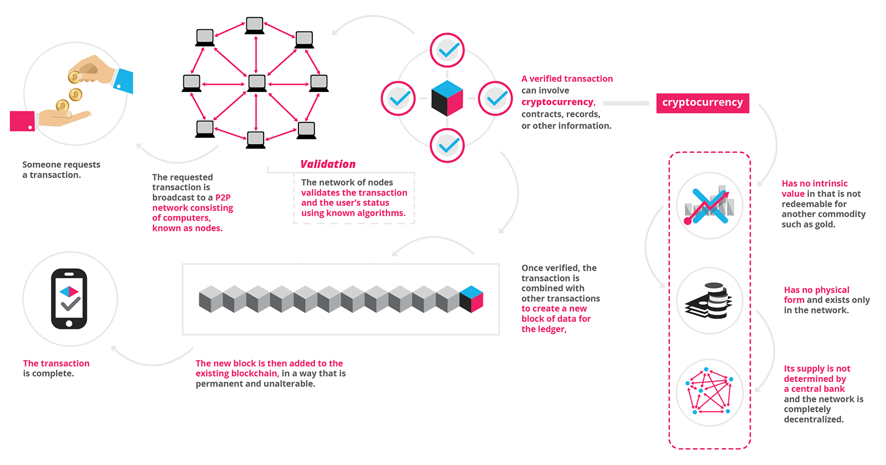

Slide 15
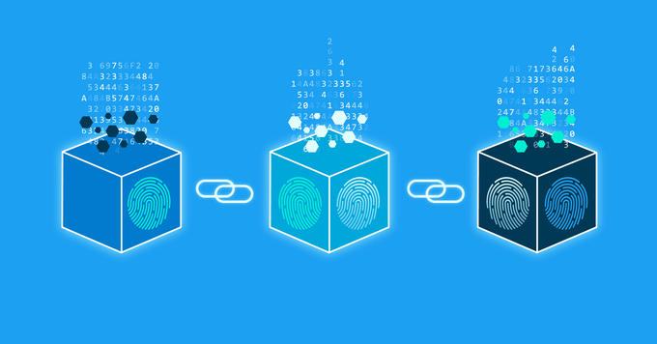

Slide 16
Afterwards
The block is added to the end of a chain
Every block is associated with its predecessor
The chain of blocks is available to every node locally
And is continuously synced with neighboring nodes
Anyone can read, write and verify

Slide 17
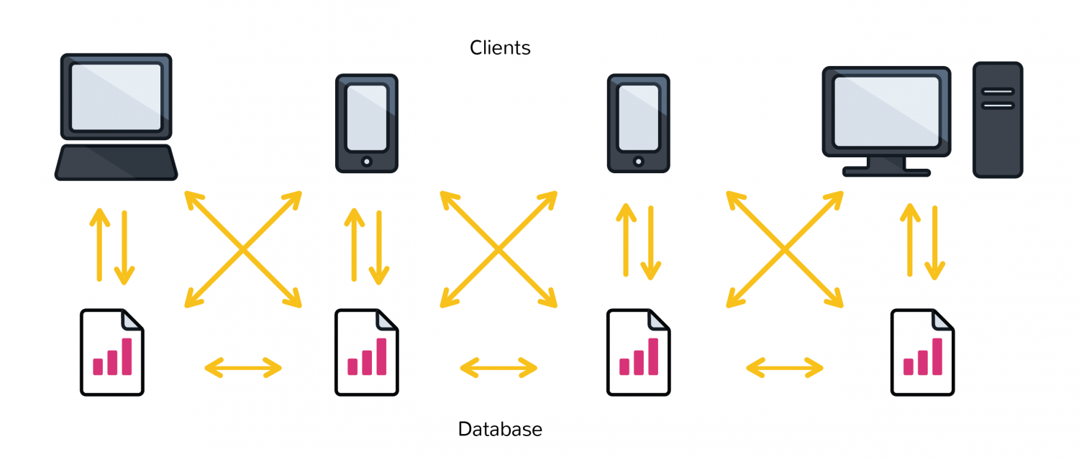
Every node is in sync with its neighbors

Slide 18
Applications of Blockchain
Cryptocurrencies
Asset Management
Insurance
Payments
IoT
Supply chain management
Healthcare
Data Science
The list is so big

Slide 19
Who is using blockchain?
Financial Industries
Less fraud
Faster transactions
World Food Programme
More than 10,000 Syrian refugees received crypto vouchers in 2017
Retailers
Walmart began in 2016
Educational Institutions
MIT for certificates
Diamond Traders
To record characteristics of diamonds

Slide 20
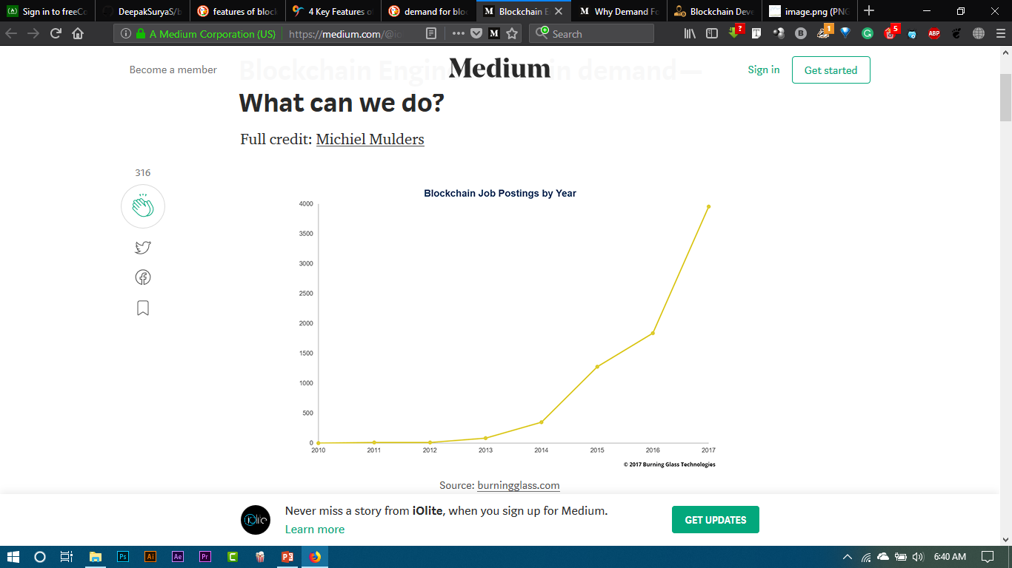
Demand for Blockchain Dev

Slide 21
DEMO TIME

Slide 22
Thanks

Slide 23
youtube.com/c/radiosurgerylabs
facebook.com/dudescorp

