Slide 1

N.B.K.R INSTITUTE OF SCIENCE & TECHNOLOGY
PARKING LOT MANAGEMENT
Presented by: ,
LOKESH 24KBIA0507
VASU 24KB1A0520
KULA DEEPAK 24KB1A0514
ANIL 24KB1AO568

Slide 2

Parking Lot Management in C
This presentation explains a C program for managing a parking lot.
Learn how vehicles are added, removed, and monitored in a parking queue system.

Slide 3
INTRODUTION:
C program is a simple parking lot management system.
It allows users to add, remove, and check the status of vehicles in the parking lot.
The program uses a fixed-size array to represent the parking spaces, and a queue-like data structure to manage the vehicles.
Key functions include addVehicle(), removeVehicle(), checkSpace(), and displayVehicles().
The main() function provides a menu-driven interface for the user to interact with the parking lot management system.
This slide provides the complete C code for the parking lot management program.
Notes:
This C program is a simple parking lot management system. It allows users to add, remove, and check the status of vehicles in the parking lot. The program uses a fixed-size array to represent the parking spaces, and a queue-like data structure to manage the vehicles. Key functions include addVehicle(), removeVehicle(), checkSpace(), and displayVehicles(). The main() function provides a menu-driven interface for the user to interact with the parking lot management system. This slide provides the complete C code for the parking lot management program.

Slide 4
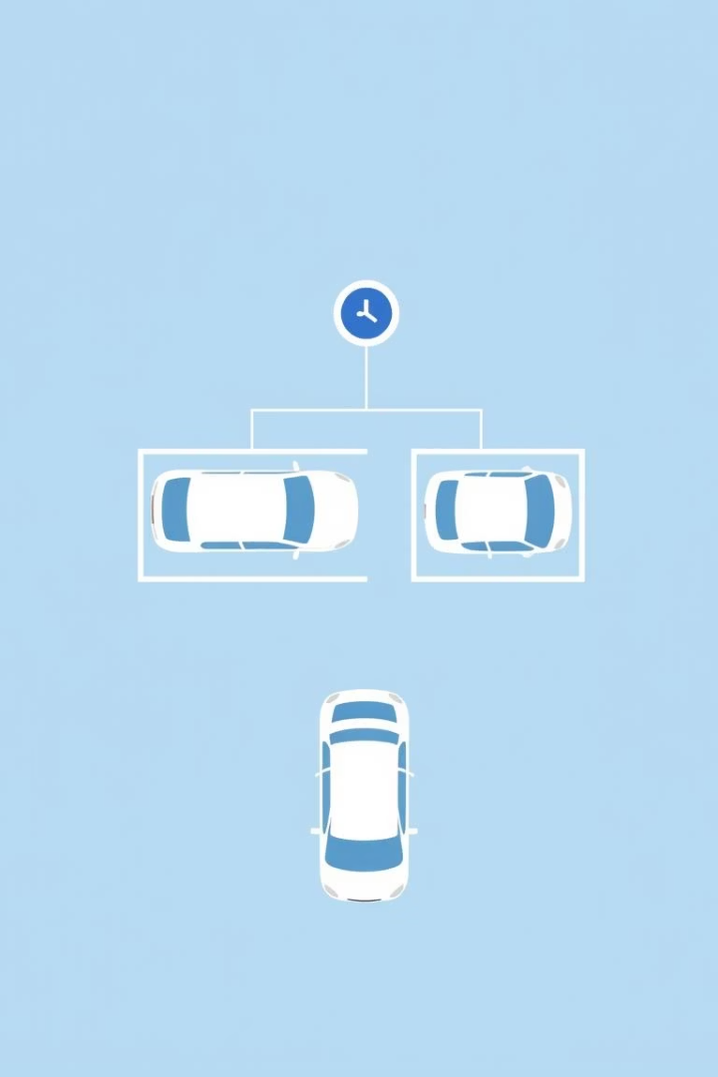
Parking Lot Data Structure
Vehicle Struct
Queue Representation
Stores vehicle plate numbers in an array.
Uses front and rear indices to manage vehicles entering and exiting.
Maximum Capacity
Parking lot size limited to 10 vehicles using MAX constant.

Slide 5
ALGORITHM:
This slide contains the C code for a Parking Lot Management program
The program allows users to perform various operations on a parking lot, such as adding vehicles, removing vehicles, checking available space, and displaying parked vehicles
The program uses a queue data structure to manage the vehicles in the parking lot
The key functions include:
isFull() and isEmpty() to check the status of the parking lot
addVehicle() to add a new vehicle to the parking lot
removeVehicle() to remove a vehicle from the parking lot
checkSpace() to check the available space in the parking lot
displayVehicles() to display the vehicles currently parked in the lot
The menu() function provides a user interface for interacting with the program
The main() function handles the user input and calls the appropriate functions based on the user's choice
Notes:
This slide contains the C code for a Parking Lot Management program The program allows users to perform various operations on a parking lot, such as adding vehicles, removing vehicles, checking available space, and displaying parked vehicles The program uses a queue data structure to manage the vehicles in the parking lot The key functions include: isFull() and isEmpty() to check the status of the parking lot addVehicle() to add a new vehicle to the parking lot removeVehicle() to remove a vehicle from the parking lot checkSpace() to check the available space in the parking lot displayVehicles() to display the vehicles currently parked in the lot The menu() function provides a user interface for interacting with the program The main() function handles the user input and calls the appropriate functions based on the user's choice

Slide 6
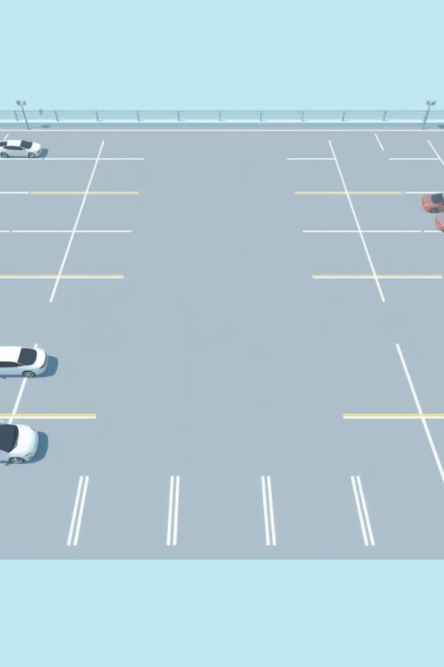
Checking Lot Status
IsFull Function
IsEmpty Function
Returns true if rear equals maximum index (lot full).
Returns true if no vehicles are parked.
Space Availability
Calculates available spots as capacity minus occupied spots.

Slide 7





Adding Vehicles to the Lot
Step 1: Check capacity
Verify if the lot is full before parking.
Step 2: Input Plate Number
Read and store the vehicle plate number.
Step 3: Update Indices
Set front or increment rear position.
Step 4: Confirm Parking
Notify vehicle spot allocation.

Slide 8

Removing Vehicles from the Lot
Adjust Indices
Remove Front Vehicle
Move front index forward; reset if empty.
Check if Lot is Empty
Remove vehicle at the front of the queue.
Prevent removal if no vehicles.

Slide 9
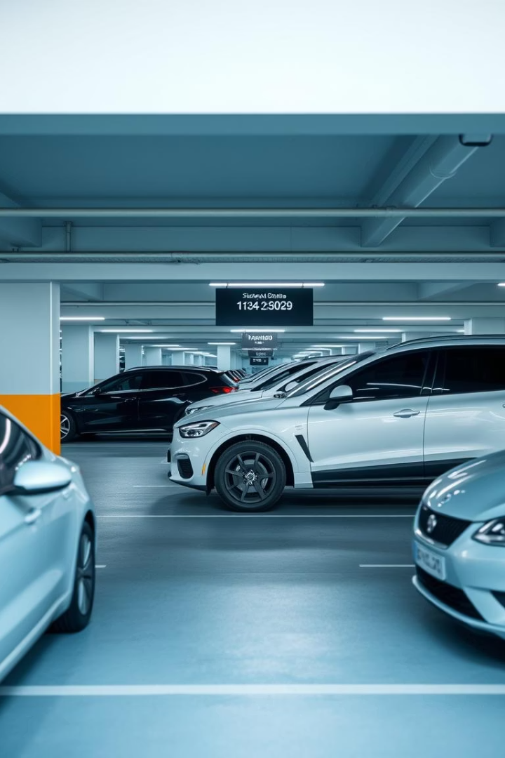
Displaying Parked Vehicles
Spot Number
Plate Number
Front Index
First vehicle's plate
Rear Index
Last vehicle's plate
Loop Through Vehicles
Print details from front to rear

Slide 10
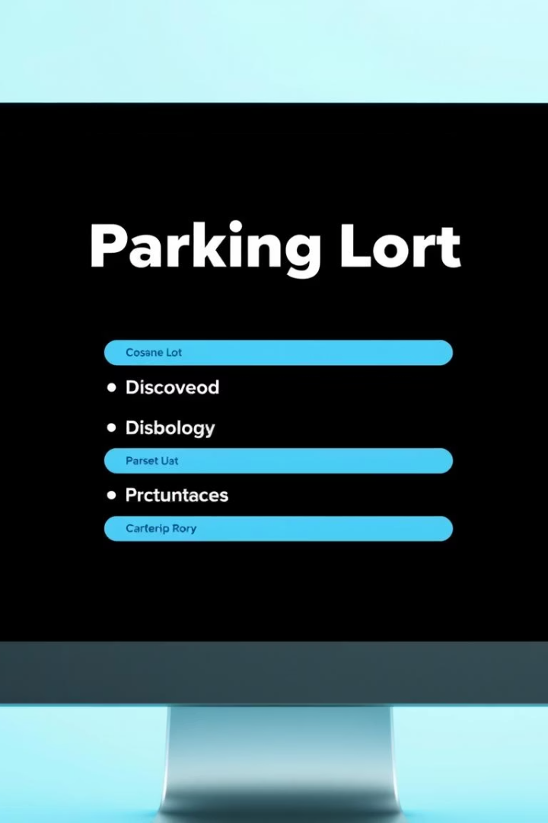




User Interaction & Menu
Add Vehicle
Remove Vehicle
Check Space
Option 1 to park a new vehicle.
Option 2 to remove a parked vehicle.
Option 3 displays available spots.
Display Vehicles
Option 4 lists all parked vehicles.

Slide 11
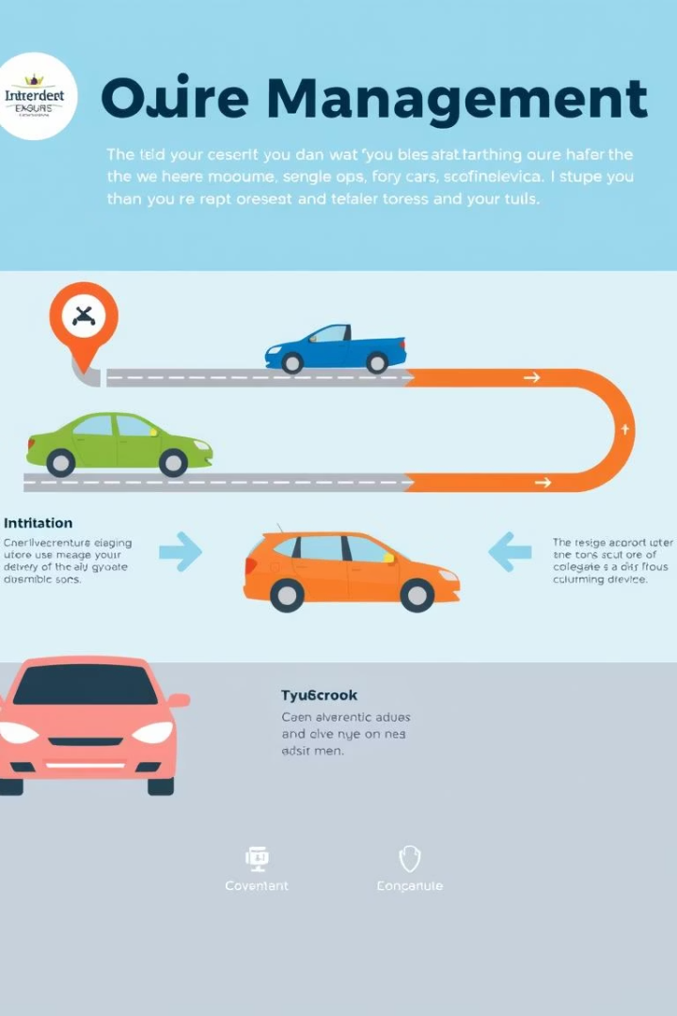
Summary and Key Takeaways
Queue-based Parking
Capacity Enforcement
Front and rear indices manage vehicles FIFO style.
Checks prevent parking when full or removing when empty.
Interactive Console Menu
User inputs control parking operations efficiently.

