Slide 1
SQL || DATA Mart Case Study
Deepak Chawde

Slide 2
Data Dart is my latest venture and I want your help to analyze the sales and performance of my venture. In June 2020 - large scale supply changes were made at Data Mart. All Data Mart products now use sustainable packaging methods in every single step from the farm all the way to the customer.
I need your help to quantify the impact of this change on the sales performance for Data Mart and its separate business areas.

Slide 3
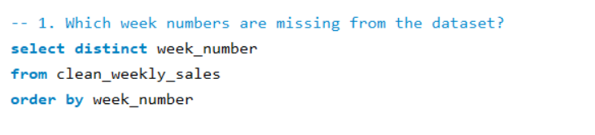
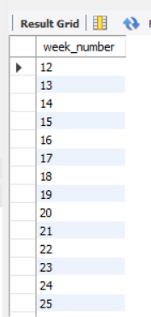
-- 1. Which week numbers are missing from the dataset?

Slide 4
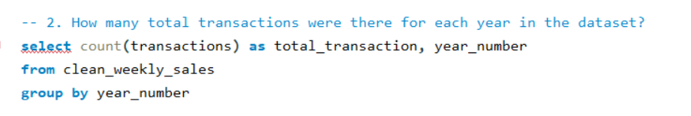
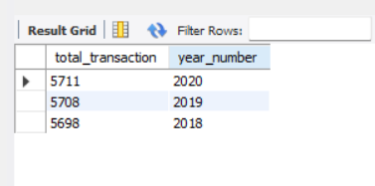
-- 2. How many total transactions were there for each year in the dataset?

Slide 5
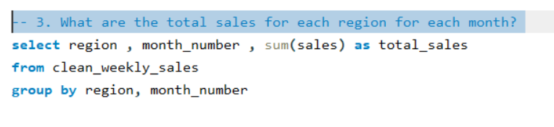
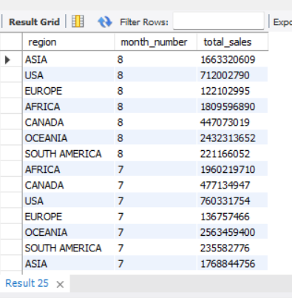
-- 3. What are the total sales for each region for each month?

Slide 6
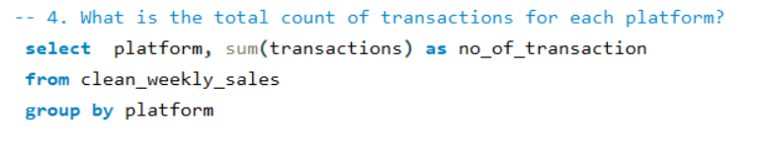
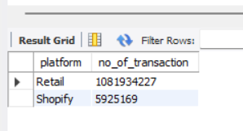
-- 4. What is the total count of transactions for each platform?

Slide 7
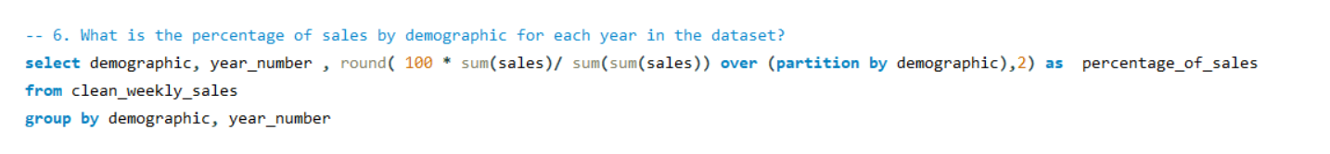
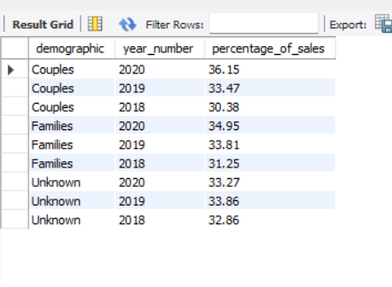
-- 6. What is the percentage of sales by demographic for each year in the dataset?

Slide 8
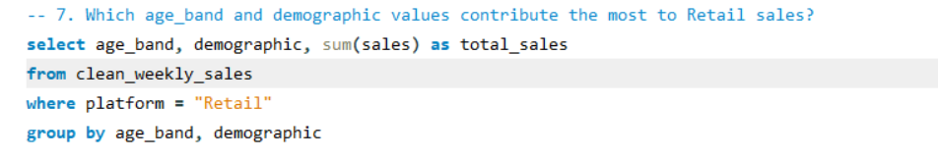
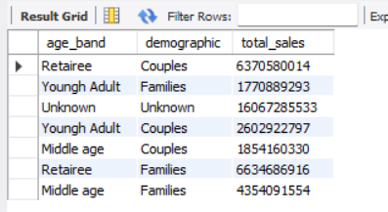
-- 7. Which age_band and demographic values contribute the most to Retail sales?

Slide 9
Thank you

