Slide 1
Python
Python is an interpreted, object-oriented programming language similar to PERL, that has gained popularity because of its clear syntax and readability
Note: Python is case Sensitive

Slide 2
Why Python ?
Python works on different platforms (Windows, Mac, Linux, Raspberry Pi, etc.)
Python has a simple syntax similar to the English language.
Python has syntax that allows developers to write programs with fewer lines than some other programming languages.
Python runs on an interpreter system, meaning that code can be executed as soon as it is written. This means that prototyping can be very quick.
Python can be treated in a procedural way, an object-orientated way or a functional way.

Slide 3
Python Applications
web development (server-side)
software development
Mathematics – Scipy, Numpy
system scripting
Astropy
Earthpy
Boto 3

Slide 4
Boto 3
Boto is the Amazon Web Services (AWS) SDK – Software Development Kit for Python. It enables Python developers to create, configure, and manage AWS services, such as EC2 and S3. Boto provides an easy to use, object-oriented API, as well as low-level access to AWS services.

Slide 5
Levels of Language
High level Language
C, C++
Python
Java
Assembly level Language
Micro Processor Language – 8085,8086
Low level Language
Machine Language – 1011 0001

Slide 6
High level Language
C,C++ - Compiler
Python - Interpreter
Java – Interpreter/Compiler
Compiler
It converts instructions into a machine-code or lower-level form so that they can be read and executed by a computer.
Interpreter
It can analyze and execute a program line by line.

Slide 7
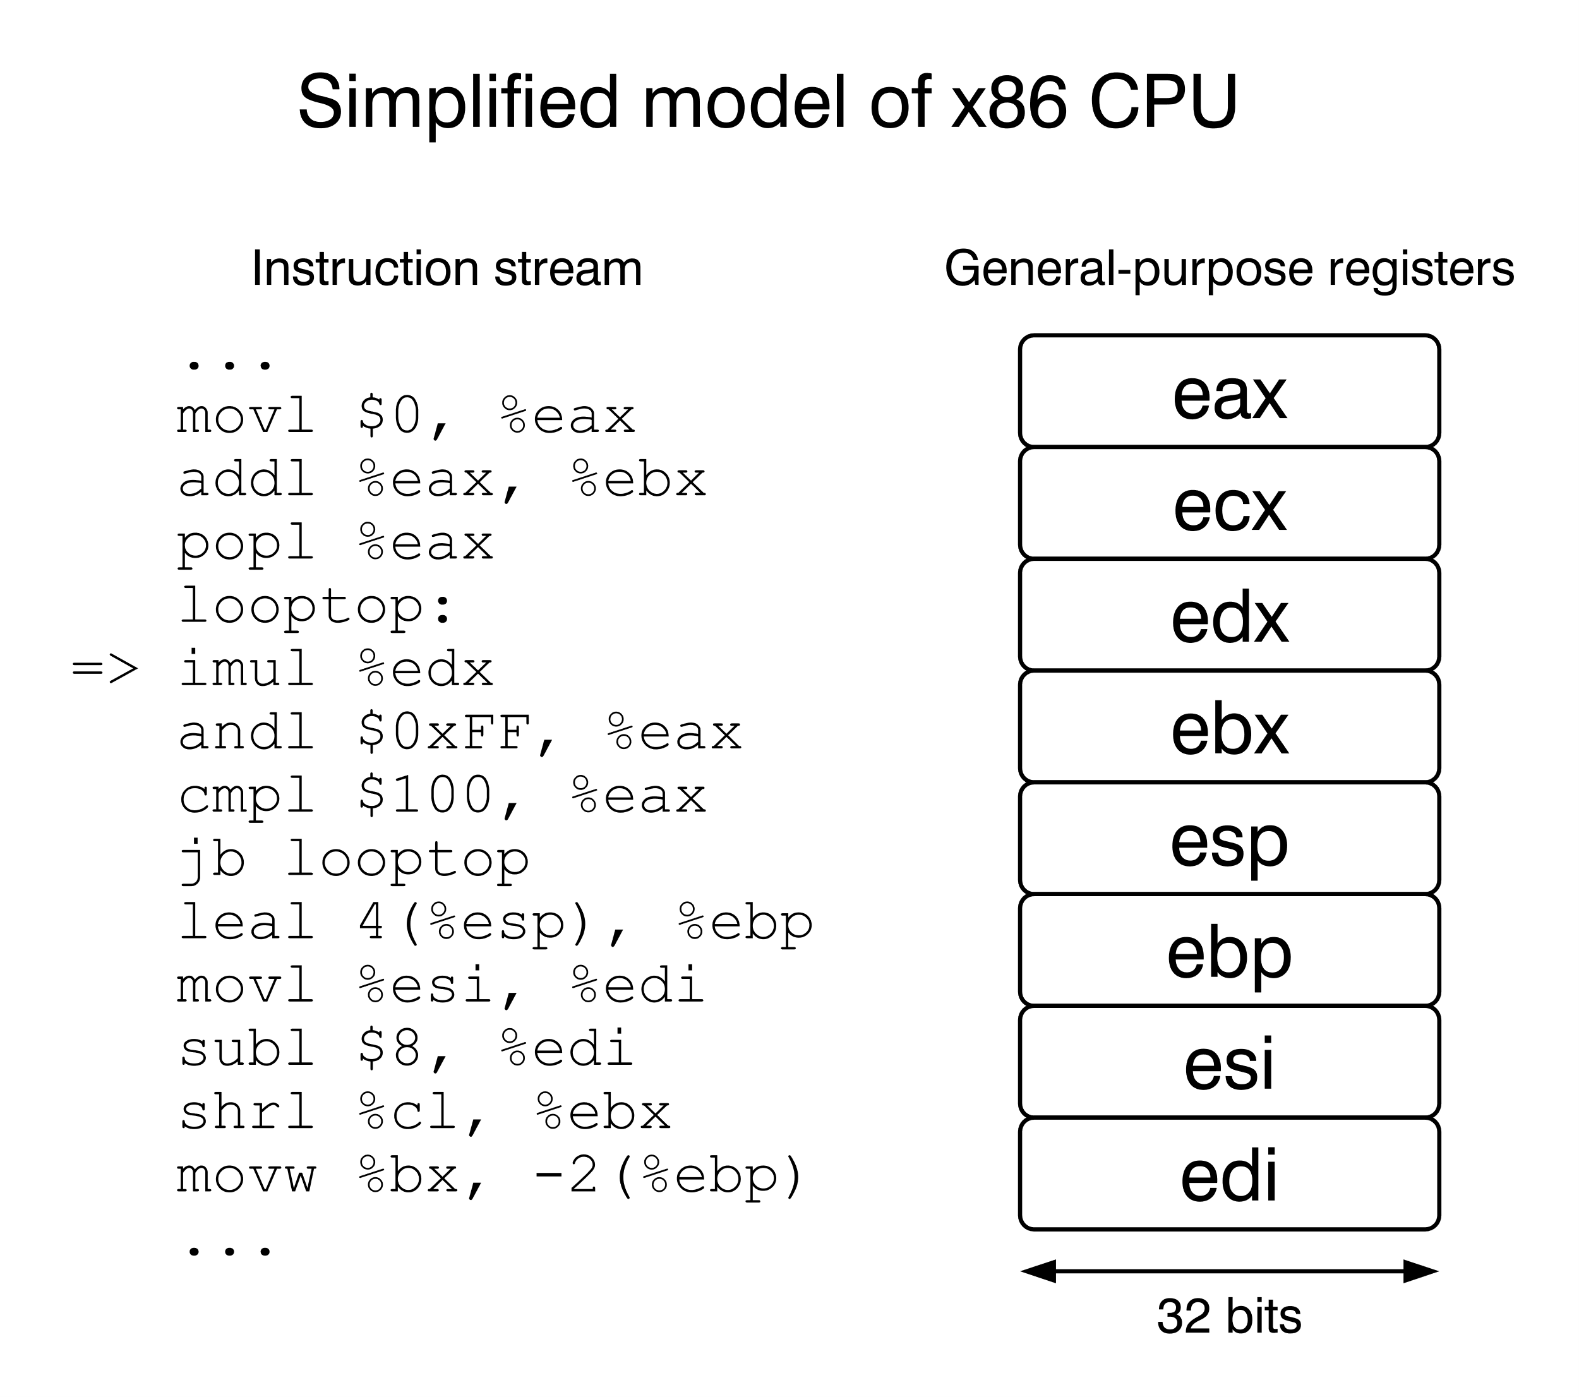
Assembly level & Low level
Assembly level Language
An assembly language is a low-level programming language for microprocessors – 8085,8086
Low level Language
A Low-level language is a programming language that provides little or no abstraction of coding concepts - 1011 0011

Slide 8
History of Python
Guido van Rossum at Netherland
Python 1x - 1991
Python 2x - (2000 - Jan 1, 2020)
Python 3x (Py3K) - 2008

Slide 9
Example of C program
#include<stdio.h>
int main()
{
printf("\nHello world");
return 0;
}

Slide 10
Example of C++
#include<iostream>
int main()
{
cout<<“\nHello world”;
return 0;
}

Slide 11
Example of JAVA
class HelloWorld
{
public static void main(String args[])
{
System.out.println("Hello, World");
}
}

Slide 12
Example of Python
Print (“Hello world”)

Slide 13
Installation & IDE
IDE - Integrated Development Environment
An integrated development environment (IDE) is a software suite that consolidates basic tools required to write and test software.
CS50 ide – Python <replace with program name>
Anaconda – Spyder (Use play button to run)
Python – Direct Download (Enter to run)
Thonny
Pychram
Netbeans

Slide 14
Comments
They are used to main readability & turn On or Off any part of code
Rules to create comment:
# for a single line comment
“”” start “”” end for a multi line comment

Slide 15
Keywords
Python has a set of keywords that are reserved words that cannot be used as variable names, function names, or any other identifiers:
Examples :
True, False, class, finally, is, id, return, None, continue, for, lambda, try, def, from, while, and, del, type, global, not, with, as, elif, if, or, else, break, except, in.

Slide 16
Variables
A data item that may take on more than one value during the runtime of a program.
Rules:
Starts with Alphabets or underscore (a-z, A-Z, _)
Can be a combination of Alphabets, Underscore & Number
Cannot be Keywords

Slide 17
Data Types
Integer – 1, 1244, -1234
Float – 1.0, 1e10, 123.324
complex – 1+0j
string – “Hello world”, “a”, ‘a’
bool – True, False

Slide 18
Trio : value, id, type
Each variables has three types a value, id and its type. We can access them by using built in functions named id(), type(). Normally value is accessed easily but to know its id and type these functions are used.

Slide 19
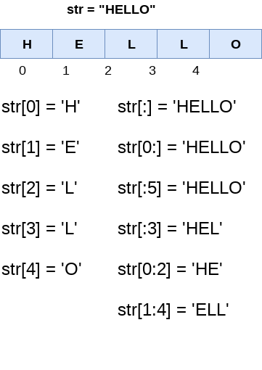
String
Strings are represented in the form of arrays in Python they are either represented by “ ” or ‘ ’

Slide 20
Type casting
There may be times when you want to specify a type on to a variable. This can be done with casting. In simplified terms one data type can be converted to another data type.
Function for Type casing
int()
float()
str()
list()
tuple()
set()

Slide 21
Input from user
Function – input()
Input always recognizes the user input word as string what ever data type it may be Type casting is used to convert the user given input to specific data type

Slide 22
Operators
Arithmetic operators +, -, *, / ,** ,//
Assignment operators =, +=, -=, /=, *=
Comparison operators ==, !=, >, <
Logical operators and, or, not
Identity operators is, is not
Membership operators in, not in
Bitwise operators &, |, ^

Slide 23
Python Collections
List is a collection which is ordered and changeable. Allows duplicate members. Denoted by []
Tuple is a collection which is ordered and unchangeable. Allows duplicate members. Denoted by ()
Set is a collection which is unordered and unindexed. No duplicate members. Denoted by {}
Dictionary is a collection which is unordered, changeable and indexed. No duplicate members. Denoted by {key, value}

Slide 24
Modules & Library
import modules
Re-usability of code is the main advantage of any programming language. It helps to minimize the need for writing code for the same problem when it is already solved.
import keyword is used to import from other modules.
Example:
math , random , statistics , os

Slide 25
Escape sequences
They are used to modify the outputs in command line or to print reserved keys.
\\ - prints \
\’ – prints ‘
\” – prints “
\n – prints a new line
\t – prints a 5 spaces(tab)
\v – prints a newline with 5 spaces(tab)

Slide 26
If … Else
Python uses If else to choose between choices, its called as Decision statement
Keywords
if
else
elif

Slide 27
While loop
With the while loop we can execute a set of statements as long as a condition is true.
Keywords
while
break
continue

Slide 28
For loop
For loop is used for iterating over a sequence (that is either a list, a tuple, a dictionary, a set, or a string). With the for loop we can execute a set of statements, once for each item in a list, tuple, set etc.
Keyword
for
range – used for numbers

Slide 29
Function
A function is a block of code which only runs when it is called. You can pass data, known as parameters, into a function. A function can return data as a result.
Keyword
def <function name> ():

Slide 30
Recursion
A function is called within a function is called Recursion. Recursion is a common mathematical and programming concept. It means that a function calls itself. This has the benefit of meaning that you can loop through data to reach a result.
The developer should be very careful with recursion as it can be quite easy to slip into writing a function which never terminates, or one that uses excess amounts of memory or processor power. However, when written correctly recursion can be a very efficient and mathematically-elegant approach to programming.

Slide 31
Classes & Objects
Python is an object oriented programming language. Almost everything in Python is an object, with its properties and methods. A Class is like an object constructor, or a "blueprint" for creating objects.
Objects are instance of a class that can be created and destroyed later
Keywords
class
__init__()
del

Slide 32
Inheritance
Inheritance allows us to define a class that inherits all the methods and properties from another class.
Parent class is the class being inherited from, also called base class.
Child class is the class that inherits from another class, also called derived class.

Slide 33
Self parameter
The self parameter is a reference to the current instance of the class, and is used to access variables that belongs to the class. It does not have to be named self , you can call it whatever you like, but it has to be the first parameter of any function in the class:

Slide 34
Iter & Next
An iterator is an object that contains a countable number of values.
An iterator is an object that can be iterated upon, meaning that you can traverse through all the values.
Technically, in Python, an iterator is an object which implements the iterator protocol, which consist of the methods iter() and next().
String, lists, tuples, dictionaries, and sets are all iterable objects. They are iterable containers which you can get an iterator from.

Slide 35
Exception Handling
Try … Except … finally
The try block lets you test a block of code for errors.
The except block lets you handle the error.
The finally block lets you execute code, regardless of the result of the try- and except blocks.
The else block works only if try is correct
Click me to see all Errors in python

Slide 36
File Handling
File handling is an important part of any web application. Python has several functions for creating, reading, updating, and deleting files.
open()
The key function for working with files in Python is the open() function.
The open() function takes two parameters; filename, and mode.
There are four different methods (modes) for opening a file:

Slide 37
Type of opening a file
"r" - Read - Default value. Opens a file for reading, error if the file does not exist
"a" - Append - Opens a file for appending, creates the file if it does not exist
"w" - Write - Opens a file for overwriting, creates the file if it does not exist
"x" - Create - Creates the specified file, returns an error if the file exists
mode
"t" - Text - Default value. Text mode
"b" - Binary - Binary mode (e.g. images)

Slide 38
Delete file
To delete a file, you must import the OS module.
Keywords
os.remove("demofile.txt") – removes file
os.rmdir("myfolder") – removes folder

