Slide 1
KEVA VISION · DELILAH
Nobody watches the cameras.
What we are building, what it found in twenty minutes, and what it will take to finish.

Slide 2
THE PROBLEM
The problem is not the cameras.
It is the hours.
39
~8 h
≈312
cameras at Delilah LA
of service, every night
camera-hours a night
Nobody can watch 312 hours. So in practice, nobody watches any of it.
Footage gets opened only after something has already gone wrong. It works as evidence. It has never worked as management.
The result: leadership learns what happened in the room from a complaint the next morning, not from the room itself.

Slide 3
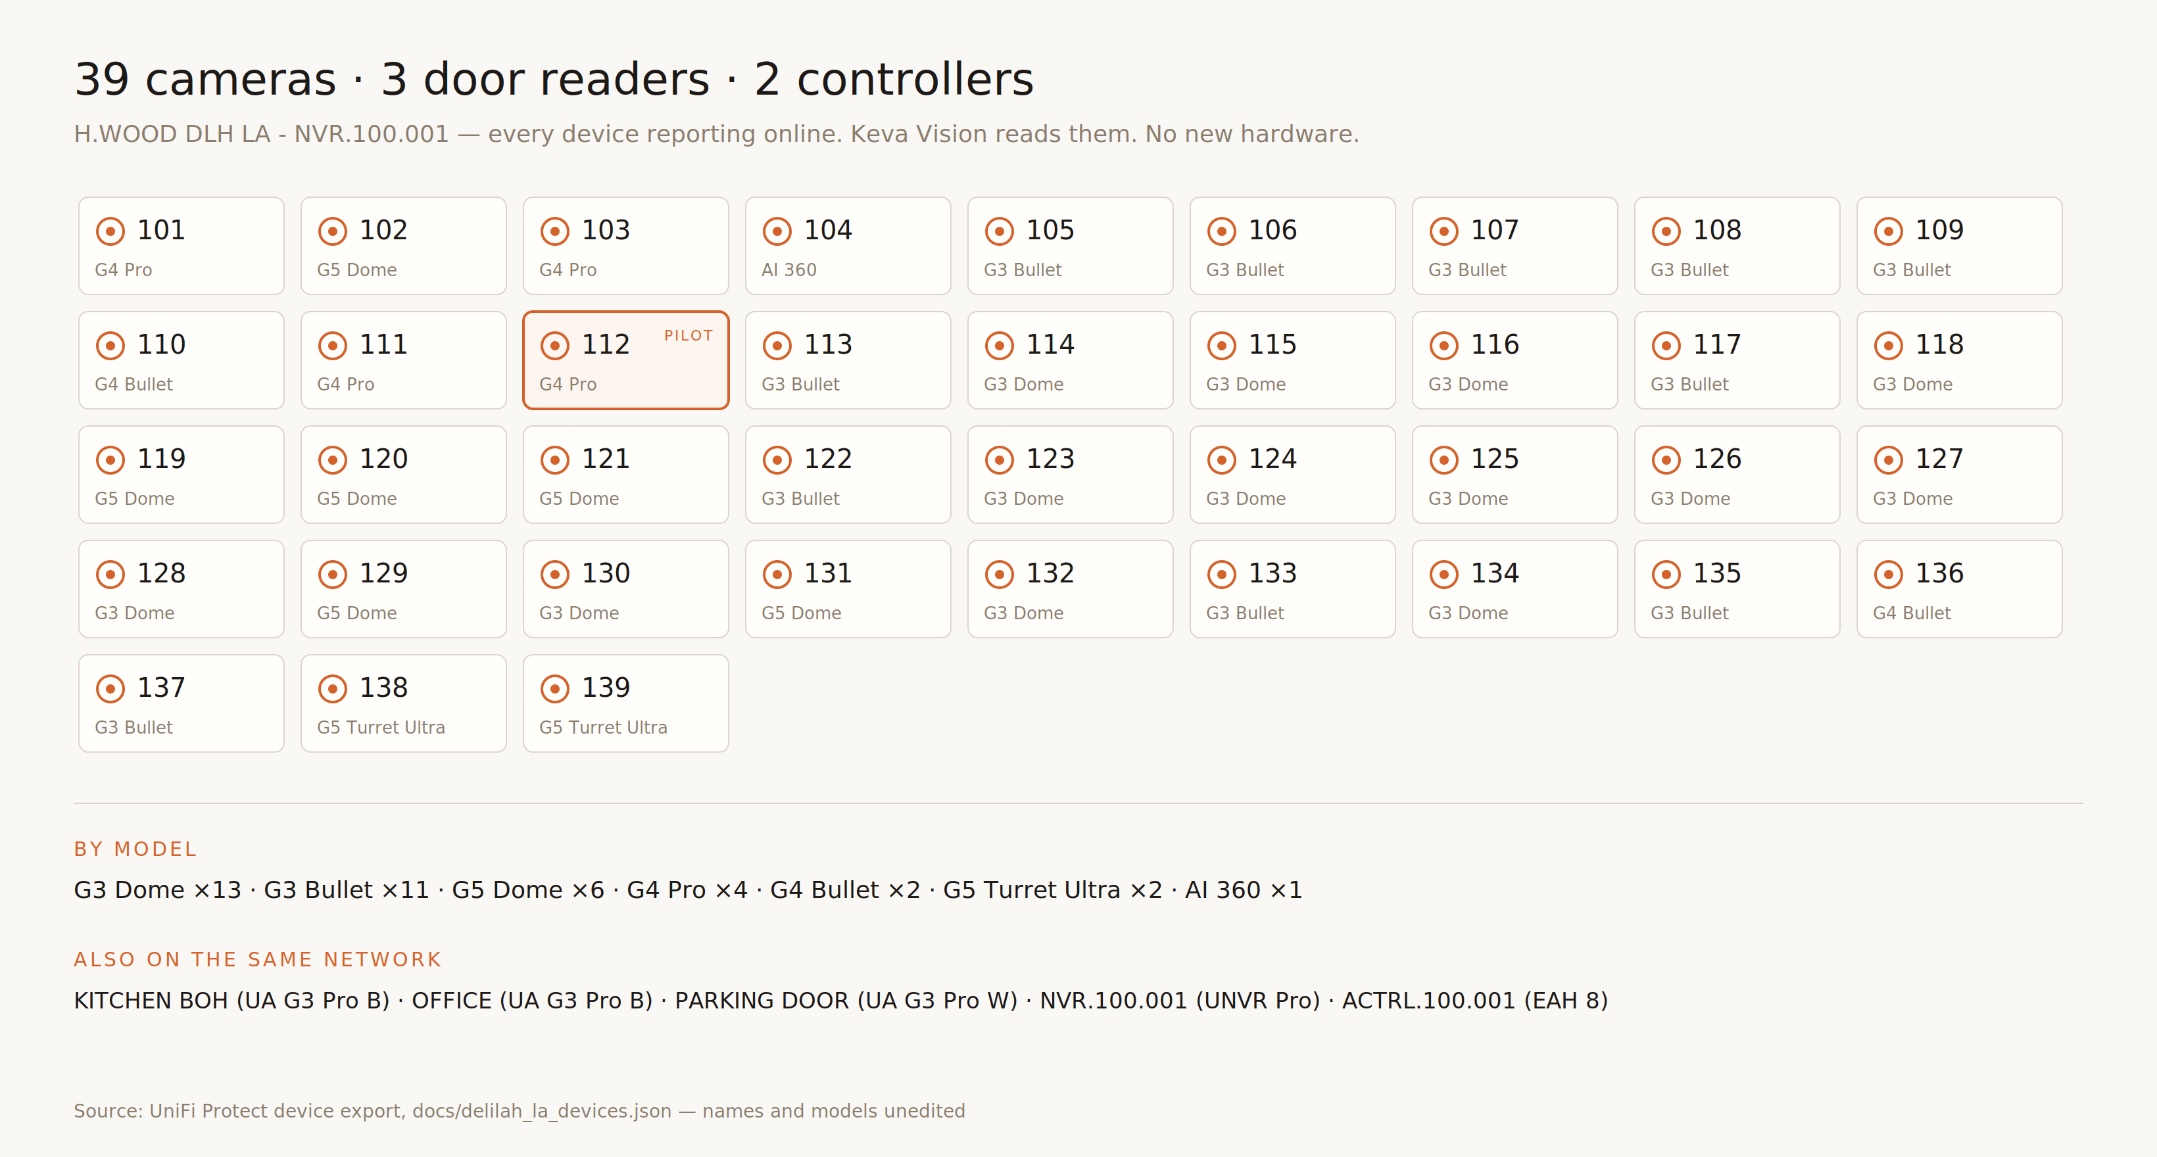
WHAT IS ALREADY IN THE CEILING
No new hardware for the pilot.
Every device here is live today on the venue's own UniFi Protect recorder. Keva Vision reads what is already recording. CAM.112 — the reception camera — is the pilot.

Slide 4
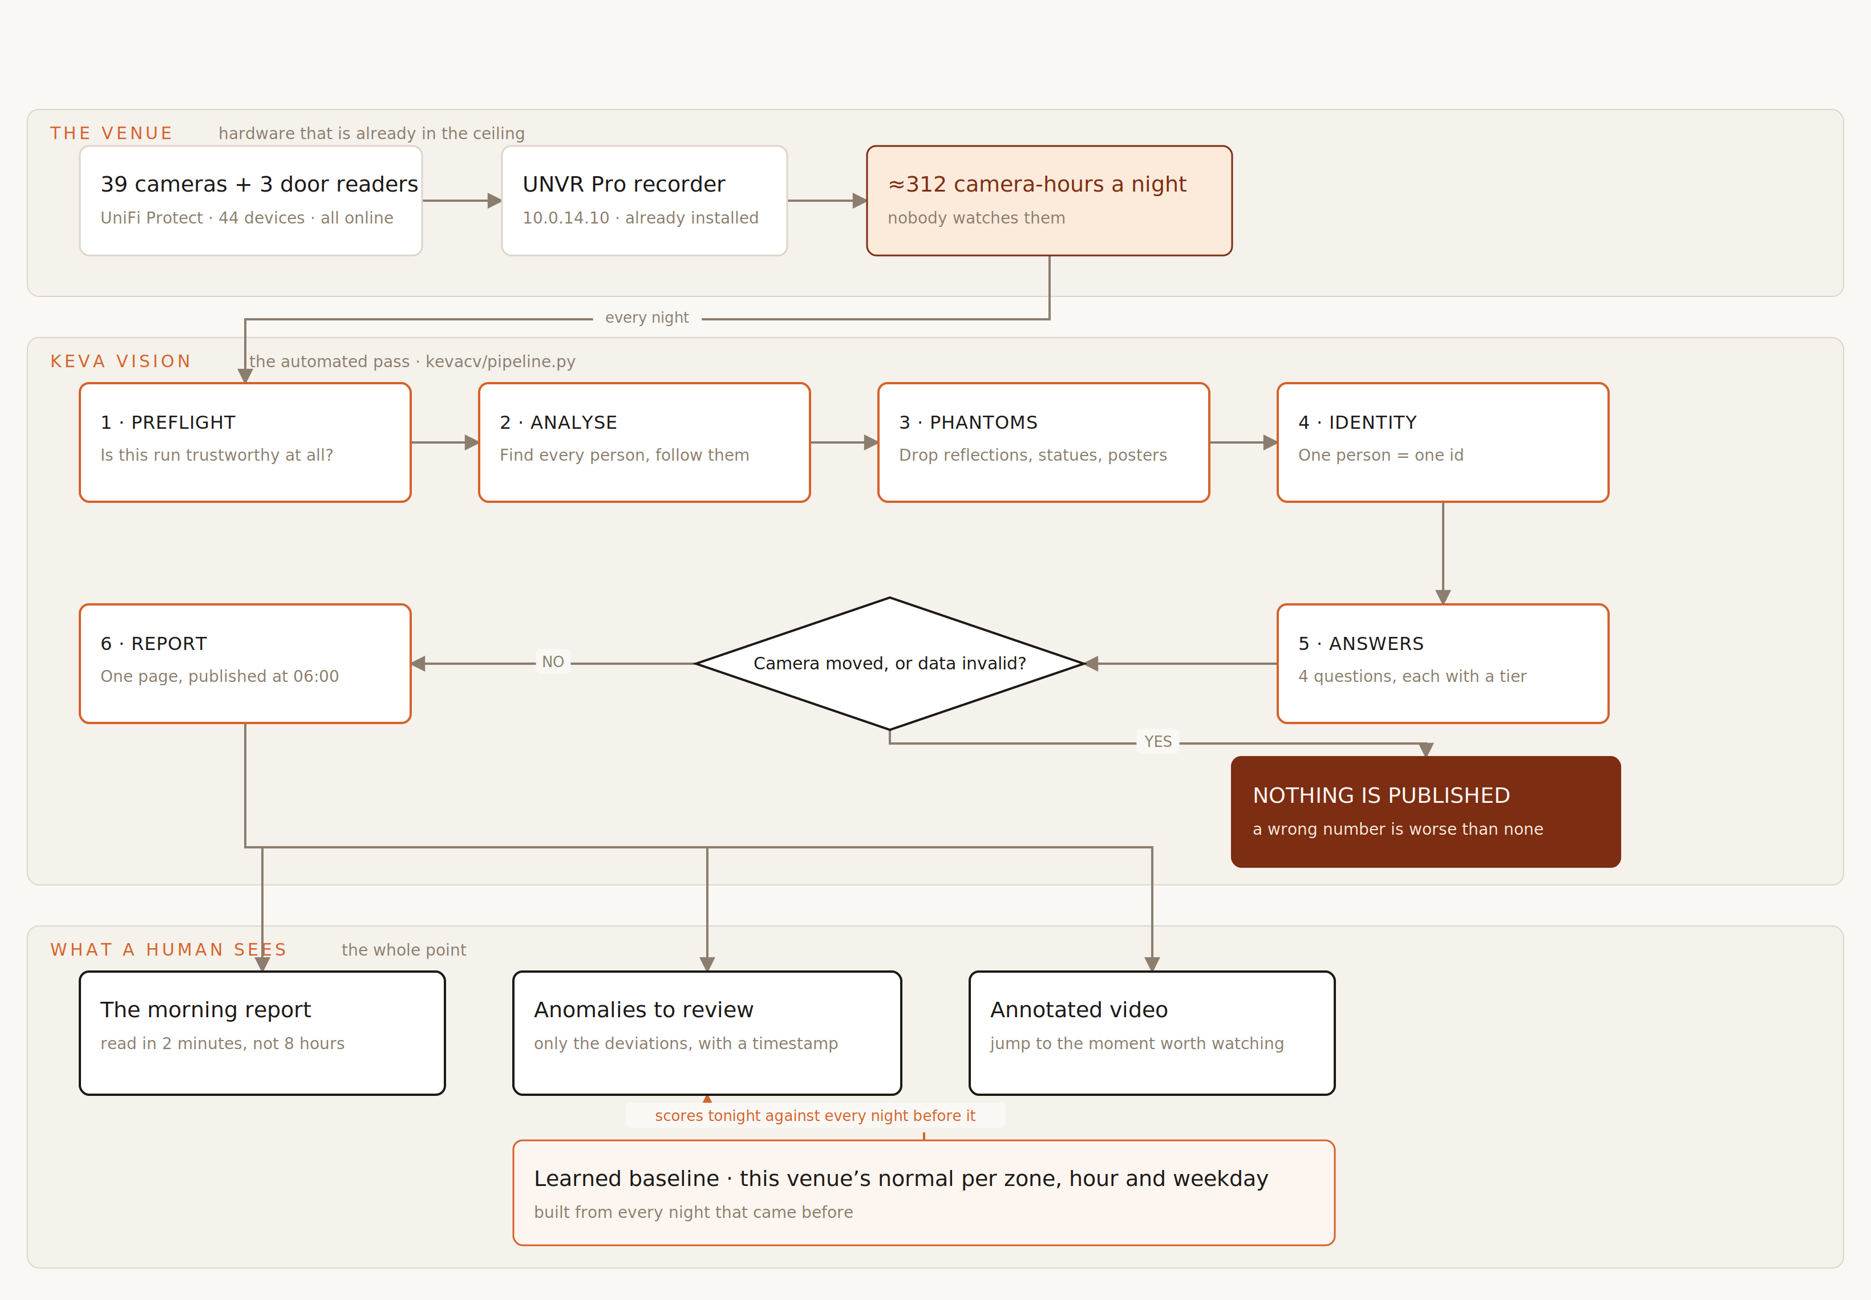
HOW IT WORKS
One night in. One page out.

Slide 5
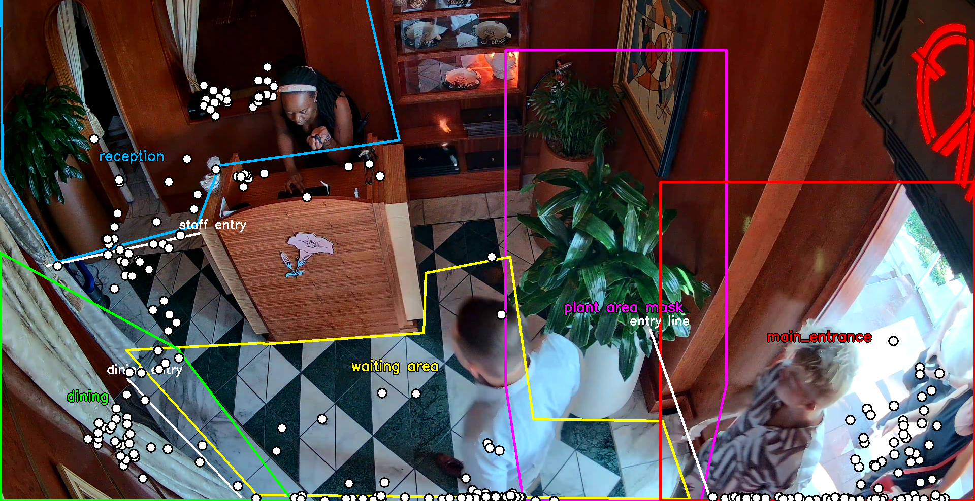
WHAT THE MACHINE IS LOOKING AT
The room, divided once.
Reception · waiting area · dining · the entry line · the main entrance. Drawn once per camera, then reused every night. The plant is masked out — it moves, and moving leaves look like people.

Slide 6
WHAT TWENTY MINUTES FOUND
The desk was empty three times.
Guests were waiting.
61.1%
3
5
desk covered · target is 90%
gaps of a minute or more
guests waited through one
This is not a capability demo. It is a finding, from twenty minutes of ordinary evening service on 28 July.
Reception went unstaffed three separate times — 3.4 minutes from 08:32, 1.9 minutes from 15:04, and 1.6 minutes from 17:44. During the first, five guests stood in the waiting area with nobody at the desk.
Three times in twenty minutes is not a fluke — it is a pattern nobody could have seen without watching the whole night.
No manager watched this footage. Nobody had to. It arrived as a line on a page the next morning.

Slide 7
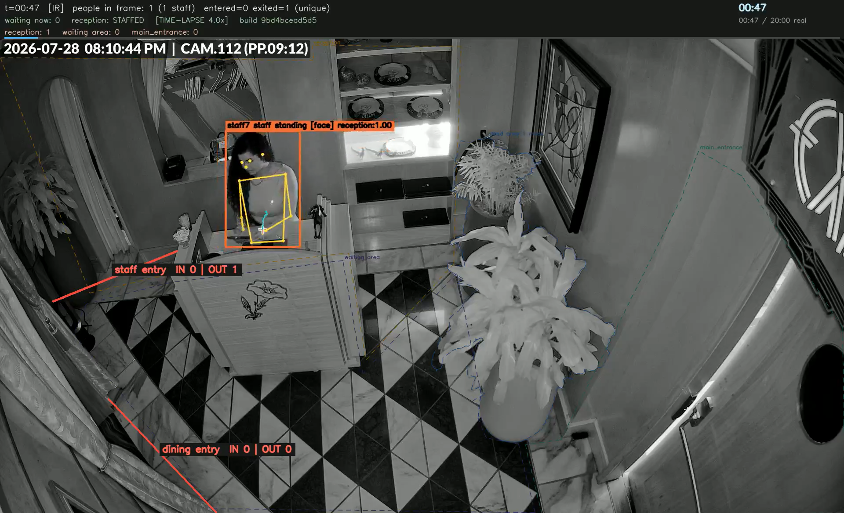
THE RESULT, PLAYED
Watch the desk go empty.
WHAT TO LOOK FOR
01
It opens on ordinary service — the HUD top left reads reception: STAFFED. Watch that word.
02
At 38 seconds it flips to AWAY and the copper bar appears. That is the first of the three gaps, caught live.
03
Watch 'waiting now' climb to 4 while the desk reads AWAY. Those are the guests standing there with nobody to greet them.
04
Orange box = staff, blue box = guest. The role comes from behaviour, not from uniforms. Names like 'staff1' are face-matched against staff photographs.
05
At 1:28 the desk reads STAFFED again. The gap ran 3.4 minutes of real service.
CAM.112 · 2026-07-28, 20:15–20:22 · 96 s · 4× speed. Embedded in this file — press play. Full-resolution master: docs/deck/keva_vision_demo_clip.mp4

Slide 8
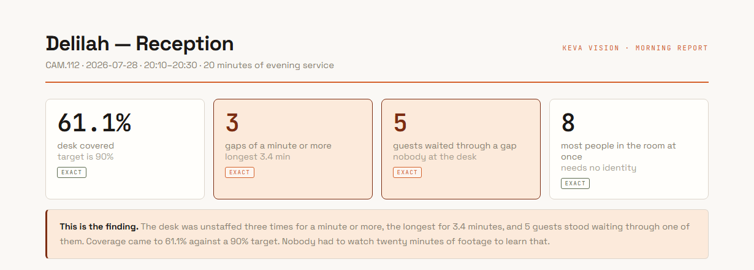
WHAT LANDS AT 06:00
The finding, on one page.
—
Every figure carries a confidence label. EXACT means measured directly; PROXY means a stand-in signal; WEAK means do not act on it alone.
—
Desk coverage is the number we are willing to promise on — it only asks whether anyone is standing at the station, so it never depends on telling people apart.
—
Occupancy — at most 8 in the room — is the other reliable one, for the same reason: it counts bodies visible, not identities.

Slide 9
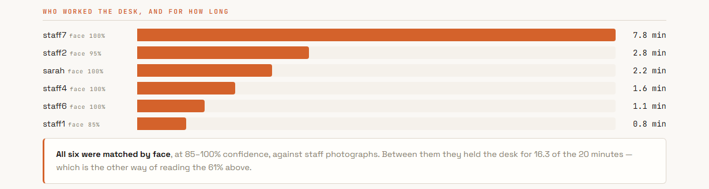
WHO ACTUALLY HELD THE DESK
Six people, all matched by face.
Every one of the six was matched against a staff photograph at 85–100% confidence. Between them they held the desk for 16.3 of the 20 minutes — which is the other way of reading 61%.

Slide 10
THE NUMBER IT GOT WRONG
It counted 168 guests. The room held 8.
WHAT IT REPORTED
WHY IT IS WRONG
WHY WE ARE SHOWING YOU
168 unique guests, tagged WEAK.
At most 8 people were ever in the room at once, and the busiest single frame held 10.
Because the system said it first. The report prints the word IMPLAUSIBLE next to its own number and tells the reader to use the identity-free count instead.
Two other counting methods disagreed with it and with each other: a line across the door said 36, a region on the floor said 10.
Even a complete turnover every two minutes only reaches about 80 people in twenty minutes.
A tool that hides a bad number costs you a decision. This one refuses to let 168 be quoted.
In an earlier one-hour run those two methods agreed exactly. On this footage they do not.
So 168 identities means the system is splitting one person into several as they move — 158 of those 168 never crossed the door at all.
The desk-coverage finding on the previous slides does not depend on identity at all, which is exactly why we lead with it.
Every figure here is read straight out of the run's own scorecard and summary — including the one it got wrong.

Slide 11
ANOMALIES
We do not set thresholds.
It learns the venue.
per zone
per hour
per weekday
reception, dining, entry
20:00 is not 23:00
Tuesday is not Saturday
The system builds a picture of what normal looks like for this room, at this hour, on this day of the week — from its own history.
Then it raises only what genuinely deviates. Nobody hand-tunes a number, and nobody re-tunes it per venue.
It has not earned that yet here. This run flagged nothing, because one twenty-minute clip is not a history — the three desk gaps were measured, not flagged. More nights is what turns the second into the first.

Slide 12
WHERE WE ACTUALLY STAND
The honest slide.
PROVEN, MEASURED
KNOWN GAPS
WHAT CLOSES THEM
A twenty-minute run produced a real operational finding: three desk gaps, 3.4 min at worst, five guests waiting.
Identity fragments: 205 tracks became 162 chains, and the guest count blew out to 168 against a true ceiling of ~8 in the room.
A labelling pass — a person marks a few hours of real footage. The single biggest credibility unlock, and what turns 'self-graded' into 'accurate'.
Six staff matched to photographs by face at 85–100% confidence.
Greet time is a proximity proxy, and 9 guests were never approached at all — we cannot yet separate a service failure from a measurement one.
Re-train the detector on our own frames rather than generic ones, which is what stops the fragmenting.
The floor geometry now solves exactly, from 36 measured correspondences rather than an estimate.
167 grid cells inside a counted zone never produced a single detection: either nobody stood there, or we are blind there.
A second angle at the entrance, which is what moves counting from a range to a number.
Desk coverage and peak occupancy need no identity, so they hold even while identity does not.
More nights, so the anomaly baseline has a normal to compare against.
No hand-labelled footage, so the system still grades its own homework.
Every figure here is measured and reproducible from the run artefacts. Nothing on this slide is a projection.

Slide 13
WHAT WE NEED
Three decisions.
01
Approval to run on live footage
Move off saved clips and onto the nightly stream from the venue's own recorder. This is the gate that turns a demonstration into a service — and the only way the anomaly baseline ever gets a history to learn from.
02
Infrastructure budget
A GPU machine to process a night's footage before morning. Twenty minutes of one camera renders in five — figure attached separately.
03
A second camera angle at the entrance
The one thing software cannot substitute for. It is what fixes the counting problem on the previous slide.
What comes back: a nightly one-page report, and an annotated video that jumps straight to the moment worth watching — like the one you just saw.

