Slide 1
STATISTICS
Presented By
Deepak Sharma

Slide 2
Topics Covered
Measure Of Location
Measure of Variability
Measure of Shape
Random Variables
Measure of Scale
Normalisation/Standardization of Data
Central Limit Theorem
Confidence Interval
Test Statistic
Hypothesis
Analysis of Variance
One Way Analysis of Variance
Covariance, Correlation and Collinearity

Slide 3
Measure of Location
Mean – The value obtained by summing all elements in a set and dividing by the number of elements
Median –A measure of central tendency give as the value above which half of the values fall and below which half of the values fall
Mode – A measure of central tendency given as the value that occur the most in a sample distribution.

Slide 4
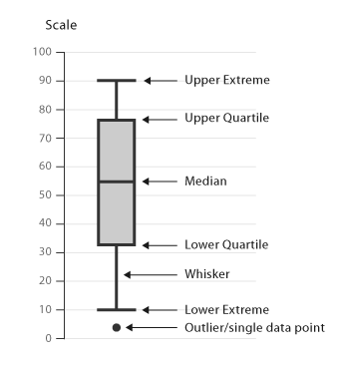
Measure of Variability
Range – The difference between the largest and the smallest values of distribution
Interquartile Range – The range of a distribution encompassing the middle 50% of the observation

Slide 5
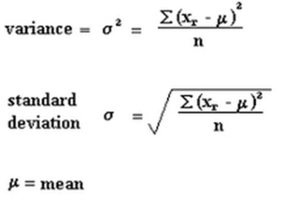
Measure of Variability
Variance – The mean squared deviation of all the values from the mean
Standard Deviation – The square root of the variance
Coefficient of Variation – A useful expression in sampling theory for the standard deviation as a percentage of mean

Slide 6
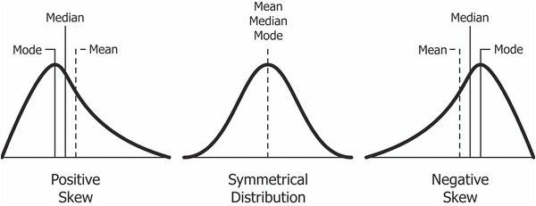
Measure of Shape
Skewness – A characteristic of a distribution that assesses its symmetry about he mean
Kurtosis – A measure of the relative peakedness or flatness of the curve defined by the frequency distribution.

Slide 7
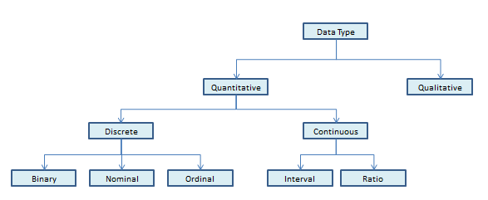
Types of Data

Slide 8
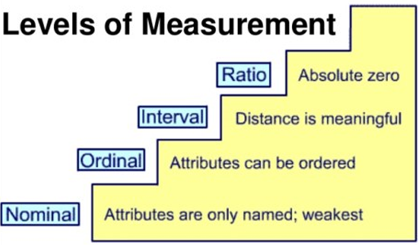

Slide 9
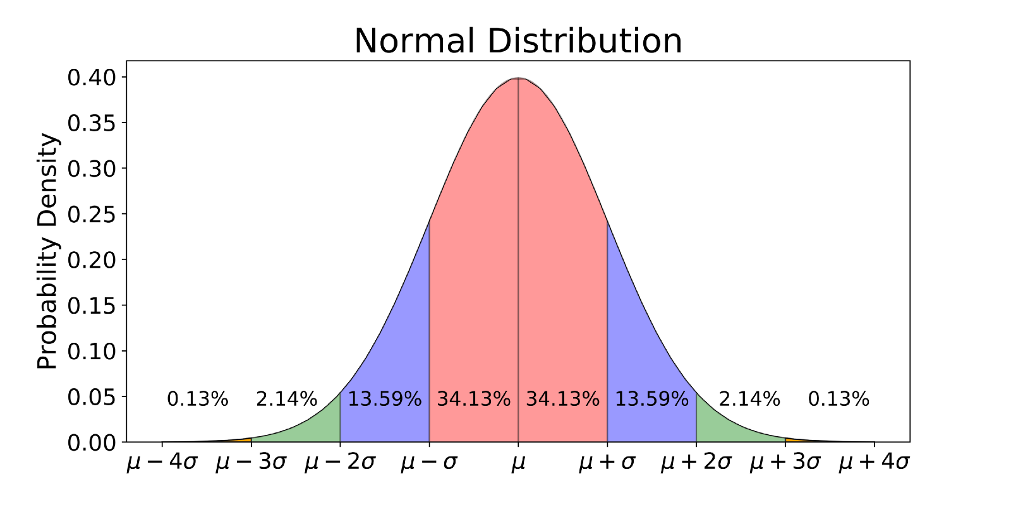
Normal Distribution

Slide 10
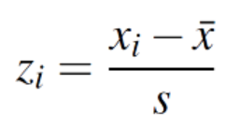
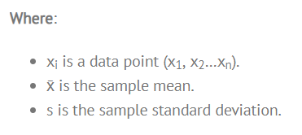
Normalization/Standardization
Normalization usually means to scale a variable to have a values between 0 and 1
Standardization transforms data to have a mean of zero and a standard deviation of 1. This standardization is called a z-score, and data points can be standardized with the following formula:

Slide 11
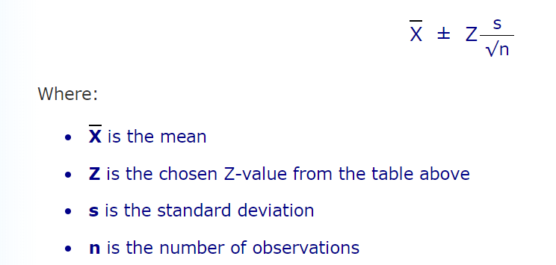
Central Limit Theorem
The sampling distribution of the sampling means approaches a normal distribution as the sample size gets larger, regardless of the shape of the population distribution.
A Confidence Interval is a range of values we are fairly sure our true value lies in.
Confidence Interval

Slide 12
Hypothesis
It refers to a supposition which is not to be rejeced or rejected.
There are two hypothesis testing procedures, i.e. parametric test and non-parametric test,
Parametric test is based on the fact that the variables are measured on an interval scale. There can be two types of test (t-test and z-test)
Non-parametric test is based on the fact that the variables are measured on an ordinal scale.

Slide 13
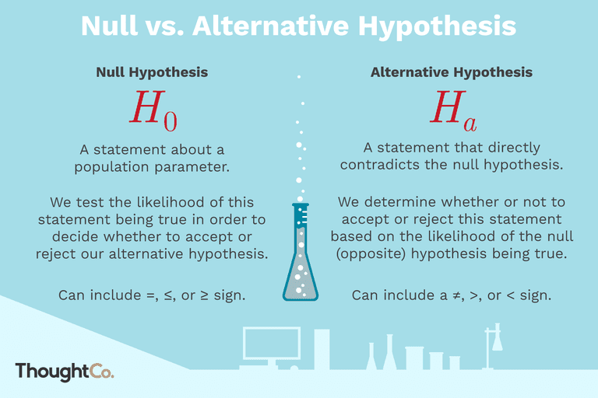

Slide 14

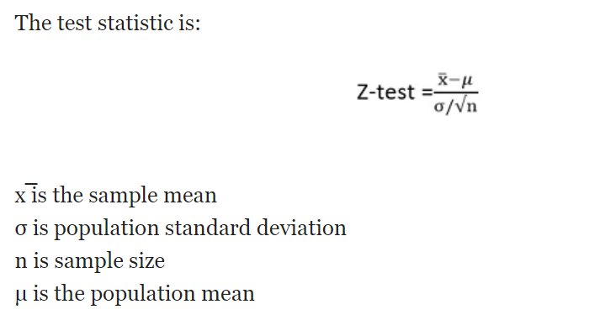
z-test
It determines to what extent a data point is away from its mean of the data set, in standard deviation
The researcher adopts z-test, when the population variance is known
When there is a large sample size
Sample variance is deemed to be approximately equal to the population variance.

Slide 15
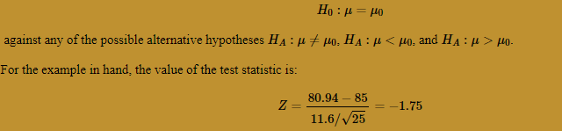
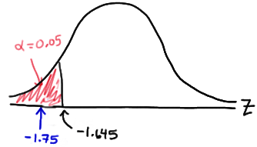
z-test
Example
Boys of a certain age are known to have a mean weight of μ = 85 pounds. A complaint is made that the boys living in a municipal children's home are underfed. As one bit of evidence, n = 25 boys (of the same age) are weighed and found to have a mean weight of x= 80.94 pounds. It is known that the population standard deviation σ is 11.6 pounds (the unrealistic part of this example!). Based on the available data, what should be concluded concerning the complaint?

Slide 16
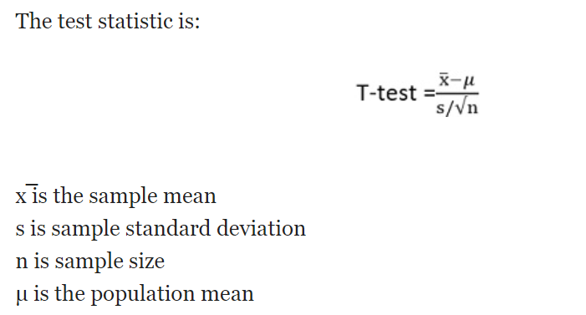
t-Test
t-test is used to examine how the means taken from two independent samples differ.
T-test follows t-distribution, which is appropriate when the sample size is small, and the population standard deviation is not known.
The shape of a t-distribution is highly affected by the degree of freedom.
The degree of freedom implies the number of independent observations in a given set of observations.

Slide 17

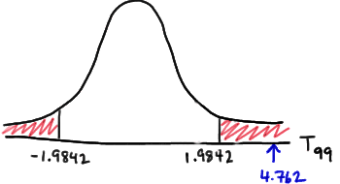
t-Test
It is assumed that the mean systolic blood pressure is μ = 120 mm Hg. In the Honolulu Heart Study, a sample of n = 100 people had an average systolic blood pressure of 130.1 mm Hg with a standard deviation of 21.21 mm Hg. Is the group significantly different (with respect to systolic blood pressure!) from the regular population?

Slide 18
Key Differences Between T-test and Z-test
The t-test is used to compare and analyse whether the means of the two population is different from one another or not when the standard deviation is not known. As against, Z-test is a parametric test, which is applied when the standard deviation is known, to determine, if the means of the two datasets differ from each other.
The t-test is based on Student’s t-distribution. On the contrary, z-test relies on the assumption that the distribution of sample means is normal.
One of the important conditions for adopting t-test is that population variance is unknown. Conversely, population variance should be known or assumed to be known in case of a z-test.
Z-test is used to when the sample size is large, i.e. n > 30, and t-test is appropriate when the size of the sample is small, in the sense that n < 30.

Slide 19
Chi-Square test
It assists us in determining whether a systematic association exists between the two categorical variables in some population.
It’s a skewed distribution whose shape depends on the number of degree of freedom.
The analysis should not be conducted if the theoretical frequencies in any cell less than 5

Slide 20
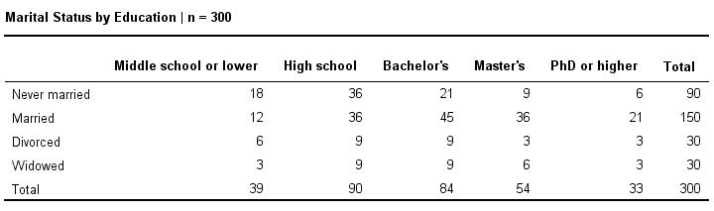
Chi-Square test
Example: a scientist wants to know if education level and marital status are related for all people in some country. He collects data on a simple random sample of n = 300 people, part of which are shown below.

Slide 21
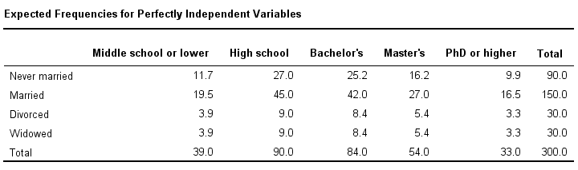
Chi-Square test
The null hypothesis for a chi-square independence test is that two categorical variables are independent in some population.

Slide 22

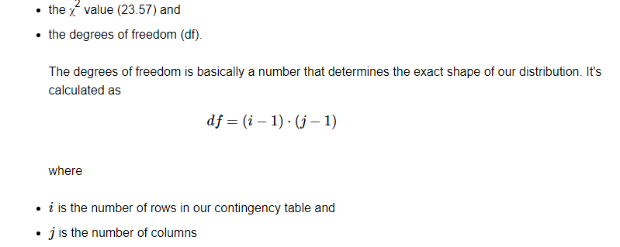

Chi-Square test

Slide 23
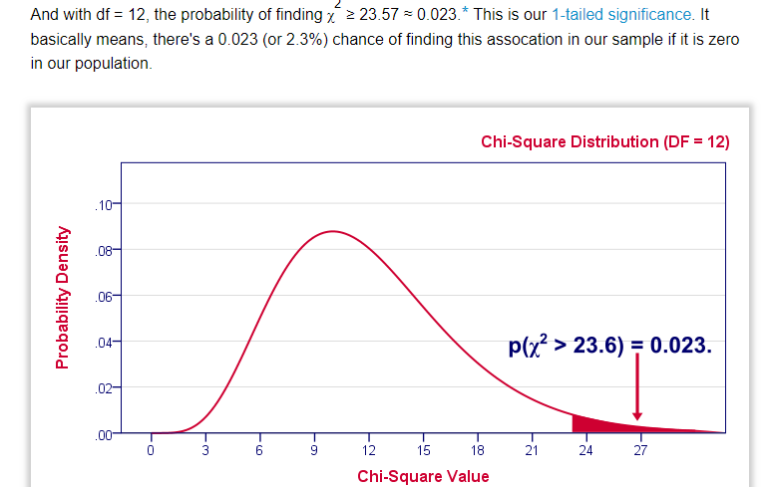
Chi-Square test
Conclusion: Marital status and Education are related

Slide 24
Anova
A statistical technique for examining the difference among mean for three or more population.
Here the dependent variable is metric and independent variables are categorical.
One-way Anova – When there is only one factor.
One-way ANOVA for comparing 3(+) groups on 1 variable: do all children from school A, B and C have equal mean IQ scores? *
Repeated measures ANOVA for comparing 3(+) variables in 1 group: is the mean rating for beer A, B and C equal for all people?*

Slide 25
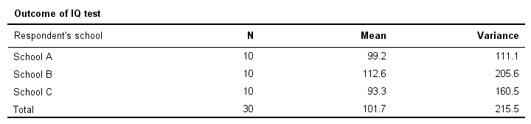
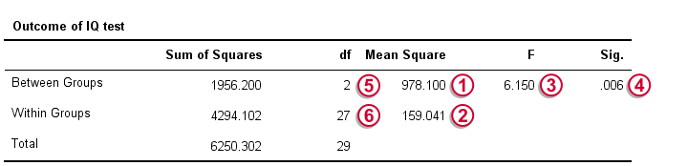
Anova
The null hypothesis for (any) ANOVA is that all population means are exactly equal.

Slide 26
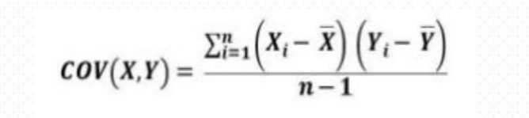
Covariance
The covariance of two variables x and y in a data sample measures how the two variables are linearly related and it is a measure of how much two random variables change together
A positive covariance would indicates a positive linear relationship between the variables, and a negative covariance would indicate the opposite.

Slide 27
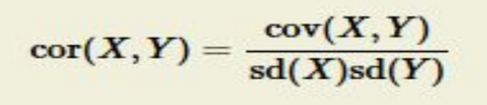
Correlation
Correlation is a statistical technique that can show whether and how strongly pairs of variables are related
It is a scaled version of covariance and values ranges from -1 to +1

Slide 28
Collinearity
Collinearity or Multicollinearity is the occurrence of several independent variables in a regression model are closely correlated to one another
Collinearity tends to inflate the variance of at least one estimated regression coefficient.
This can cause at least some regression coefficients to have the wrong sign
Get rid of the redundant variables using a variable selection technique

Slide 29
Thank You

