Slide 1
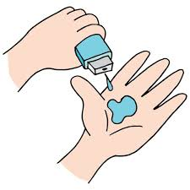
Project Title - Healthcare Analytics for Doctor Visits
Name :- Deepak Prajapat
Collage :- Poornima Institute of Engineering and Technology, Jaipur

Slide 2

PROBLEM STATEMENT
Healthcare systems face significant challenges in managing resources and ensuring equitable access to care. To address these challenges, it is essential to understand the underlying factors that influence how often patients visit doctors and utilize healthcare services. This project aims to analyze a diverse set of doctor visit data to identify key determinants of healthcare utilization.

Slide 3
Project Description
This project aims to analyze healthcare data to uncover key insights into the patterns of doctor visits. Utilizing Python for data analysis and visualization, we will investigate the relationships between patient demographics, health conditions, and the frequency of doctor visits. The process will involve data cleaning, exploratory data analysis, and the creation of visualizations to clearly present findings. The insights derived from this analysis will aid healthcare providers and policymakers in making informed decisions to enhance healthcare accessibility, improve service delivery, and optimize resource allocation.

Slide 4

WHO ARE THE END USERS?
Healthcare Providers: Use insights to optimize patient care, scheduling, and resource allocation.
Patients: Benefit from improved care and more efficient scheduling based on visit patterns.
Healthcare Policy Makers: Utilize data to shape policies and public health initiatives.
Insurance Companies: Analyze data to manage risk and adjust coverage plans.

Slide 5

Technology Used
Python
Python is used as the primary programming language for data analysis, offering a wide range of libraries and tools for handling complex data tasks.
Jupyter Notebook
Jupyter Notebook provides an interactive environment for writing and executing Python code.
Numpy
Numpy is utilized for efficient numerical computations and handling large arrays of data, Pandas
Pandas is used for data manipulation and analysis.
Seaborn
Seaborn is employed for creating informative and attractive statistical graphics, helping to visualize trends and patterns in healthcare data.
Matplotlib
Matplotlib is used to generate static, interactive, and animated plots and graphs, which are crucial for visualizing healthcare data insights.

Slide 6
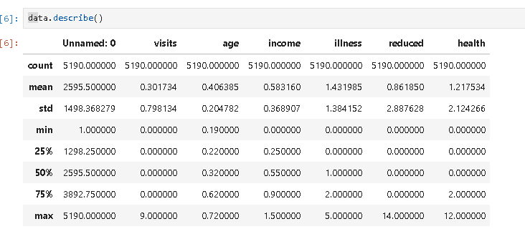
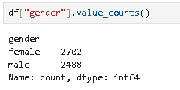
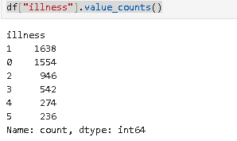
RESULTS
Summary of Dataset :
Demo Link

Slide 7
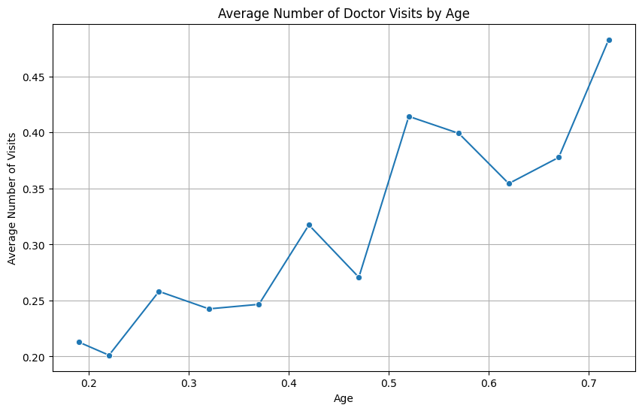
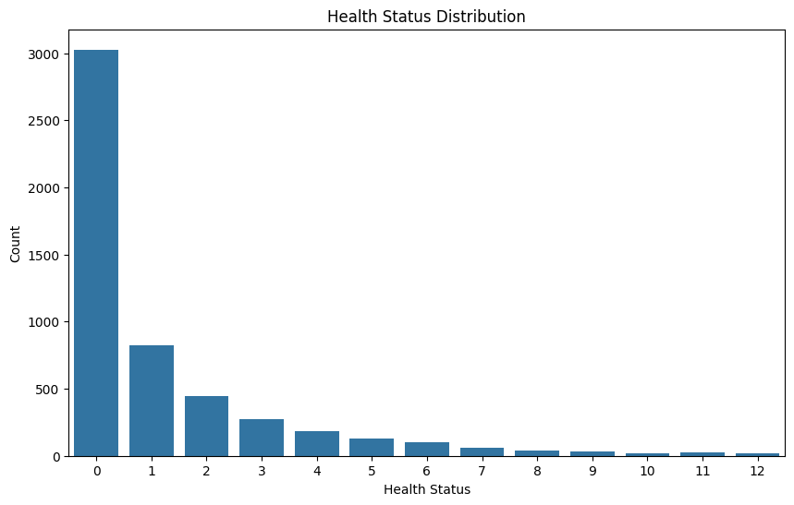
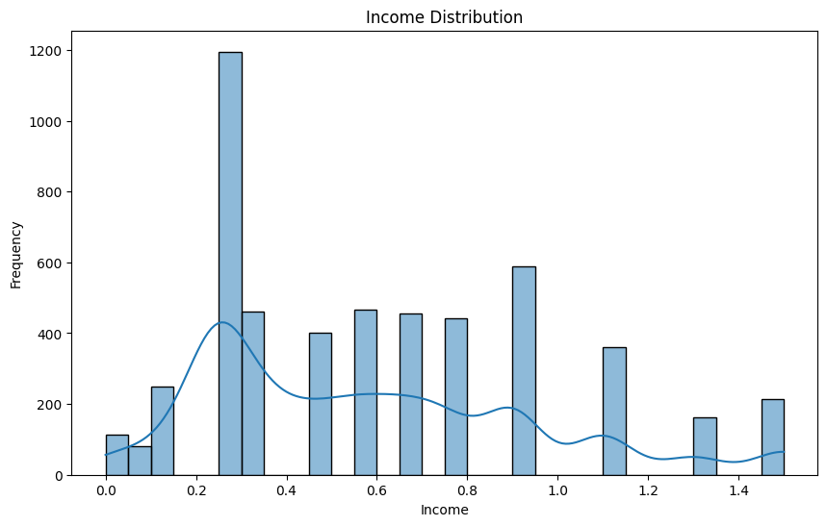
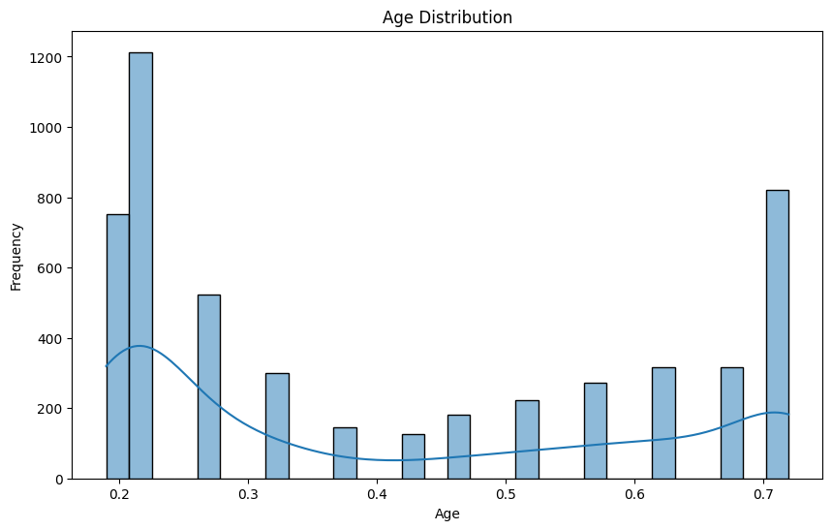
Visualization Results

Slide 8
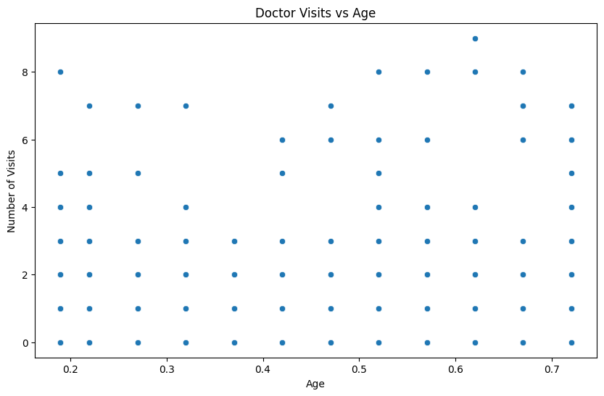
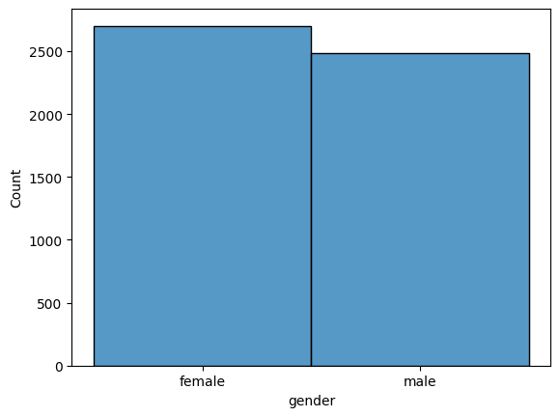
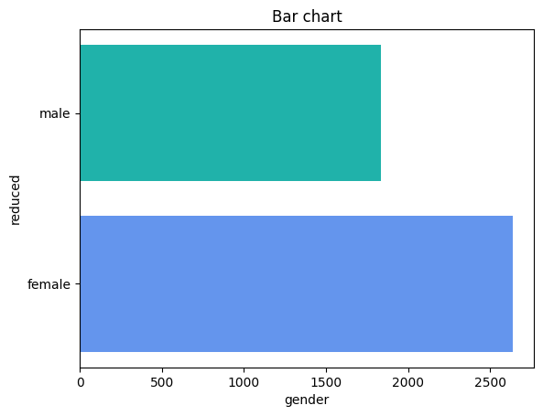
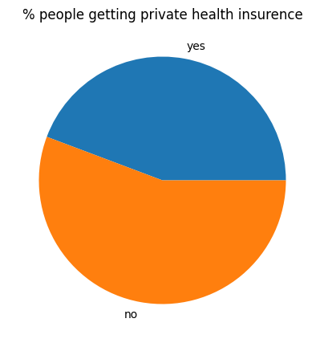
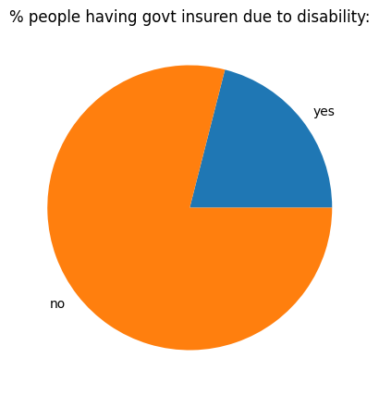
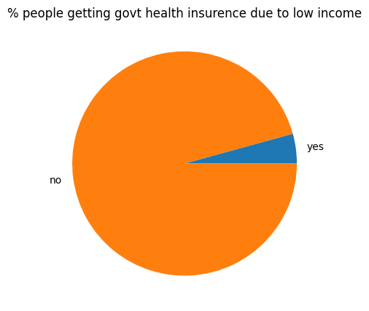
Visualization Results

Slide 9
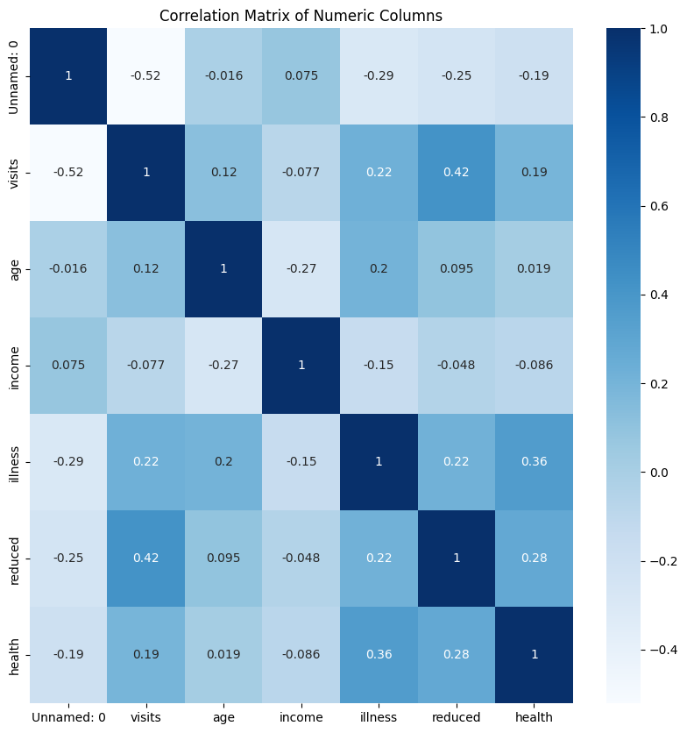
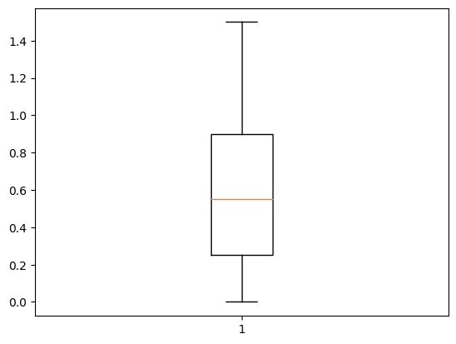
Heatmap plots:

Slide 10
Thank you
.
.

