Slide 1
House Of Hades
By Team 2

Slide 2

CRICKET PREDICTION

Slide 3
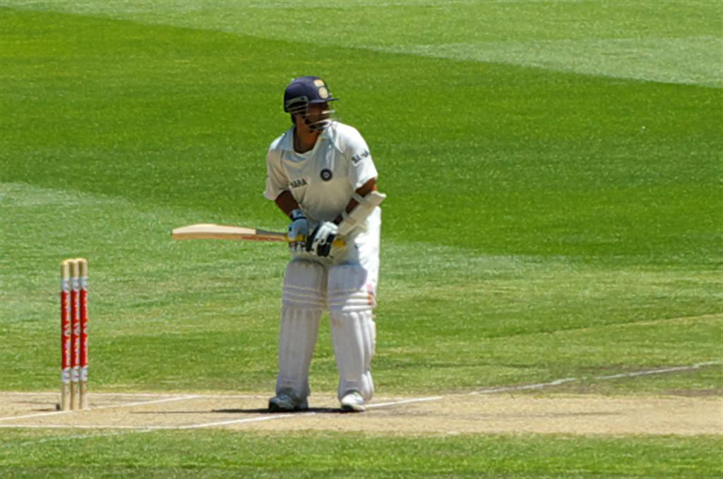
Problems faced by a predictor
Makes wrong prediction on behalf of wrong weather
Makes wrong prediction on behalf of wrong statistics
?

Slide 4
Don’t worry our group is here

Slide 5
Solution
we have a app that shows you all the stats for all the players in all the format of games in any type of condition or in any type of weather or by any type of opponents.
This will help you to predict you before the game and makes you win the any competition (dream 11, fantasy league)

Slide 6
By Deepak Raja RA Rahul Ragavendar GJ Nithish Kumar B Sandeep Akash B Sanjay Kumar S Sairam M
Thank you this is a small presentation by our team which makes you get our bullet points easier…………….

