Slide 1

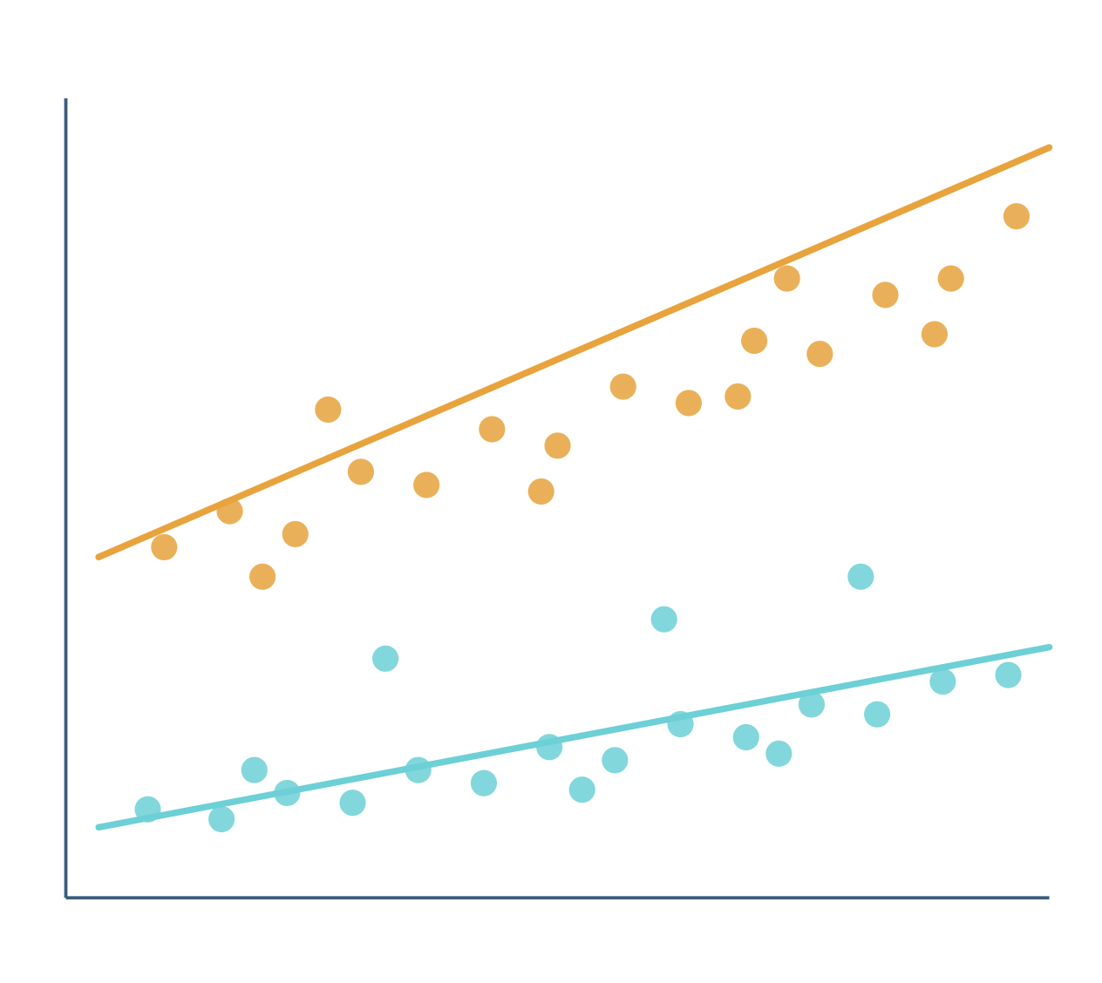
Predicting Medical Insurance Charges
REGRESSION PROJECT · OCTOBER 2026
Multiple linear regression with a BMI × smoking interaction
Notes:
This deck summarises the executed notebook Medical_Insurance_Charges_Regression. The goal was to predict recorded medical insurance charges from six inputs and to be honest about what the model can and cannot show. The five parts are Objective, Data, Methods, Results and Conclusion. Charges are labelled in charge units because the CSV does not state a currency.

Slide 2
Roadmap
OVERVIEW
1
2
3
4
5
Objective
Data
Methods
Results
Conclusion
Predict charges from six inputs
1,338 records, split before any exploration
Least squares, three candidates, five-fold validation
Held-out error and residual
What the evidence does and does not support
HEADLINE RESULT
Multiple OLS with a BMI × smoking interaction was selected. On 268 reserved test rows it reaches MAE 2,828.53, RMSE 4,572.84 and R² 0.8862.
Insurance charges prediction
Notes:
Five parts: objective, data, methods, results and conclusion. The headline result is on this slide so the audience knows where the talk is heading: the BMI × smoking interaction model was chosen by five-fold validation and then checked once on a reserved test set.

Slide 3

Predict recorded insurance charges
1 · OBJECTIVE
Estimate the insurance charge recorded for a person from their age, sex, BMI, number of children, smoking status and region. The target is a number, so this is regression, not classification.
Six inputs
Multiple OLS
Predicted charge
age
sex
BMI
children
Learns from training data the average charge for people with similar inputs
One number, in charge units
smoker
region
Example: a 34-year-old smoker with BMI 31.92 and one child goes in, and a predicted charge comes out.
Insurance charges prediction
Notes:
Classification predicts a category such as smoker or non-smoker; regression predicts an amount. Under squared-error loss the ideal predictor is the conditional mean, the average charge for observations that share the same inputs. Charges are in charge units because the CSV does not state a currency or period.

Slide 4


Objectives and scope
1 · OBJECTIVE
What we set out to do
What the data cannot show
Predict charges accurately for observations the model has not seen
A causal effect of smoking on charges
All healthcare spending, or fair and valid premiums in India
Compare candidate models fairly, on the same validation folds
Diagnoses, policy design or time trends: the data has none
Inspect residuals and influential points before trusting the result
Insurance charges prediction
Notes:
This is an academic prediction and model-diagnostics study. A useful predictor is not automatically a causal explanation, and the dataset has no diagnoses, policy design, patient identifiers or timestamps.

Slide 5
Dataset overview
2 · DATA
Column | Recorded values | Role
age | 18–64 | Numerical
sex | female, male | Categorical
bmi | 15.96–53.13 | Numerical
children | 0–5 | Count
smoker | no, yes | Binary
region | 4 regions | Nominal
charges | 1,121.87–63,770.43 | Target
1,338
7
records
columns
0
1
missing values
exact duplicate pair, kept
Charges are in charge units: the CSV does not state a currency or period.
Insurance charges prediction
Notes:
The repository CSV has 1,338 rows and 7 columns, with no missing fields, finite numerical values and positive charges. Range checks catch invalid coding but cannot prove every value is clinically correct. The dataset is attributed to Kaggle's Medical Cost Personal Dataset; the original collection process was not verified.

Slide 6
Split first: train, validate, test
2 · DATA
TRAINING
VALIDATION
RESERVED TEST
1,070
5 folds
268
observations
inside the training data
observations
Exploration, fitting, diagnostics and cross-validation
Compare candidate models on identical folds
One final evaluation, after the model is chosen
DUPLICATES AND GROUPING
Rows 195 and 581 match in all seven columns, so identical records are grouped.
GroupShuffleSplit with seed 42 reserves about 20% of the unique-record groups.
Insurance charges prediction
Notes:
A model is chosen to fit its training data, so training error is optimistic. The test set was reserved first and untouched until the model was selected. Splitting is by group rather than by row, which is why the counts are 1,070 and 268 rather than an exact 80/20 split of 1,338. There is no identifier proving whether the duplicate pair is accidental, so both rows are kept.

Slide 7
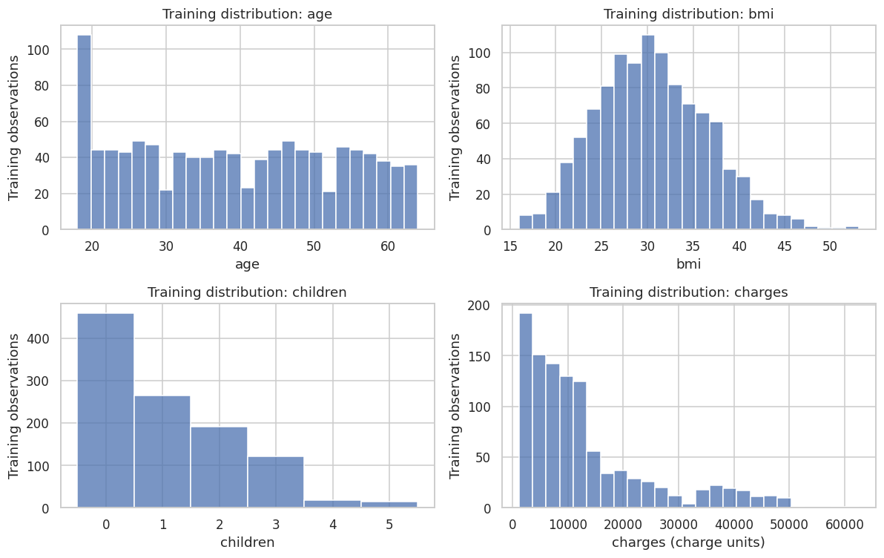
Charges have a long right tail
2 · DATA
13,019.56
mean charge, training data
9,289.08
median charge
1.510
sample skewness
The mean exceeds the median and skewness is positive: a few large charges stretch the right tail.
Insurance charges prediction
Notes:
Figure 1 of the report. Each bar counts training observations in a bin: 25 bins for age, BMI and charges, and one bin per value for children. Age is concentrated among young adults, BMI is roughly mound-shaped with some high values, and most people have no children. Normal-looking predictors are not an OLS requirement.

Slide 8
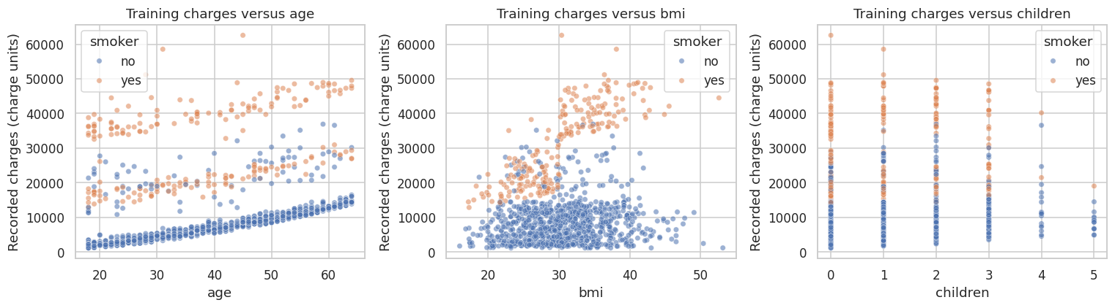
Smoking changes the charge pattern
2 · DATA
Smokers sit in a higher charge band, and their charges rise faster with BMI.
Boxplots agree: smoking splits charges sharply, while sex and region overlap.
Correlation with charges: age 0.29, BMI 0.18, children 0.09.
Insurance charges prediction
Notes:
Figure 3 of the report, with the boxplot and correlation findings from Figures 2 and 4. These are unadjusted comparisons, so a difference is not a causal effect. The BMI panel motivates testing a BMI × smoker term; it does not guarantee that the term will win, which is why it is tested on validation folds. The correlation matrix covers numerical variables only.

Slide 9
Preparing the inputs
3 · METHODS
Encode categories
Drop one region
Centre the numbers
sex_male and smoker_yes are 0/1 indicators. Region gets three, with northeast as the reference.
Four region indicators sum to 1 and duplicate the intercept. Dropping one avoids the dummy-variable trap.
Subtract training means: age 39.179, BMI 30.540, children 1.083. The intercept then describes an average profile.
Additive design: p = 9
With BMI × smoker: p = 10
Insurance charges prediction
Notes:
Region is not coded 1 to 4 because that would invent an order and equal distances. Centring moves zero to an average training value so the intercept and interaction are easier to read; it does not discard information, and ordinary OLS does not need standardisation. During cross-validation each fitting fold recomputes its own means. The baseline design has eight predictor columns plus an intercept, so p = 9; the interaction adds one column.

Slide 10
Ordinary least squares
3 · METHODS
MODEL
y = Xβ + ε
Squaring stops positive and negative errors cancelling and punishes big misses: a 10,000 error costs four times a 5,000 error.
LOSS
SSE(β) = Σ (yᵢ − xᵢᵀβ)²
SOLUTION
Solved numerically with statsmodels, then cross-checked against scikit-learn fits.
β = (XᵀX)⁻¹ Xᵀ y
y: actual charges · X: encoded inputs · β: intercept and slopes, chosen to minimise squared errors
Insurance charges prediction
Notes:
Setting the derivative of the squared-error loss to zero gives the normal equations, which have the closed-form solution shown when X has full column rank. The implementation uses a numerical solver rather than inverting XᵀX by hand. A residual is the observable difference after fitting; it is not the same as the unknown true error. OLS can be calculated without normal errors, but classical inference needs more assumptions, and predictive quality must be measured on held-out data.

Slide 11
Three candidate models
3 · METHODS
Candidate | What changes | Role
Additive OLS | All inputs, one BMI slope for everyone | Baseline
Interaction OLS | Adds a BMI × smoker term | Extension
Log interaction OLS | Fits log charges, then back-transforms | Extension
Why an interaction?
Non-smokers share one BMI slope; smokers get that slope plus the interaction coefficient. The scatterplot showed smokers' charges climbing faster with BMI.
Insurance charges prediction
Notes:
An additive smoking indicator shifts the fitted level but gives both groups the same BMI slope; the interaction lets the slopes differ while staying linear in the coefficients. The log candidate fits log charges and converts back with a smearing factor, the mean of the exponentiated training log residuals. The 1.5 gate was a predeclared heuristic, not a formal test. All log predictions are judged in original charge units.

Slide 12
Five-fold validation protocol
3 · METHODS
1
Shuffle the unique training groups with a fixed seed
Selection rule
2
Split them into five folds
Lowest mean RMSE wins, unless a simpler model is within 1%. The tolerance was fixed in advance.
3
Fit on four folds, predict the fifth
4
Repeat until every row has an out-of-fold prediction
No leakage
5
Run the same folds for every candidate
Centring means are recomputed inside each fold. Test charges never touch exploration or selection.
Insurance charges prediction
Notes:
Each training row gets one prediction from a model that did not fit it, so out-of-fold residuals are honest. The 1% tolerance is a practical simplicity rule, not statistical evidence that candidates are equivalent. The log-candidate eligibility gate uses the whole training partition, so cross-validation is an internal comparison rather than an unbiased evaluation of the entire design process; the untouched test set is the final check.

Slide 13
Metrics and diagnostics
3 · METHODS
Judging predictions
MAE
mean |y − ŷ|: average absolute miss, in charge units
RMSE
√ mean (y − ŷ)²: punishes large misses
R²
1 − SSE/SST: error relative to target spread
Insurance charges prediction
Notes:
R² does not mean 83.5 percent or any other percentage of predictions are correct; it compares squared error with the variation in the target. Held-out R² can be negative if predictions are worse than predicting the evaluation-set mean. The screening thresholds are heuristics, not proof that a row is an outlier or an error, and no flagged row is removed automatically. HC3 standard errors change uncertainty estimates but not coefficients or predictions.

Slide 14
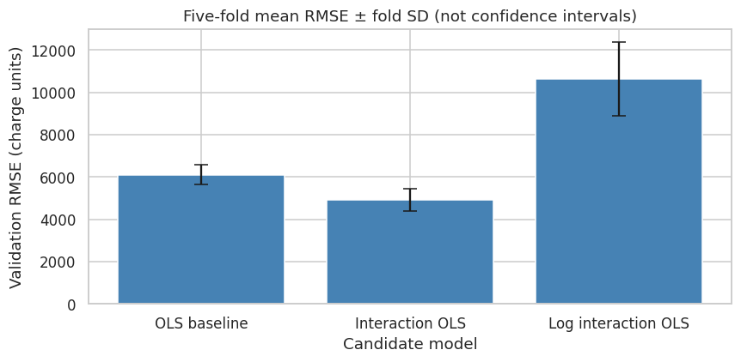
The interaction model wins validation
4 · RESULTS
19.61%
lower mean validation RMSE than the additive baseline
Candidate | Mean RMSE | Mean MAE
Additive OLS | 6,107.20 | 4,210.73
Interaction OLS | 4,909.40 | 2,986.02
Log interaction OLS | 10,622.51 | 5,193.15
Highlighted row: the selected model. Lower is better.
Insurance charges prediction
Notes:
Figure 5 of the report. Bars show the mean of five fold RMSEs; error bars are the sample standard deviation across folds, not confidence intervals. Fold SDs are 469.21 for additive, 523.12 for interaction and 1,751.69 for the log model. The log model is much worse on the original charge scale; that is an empirical result here, not a general claim that logarithms are bad.

Slide 15
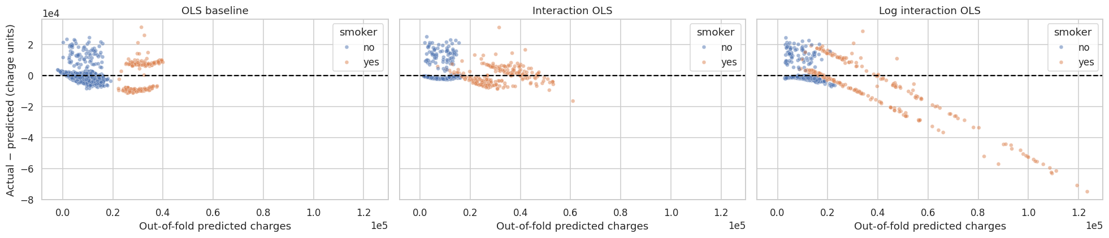
Out-of-fold residuals by model
4 · RESULTS
Additive OLS: smoker residuals split into strong positive and negative bands.
Interaction OLS: the bands shrink, but large misses remain.
Log interaction OLS: some predictions exceed 100,000 units, with large overpredictions.
Insurance charges prediction
Notes:
Figure 6 of the report. Each point is a training row predicted by a fold that did not fit it; the residual is actual minus predicted, so positive means underprediction. All three panels share the same axes, so the baseline cloud looks compressed because the scale stretches to the log model's extreme predictions. The plot supports rejecting the log candidate without establishing the exact cause of its failures.

Slide 16
Final reserved-test performance
4 · RESULTS
TEST MAE
TEST RMSE
TEST R²
2,828.53
4,572.84
0.8862
Evaluation | MAE | RMSE | R²
Training fit | 2,965.31 | 4,896.46 | 0.825
Pooled out-of-fold | 2,986.32 | 4,931.88 | 0.822
Reserved test | 2,828.53 | 4,572.84 | 0.8862
Insurance charges prediction
Notes:
The test set was evaluated once, after the model was selected. Test R² is 0.8862 on this particular partition; it is not 88.62 percent accuracy and not a guaranteed future score. Test error can be lower than training error because a random test set can contain easier observations and R² depends on its target variance. There is no mathematical rule that every test metric must be worse than training. Charges are in charge units.

Slide 17
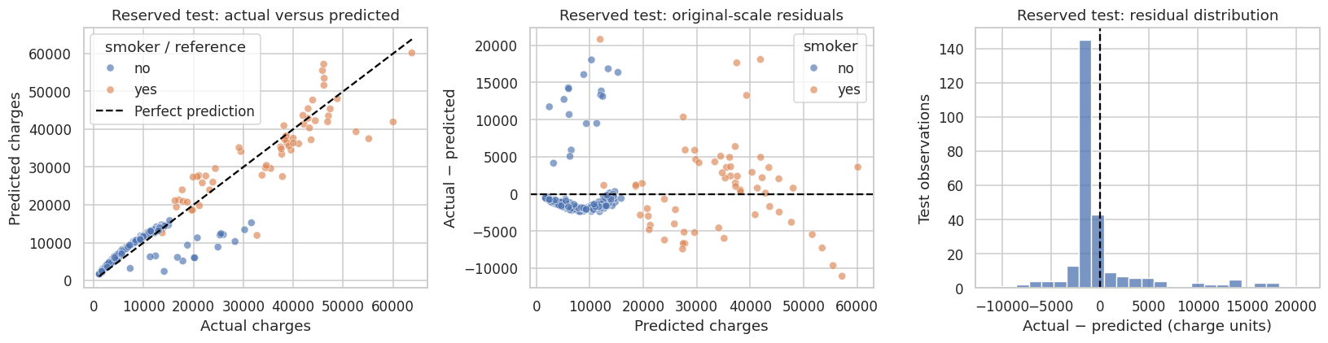
Reserved test: where predictions land
4 · RESULTS
Actual vs predicted: low costs track well; some high costs are underpredicted.
Residuals: bands remain, so a good average still hides systematic misses.
Histogram: most errors are small, with a tail of large misses.
Insurance charges prediction
Notes:
Figure 9 of the report, using the 268 reserved test observations. In the left panel points below the dashed identity line are underpredictions. Many lower-cost predictions are close to their actual values, but some high actual costs are substantially underpredicted and some smokers have large errors. The model is not redesigned using these test plots, which would compromise the reserved-test role.

Slide 18
Smokers are harder to predict
4 · RESULTS
Test subgroup | n | MAE | RMSE | R²
Non-smoker | 208 | 2,282.29 | 3,920.01 | 0.516
Smoker | 60 | 4,722.17 | 6,334.95 | 0.714
Larger absolute errors
Higher R², not a better fit
Small sample
Smokers have higher MAE and RMSE, so their typical misses are bigger.
Subgroup R² depends on each group's target variance, so it is not an error comparison.
Only 60 smokers in the test set, so broad conclusions are less secure.
Insurance charges prediction
Notes:
Smokers have larger absolute prediction errors by both MAE and RMSE. Their higher subgroup R² does not contradict this, because the target variances differ between the groups. With only 60 smokers in the test partition, subgroup conclusions are less secure.

Slide 19
Reading the fitted coefficients
4 · RESULTS
Term | Coefficient
Intercept | 9,312.49
Age (centred) | 259.11
BMI (centred) | 12.44
Children (centred) | 570.55
Male (vs female) | −648.67
Smoker (at mean BMI) | 23,409.24
BMI × smoker | 1,476.64
SMOKER BMI SLOPE
12.44 + 1,476.64 = 1,489.08
charge units per BMI point, against 12.44 for non-smokers
Worked example: test row 23
34-year-old female smoker, BMI 31.92, one child, northeast: underpredicted
Predicted
33,386.44
Actual
37,701.88
Residual (full precision)
+4,315.43
Region vs northeast: northwest −440.91, southeast −895.46, southwest −884.51.
Insurance charges prediction
Notes:
Numerical predictors are centred at the training means, so the intercept is the prediction for a female non-smoker from the northeast at average age, BMI and children. Once the interaction is in the model, the smoking coefficient is the smoker difference at mean BMI, not a fixed difference at every BMI. The model keeps a common age slope, so these numbers are conditional on a still-restricted specification and should not be read causally. Displayed coefficients are rounded, and the actual charge 37,701.88 is rounded from 37,701.8768, so subtracting the displayed figures can differ from the notebook's full-precision residual of +4,315.43 by 0.01.

Slide 20
What the evidence shows
5 · CONCLUSION
19.61%
0.8862
lower mean validation RMSE for the interaction model than for the additive baseline
test R², with MAE 2,828.53 and RMSE 4,572.84 charge units on 268 reserved rows
10,622.51
2828.53 charge units
mean validation RMSE of the log model: not useful here, so it was not selected
Average absolute difference between predicted and actual charges on 268 reserved test observations
Insurance charges prediction
Notes:
The interaction model was the strongest tested candidate for this small project. Its validation and test results are useful evidence, while the residual diagnostics show it remains an imperfect explanation of what generates charges. Deleting high-cost observations merely because they are hard to predict would narrow the target population and make evaluation misleading.

Slide 21
What the claims can and cannot say
5 · CONCLUSION
What it says
What it does NOT say
The interaction model has lower validation error than the additive model
“88.62% accuracy”
“All assumptions passed”
The log candidate was not useful in this comparison
“Smoking causes this exact cost increase”
“Logging always improves skewed targets”
No negative test predictions occurred, so none were clipped
Insurance charges prediction
Notes:
Each phrase on the right overstates what the experiment establishes. R² of 0.8862 is a score on one particular split, not a percentage of correct predictions. The residual plots and the Q–Q plot show assumption violations. Boxplot differences and adjusted coefficients are associations, and adjusting for recorded variables does not remove all confounding. The diagnostic flags are screening heuristics, not proof of faulty records. A log transform is an option for skewed targets, not a guaranteed improvement; here it performed much worse.

Slide 22

Thank you
SUMMARY
Questions and discussion
Selected model: multiple OLS with a BMI × smoking interaction. Test MAE 2,828.53, RMSE 4,572.84 and R² 0.8862. A useful predictor, but an imperfect explanation of what drives charges.
Notes:
Closing summary. The interaction model reduced mean validation RMSE by 19.61 percent over the additive baseline and scored MAE 2,828.53, RMSE 4,572.84 and R² 0.8862 on the reserved test set. Residual structure remains, so the results support prediction rather than causal explanation. Suggested phrasing: I predicted recorded medical insurance charges from six inputs, compared models on five training folds, and reported the limitations rather than interpreting coefficients causally.

