Slide 1
ELL897 Project Presentation
Scene Implementation in a Smart Home
GitHub Repository:
https://github.com/Deepakrewa/ELL893CyberPhisicalSystem
11 November 2021
2020ANZ8599

Slide 2
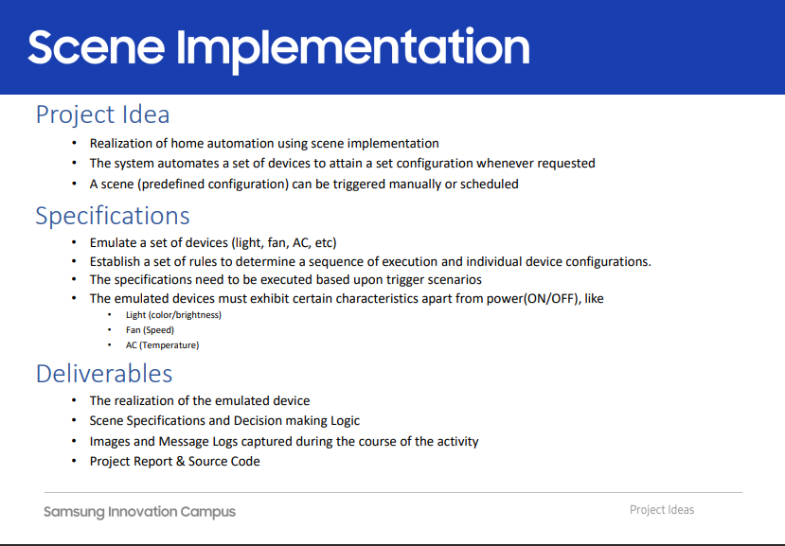

Slide 3
Overview
Pre-configured Scenes
Good Morning Scene at 0600 hrs
Main door opens or some one walks by
Fire incident is detected in living room .
Smoke is detected in Store or Garage
High level of Carbon Dioxide in bedroom
High level of Carbon Mono-oxide in Kitchen
Room temperature rises
Manual Commands
Deployment Layout
IoT Monitor
Protocol & Security
Communication protocols
Authentication and Communication Security

Slide 4
Smart Home Layout
PLATFORM USED:
CISCO Packet Tracker v8.0
MCU for controller implementation
Python as programming language
Communication: MQTT/HTTPS
UI: Standard CPT GUI
Living Room
Play Room
Kitchen
Garden/lawn
DOOR
Bed Room
Store Room

Slide 5
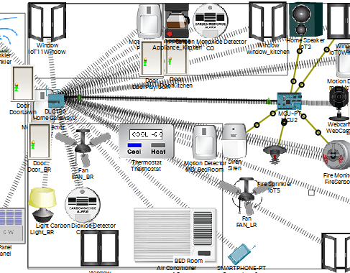
Good Morning Routine
Sun rises at 0600 Hrs
Solar panels start generating electricity
Start water sprinkler at lawn
Bedroom
Switched the light to dim
Turn off AC
Unlock the door
Kitchen
Open the Window
Start kitchen appliance, Coffee Maker
Living Room
Switch on the Fan with medium speed
Open windows for fresh air

Slide 6
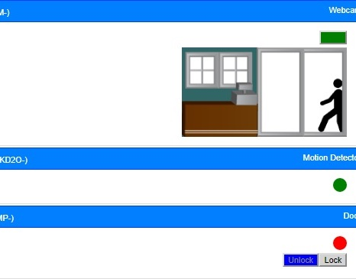
Main door opens or someone walks by
Light at front door gets switched on
Front door camera is switched on and started recording
Live video feed from camera is sent to the smart phone or tablet of the owner

Slide 7
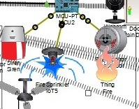
Fire incident is detected in living room
Sound the siren to alert home users
Initiate fire sprinkler to contain and eliminate fire
Open all doors and windows to allow fresh air in home and enhance escape routes for home users
Announce appropriate recorded message through speaker suggesting users to exit the premise to safety.

Slide 8
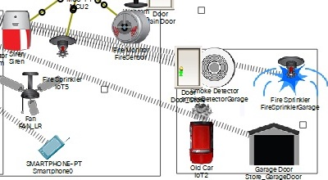
Smoke in Store or Garage
Sound the siren so that owner can know
Start fire sprinkler
Open all doors & Windows
If no smoke then switch off sprinkler, however siren and doors/windows needs to be closed with manual intervention

Slide 9
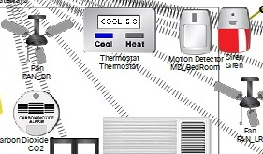
High level of CO₂ bedroom
Open the Door and Windows of bedroom
Switch off the AC
Set the FAN to the highest speed to disperse the high concentrated CO2
Switch On the bedroom light
Alert the user by activating the siren

Slide 10
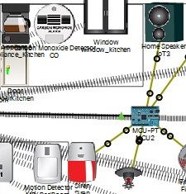
High level of Carbon Monoxide in Kitchen
Switch of the kitchen appliance
Open windows and doors
Sound alarm to alert the user

Slide 11
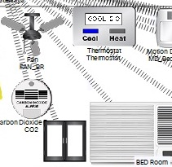
Room Temperature Rises
Temperature rises above 18 ◦Celsius then the FAN is switched ON.
Temperature rises above 20 ◦Celsius then AC is also switched On
Temperature drops below 20 ◦Celsius then AC is switched Off
Temperature further drops below 18 ◦Celsius then FAN is switched Off
Temperature drops below 15 ◦Celsius then heating equipment is switched On.

Slide 12
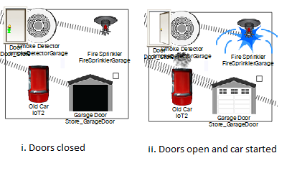
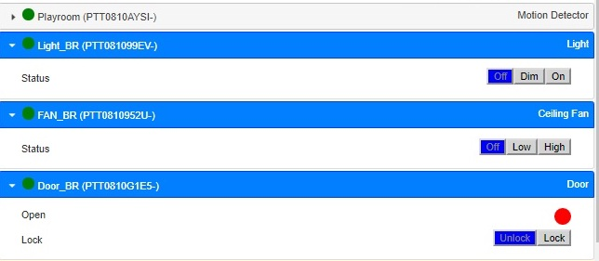
Manual User Interface
IoT Emulation Layout
IoT Monitor

Slide 13
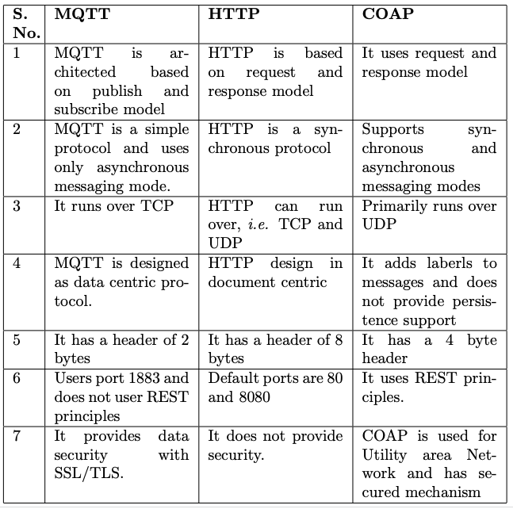
Protocol & Security

Slide 14
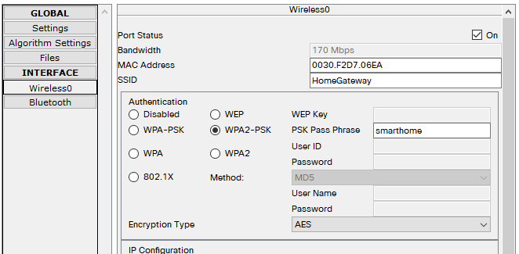
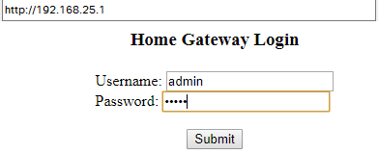
Authentication
User Authentication
IoT Equipment Authentication

Slide 15

Thank You

