Slide 1

Face Mask Detection with Convolutional Neural Networks
This presentation will explore the use of Convolutional Neural Networks (CNNs) for face mask detection. We'll delve into the fundamentals of neural networks and CNNs, and then illustrate how CNNs are applied in this specific task.
By Deepak Vishwakarma

Slide 2
What is a Neural Network?
A Neural Network is a computational model inspired by the human brain.
- Consists of layers of nodes (neurons).
- Used for pattern recognition and decision making.
Biological Inspiration
Interconnected Nodes
Nodes, or neurons, are connected in layers, forming a network. Each connection has a weight.
Mimics the structure and function of the human brain.

Slide 3
What is CNN?
Convolutional Neural Network (CNN) is a specialized type of neural network for processing grid-like data such as images.
- Uses convolutional layers to extract features.
- Suitable for image classification, object detection, etc.

Slide 4



Convolutional Neural Networks (CNNs): Fundamentals
1
Convolutional Layers
2
Pooling Layers
3
Fully Connected Layers

Slide 5



Convolutional Layers: Extracting Visual Features
Filters
Convolutional layers apply filters to the input image, extracting features.
Feature Maps
Each filter produces a feature map, highlighting specific patterns.

Slide 6
Pooling Layers: Reducing Spatial Dimensions
Downsampling
1
Pooling layers reduce the spatial dimensions of the feature maps.
Feature Preservation
2
This downsampling helps preserve important features while reducing computational cost.

Slide 7
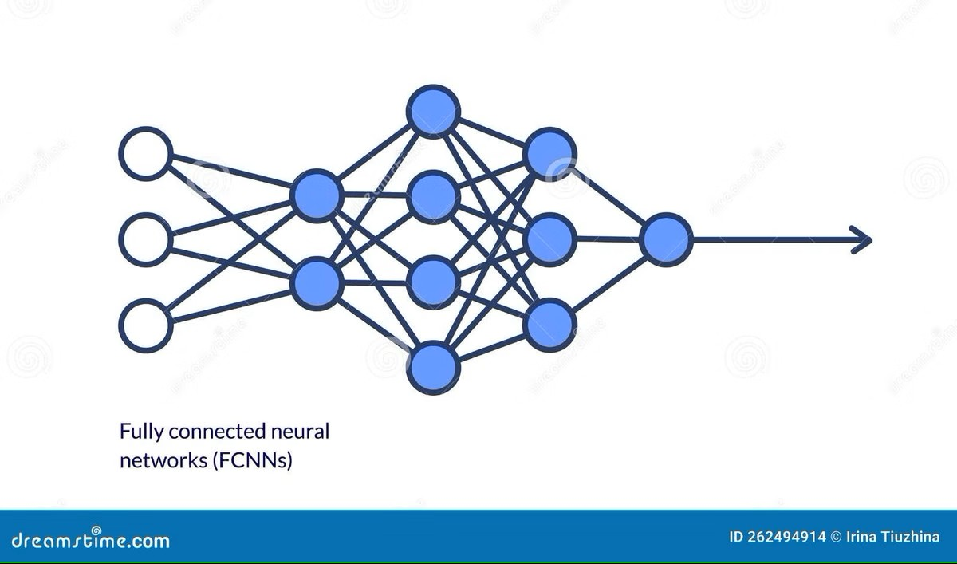
Fully Connected Layers: Classification
1
Final Layer
2
Prediction
Fully connected layers transform the extracted features into a probability distribution.
The network outputs the probability of the image containing a face mask or not.

Slide 8


How CNNs Help in Face Mask Detection
Face Recognition
Mask Recognition
CNNs identify and locate the face in the image.
They analyze the image for the presence of a mask.

Slide 9
Training and Validating the CNN Model
Labeled Data
The model is trained using a dataset of images labeled with mask/no-mask.
Validation
The trained model is evaluated on unseen data to assess its accuracy.
1
2
3
Optimization
The model adjusts its weights to minimize prediction errors.

Slide 10
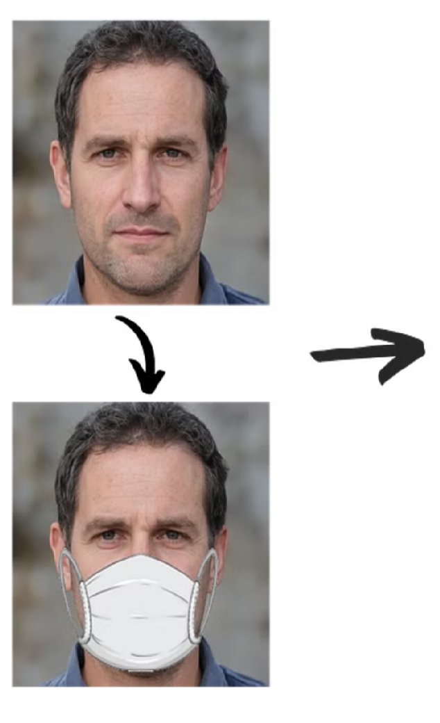
Advantages of Using CNNs for Face Mask Detection
High Accuracy
Real-Time Performance
CNNs can achieve high accuracy in face mask detection.
CNNs can process images in real-time, making them suitable for practical applications.
Scalability
CNN models can be easily scaled to handle larger datasets and more complex scenarios.

Slide 11
Limitations and Challenges of the CNN Approach
1
2
Occlusion
Lighting Conditions
Masks covering part of the face can challenge detection accuracy.
Varying lighting can affect model performance.

Slide 12
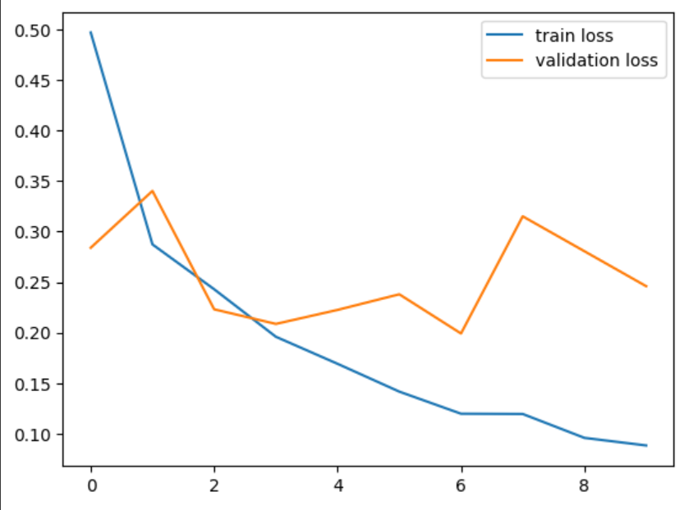
Loss Graph
Training Loss (Blue Line):
Trend: Steadily decreases.
Insight: Indicates the model is effectively learning from the training data.
Validation Loss (Orange Line):
Trend: Generally decreases with some fluctuations.
Insight: Suggests the model is improving but may face challenges in generalizing to unseen data.

Slide 13
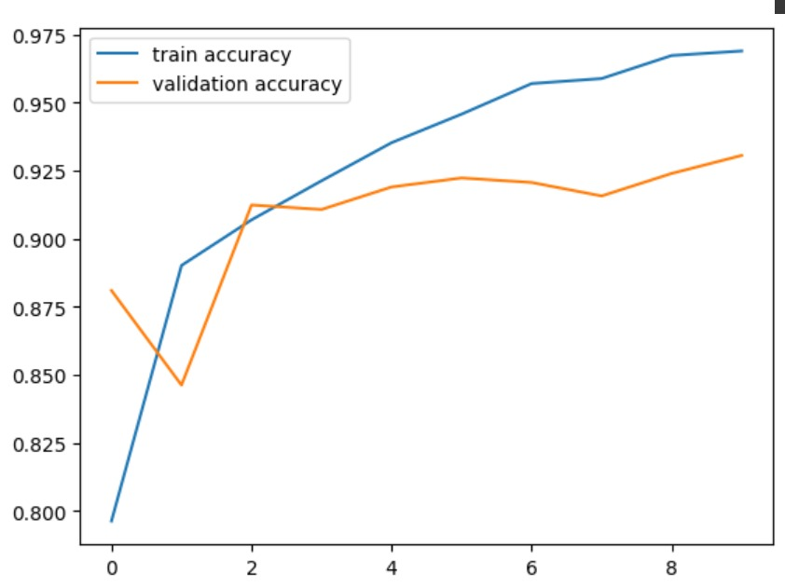
Accuracy Graph
Training Accuracy (Blue Line)
Trend: Steady increase over epochs.
Insight: Indicates the model is effectively learning from the training data.
Validation Accuracy (Orange Line)
Trend: General upward trend with minor fluctuations.
Insight: Suggests the model is improving but experiencing slight variability when generalizing to unseen data.

Slide 14
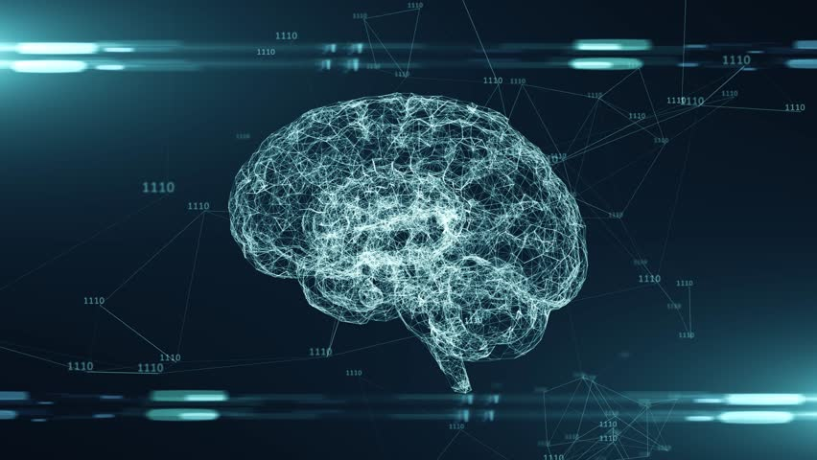
Thank you!
GitHub:-https://github.com/Deepakvishwakarma1/Machine_learning_and_Neural_Network.git

