Slide 1
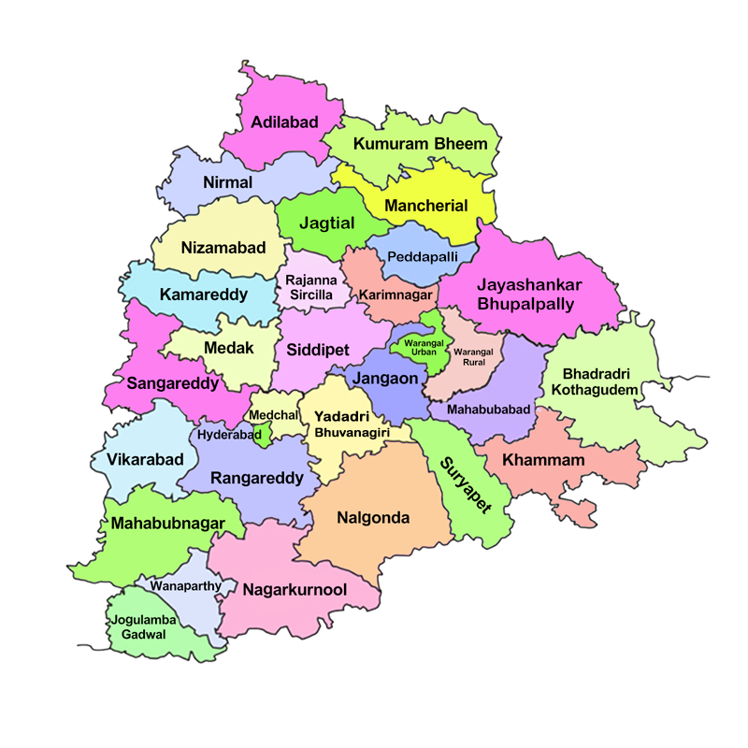

Telengana Tourism Insights
Location
Year
Trend of No of Visitors
Location
DTF Ratio
PTT Footfall Ratio
Last Year:
Last Year:
Location
Year
Visitors KPIs
Domestic
Visitors
Avg Visitors/month
Trend of DTF Ratio
Foreign
Location
Compounded Annual Growth Rate 2016 - 2019
Overall
Domestic
Foreign
Foreign Visitors % Analysis
Year
Hyderabad’s Contribution to Foreign Visitors
Trend of Foreign Visitors %
Trend of Avg Monthly Visitors
Top/Bottom Districts By Visitors
Year
Overall
Domestic
Foreign
Top/Bottom Districts By CAGR
Year
Overall
Domestic
Foreign
Top/Bottom Districts By PTT Footfall Ratio
Top
Bottom
Trend of PTT Footfall Ratio
Forecasting
Location
Domestic
Foreign

